Slide 1
MODULE:

Slide 2
Understanding the data :
Data Source The dataset used here for predicting heart disease is taken from UCI Machine learning repository. UCI is a collection of databases that are used for implement machine learning algorithms. The dataset used here is real dataset. The dataset consists of 300 instance of data with the appropriate 14 clinical parameters. The clinical parameter of dataset is about tests which are taken related to the heart disease as like blood pressure level, chest pain type, electrocardiographic result and etc.

Slide 3
Data Pre-Processing
Organize your selected data by formatting, cleaning and sampling from it.
Three common data pre-processing steps are:
Formatting
Cleaning
Sampling

Slide 4
Formatting: The data you have selected may not be in a format that is suitable for you to work with. The data may be in a relational database and you would like it in a flat file, or the data may be in a proprietary file format and you would like it in a relational database or a text file.
Cleaning: Cleaning data is the removal or fixing of missing data. There may be data instances that are incomplete and do not carry the data you believe you need to address the problem. These instances may need to be removed. Additionally, there may be sensitive information in some of the attributes and these attributes may need to be anonym zed or removed from the data entirely.
Sampling: There may be far more selected data available than you need to work with. More data can result in much longer running times for algorithms and larger computational and memory requirements. You can take a smaller representative sample of the selected data that may be much faster for exploring and prototyping solutions before considering the whole dataset.

Slide 5
EXPLORATORY DATA ANALYSIS (EDA)
In this section we are going to count values of explained variable otherwise known as the determining variable which is going to give us the prediction of a patient being affected by heart disease or not. Second of all we are going to separate numeric features from categorical features. Then we are going to show the relation between the categorical features in various plots and try to figure out or rather observe the influence of those categorical features in the actual determining variable “diagnosis”.

Slide 6
Splitting and Classification:
The whole database is split into training and testing database. The 80% data is taken for training while remaining 20% data is used for testing. Classification The training data is trained by using different machine learning algorithms Random Forest, Decision tree, Naive Bayes, SVM

Slide 7
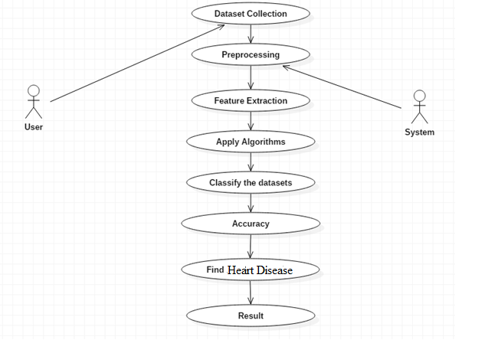
UML DIAGRAMS:

Slide 8
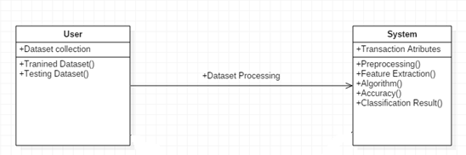
CLASS DIAGRAM

Slide 9
CLASS DIAGRAM

Slide 10
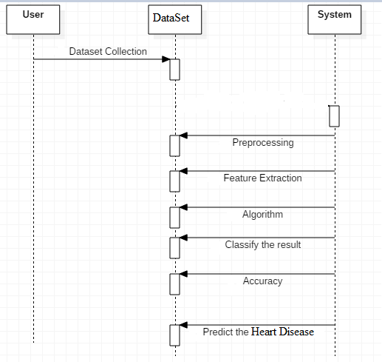
SEQUENCE DIAGRAM

Slide 11
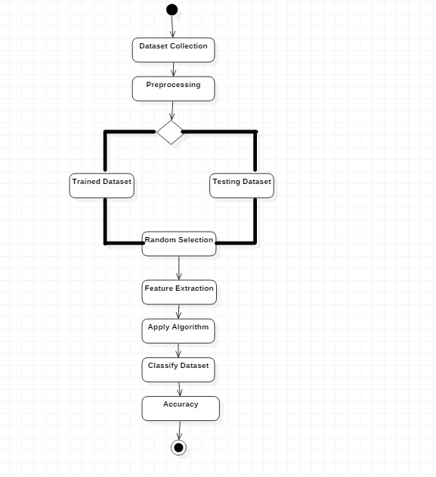
ACTIVITY DIAGRAM

