Slide 1


PLANT & MACHINERY

Slide 2







R&D
STRENGTH & CAPABILITIES
STATE-OF-THE ART TESTING
DRIVE
INDIGENIZATION
5
1
4
SKILLED
MANPOWER
STATE-OF-THE ART MACHINERY
3
2
3

Slide 3
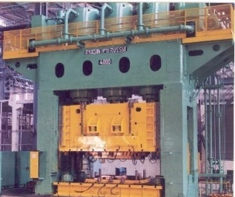
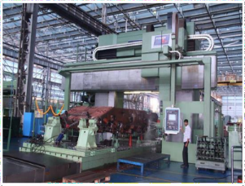
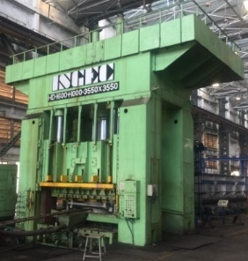
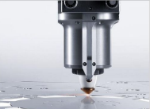
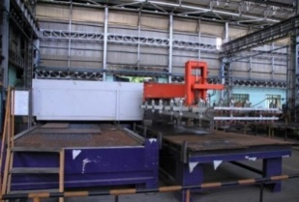
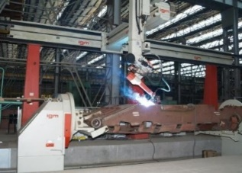
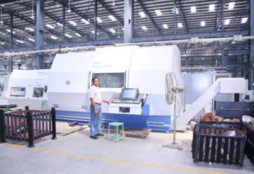
STATE-OF-THE-ART MANUFACTURING FACILITIES
COLD PRESS
5 AXIS PLANO MILLER
6
1
THERMO
PRESS
5
2
CNC LASER
CUTTING
4
3
ROBOTIC HULL WELDING
TURN MILL CENTRE

Slide 4
STATE-OF-THE-ART MACHINERY : TESTING
CMM
TEST
TRACK
RUBBER
TESTING
FIRING
RANGE
METAL
TESTING
ENVIRONMENTAL
TESTING

Slide 5


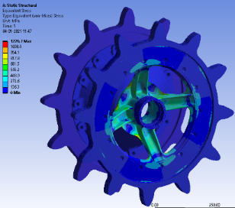
RESEARCH & DEVELOPMENT
ASSOCIATION WITH IIT, IISc & CSIR
SKILLED
MANPOWER
HARDWARE
SOFTWARE

Slide 6
FACILITIES
INVESTMENT CASTING
PRESSURE DIE CASTING
5 AXIS LASER CUTTING
HEAVY DUTY MILLING & BORING MACHINES
HORIZONTAL & VERTICAL CNC MACHINING CENTRES
ARMOUR WELDING
FOAM FILLING
4000 TONNE PRESS

Slide 7
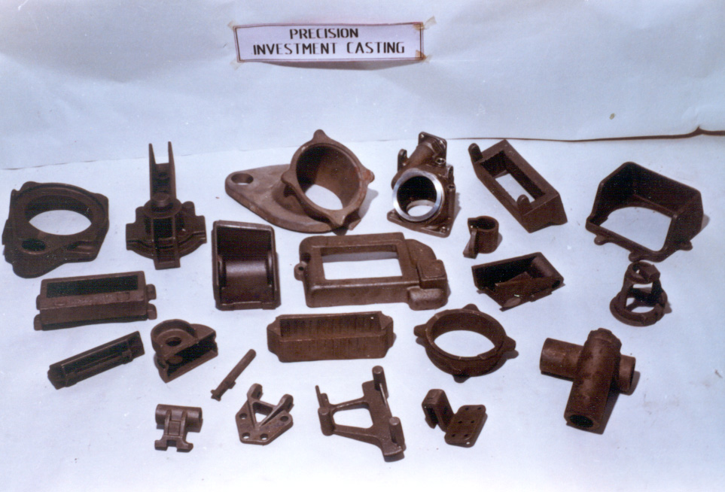
FACILITIES – PRECISION INVESTMENT CASTING
WEIGHT OF CASTING:
5 GMS – 7 KGS
PLANT CAPACITY: 40 T

Slide 8
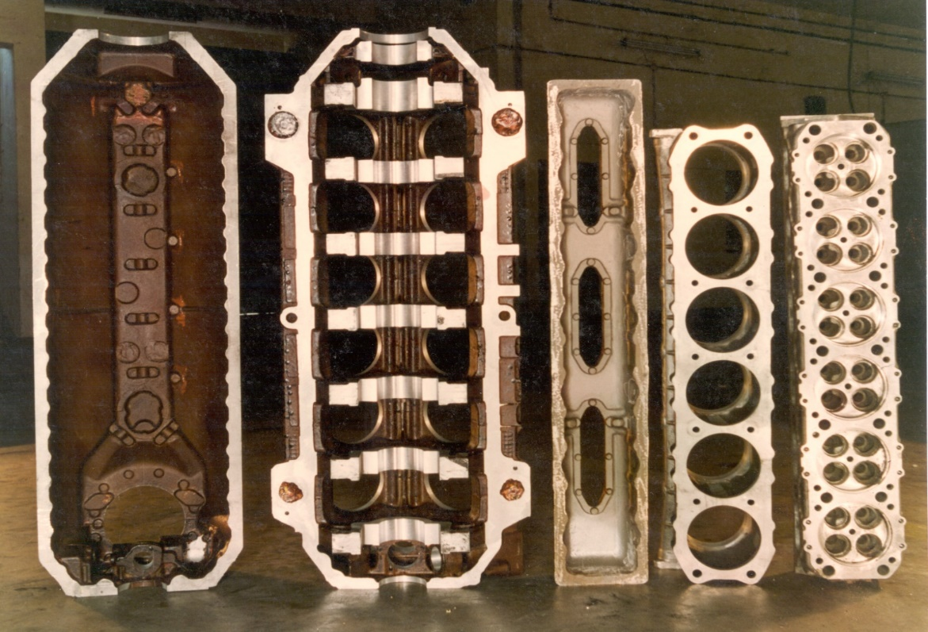
FACILITIES – ALUMINIUM CASTING
ENGINE PARTS
L.C.C
U.C.C
CYLINDER HEAD COVER
CYLINDER JACKET
CYLINDER
HEAD

Slide 9
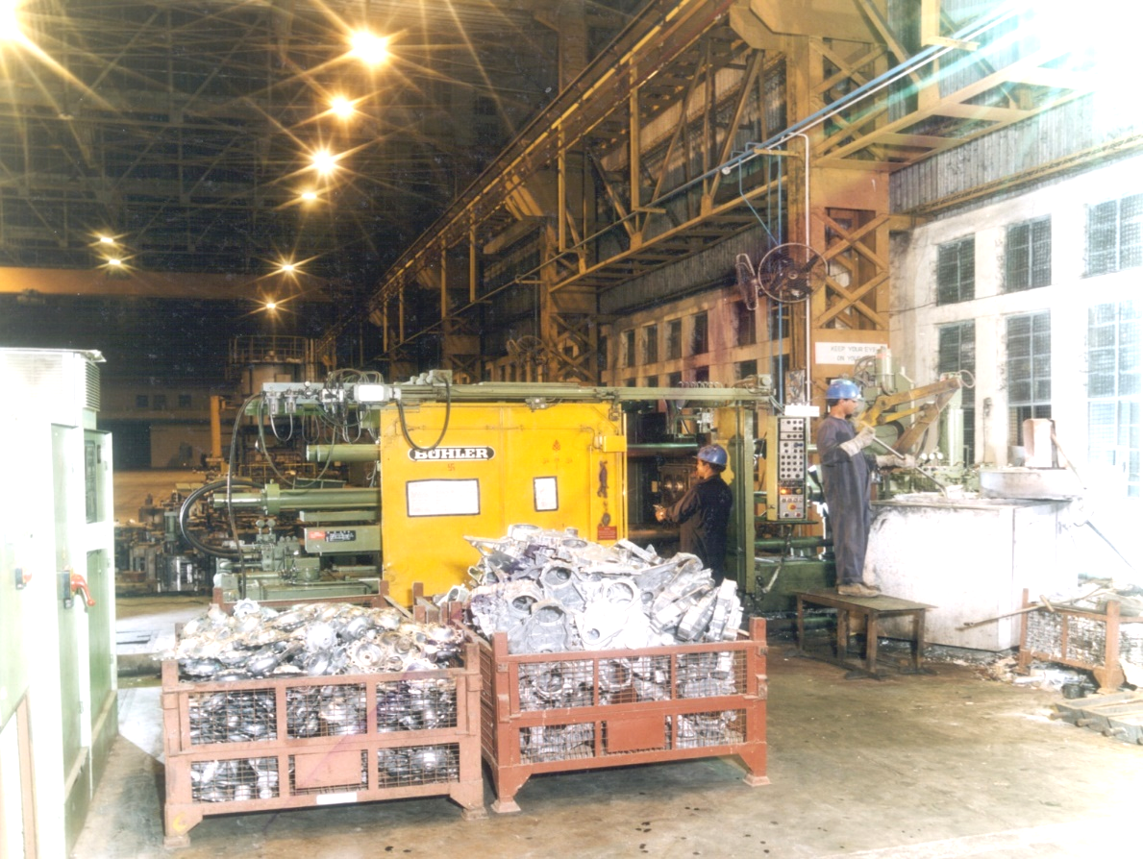
FACILITIES – PRESSURE DIE CASTING
ALUMINIUM PRESSURE DIE CASTING:
MAX WEIGHT : 6 KGS
MACHINE : 400 T

Slide 10
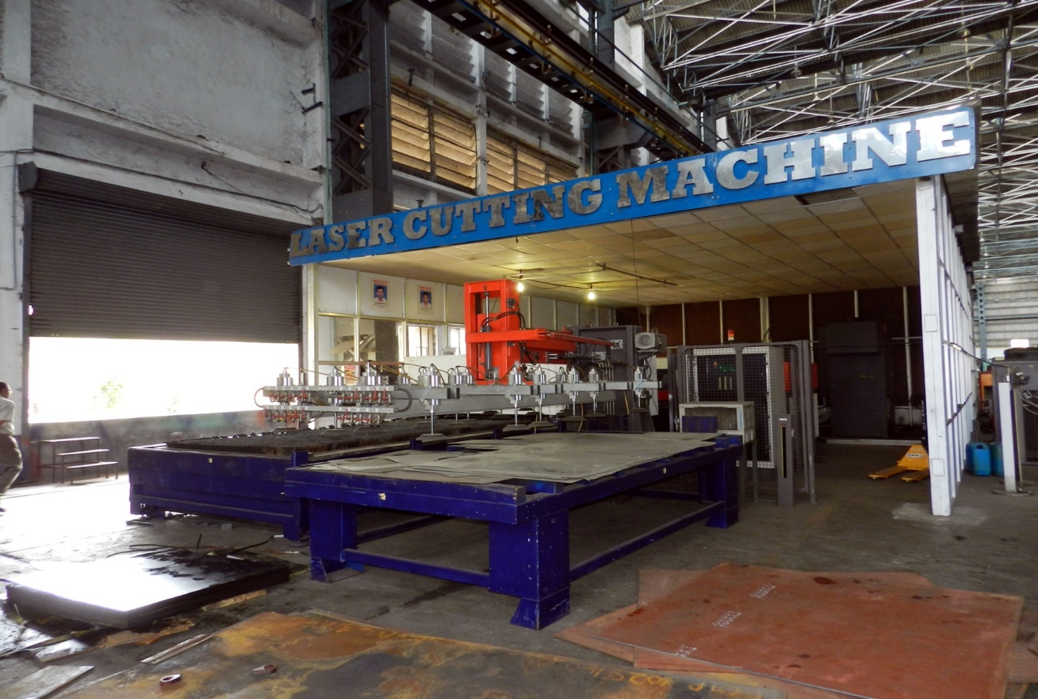
FACILITIES – LASER CUTTING MACHINE

Slide 11
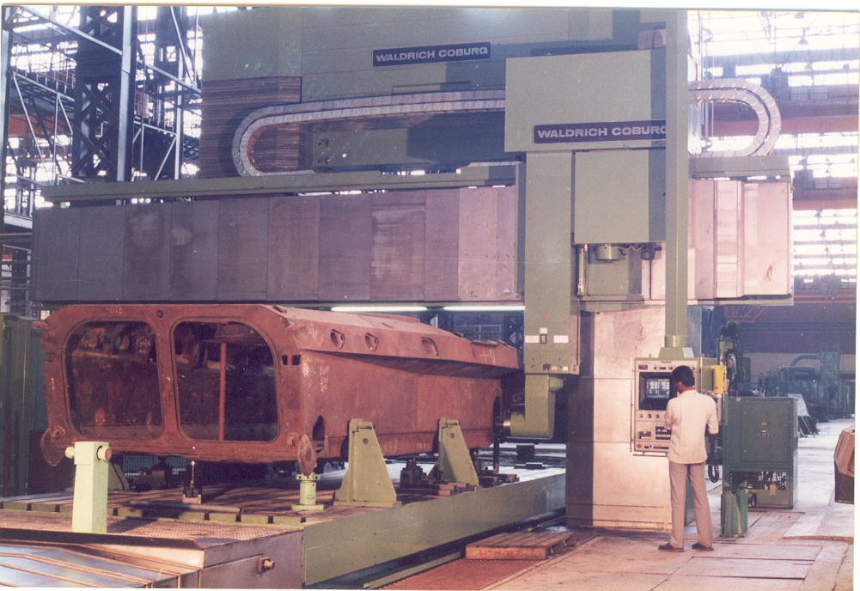
FACILITIES – HEAVY DUTY MILLING AND BORING
M/S WALDRICH COBURG
X - 18000mm
Y - 2000mm
Z - 1000mm
ATC : 20

Slide 12
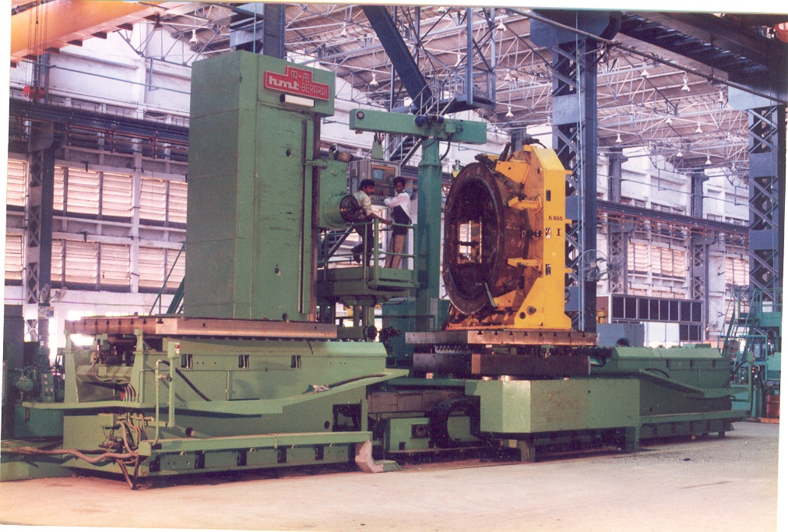
FACILITIES – HORIZONTAL MACHNING CENTRE
X-1300
Y-1000
Z -1000
SPINDLE DIA: 100
ATC – 40

Slide 13

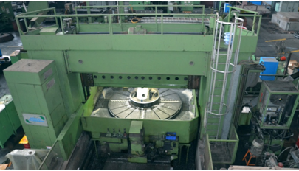
STATE OF THE ART MANUFACTURING FACILITIES
HEAVY DUTY MILLING & BORING
DORRIES SCHARMANN CNC MILLING & TURNING CENTRE

Slide 14
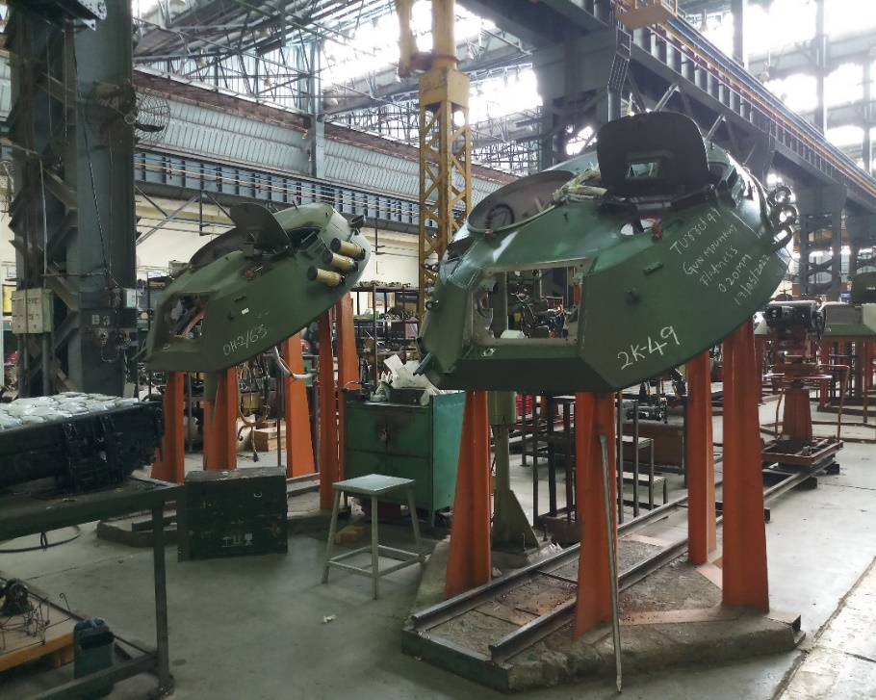
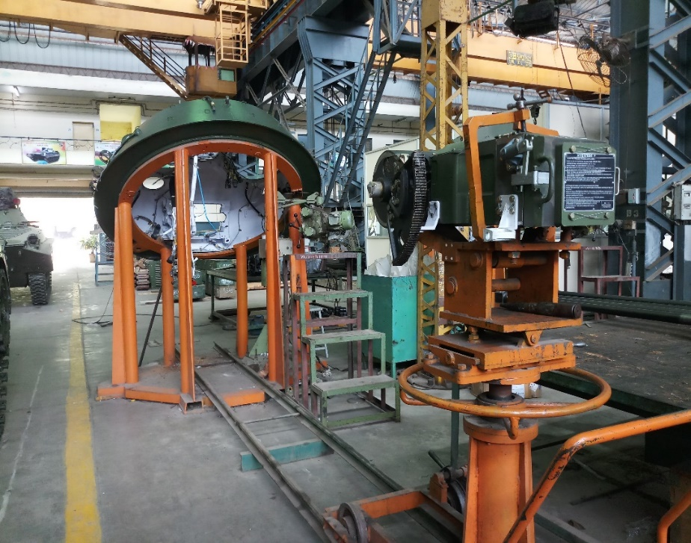
TURRET ASSEMBLY

Slide 15
TURRET ASSEMBLY

Slide 16
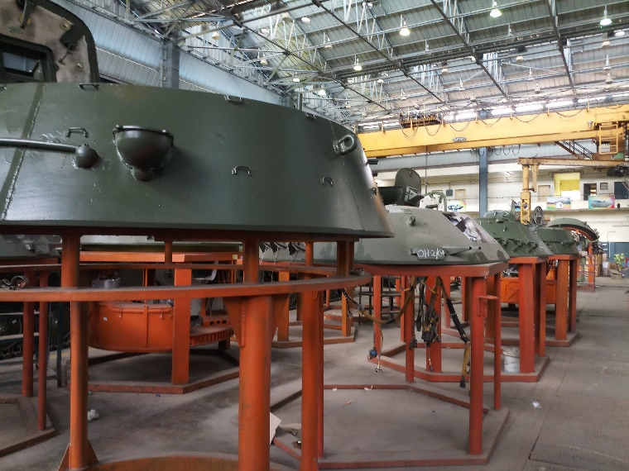
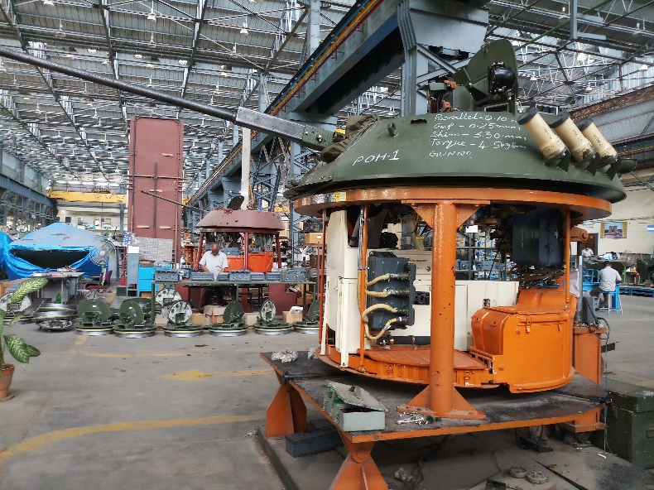
TURRET ASSEMBLY

Slide 17
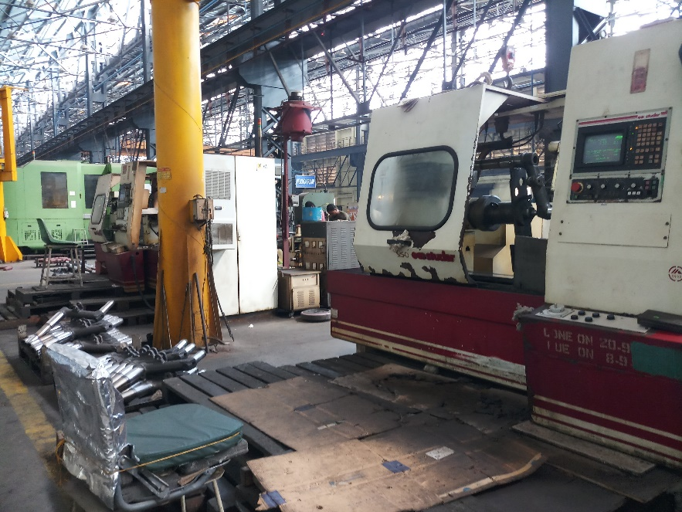
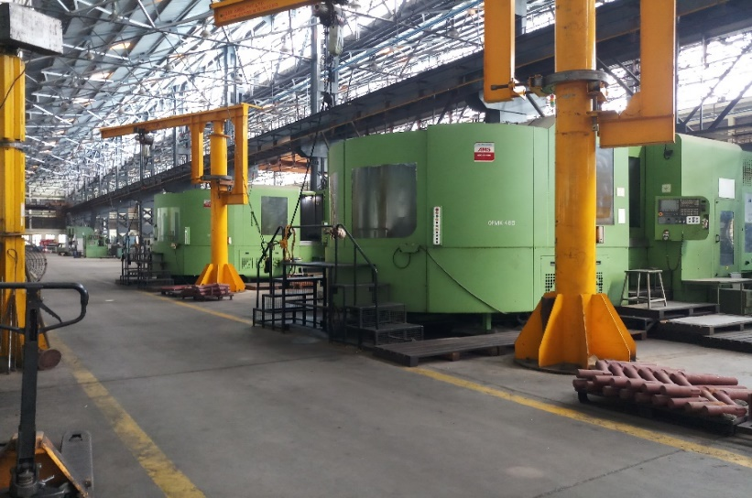
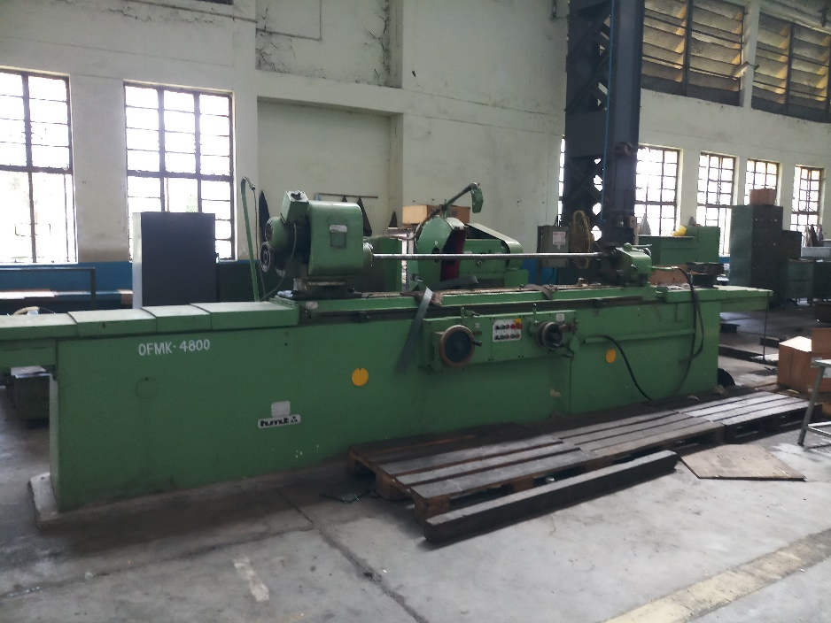
RUNNING GEAR MACHINING FACILITIES

Slide 18
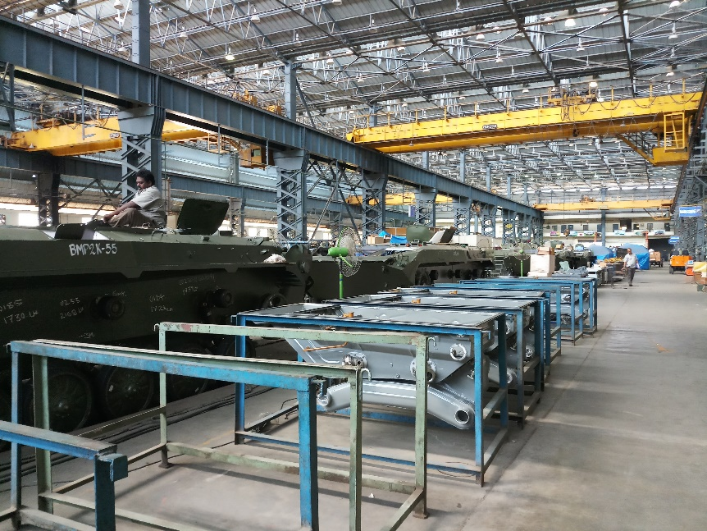
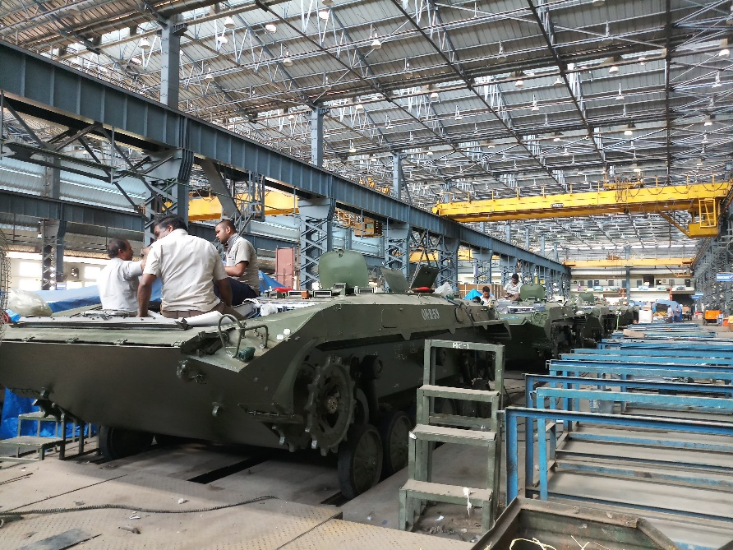
ASSEMBLY

Slide 19
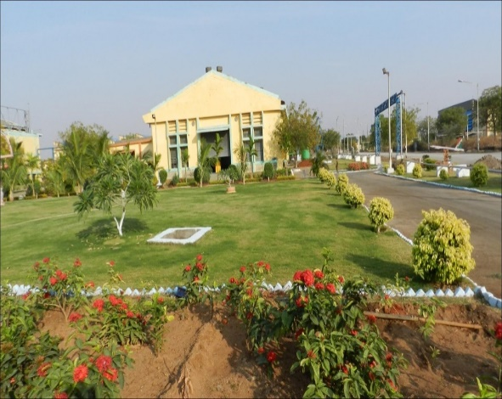
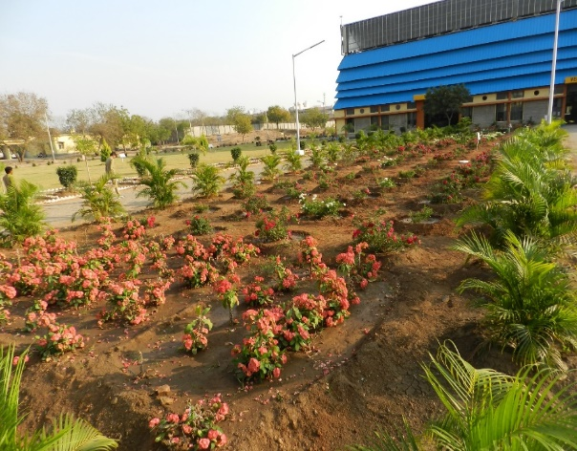
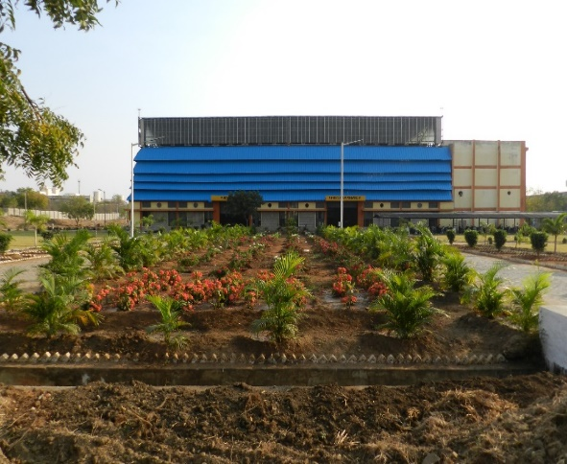
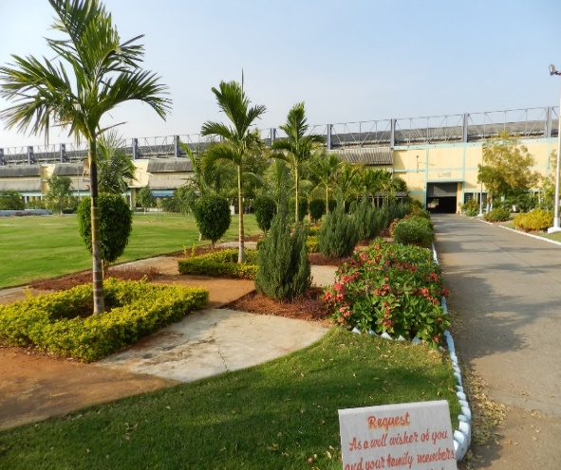
FACTORY AREA

Slide 20
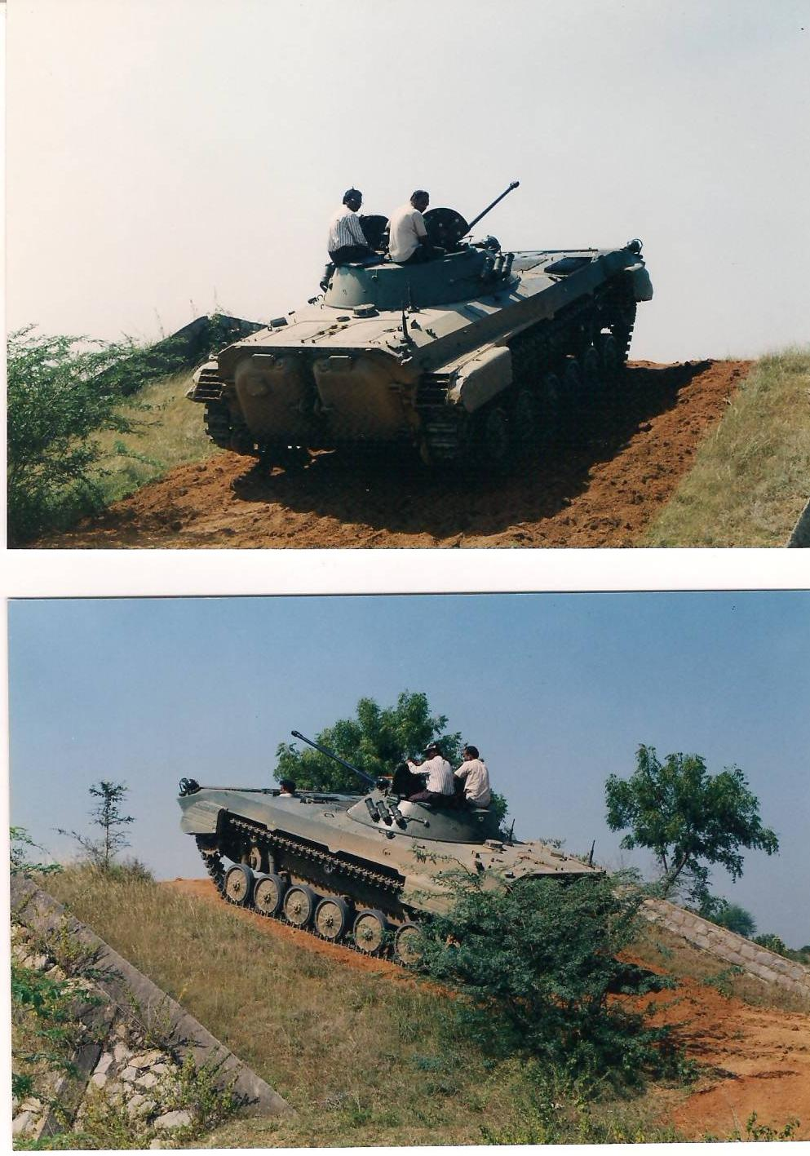
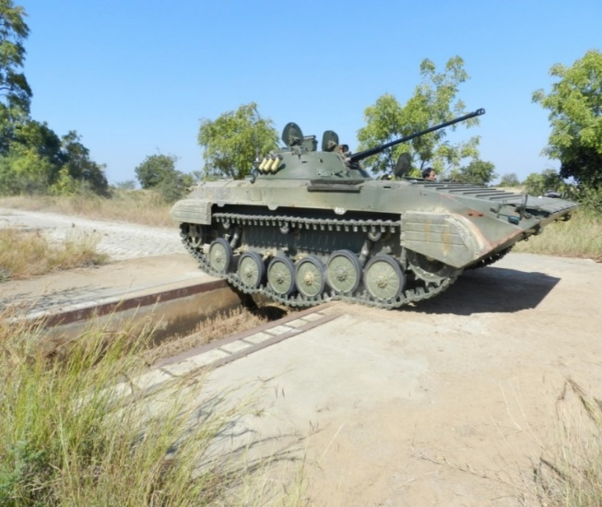
TEST TRACK

