Slide 1



ORDNANCE FACTORY MEDAK
A UNIT OF AVNL
Notes:
ODC-OFMK

Slide 2

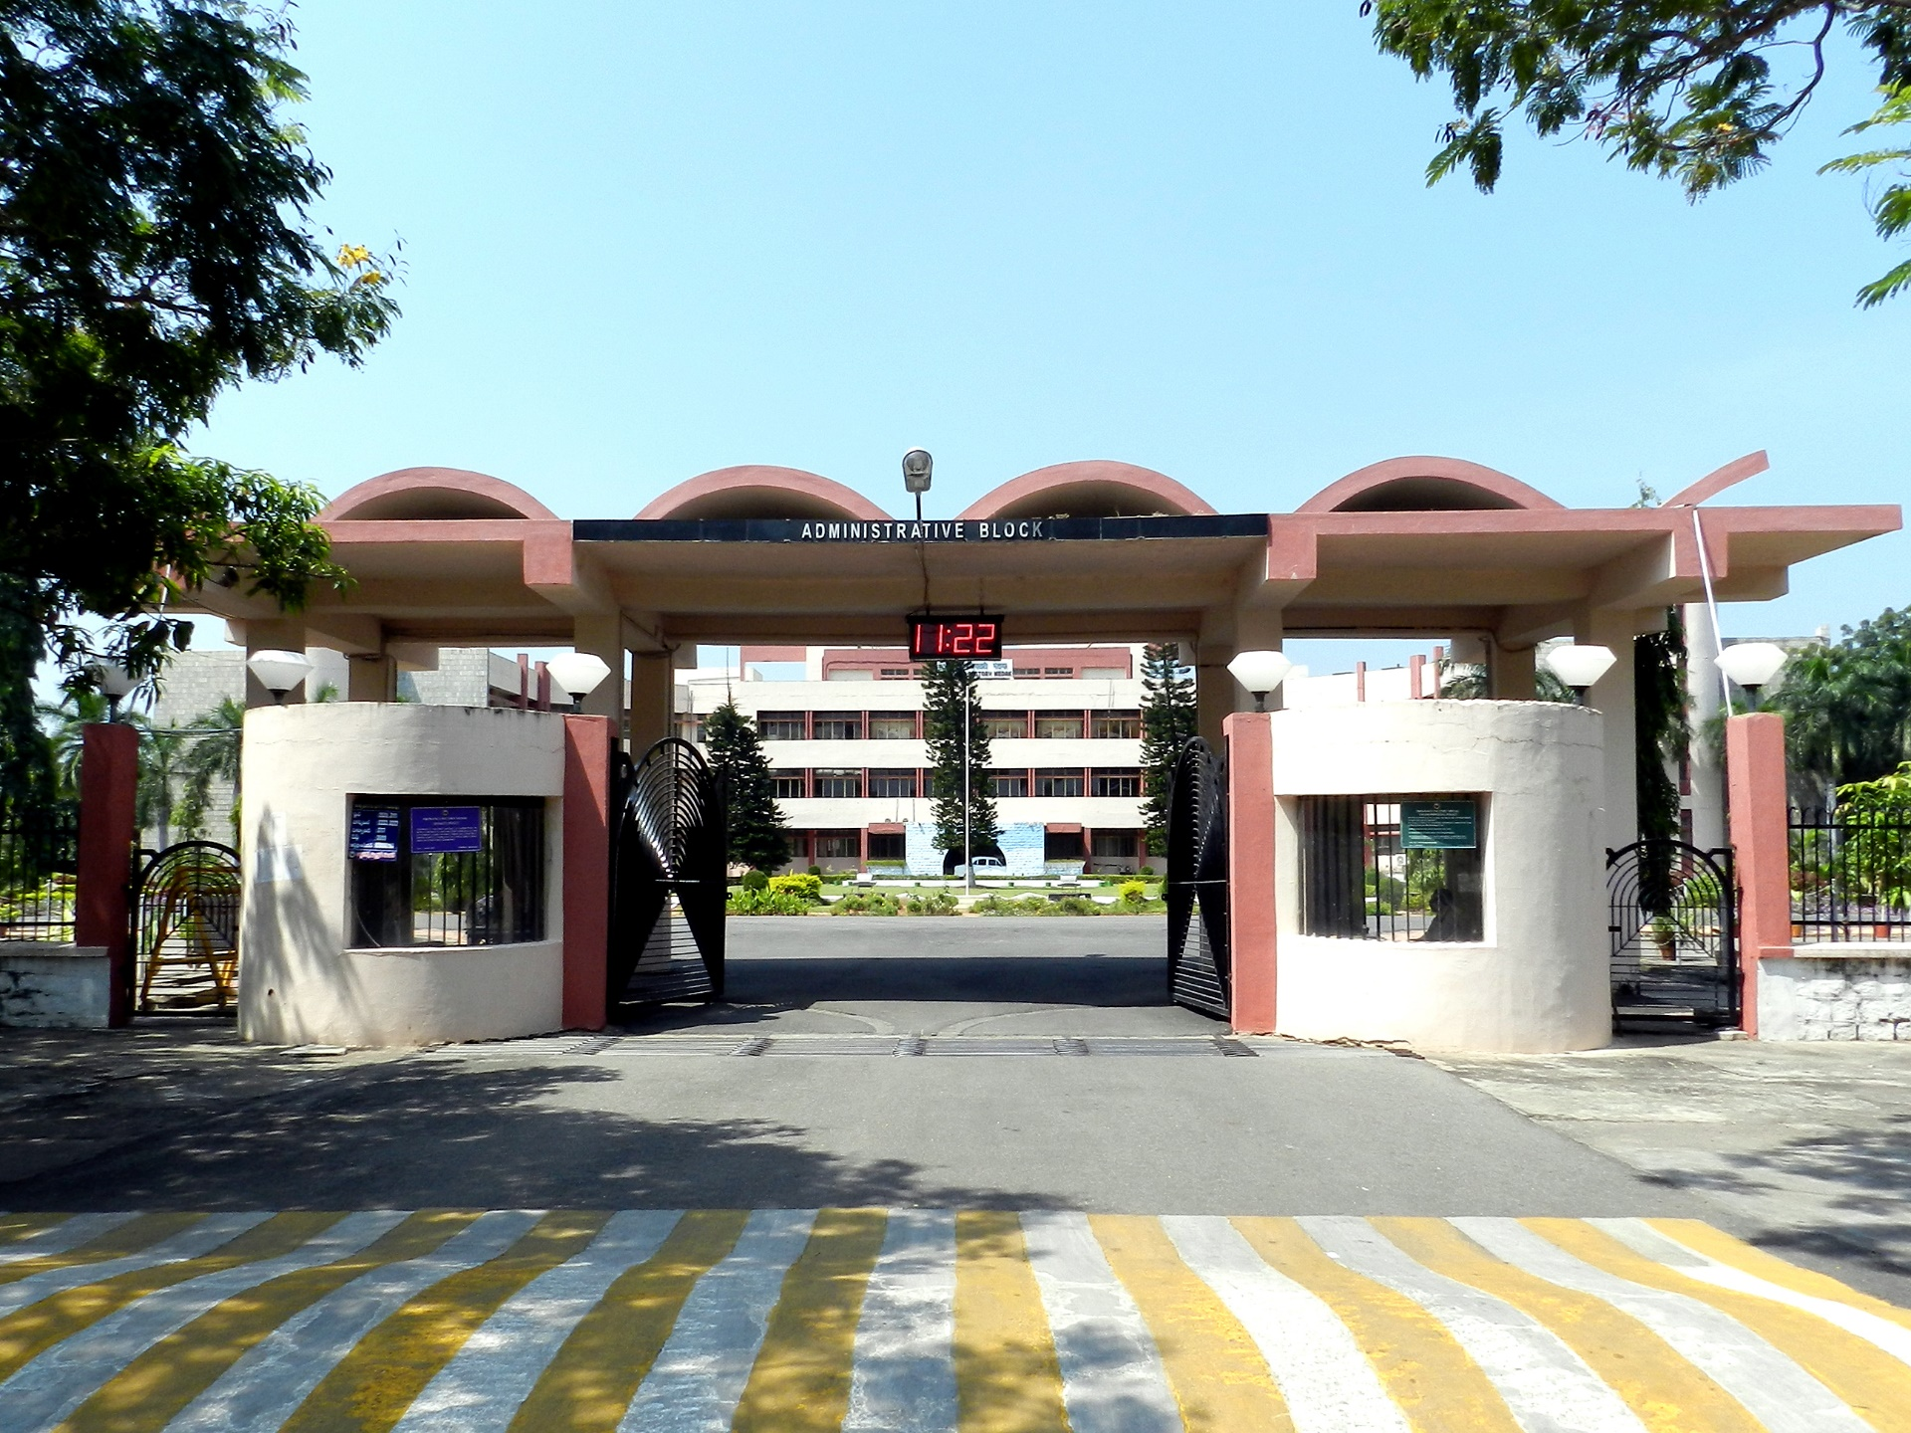
ADMIN ENTRANCE

Slide 3
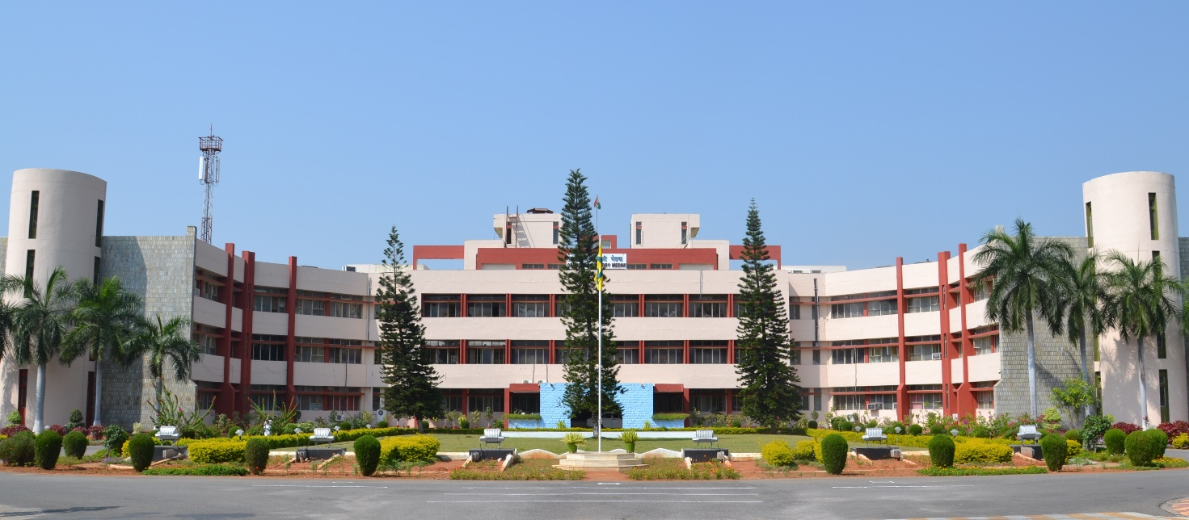
ADMINISTRATIVE BLOCK

Slide 4
OFMK PRODUCTS

Slide 5
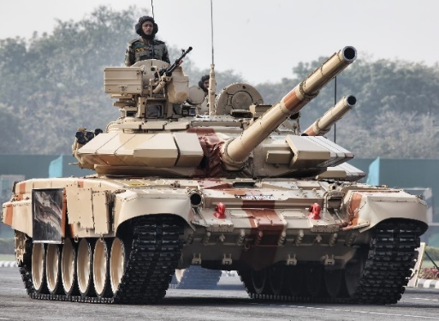
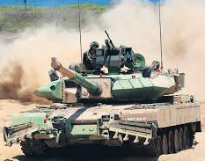

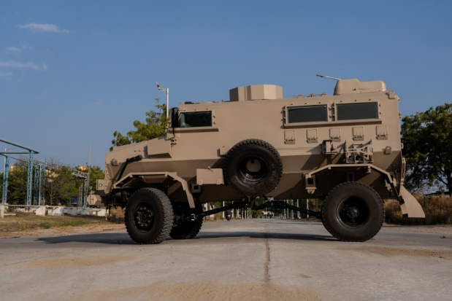
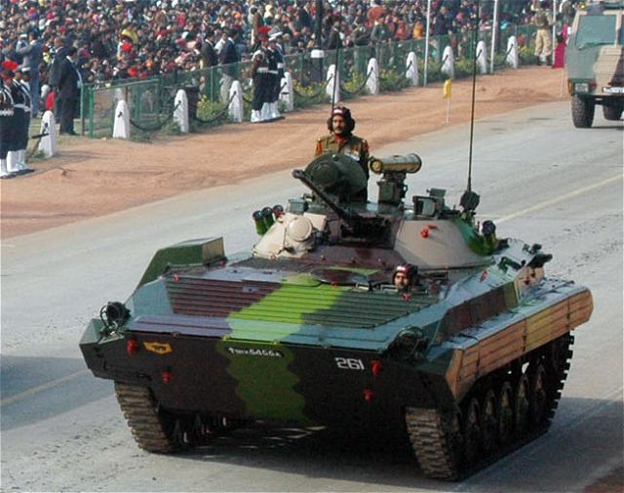
ARMOURED VEHICLES NIGAM LIMITED

Slide 6
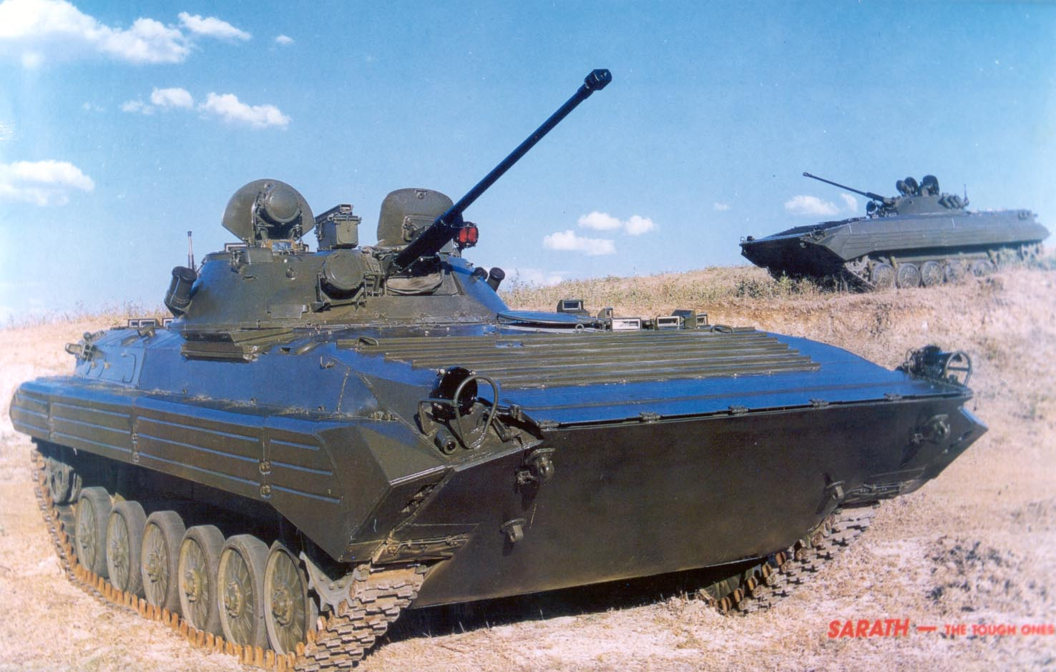
BMP II

Slide 7
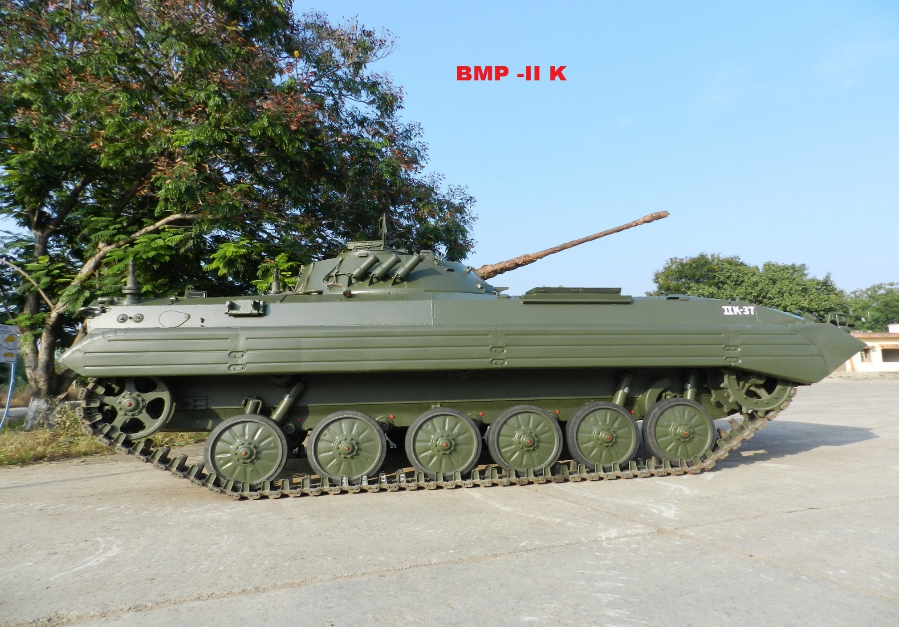
BMP IIK

Slide 8
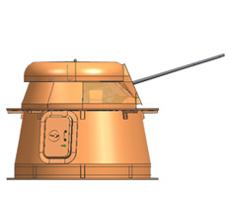
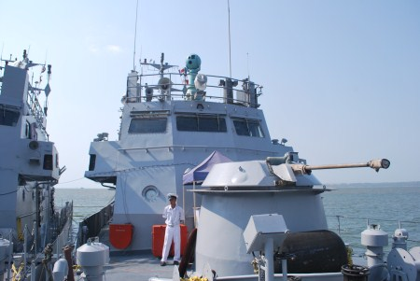
CRN-91

Slide 9
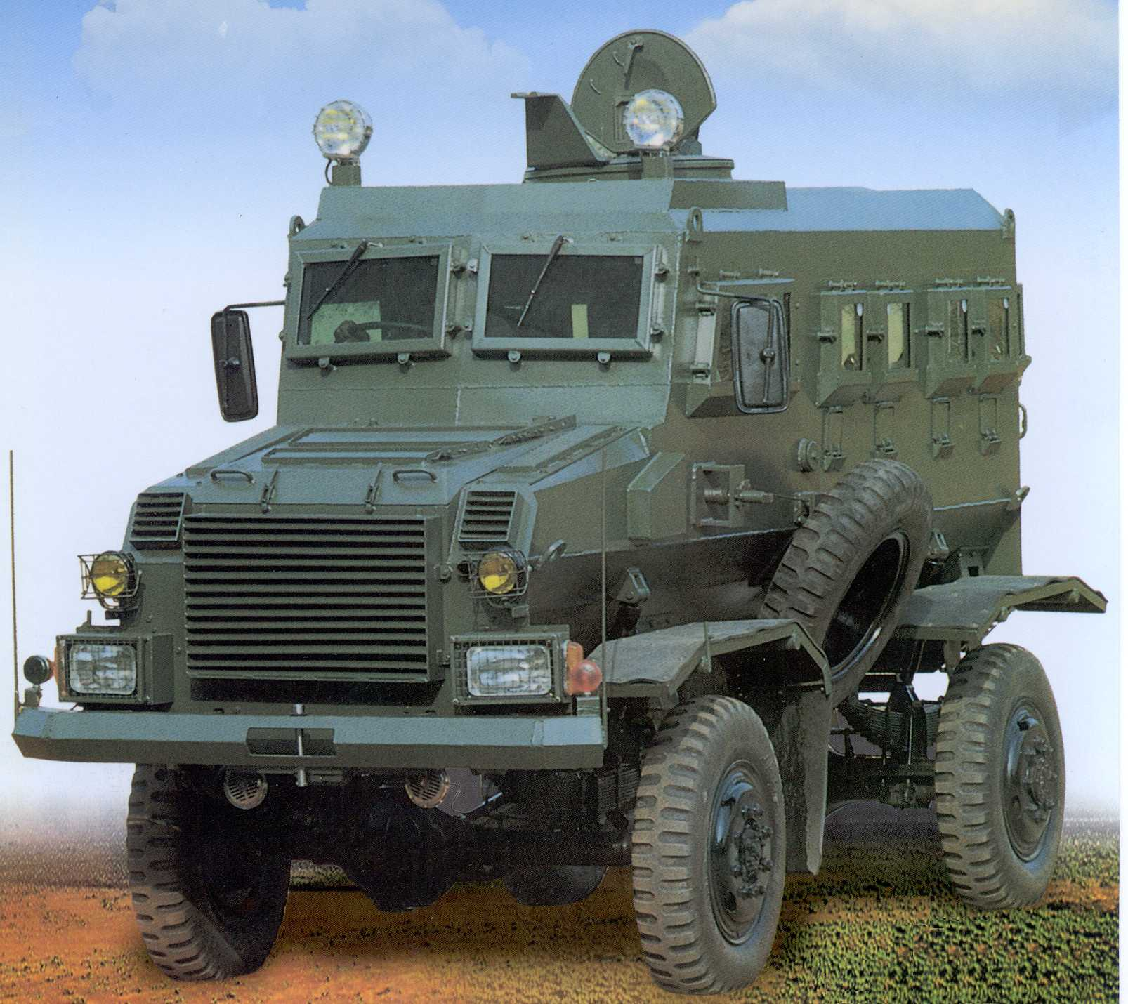
MINE PROTECTED VEHICLE FOR ARMY

Slide 10
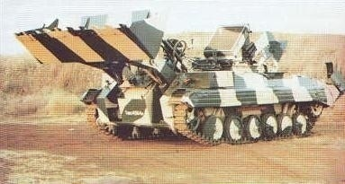
ARMOURED AMPHIBIOUS DOZER

Slide 11
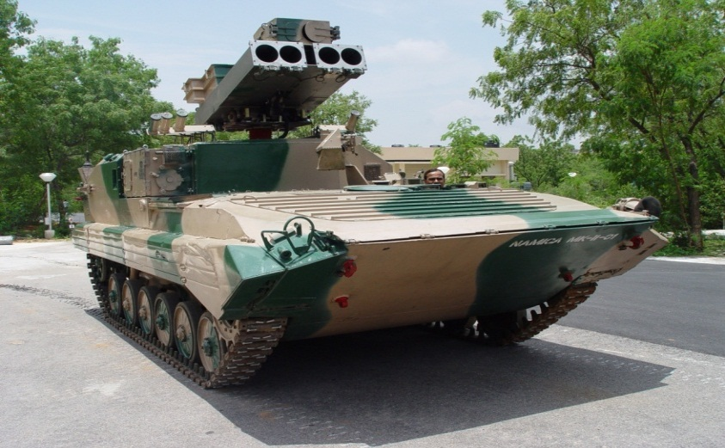
NAMICA

Slide 12
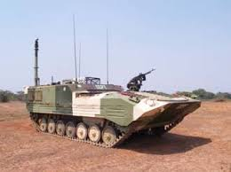
CARRIER COMMAND POST TRACKED

Slide 13
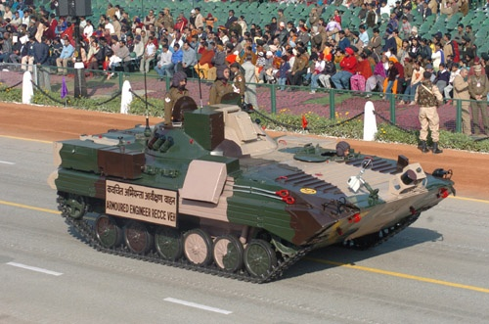
ARMOURED ENGINEER RV

Slide 14
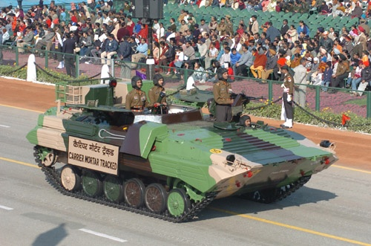
CARRIER MORTAR TRACKED

Slide 15
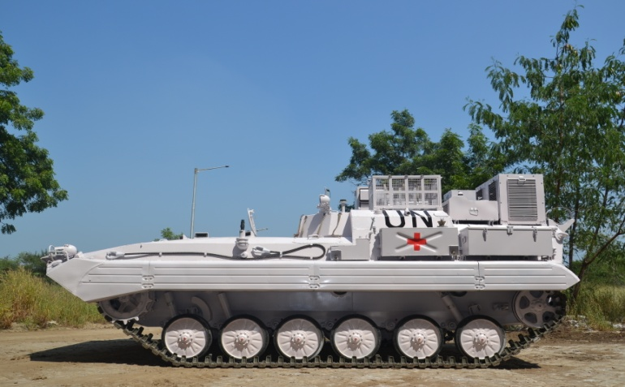
ARMOURED AMBULANCE TRACKED

Slide 16

Carrier Mortar Tracked

Slide 17
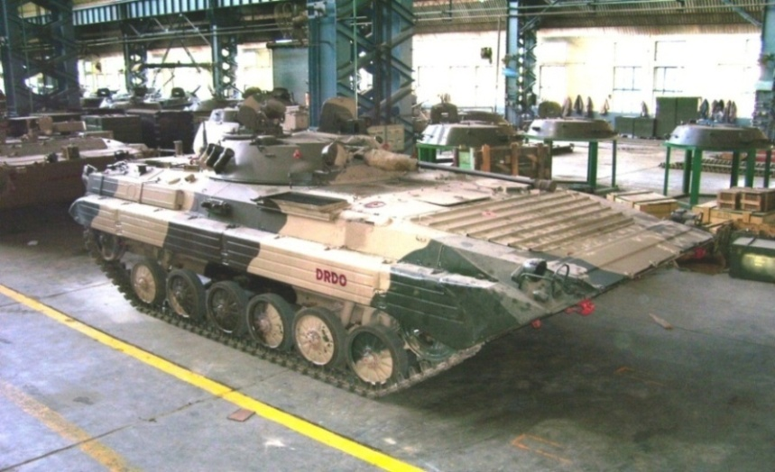
NBC RECCEE VEHILCE

Slide 18
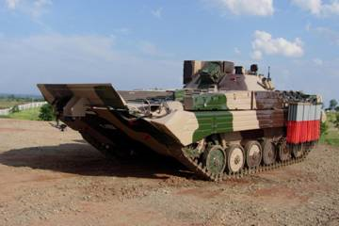
Armoured Engineering Reconnaissance Vehicle

Slide 19
AWARDS

Slide 20
AWARDS :
2015 : “Golden Peacock HR Excellence Award – 2015”
2016 : “Golden Peacock Innovative / Product Service
Award – 2016”
2017 : “Hon’ble Raksha Mantri Award for Excellence
for 2014-15”.
2017 : “Hon’ble Raksha Mantri Award for Excellence
for 2015-16”.
2017 : “Golden Peacock Environment Management
Award-2017”
2019 : “Bagged 1st prize in BEE’s National Energy Conservation Awards 2019”.
Notes:
ODC-OFMK

Slide 21
AWARDS :
2020 : Ordnance Factory Medak has been awarded “Silver Prize”
under Industry – Large Scale Industries Category by
“Government of Telangana, Department of Energy” in appreciation of the efforts for Energy Conservation for the
year 2020-21.
Notes:
ODC-OFMK

Slide 22
CERTIFICATIONS

Slide 23




  CERTIFICATIONS
IS-16001 : 2012 (SAMS) SOCIAL ACCOUNTABILITY MANAGEMENT SYSTEM
AS9100D “Quality Management System Standards” for meeting requirements for Aviation, Space & Defence Organization. OFMK is the first factory among the group of Ordnance Factories to be awarded with such coveted certification.

