Slide 1




Code for Police Code for India
TEAM NAME:
Nmitians
TEAM LEADER: DHANUSH P
TEAM MEMBERS:
G.Y.SREE VYSHNAVI
JNANA KP
CHETHAN
MASI

Slide 2

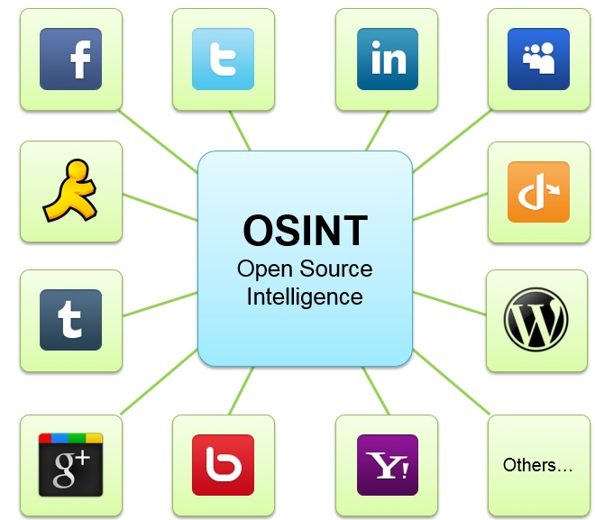

OSINT:

Slide 3
OSINT includes all publicly accessible sources of information. This information can be found either online or offline:
The Internet, which includes the following and more: forums, blogs, social networking sites, video-sharing sites like YouTube.com, wikis, Who is records of registered domain names, metadata and digital files, dark web resources, geolocation data, IP addresses, people search engines, and anything that can be found online.
Traditional mass media (e.g., television, radio, newspapers, books, magazines).
Specialized journals, academic publications, dissertations, conference proceedings, company profiles, annual reports, company news, employee profiles, and resumes.
Photos and videos including metadata.
Geospatial information (e.g., maps and commercial imagery products)

Slide 4

OSINT:
CHALLENGES:
BENEFITS:
Information Gathering Types:
Less risky
Cost effective
Ease of accessibility
Legal issues
Aiding financial investigators
Fighting against online counterfeiting
Maintaining national security and political stability
Passive- collection
Semi-passive
Active collection
Sheer volume of data
Reliability of sources
Human efforts

Slide 5



PROBLEM STATEMENT: Develop an application to find person /people details based on image and name search.
FIRST TARGET
SECOND TARGET
Name search
IMAGE SEARCH

Slide 6


TOOLS USED:
Twitty
Sherlock
Visual studio
Notepad++

Slide 7

OUTPUT DEMO:

Slide 8
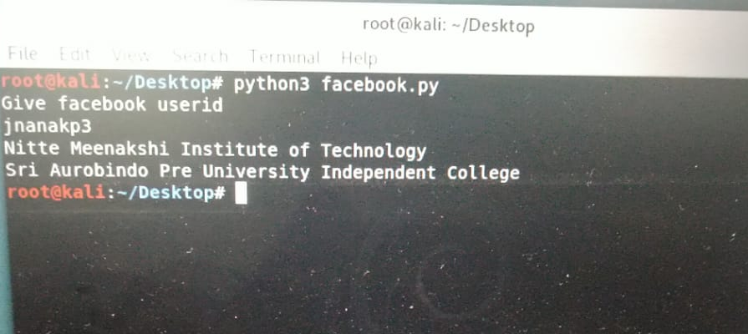
OUTPUT DEMO: -search by name o/p:got educational details of the user

Slide 9
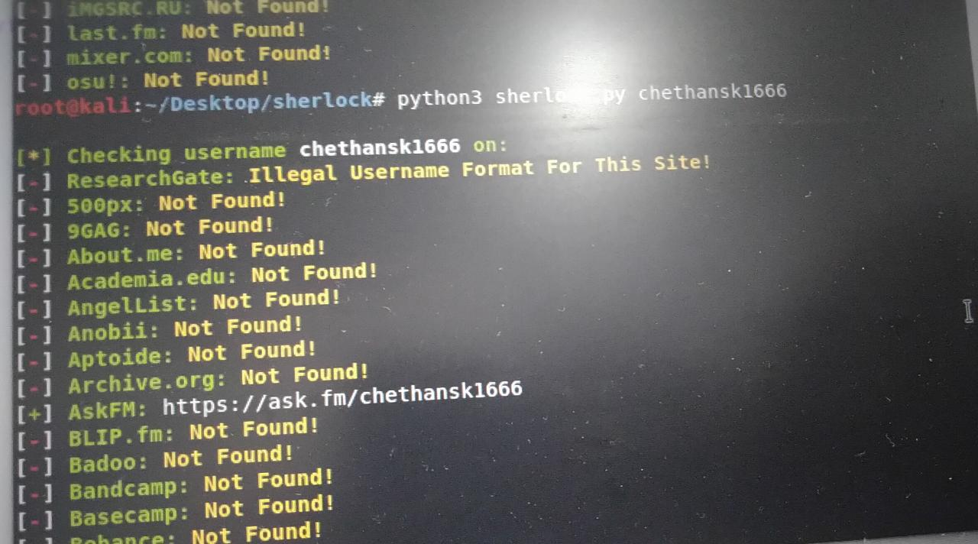
OUTPUT DEMO: -search by name o/p:got the user accounts

Slide 10
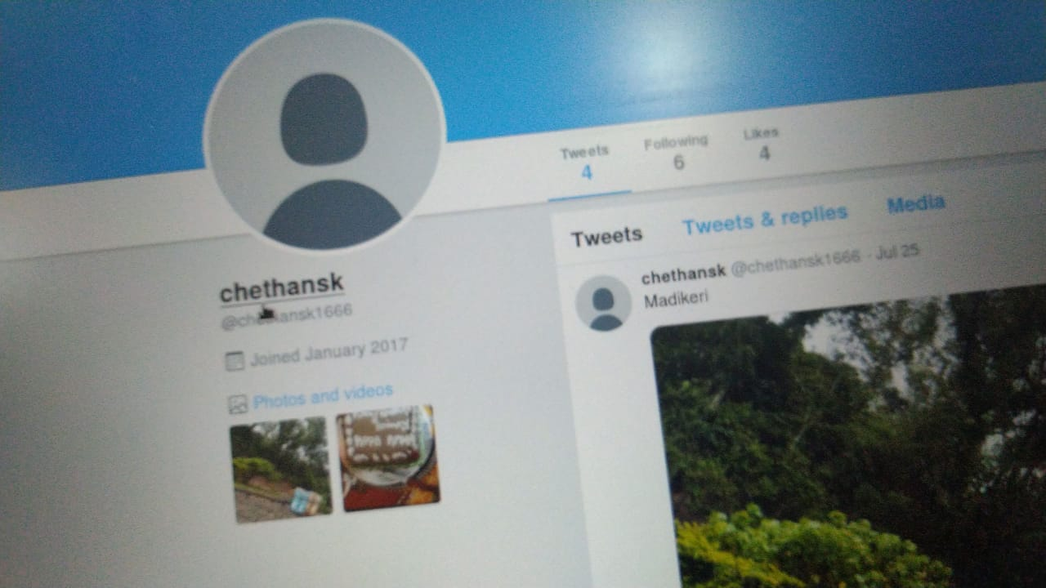
OUTPUT DEMO: -search by name o/p:can directly get access to the user accounts

