Slide 1
Applied Data Science Capstone Week 5 Fredericton Crime Study:
3/3/2019

Slide 2

Introduction:
Researches and developers are usually interested to decreasing the crime in this city, so there is usually a big question about what neighbourhoods have the highest crime, and Is population density correlated to crime level.

Slide 3
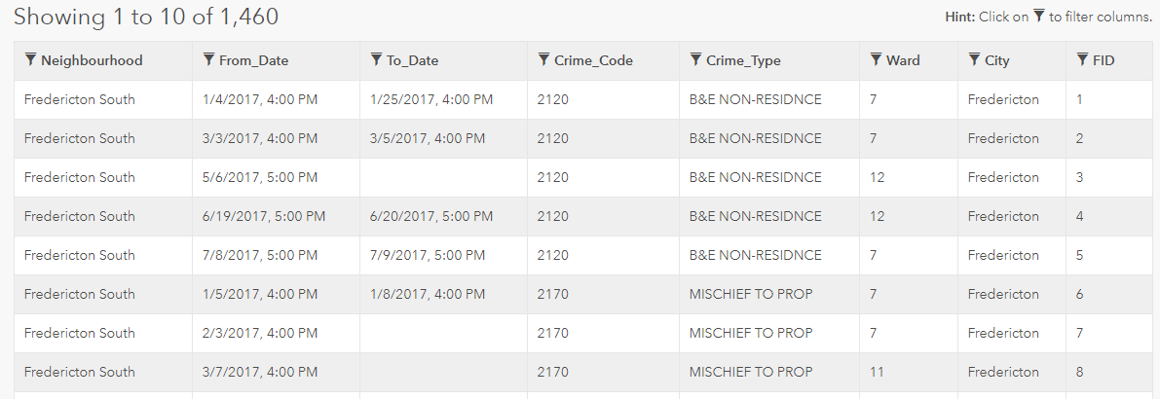
Data
https://foursquare.com/
https://www.numbeo.com/crime/in/Fredericton
http://www.fredericton.ca/en/fredericton-police/crime-map

Slide 4

Methodology
The methodology of work will start in loading data set, then we will study different descriptive statistics for different parameters like crime type and neighbourhood ,after that we will study the crime types and then pivot analysis of crime type frequency by neighbourhood, then we will study the correlation between population density and crimes. In orders to build a model, we will use k-means statistical algorithm on venues by locations of interest based on findings from crimes and neighbourhood.

Slide 5
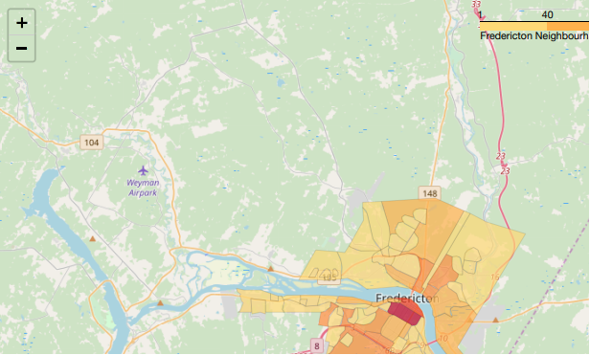
Visualization

Slide 6
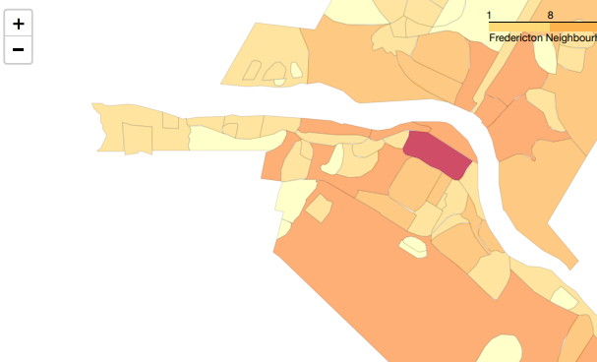
Motor Vehicle Crime

Slide 7
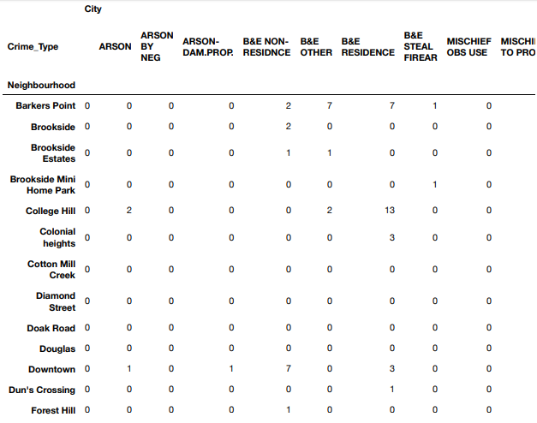
Crime type table

Slide 8
Results:
The analysis enabled us to discover and describe visually and quantitatively: neighbourhoods in Fredericton, crime frequency by neighbourhood, Crime type frequency and statistics, the mean crime count in the City of Fredericton is 22. Crime type count by neighbourhood. Theft from motor vehicles is most prevalent in the same area as the most frequent crimes. It's interesting to note this area is mostly residential and most do not have garages. It would be interesting to further examine if surveillance is a deterrent for motor vehicle crimes in the downtown core compared to low surveillance in the Platt neighbourhood

Slide 9
Conclusion
Using a combination of datasets from the City of Fredericton Open Data project and Foursquare venue data we were able to analyse, discover and describe neighbourhoods, crime, population density and statistically describe quantitatively venues by locations of interest. While overall, the City of Fredericton Open Data is interesting, it misses the details required for true valued quantitative analysis and predictive analytics which would be most valued by investors and developers to make appropriate investments and to minimize risk.

