Slide 1
CALIBO AI ACADEMY · PATH 2 · KLU BATCH · PHASE 2, MINI USE CASE 02
Credit Pre-Screening Engine
Loan Intake Optimisation · BFSI — Retail Lending
Can six months of our own decisions tell us which loan applications
we never needed to read?
BATCH 9
Mohammed Mutee Ruknuddin
Data Analyst
Cleaning · CBIM Canvas
Mohammed Saalif Udyawar
Insights Analyst
Approval drivers · Affordability
Mulla Javeed
Model Builder
Logistic regression · Threshold
Nagothu Varshitha
Policy Synthesiser
Fairness · Credit Policy Briefing
27 October 2026

Slide 2
THE STORY
A day inside the lending unit
Where this use case begins — before any data, any model, any code.
A mid-size private bank lends unsecured personal loans across India — to salaried staff, self-employed professionals, small business owners and gig workers, in metros and in Tier 2 and Tier 3 towns.
Every month about 3,000 applications arrive. And every single one of them is opened, read and judged by a human credit analyst. That takes about 25 minutes each.
3,000
25 min
1,250 hrs
47%
applications arrive
every month
manual review
for every one
analyst time spent
each month
of them end up
declined
PUT ANOTHER WAY
1,250 hours a month is roughly eight full-time people doing nothing but reading application forms. Half of what they read ends in a 'no'.
Batch 9 · MUC02 Credit Pre-Screening Engine · Mohammed Mutee Ruknuddin
2 / 17

Slide 3
THE COMPLICATION
The problem is not the volume — it is what fills the queue
Most of the declined applications were never a judgement call.
Nearly half of all applications are declined — and a large share of those are decided inside the first minute.
The credit score is far below what the bank will accept, or the applicant's existing EMIs already swallow most of their income.
An analyst still spends the full 25 minutes on that file — opening it, checking it, writing it up, closing it.
Three things go wrong because of this
For the bank
For the analysts
For good customers
It cannot take more applications without hiring more analysts.
Their day goes to obvious 'no's, not the borderline files that need a person.
They wait behind applications nobody needed to read.
THE QUESTION THAT STARTED THIS
“Can we use our own history to build a pre-screening model, so analysts spend their time on applications that genuinely need judgement?”
— the Head of Retail Lending, to the Credit Policy Analyst
Batch 9 · MUC02 Credit Pre-Screening Engine · Mohammed Mutee Ruknuddin
3 / 17

Slide 4
HOW WE FRAMED IT
CBIM Problem Canvas
Filled in together, in 20 minutes, before the dataset was opened.
SITUATION
COMPLICATION
QUESTION
3,000 personal loan applications a month. Every one reviewed by hand, 25 minutes each — about 1,250 analyst hours.
47% are declined and many are obvious in a minute. Analyst time goes to clear-cut 'no's; good customers wait; the bank cannot grow without hiring.
Which applications can leave the manual queue automatically, at what confidence level, without wrongly declining more than 5% of customers we would have approved?
SSOT
SUCCESS
STAKEHOLDER
MUC02_Credit_PreScreening_Dataset.csv — 12,000 applications, Apr–Sep 2026. The 'decision' column is the credit team's past judgement, NOT whether the customer repaid.
Not accuracy. At most 5% of auto-declines may be people we would have approved — and the volume freed must be stated in applications and analyst hours per month.
The Credit Policy Analyst. Also affected: the Head of Retail Lending, the analysts whose queue changes, and the applicants declined without a human reading their file.
Batch 9 · MUC02 Credit Pre-Screening Engine · Mohammed Mutee Ruknuddin
4 / 17

Slide 5
OUR APPROACH
Seven steps, four owners, one notebook
Each step is code plus a plain-English explanation of what it found.
1
2
3
4
5
6
7
›
›
›
›
›
›
Clean
Find the
drivers
Build
affordability
Train the
model
Choose the
threshold
Check
fairness
Brief the
bank
Member
Role
Steps owned
What they answered
Mohammed Mutee Ruknuddin
Data Analyst
5.1 + Canvas
Is the data honest enough to model?
Mohammed Saalif Udyawar
Insights Analyst
5.2, 5.3
What does the credit team actually do today?
Mulla Javeed
Model Builder
5.4, 5.5
How far can a model be trusted, and where do we cut?
Nagothu Varshitha
Policy Synthesiser
5.6, 5.7
Is it fair, and what do we tell the bank?
WHY THE ORDER MATTERS
Everyone's section feeds the next one. The cleaning decides the features, the features decide the model, the model decides the threshold — and the briefing has to defend all four.
Batch 9 · MUC02 Credit Pre-Screening Engine · Mohammed Mutee Ruknuddin
5 / 17

Slide 6
OWNED BY MUTEE
Step 1 — Three problems in the data, three decisions
What we found
What it really was
What we did
Why
441 missing incomes
Not random — 13% of Business Owners and 11% of Self-Employed, but under 0.7% of Salaried
Filled with the median income of that employment type
Someone without a salary slip has no single clean number to declare. The gap is itself information.
1,039 blank credit scores
Credit history is 0 months for every one of them — these are new-to-credit people
Kept them, flagged with is_ntc
Dropping them deletes 8.7% of applicants, mostly young first-time borrowers.
12 impossible incomes (over ₹6 lakh a month)
Annual income typed into a monthly box — all 12 were Salaried
Divided by 12
Dividing puts every one back into a normal salary band. Left in, they teach the model that huge loans are effortless.
WHY THIS MATTERS TO THE BANK
We kept all 12,000 rows. A single dropna() would have deleted 9% of applicants — the young first-time borrowers and the self-employed. Those are exactly the customers the bank is trying to grow.
Batch 9 · MUC02 Credit Pre-Screening Engine · Mohammed Mutee Ruknuddin
6 / 17

Slide 7
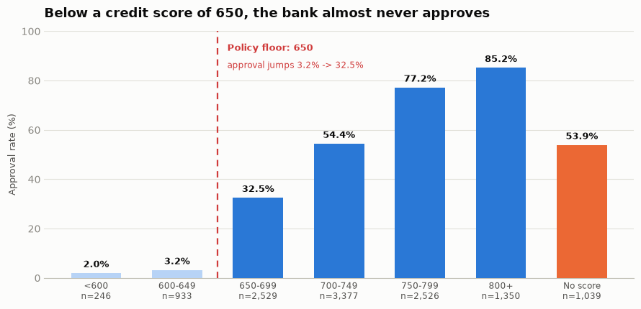
OWNED BY SAALIF
Finding 1 — The bank has a credit score rule nobody wrote down
Below 650, approval is 3.0% across 1,179 applications.
Just above it, 32.5%. At 800+, 85.2%.
That is a tenfold jump across a single point on the scale. It is not a gradient — it is a rule. No one has written “650” into the credit policy, but every analyst applies it.
And applicants with no score at all sit in the middle at 53.9% — the credit team is using judgement there, not a rule. Remember that one.
WHY THIS MATTERS TO THE BANK
This is the safest thing in the whole dataset to automate. The machine is not being asked to judge — it is being asked to repeat a decision the credit team has already made the same way 1,179 times.
Batch 9 · MUC02 Credit Pre-Screening Engine · Mohammed Saalif Udyawar
7 / 17

Slide 8
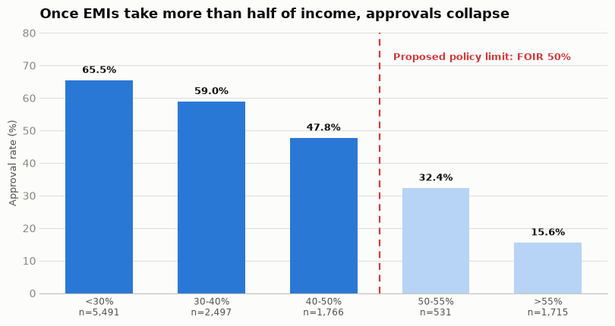
OWNED BY SAALIF
Finding 2 — Approvals fall off a cliff once EMIs pass half the income
FOIR = (EMIs they already pay + the new EMI) ÷ monthly income.
It was not in the file. We had to build it — and it turned out to be the strongest single number in the dataset.
Up to 50% the fall is gentle — 65% → 59% → 47%.
Then it collapses: 47% → 32% → 16%.
Approval more than halves at one line.
WHY THIS MATTERS TO THE BANK
The bank gets a written credit policy out of its own history: FOIR limit 50%, 50–55% a referral band, above 55% a decline unless justified. Not a new rule — the existing unwritten one made explicit, so every analyst applies it the same way.
Batch 9 · MUC02 Credit Pre-Screening Engine · Mohammed Saalif Udyawar
8 / 17

Slide 9
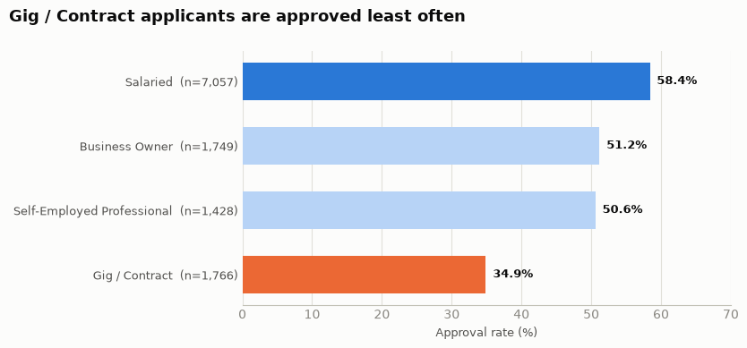
OWNED BY SAALIF
Finding 3 — Gig workers are not declined for being gig workers
Salaried applicants are approved 58.4% of the time. Gig and contract applicants, 34.9% — a 23-point gap.
But the label is not the cause. Gig applicants have a median income of ₹28,000 against ₹50,000 for salaried applicants, plus shorter job tenure. The same loan therefore produces a far higher FOIR for them.
Employment type is standing in for income stability — not for the job title.
WHY THIS MATTERS TO THE BANK
This is defensible, and it points to a product fix. The bank is declining on affordability, not on occupation. Offer gig applicants a smaller ticket size or a longer tenure and their FOIR drops under 50% — turning a decline into a sale instead of a loss.
Batch 9 · MUC02 Credit Pre-Screening Engine · Mohammed Saalif Udyawar
9 / 17

Slide 10
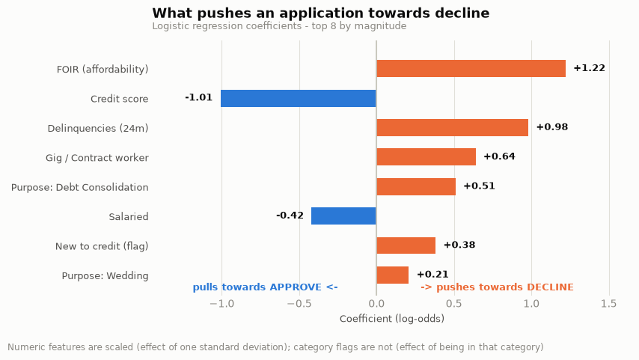
OWNED BY JAVEED
The model — and what it taught itself
Logistic regression · 12 features · 9,600 applications to learn from, 2,400 held back to test on.
The target is Declined = 1, because auto-declining is the action we are trying to take.
Gender, city and the decision itself were left out — gender because a bank cannot defend a credit decision that uses it.
The top three are FOIR, credit score and delinquencies — the same three drivers Saalif found by hand, in the same order.
WHY THIS MATTERS TO THE BANK
We never told the model about the 650 cliff or the 50% FOIR line. It found both on its own. That is the strongest evidence that it learned the bank's real credit policy rather than a fluke of this six months — and what makes it defensible to a credit analyst.
Batch 9 · MUC02 Credit Pre-Screening Engine · Mulla Javeed
10 / 17

Slide 11
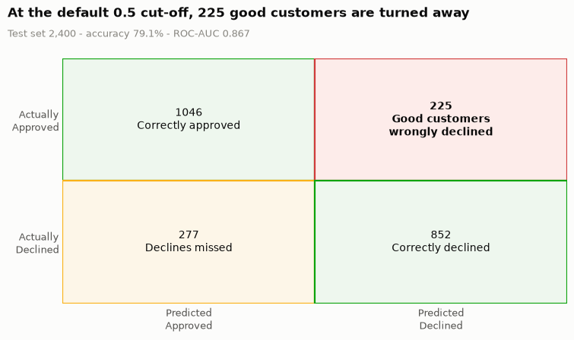
OWNED BY JAVEED
How we judge it — and why accuracy is the wrong headline
The confusion matrix: a simple 2×2 of what the model said against what really happened.
True Negative — 1,046
Model said approve, the team approved. Correct.
False Positive — 225
Model said decline, the team had APPROVED. A real customer lost. The expensive error.
False Negative — 277
Model said approve, the team declined. Costs 25 minutes of an analyst's time. Cheap.
True Positive — 852
Model said decline, the team declined. Correct.
Precision (Declined) = 79.1% — of everyone the model declines, how many really were declines.
Recall (Declined) = 75.5% — of all the real declines, how many the model caught.
Accuracy 79.1% · ROC-AUC 0.867
THE NUMBER THAT CHANGED THE CONVERSATION
“The model is 79% accurate” describes the model. “225 applicants we would have approved are turned away” describes the business — and that is why the next slide exists.
Batch 9 · MUC02 Credit Pre-Screening Engine · Mulla Javeed
11 / 17

Slide 12
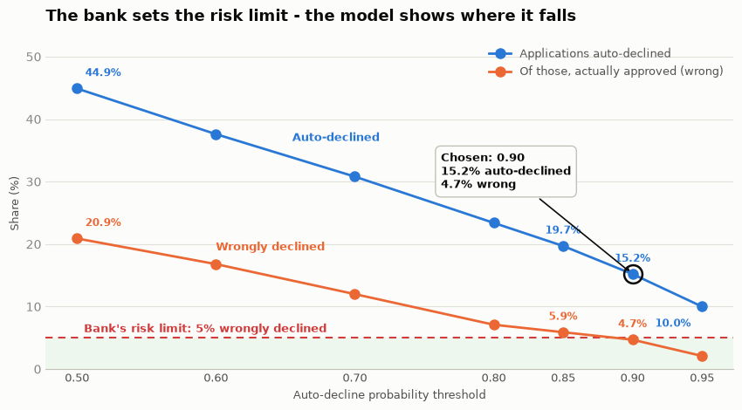
OWNED BY JAVEED
Finding 4 — The bank sets the limit, the model finds it
A logistic regression outputs a probability, not a decision. Python's default cut-off is 0.5 — a statistical convention with nothing to do with lending.
At 0.5 it auto-declines 44.9% of applications — but one in five of those is a customer the bank wanted. No lending unit would sign that off.
THE BANK'S RULE
No more than 5% of auto-declined applications may be ones the credit team would have approved.
WHY THIS MATTERS TO THE BANK
We recommend 0.90 — the lowest cut-off that stays inside the 5% rule, at 4.7% wrong. That removes 15.2% of applications: about 456 a month and 190 analyst hours. Anything higher buys safety the bank already said it does not need, and pays for it in volume.
Batch 9 · MUC02 Credit Pre-Screening Engine · Mulla Javeed
12 / 17

Slide 13
OWNED BY VARSHITHA
Finding 5 — The one group the model must not decide
81.2%
56.7%
0
6 of 12
accuracy on applicants
WITH a credit score
accuracy on applicants
with NO credit score
delinquencies, active loans
and EMIs — for all 1,039
new-to-credit auto-declines
the bank had APPROVED
Why it fails is structural, not statistical. Someone who has never borrowed has no loans to be late on — so delinquencies, active loans and existing EMIs are zero by definition for all 1,039 of them. Three of the model's four strongest features are blank for this group, and no amount of modelling fixes it.
Design A — one lane for everyone
Design B — no credit history always sees a human
Threshold
0.90
0.88
Applications auto-declined
15.2%
16.4%
Wrongly declined
4.7%
4.1%
Per month
~456 applications · ~190 hours
~492 applications · ~205 hours
WHY THIS MATTERS TO THE BANK
More applications removed AND fewer mistakes, at the same time — and it protects young first-time borrowers. One sentence to explain: “we never auto-decline someone with no credit history.”
Batch 9 · MUC02 Credit Pre-Screening Engine · Nagothu Varshitha
13 / 17

Slide 14
OWNED BY VARSHITHA
Fairness — we measured it instead of assuming it
We did not use gender as a feature. That on its own does not make a model fair.
1. There IS a gap in the history
54.1% of men approved against 50.4% of women — a 3.7-point gap in the bank's own past decisions.
2. It is about which jobs, not about gender
Inside Gig/Contract the gap is 0.5 points; inside Business Owner it is −0.6 (favouring women). The aggregate gap comes from composition.
3. What explains it
Female applicants: median income ₹45,000 vs ₹55,000, and 21% are gig workers against 12% of men — the lowest-approval category. Credit scores are near-identical (723 vs 727).
4. Our model does not widen it
At 0.90 it auto-declines 15.6% of women and 15.0% of men — a 0.6-point gap, against 3.7 in the human decisions. Errors do not fall harder on women (3.4% vs 5.2%).
Our position: gender should never be a feature in a credit model — it is indefensible to a regulator and to a customer, whatever it does for accuracy. But leaving it out is necessary, not sufficient: income and employment type are strong proxies, and a model built only on those can reproduce a gender gap without ever seeing the column.
WHY THIS MATTERS TO THE BANK
The bank can show a regulator a measured answer instead of an assurance — and it gets an early-warning system: report auto-decline rates by gender every month, and treat a widening gap as the trigger to review the threshold.
Batch 9 · MUC02 Credit Pre-Screening Engine · Nagothu Varshitha
14 / 17

Slide 15
THE BIG PICTURE
What this is actually worth to the bank
Five ways the pre-screener turns into money — three we measured, two the bank can now go and measure.
1
Capacity without hiring
190 hours a month = 2,280 hours a year ≈ 1.2 full-time analysts. The unit can absorb about 15% more applications with the team it already has.
MEASURED
2
Analyst time moves to where money is made
Those hours shift from obvious 'no's onto borderline files — the ones where an approval is actually won or lost. A clear decline earns the bank nothing.
MEASURED
3
Good customers get answers faster
456 files leave the queue every month, so everyone behind them moves up. Fewer applicants give up and go to a competitor while waiting.
MEASURED VOLUME
4
One consistent, written credit policy
A 50% FOIR limit applied the same way by every analyst, every day — less inconsistency, fewer over-leveraged loans written by accident.
POLICY GAIN
5
Protecting tomorrow's customers
The new-to-credit carve-out saves about 6 young first-time borrowers a month from a wrong machine rejection. These are the longest-lifetime customers the bank has.
RISK AVOIDED
PUTTING A NUMBER ON IT — WITH ONE ASSUMPTION STATED OUT LOUD
2,280 analyst hours a year. At an assumed fully-loaded analyst cost of ₹500 an hour, that is roughly ₹11.4 lakh a year of capacity released — before counting a single rupee from faster decisions or recovered gig-worker applications.
₹500/hour is our assumption, not the bank's figure. The hours are ours; the rate has to come from Finance.
Batch 9 · MUC02 Credit Pre-Screening Engine · Nagothu Varshitha
15 / 17

Slide 16
OWNED BY VARSHITHA
What we recommend the bank does — in this order
Shadow-run it for one month
Score live applications and record what the model would have done — without acting on it. Compare against the analysts' real decisions.
Month 1
1
Launch at 0.90, with the carve-out
Auto-decline at 0.90, and never auto-decline an applicant with no credit history. Move to Design B at 0.88 once the shadow month confirms the rates.
Month 2
2
Write the FOIR limit into policy
50% limit, 50–55% a referral band, above 55% a decline unless justified. The bank's own history already supports it.
Month 2
3
Start capturing repayment outcomes
Today we only know who was approved, not who repaid. This is the single biggest upgrade available to the next version.
From day 1
4
Stand up monthly monitoring
Auto-decline rate and wrong-decline rate, overall and by gender, with a written trigger to review the threshold.
Ongoing
5
Recalibrate every quarter
The threshold is estimated from 2,400 test applications and the credit policy itself will drift. Re-fit and re-choose quarterly.
Quarterly
6
WHY THIS MATTERS TO THE BANK
The ask is small and the exit is easy. A shadow month costs nothing and can be stopped at any point. If the numbers hold, the bank gets 190 hours a month back; if they do not, nobody was ever auto-declined.
Batch 9 · MUC02 Credit Pre-Screening Engine · Nagothu Varshitha
16 / 17

Slide 17
HONEST LIMITATIONS
What we would want before this goes live
The four things we would raise ourselves if we were sitting on the other side of the table.
The target is a human decision, not repayment
The model learns to copy past analyst judgement. “4.7% wrong” means “4.7% disagreed with an analyst” — not “4.7% were good credit risks.” This is the deepest limitation in the whole analysis.
The threshold is estimated from 2,400 applications
4.7% carries sampling error. At ~456 auto-declines a month, expect real month-to-month movement — which is why we recommend recalibrating quarterly.
Our own cleaning choices move the answer
Under different but equally defensible handling of 453 rows, the recommended threshold moves between 0.85 and 0.90 — about 160 applications and 65 analyst hours a month. The cleaning log is the audit trail.
A model is only as current as the policy it learned
If the credit team changes how it lends, the model keeps applying the old policy until someone retrains it.
WHERE WE LAND
Our recommendation in one line: auto-decline at 0.90, never auto-decline someone with no credit history, and shadow-run it for a month first. That frees about 190 analyst hours a month at a wrong-decline rate of 4.7% — inside the limit the bank set itself.
Thank you. · Questions welcome.
Batch 9 · MUC02 Credit Pre-Screening Engine · Nagothu Varshitha
17 / 17

