Slide 1
KLU+PATH-3 · ML-02 HACKATHON
Catch fraud, not customers
A cost-aware Approve / Step-up OTP / Block system for UPI and digital payments
Team: [names]
github.com/MohammedMutee/upi-fraud-detection
Notes:
Hook: we built one fraud decision system and tested it on two payment channels. Promise the audience one surprising result: a 99.9%-accurate model that is useless.

Slide 2
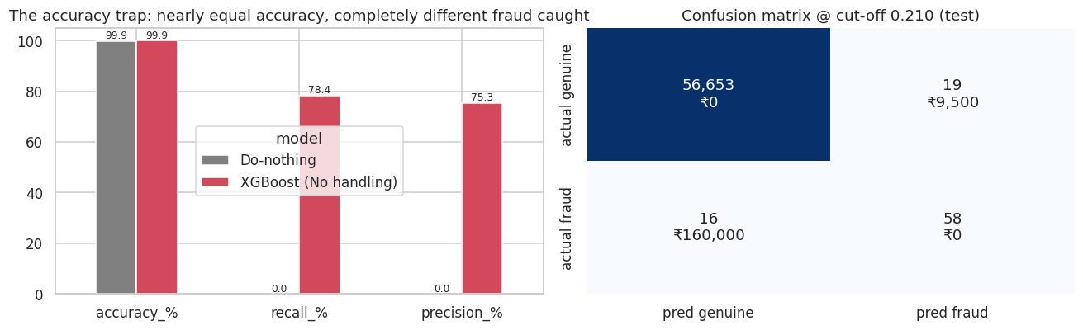
THE ACCURACY TRAP
A 99.87%-accurate model that catches zero fraud
99.87%
0 of 74
78%
accuracy of a model that
says “genuine” to everything
frauds it catches on the test set
caught by our model, at
almost the same accuracy
Card / digital channel, test slice (newest 20% of transactions). We use recall, precision, PR-AUC and expected ₹ cost instead.
2
Notes:
Open with the trap. A model that says 'genuine' to every payment is 99.87% accurate and catches nothing. Our model has almost the same accuracy but catches 78% of fraud. So accuracy cannot tell a useless model from a useful one; we judge with recall, precision, PR-AUC and rupees.

Slide 3
THE BUSINESS PROBLEM
Every decision has two ways to lose money
Miss a fraud
Block a good user
Ask for an OTP
Money lost and trust lost.
Cost assumed: ₹10,000 each
Angry customer, may switch apps.
Cost assumed: ₹500 each
5 seconds of friction.
Cost assumed: ₹10 each
Channel | Dataset | Payments | Frauds
UPI | upi_transactions 2024.csv (simulated, per the brief) | 250,000 | 480 (0.19%)
Card / digital | creditcard.csv (real, ULB) | 283,726 (after cleaning) | 473 (0.17%)
⚠ The ₹ costs are placeholder assumptions (no official values were published). Every saving shown is a scenario estimate.
3
Notes:
Two-sided cost: missing fraud loses money; blocking a genuine customer loses trust. Fraud is about 1 in 600 payments. We test one pipeline on two channels.

Slide 4
PS1 · DATA QUALITY
Clean the data, and remove the columns that cheat
Check | Found | What we did
Exact duplicate rows (card) | 1,081 (19 fraud) | Dropped: a copy in train and test inflates scores
Amount = 0 (card) | 1,825 | Kept: likely card-verification pings
Missing values / bad timestamps | 0 in both files | No action
UPI duplicates / bad categories | 0: “too perfect” for real data | Noted: first hint the UPI file is synthetic
transaction_status (UPI) | 12,376 FAILED | EXCLUDED: only known after processing (leakage)
transaction id (UPI) | 250,000 unique | EXCLUDED: an identifier, not a signal
Split: time-aware. Oldest 60% train · next 20% validation (every choice made here) · newest 20% test (reported once).
4
Notes:
We checked 13 kinds of problems. Card data had 1,081 duplicate rows: removed, because a copy in train and test inflates the score. UPI had zero problems, which is suspicious for real data. transaction_status is only known after processing, so it is leakage and excluded.

Slide 5
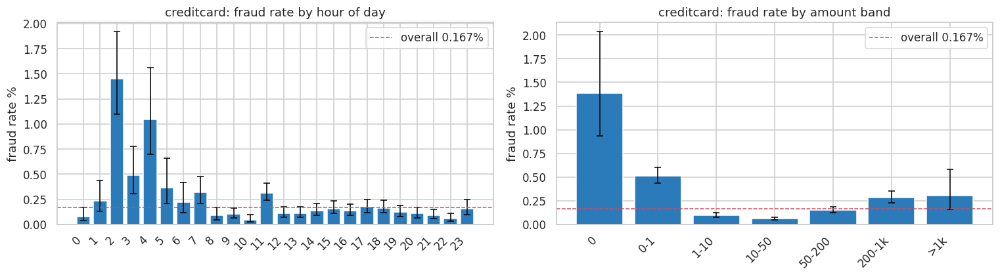
PS3 · WHERE FRAUD LIVES
Fraud peaks at night and on tiny “test” payments
1–5 AM: 0.67% fraud vs 0.14% at other hours (about 5×), peaking at 1.45% at 2 AM.
Amount is U-shaped: ₹0–1 payments 0.51% and mid amounts 0.06%. UPI: every type, bank and hour sits on the overall rate.
Error bars = 95% confidence intervals. Observed associations only; no causal claims.
5
Notes:
Card fraud is about 5 times more common between 1 and 5 AM, and amounts are U-shaped: tiny “card-testing” payments and large ones are riskier. These are associations, not causes. UPI shows no such pattern: every slice sits on the overall rate.

Slide 6
PS4 · SUPERVISED MODELS
Nine models against a hand-written rule
Model | PR-AUC | Frauds caught | Genuine blocked | Test cost
Rule: night + tiny amount | 0.002 | 28 / 74 | 6,343 | ₹36,31,500
Logistic Regression (Class weights) | 0.745 | 55 / 74 | 24 | ₹2,02,000
Random Forest (Class weights) | 0.819 | 56 / 74 | 9 | ₹1,84,500
Random Forest (SMOTE) | 0.812 | 61 / 74 | 81 | ₹1,70,500
XGBoost (No handling) | 0.796 | 58 / 74 | 19 | ₹1,69,500
XGBoost (Class weights) | 0.791 | 56 / 74 | 10 | ₹1,85,000
Rules alone fail: the rule costs about 5× more than doing nothing.
Imbalance tricks help simple models (LR: 0.61 → 0.75 PR-AUC). For trees, a cost-tuned cut-off does the same job.
Card / digital channel, test slice. SMOTE applied only inside the training pipeline. Highlighted = final model (chosen on validation).
6
Notes:
Nine models were trained (3 algorithms × no handling / class weights / SMOTE inside the pipeline), with each cut-off chosen on validation. The hand-written rule annoys 6,343 good customers, which is worse than doing nothing. XGBoost won on validation cost and trains in about 3 seconds.

Slide 7
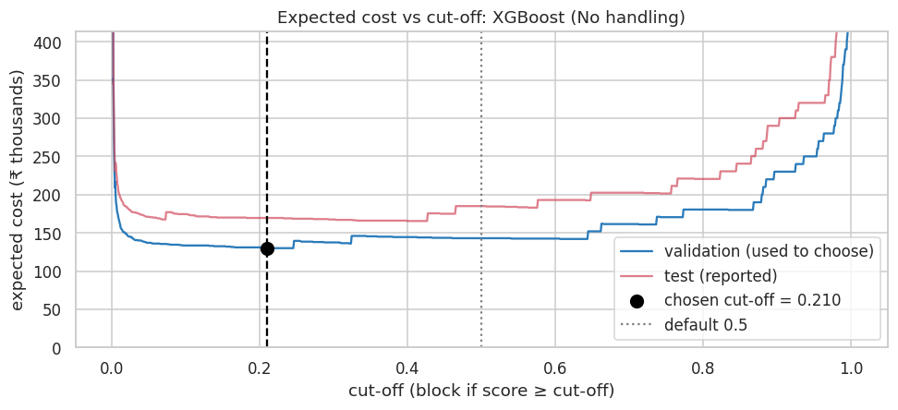
PS6 · MONEY PICKS THE CUT-OFF
The cheapest line is 0.21, not 0.5
₹7.40 lakh
do nothing (approve all)
₹1.85 lakh
default 0.5 cut-off
₹1.70 lakh
cost-chosen 0.21 cut-off
At 0.21: 58 of 74 frauds caught, only 19 genuine customers blocked.
Test-slice expected cost under placeholder costs (scenario estimate). The cut-off was chosen on validation, never on test.
7
Notes:
We tried about 1,500 cut-offs on validation. Cost = missed fraud × ₹X + wrong blocks × ₹Y. The cheapest is 0.21, not the habitual 0.5. The sensitivity check shows the cut-off stays at 0.21 for cost ratios from 10 to 100, so the choice is robust.

Slide 8
PS7 · THE DECISION RULE
Approve 96.6% · OTP 3.2% · Block 0.1%
Approve
Step-up OTP
Block
96.6%
3.2%
0.1%
of payments
of payments
of payments
10 frauds slip through
8 frauds · 1,828 genuine asked
56 frauds (76%) · only 9 genuine
₹1.39 lakh
81%
18%
3-zone rule, test cost
cheaper than doing nothing
cheaper than the best single cut-off
OTP assumed to stop 80% of fraud; OTP zone capped at 5% of traffic. Scenario estimate under placeholder costs.
8
Notes:
Two cut-offs make three zones. Most payments sail through, a small slice gets an OTP, and the block zone is tiny but holds three quarters of the fraud. We checked it against no-model policies (OTP everyone, OTP a random 5%) so the saving is due to the model, and capped OTP at 5% of traffic.

Slide 9
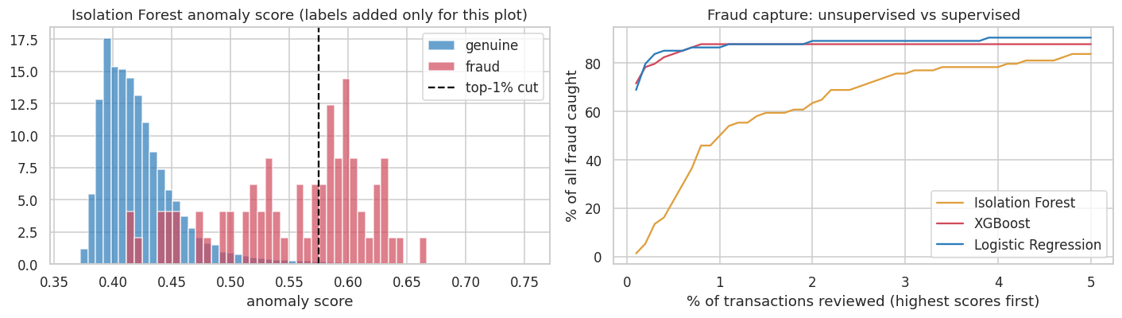
PS5 · UNKNOWN FRAUD
A detector that never saw a label finds half the fraud
50%
84%
0.95 vs 0.05
of fraud in its top 1%, with no labels
of fraud in its top 5%
ROC-AUC vs PR-AUC: why ROC flatters
Isolation Forest: 300 trees, trained on features only; labels used afterwards to evaluate.
9
Notes:
New scams have no labels yet. The Isolation Forest never sees a fraud label, yet its top 1% most unusual payments hold half of all fraud. It is a second line of defence for a review queue. Bonus: its ROC-AUC is 0.95 but PR-AUC only 0.05, which is why we don’t trust ROC-AUC on rare fraud.

Slide 10
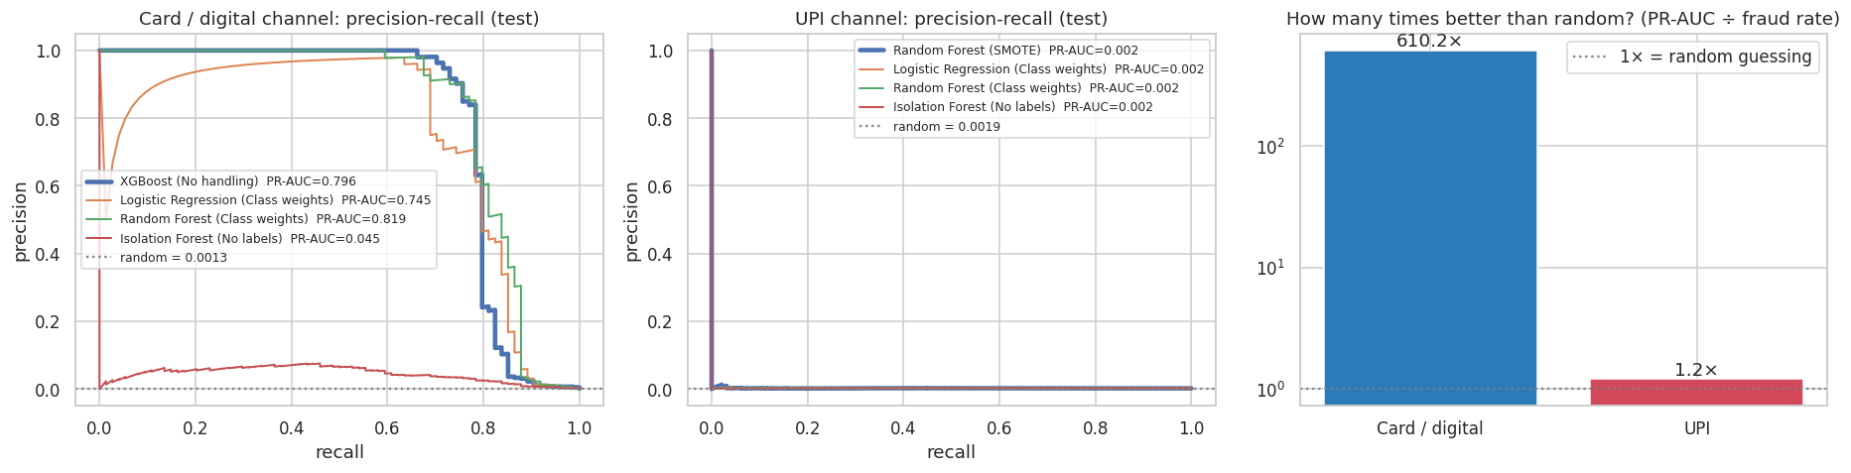
TWO CHANNELS, ONE PIPELINE
Cards: 610× better than random. UPI: 1.2×
78% caught · 81% saved
0% caught · 2 blocked
Card / digital: real labels, real signal
UPI: of 50,000 payments. No signal, so it refuses to block
PR-AUC ÷ fraud rate on each test slice. Identical code, no channel-specific tuning.
10
Notes:
The same pipeline on both channels. On cards it is 610 times better than random and catches 78% of fraud. On UPI it is 1.2 times random and refuses to block: it blocked 2 of 50,000 payments instead of guessing.

Slide 11
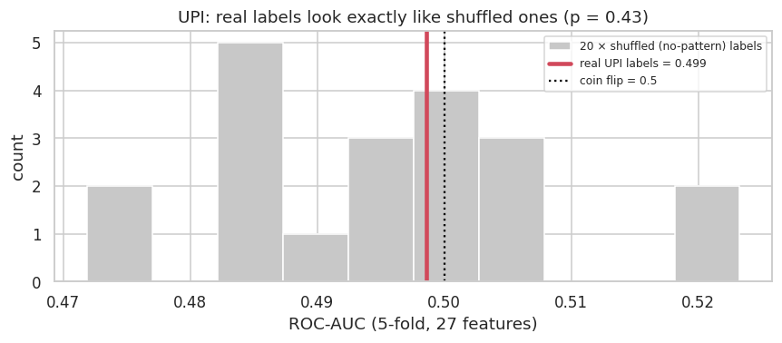
WHY ARE UPI RESULTS LOW?
Real UPI labels score the same as shuffled ones
0.499
ROC-AUC with the real UPI labels
0.495 ± 0.013
20 × randomly shuffled labels
p = 0.43
no evidence of any pattern
Cleaning fixes broken values, and this file has none. The labels don’t depend on the inputs: a labelling problem, not a model problem.
27 features (14 engineered), gradient boosting, 5-fold cross-validation. Script: scripts/upi_rescue_test.py
11
Notes:
Could we just clean the UPI data? We added 14 engineered features and a strong model, then shuffled the labels 20 times. The real labels score no better than shuffled ones (p = 0.43): the flags were assigned without looking at any column. Inventing our own labels would be circular, so we report it honestly.

Slide 12
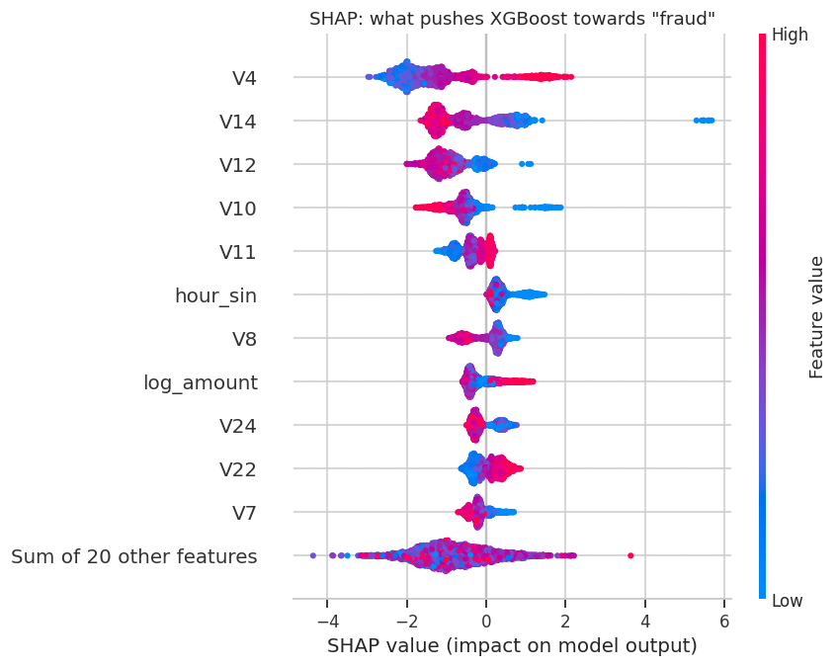
PS8 · WHY THE MODEL BLOCKS
Explaining every decision with SHAP
Top drivers: V4, V14, V12, V10, V11
Also matter: hour of day and amount, consistent with the EDA
Read it: red = high feature value; right of centre = pushes towards fraud
Limit: V1–V28 are anonymised (PCA), so we rank them but cannot name them
SHAP TreeExplainer on 3,000 test payments, final XGBoost model.
12
Notes:
SHAP shows what pushes a payment towards fraud: V4, V14, V12, V10, V11. Hour of day and amount also matter, which matches the EDA. The V-columns are anonymised by the bank, so we can rank them but not name them.

Slide 13
PS8 · THREE RECOMMENDATIONS
Finding → evidence → action
1 · Pilot the 3-zone rule
2 · Add a no-label safety net
3 · Fix UPI fraud labelling
81% cheaper than doing nothing; blocks only 0.1% of payments
Isolation Forest: 50% of fraud in its top 1%, without labels
UPI labels: 1.2× random, the same as shuffled labels (p = 0.43)
Run XGBoost + Approve/OTP/Block on a slice of live card traffic. Re-tune the cut-offs monthly with real costs.
Send unusual-but-approved payments to a human review queue to catch new scam types early.
Label from confirmed complaints and chargebacks. Until then: approve + capped OTP on UPI, never auto-block.
Priority: 1 and 3 high, 2 medium. Observed results and projected savings are kept separate.
13
Notes:
Three actions, each tied to evidence. All savings are scenario estimates under placeholder costs.

Slide 14
LIMITATIONS
What is measured, what is assumed
Limitation | Effect
₹ costs are placeholders | Savings are scenario estimates; cut-offs may move (stable for cost ratios 10–100)
OTP stop rate (80%) and 5% OTP cap | Assumptions: they change the OTP zone, not the model
Card data covers 2 days; 74 test frauds | One fraud = 1.4% recall; no seasonal patterns
V1–V28 anonymised | We can rank drivers but not name them
UPI data is simulated | Its labels carry no signal; UPI results show behaviour, not patterns
Observational data | Associations, never causes
Re-run with official costs: change one cell in the notebook (about 15 min end to end).
14
Notes:
Be upfront: what is assumed, what is measured, and what the data cannot show.

Slide 15
Catch fraud, not customers
• Accuracy lies: 99.87% accurate, 0 frauds caught
• Cost-chosen 3-zone rule: 78% of fraud caught, 81% cheaper than doing nothing
• Same pipeline on UPI: no signal in the labels, so it safely refuses to block
Questions?
github.com/MohammedMutee/upi-fraud-detection
Notes:
Close: repeat the three numbers, then take questions.

