Slide 1

StreetBite
Food discovery & demo ordering
Flutter graduation project
Mohammed Nasser · October 2026
Notes:
Implementation and screenshots: https://github.com/MohammedNasser0/streetbite. Captured from the Android emulator on 12 October 2026. Figma reference: https://www.figma.com/community/file/1352761962360670057/food-delivery-mobile-app-ui-kit by Vlad Solomakha, CC BY 4.0. Recipe data: https://www.themealdb.com/api.php. Prices, vendors and payment results are demonstration data.

Slide 2
Developer introduction
Mohammed Nasser
Flutter development, application architecture and QA
StreetBite brings live recipes, a reactive cart and account features
into one Arabic and English application.
github.com/MohammedNasser0/streetbite
Notes:
Implementation and screenshots: https://github.com/MohammedNasser0/streetbite. Captured from the Android emulator on 12 October 2026. Figma reference: https://www.figma.com/community/file/1352761962360670057/food-delivery-mobile-app-ui-kit by Vlad Solomakha, CC BY 4.0. Recipe data: https://www.themealdb.com/api.php. Prices, vendors and payment results are demonstration data. Developer name is taken from the project owner’s Git identity. No additional biography is asserted.

Slide 3
Development and planning
01
Requirements & design
Map the assignment to screens, integrations and acceptance evidence.
Inspect the supplied Figma frames and preserve the green delivery brand.
02
Application implementation
Build the domain contracts, repositories, BLoCs and bilingual screens.
Connect live recipes, local caching, Firebase accounts and demo orders.
03
Verification & beta delivery
Verify the core flows on emulator and physical Android.
Document beta delivery and distinguish optional QA evidence.
Notes:
Implementation and screenshots: https://github.com/MohammedNasser0/streetbite. Captured from the Android emulator on 12 October 2026. Figma reference: https://www.figma.com/community/file/1352761962360670057/food-delivery-mobile-app-ui-kit by Vlad Solomakha, CC BY 4.0. Recipe data: https://www.themealdb.com/api.php. Prices, vendors and payment results are demonstration data. Process is based on the assignment, saved implementation and verification records. This is a workflow, not an invented schedule.

Slide 4
Application architecture
Presentation
Screens and reusable widgets
AuthCubit, MenuCubit, CartBloc, ThemeBloc and LocaleCubit
Domain
Entities, repository contracts and use cases
SearchMeals, PlaceOrder, cash and demo-card payment strategies
Data
Dio remote source, shared_preferences cache and JSON models
Firebase repositories and the Firestore service
GetIt dependencies · Builder profiles · Factory sources · Singleton Firestore
Notes:
Implementation and screenshots: https://github.com/MohammedNasser0/streetbite. Captured from the Android emulator on 12 October 2026. Figma reference: https://www.figma.com/community/file/1352761962360670057/food-delivery-mobile-app-ui-kit by Vlad Solomakha, CC BY 4.0. Recipe data: https://www.themealdb.com/api.php. Prices, vendors and payment results are demonstration data. See flutter_app/lib and README.md for the implementation. Firebase app identifiers do not replace security rules.

Slide 5



Live discovery in English and Arabic
English
Arabic / RTL
Dark theme
Notes:
Implementation and screenshots: https://github.com/MohammedNasser0/streetbite. Captured from the Android emulator on 12 October 2026. Figma reference: https://www.figma.com/community/file/1352761962360670057/food-delivery-mobile-app-ui-kit by Vlad Solomakha, CC BY 4.0. Recipe data: https://www.themealdb.com/api.php. Prices, vendors and payment results are demonstration data. Screenshots are actual emulator captures; full Figma fidelity is still under review.

Slide 6
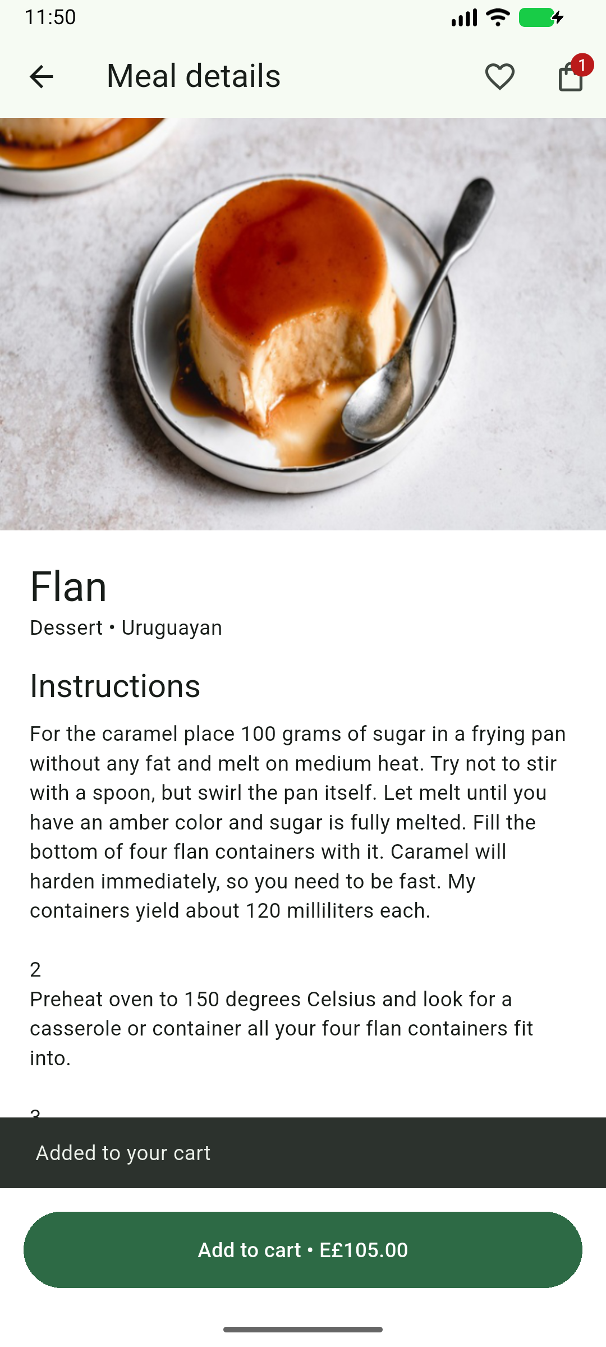
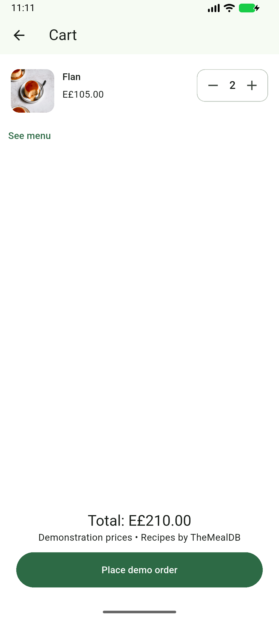
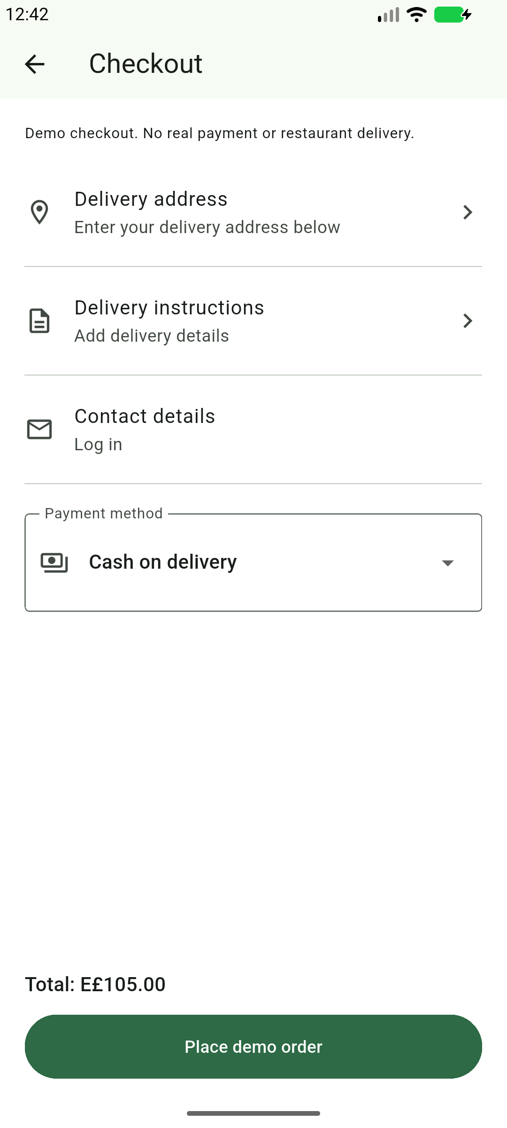
Meal details, cart and checkout
Meal details
Reactive cart
Checkout
Notes:
Implementation and screenshots: https://github.com/MohammedNasser0/streetbite. Captured from the Android emulator on 12 October 2026. Figma reference: https://www.figma.com/community/file/1352761962360670057/food-delivery-mobile-app-ui-kit by Vlad Solomakha, CC BY 4.0. Recipe data: https://www.themealdb.com/api.php. Prices, vendors and payment results are demonstration data. Cart prices are educational demonstration data. No real payment or restaurant dispatch is performed.

Slide 7
Verification and release status
29
Android beta 1.0.0 (10)
Firebase build 10 shared with two testers.
Checkout verified on emulator.
unit and layout tests passed
5
Scope and remaining work
physical Appium cases (build 9)
Figma fidelity remains partial.
Bonus map-tile diagnosis is deferred.
Notes:
Build 10 final APK SHA256: 549280bd7c069657573bc40c3609c31d647246432198a5cb04f2fb1a0949bb5b. Firebase release 10m6d1qnfpap0 uploaded and distributed to the same two authorized testers on 14 October 2026. All 29 Flutter tests passed before a localized demo-notice wording correction; both affected compact EN/AR Checkout tests passed again after that correction. Final analyzer clean. Final native CheckoutTest cash order/history/restart and EvidenceTest screen tour passed in 2m 48s. The physical five-case core suite remains historical build 9; full physical profile/photo/restart evidence remains build 4. Slide 6 details and cart are genuine build 9 screenshots; Checkout is a signed-out final build 10 screenshot. Tester installation/acceptance unverified. Figma composition improved for Checkout node 10:338; full fidelity remains partial. Delivery-time choices and promotion row absent. Bonus map-tile diagnosis deferred. Manual QA remains open. Payments are simulated; no actual restaurant dispatch.

