Slide 1

StreetBite
Food discovery & demo ordering
Flutter graduation project
Mohammed Nasser · October 2026
Notes:
Implementation and screenshots: https://github.com/MohammedNasser0/streetbite. Captured from the Android emulator on 12 October 2026. Figma reference: https://www.figma.com/community/file/1352761962360670057/food-delivery-mobile-app-ui-kit by Vlad Solomakha, CC BY 4.0. Recipe data: https://www.themealdb.com/api.php. Prices, vendors and payment results are demonstration data.

Slide 2
Developer introduction
Mohammed Nasser
Flutter development, application architecture and QA
StreetBite brings live recipes, a reactive cart and account features
into one Arabic and English application.
github.com/MohammedNasser0/streetbite
Notes:
Implementation and screenshots: https://github.com/MohammedNasser0/streetbite. Captured from the Android emulator on 12 October 2026. Figma reference: https://www.figma.com/community/file/1352761962360670057/food-delivery-mobile-app-ui-kit by Vlad Solomakha, CC BY 4.0. Recipe data: https://www.themealdb.com/api.php. Prices, vendors and payment results are demonstration data. Developer name is taken from the project owner’s Git identity. No additional biography is asserted.

Slide 3
Development and planning
01
Requirements & design
Map the assignment to screens, integrations and acceptance evidence.
Inspect the supplied Figma frames and preserve the green delivery brand.
02
Application implementation
Build the domain contracts, repositories, BLoCs and bilingual screens.
Connect live recipes, local caching, Firebase accounts and demo orders.
03
Verification & beta delivery
Verify the core flows on emulator and physical Android.
Document beta delivery and distinguish optional QA evidence.
Notes:
Implementation and screenshots: https://github.com/MohammedNasser0/streetbite. Captured from the Android emulator on 12 October 2026. Figma reference: https://www.figma.com/community/file/1352761962360670057/food-delivery-mobile-app-ui-kit by Vlad Solomakha, CC BY 4.0. Recipe data: https://www.themealdb.com/api.php. Prices, vendors and payment results are demonstration data. Process is based on the assignment, saved implementation and verification records. This is a workflow, not an invented schedule.

Slide 4
Application architecture
Presentation
Screens and reusable widgets
AuthCubit, MenuCubit, CartBloc, ThemeBloc and LocaleCubit
Domain
Entities, repository contracts and use cases
SearchMeals, PlaceOrder, cash and demo-card payment strategies
Data
Dio remote source, shared_preferences cache and JSON models
Firebase repositories and the Firestore service
GetIt dependencies · Builder profiles · Factory sources · Singleton Firestore
Notes:
Implementation and screenshots: https://github.com/MohammedNasser0/streetbite. Captured from the Android emulator on 12 October 2026. Figma reference: https://www.figma.com/community/file/1352761962360670057/food-delivery-mobile-app-ui-kit by Vlad Solomakha, CC BY 4.0. Recipe data: https://www.themealdb.com/api.php. Prices, vendors and payment results are demonstration data. See flutter_app/lib and README.md for the implementation. Firebase app identifiers do not replace security rules.

Slide 5
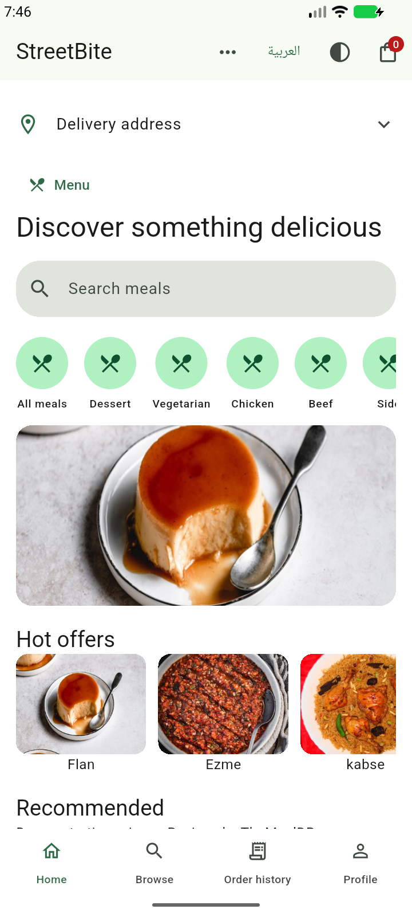
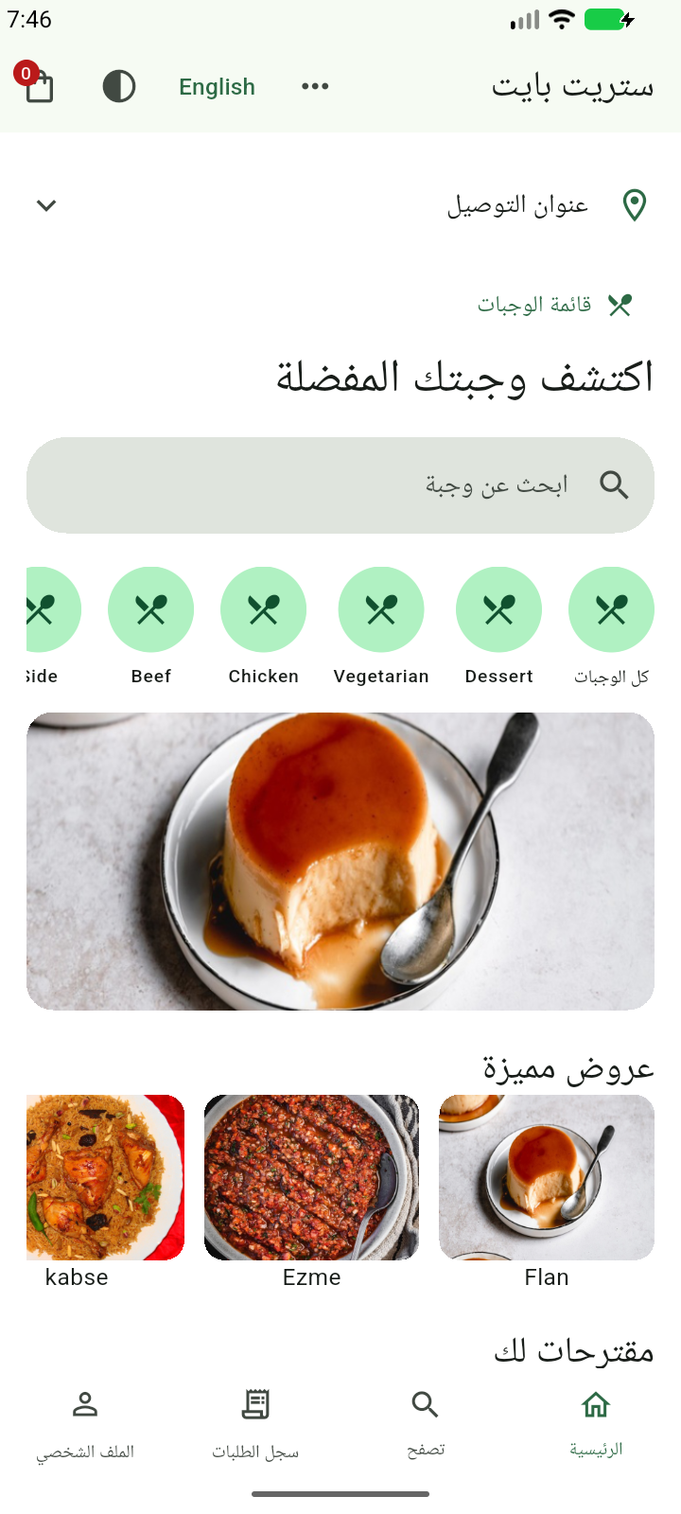
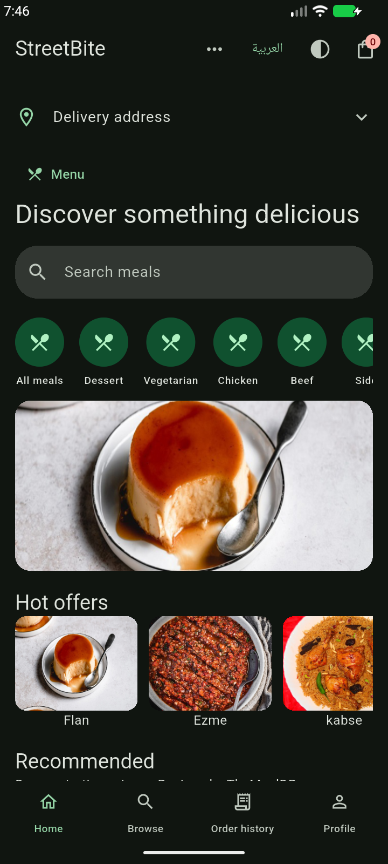
Live discovery in English and Arabic
English
Arabic / RTL
Dark theme
Notes:
Implementation and screenshots: https://github.com/MohammedNasser0/streetbite. Captured from the Android emulator on 12 October 2026. Figma reference: https://www.figma.com/community/file/1352761962360670057/food-delivery-mobile-app-ui-kit by Vlad Solomakha, CC BY 4.0. Recipe data: https://www.themealdb.com/api.php. Prices, vendors and payment results are demonstration data. Screenshots are actual emulator captures; full Figma fidelity is still under review.

Slide 6
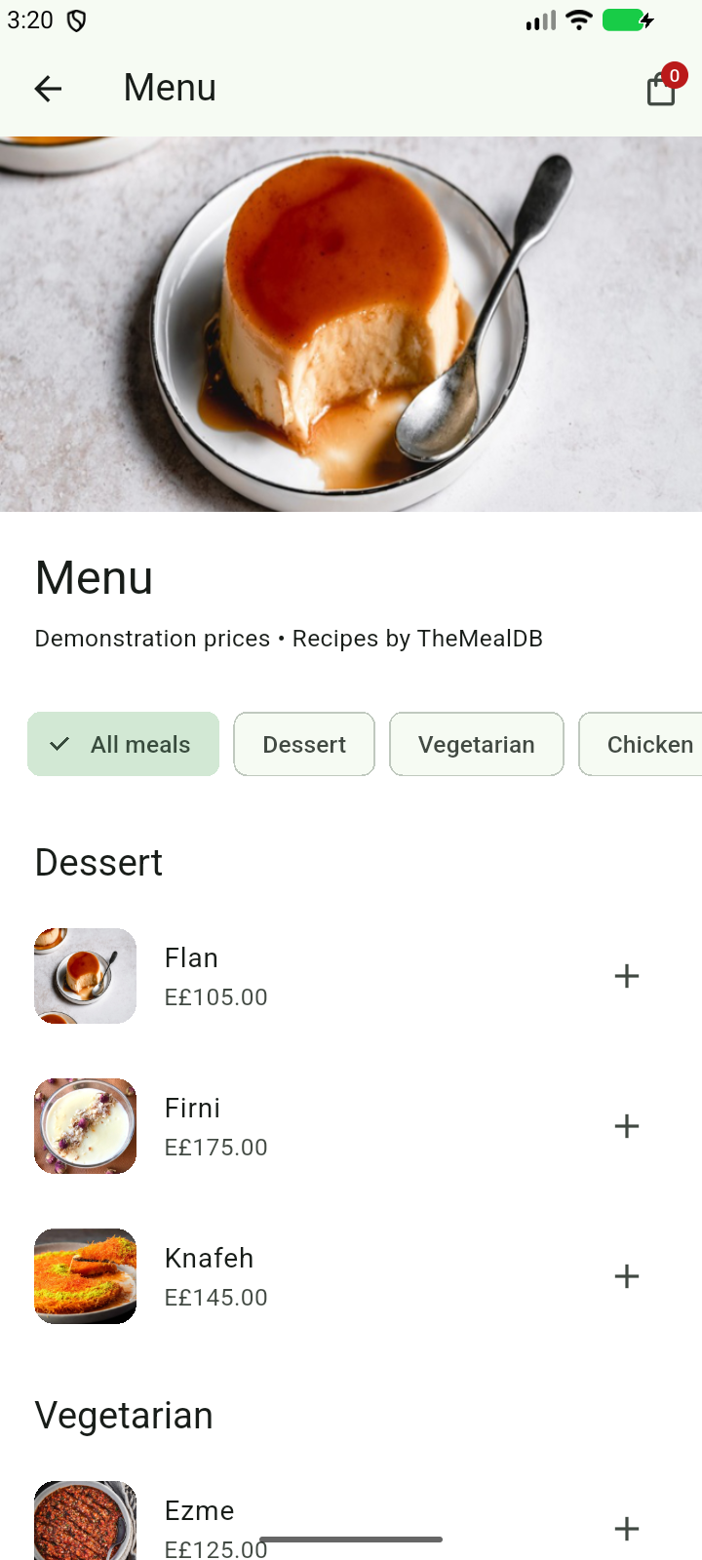
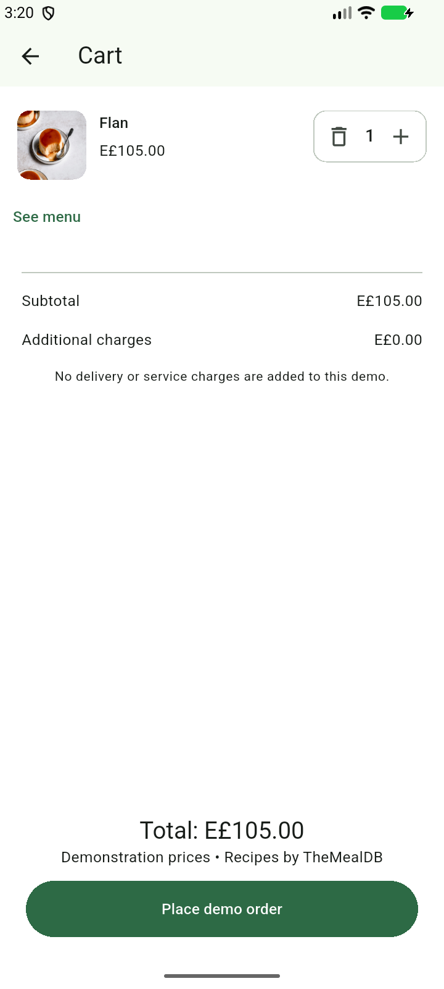
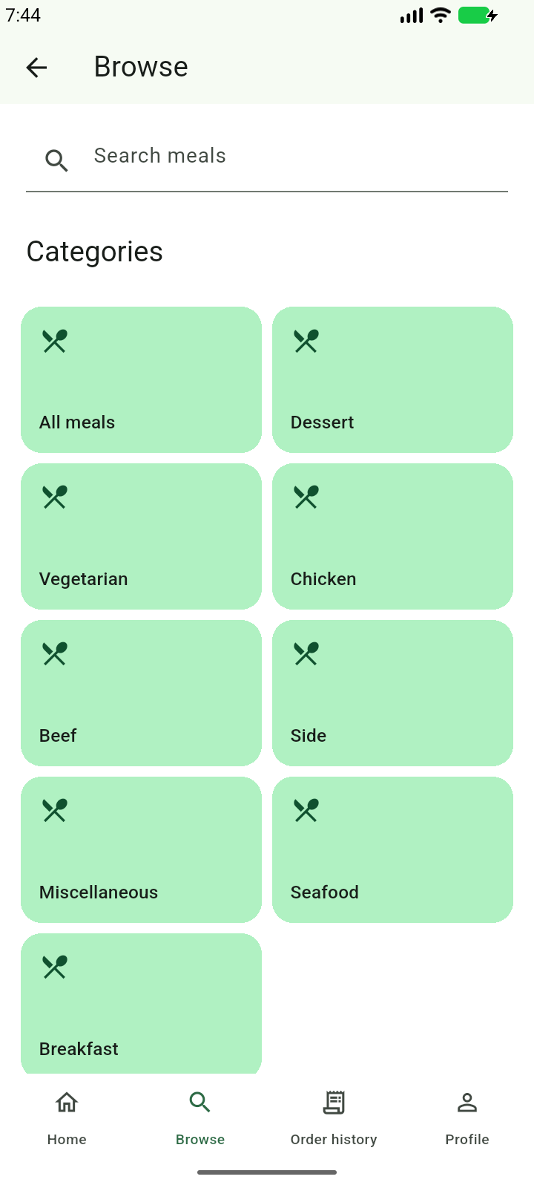
Menu, cart and category browsing
Grouped menu
Reactive cart
Categories
Notes:
Implementation and screenshots: https://github.com/MohammedNasser0/streetbite. Captured from the Android emulator on 12 October 2026. Figma reference: https://www.figma.com/community/file/1352761962360670057/food-delivery-mobile-app-ui-kit by Vlad Solomakha, CC BY 4.0. Recipe data: https://www.themealdb.com/api.php. Prices, vendors and payment results are demonstration data. Cart prices are educational demonstration data. No real payment or restaurant dispatch is performed.

Slide 7
Verification and release status
43
Android beta 1.0.0 (13)
Firebase build 13 shared with two testers.
Address, menu and cart verified on Android.
unit and layout tests passed
6
Scope and remaining work
physical Appium cases (build 13)
Figma fidelity remains partial.
Bonus map-tile diagnosis is deferred.
Notes:
Final build13 SHA256318b20bf2526d994377d4df2e9b4f43058029be8ddc361f24797b111454a95b3; Firebase release1p7qp7hs4ct48 distributed to two authorized testers on14October2026. All43Flutter tests and analyzer pass. Four final emulator cases passed2m37: BrowseRetry, categories/details quantity, shared address/grouped menu/cart and screenshot tour. Five core physical cases passed; initialProfile setup interrupted byPlayProtect and retained. Owner completed scanner and touchedfingerprint; Profile retry passed1m29 after installed APK checksum verification. Six unique physical cases across scoped runs. Gallery/photo/restart remains historicalbuild4. All physical screenshots privateZIPonly. Slides5/6 genuine signed-out emulator13captures. STREET3 saved-address prompt fixed and verifiedDone. Manual matrix:36Pass6NotRun1Blocked, automation doesnotcomplete manualcycle. Figma fidelitypartial, mapsbonusdeferred, testeracceptanceunverified. Demoorderingonly. No finalplatformsubmission. Physical exploratory QA later on14October2026:34 newly observed cases with actual phone input/visual review and scoped technical REST checks; two earlier owner-assisted cases preserve build13/build4 scopes. See physical-exploratory-qa.md. Original display/network/preferences restored. Six remaining manual cases are not certified; bonus Maps deferred.

