Slide 1

StreetBite
Food discovery & demo ordering
Flutter graduation project
Mohammed Nasser · October 2026
Notes:
Implementation and screenshots: https://github.com/MohammedNasser0/streetbite. Captured from the Android emulator on 12 October 2026. Figma reference: https://www.figma.com/community/file/1352761962360670057/food-delivery-mobile-app-ui-kit by Vlad Solomakha, CC BY 4.0. Recipe data: https://www.themealdb.com/api.php. Prices, vendors and payment results are demonstration data.

Slide 2
Developer introduction
Mohammed Nasser
Flutter development, application architecture and QA
StreetBite brings live recipes, a reactive cart and account features
into one Arabic and English application.
github.com/MohammedNasser0/streetbite
Notes:
Implementation and screenshots: https://github.com/MohammedNasser0/streetbite. Captured from the Android emulator on 12 October 2026. Figma reference: https://www.figma.com/community/file/1352761962360670057/food-delivery-mobile-app-ui-kit by Vlad Solomakha, CC BY 4.0. Recipe data: https://www.themealdb.com/api.php. Prices, vendors and payment results are demonstration data. Developer name is taken from the project owner’s Git identity. No additional biography is asserted.

Slide 3
Development and planning
01
Requirements & design
Map the assignment to screens, integrations and acceptance evidence.
Inspect the supplied Figma frames and preserve the green delivery brand.
02
Application implementation
Build the domain contracts, repositories, BLoCs and bilingual screens.
Connect live recipes, local caching, Firebase accounts and demo orders.
03
Verification & beta delivery
Run unit, layout and emulator tests; capture genuine screenshots.
Finish physical-device QA, design coverage and beta distribution evidence.
Notes:
Implementation and screenshots: https://github.com/MohammedNasser0/streetbite. Captured from the Android emulator on 12 October 2026. Figma reference: https://www.figma.com/community/file/1352761962360670057/food-delivery-mobile-app-ui-kit by Vlad Solomakha, CC BY 4.0. Recipe data: https://www.themealdb.com/api.php. Prices, vendors and payment results are demonstration data. Process is based on the assignment, saved implementation and verification records. This is a workflow, not an invented schedule.

Slide 4
Application architecture
Presentation
Screens and reusable widgets
AuthCubit, MenuCubit, CartBloc, ThemeBloc and LocaleCubit
Domain
Entities, repository contracts and use cases
SearchMeals, PlaceOrder, cash and demo-card payment strategies
Data
Dio remote source, shared_preferences cache and JSON models
Firebase repositories and the Firestore service
GetIt dependencies · Builder profiles · Factory sources · Singleton Firestore
Notes:
Implementation and screenshots: https://github.com/MohammedNasser0/streetbite. Captured from the Android emulator on 12 October 2026. Figma reference: https://www.figma.com/community/file/1352761962360670057/food-delivery-mobile-app-ui-kit by Vlad Solomakha, CC BY 4.0. Recipe data: https://www.themealdb.com/api.php. Prices, vendors and payment results are demonstration data. See flutter_app/lib and README.md for the implementation. Firebase app identifiers do not replace security rules.

Slide 5



Live discovery in English and Arabic
English
Arabic / RTL
Dark theme
Notes:
Implementation and screenshots: https://github.com/MohammedNasser0/streetbite. Captured from the Android emulator on 12 October 2026. Figma reference: https://www.figma.com/community/file/1352761962360670057/food-delivery-mobile-app-ui-kit by Vlad Solomakha, CC BY 4.0. Recipe data: https://www.themealdb.com/api.php. Prices, vendors and payment results are demonstration data. Screenshots are actual emulator captures; full Figma fidelity is still under review.

Slide 6
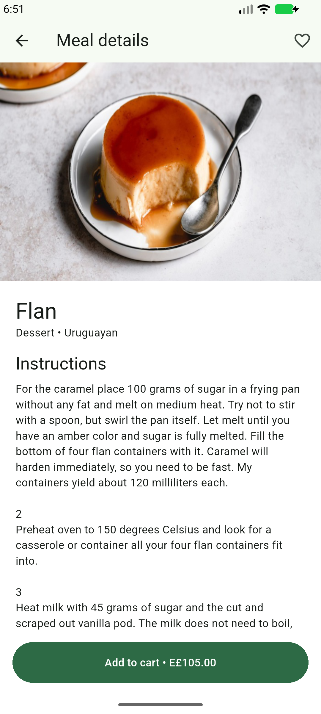
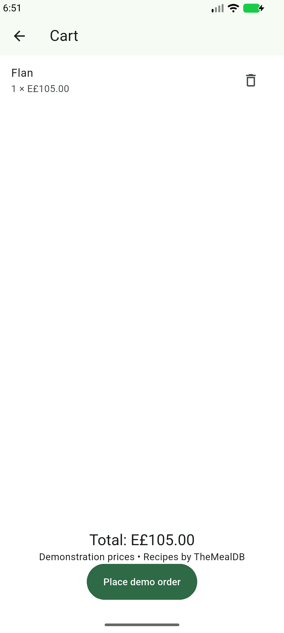
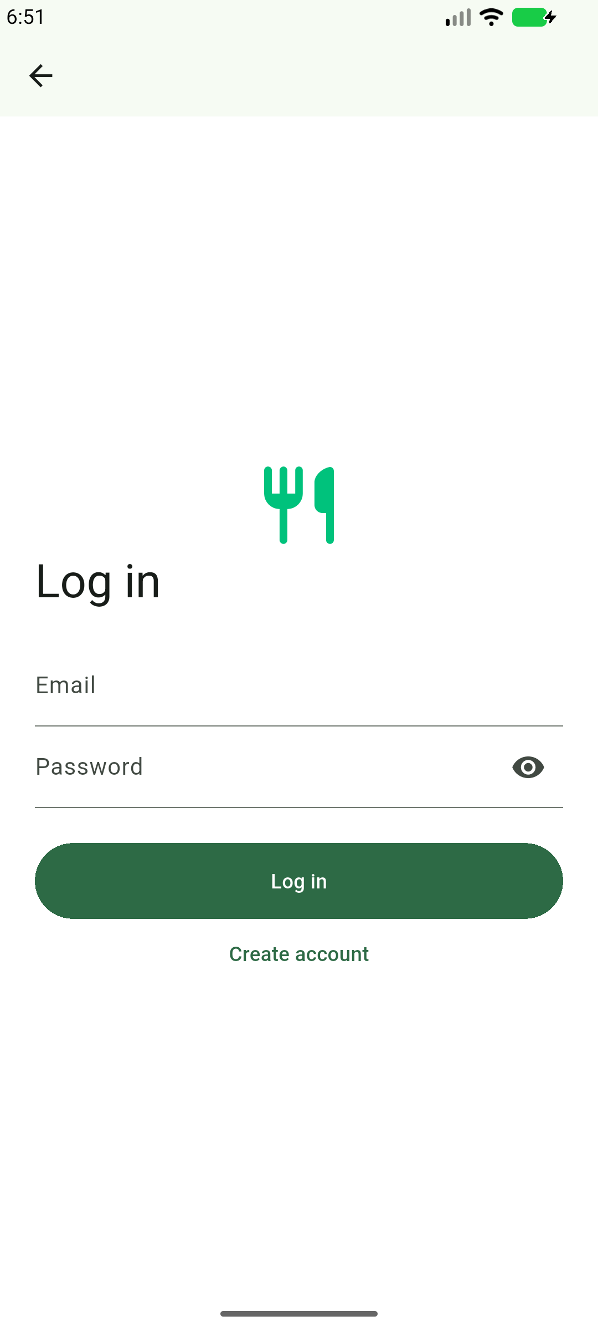
Meal details, cart and account access
Meal details
Reactive cart
Email sign-in
Notes:
Implementation and screenshots: https://github.com/MohammedNasser0/streetbite. Captured from the Android emulator on 12 October 2026. Figma reference: https://www.figma.com/community/file/1352761962360670057/food-delivery-mobile-app-ui-kit by Vlad Solomakha, CC BY 4.0. Recipe data: https://www.themealdb.com/api.php. Prices, vendors and payment results are demonstration data. Cart prices are educational demonstration data. No real payment or restaurant dispatch is performed.

Slide 7
Verification and release status
10
Android release APK built
Firebase beta distributed to two testers.
Authentication and Maps verified on emulator.
unit and layout tests passed
5
Remaining acceptance work
Appium scenarios passed on emulator
Physical-device QA, full Figma coverage,
profile/biometric checks and tester acceptance.
Notes:
Implementation and screenshots: https://github.com/MohammedNasser0/streetbite. Captured from the Android emulator on 12 October 2026. Figma reference: https://www.figma.com/community/file/1352761962360670057/food-delivery-mobile-app-ui-kit by Vlad Solomakha, CC BY 4.0. Recipe data: https://www.themealdb.com/api.php. Prices, vendors and payment results are demonstration data. Verification source: docs/emulator-verification.md. Five functional scenarios passed with no skips. Physical-device results and final acceptance are not claimed.

