Slide 1

StreetBite
Food discovery & demo ordering
Flutter graduation project
Mohammed Nasser · October 2026
Notes:
Implementation and screenshots: https://github.com/MohammedNasser0/streetbite. Captured from the Android emulator on 12 October 2026. Figma reference: https://www.figma.com/community/file/1352761962360670057/food-delivery-mobile-app-ui-kit by Vlad Solomakha, CC BY 4.0. Recipe data: https://www.themealdb.com/api.php. Prices, vendors and payment results are demonstration data.

Slide 2
Developer introduction
Mohammed Nasser
Flutter development, application architecture and QA
StreetBite brings live recipes, a reactive cart and account features
into one Arabic and English application.
github.com/MohammedNasser0/streetbite
Notes:
Implementation and screenshots: https://github.com/MohammedNasser0/streetbite. Captured from the Android emulator on 12 October 2026. Figma reference: https://www.figma.com/community/file/1352761962360670057/food-delivery-mobile-app-ui-kit by Vlad Solomakha, CC BY 4.0. Recipe data: https://www.themealdb.com/api.php. Prices, vendors and payment results are demonstration data. Developer name is taken from the project owner’s Git identity. No additional biography is asserted.

Slide 3
Development and planning
01
Requirements & design
Map the assignment to screens, integrations and acceptance evidence.
Inspect the supplied Figma frames and preserve the green delivery brand.
02
Application implementation
Build the domain contracts, repositories, BLoCs and bilingual screens.
Connect live recipes, local caching, Firebase accounts and demo orders.
03
Verification & beta delivery
Verify the core flows on emulator and physical Android.
Document beta delivery and distinguish optional QA evidence.
Notes:
Implementation and screenshots: https://github.com/MohammedNasser0/streetbite. Captured from the Android emulator on 12 October 2026. Figma reference: https://www.figma.com/community/file/1352761962360670057/food-delivery-mobile-app-ui-kit by Vlad Solomakha, CC BY 4.0. Recipe data: https://www.themealdb.com/api.php. Prices, vendors and payment results are demonstration data. Process is based on the assignment, saved implementation and verification records. This is a workflow, not an invented schedule.

Slide 4
Application architecture
Presentation
Screens and reusable widgets
AuthCubit, MenuCubit, CartBloc, ThemeBloc and LocaleCubit
Domain
Entities, repository contracts and use cases
SearchMeals, PlaceOrder, cash and demo-card payment strategies
Data
Dio remote source, shared_preferences cache and JSON models
Firebase repositories and the Firestore service
GetIt dependencies · Builder profiles · Factory sources · Singleton Firestore
Notes:
Implementation and screenshots: https://github.com/MohammedNasser0/streetbite. Captured from the Android emulator on 12 October 2026. Figma reference: https://www.figma.com/community/file/1352761962360670057/food-delivery-mobile-app-ui-kit by Vlad Solomakha, CC BY 4.0. Recipe data: https://www.themealdb.com/api.php. Prices, vendors and payment results are demonstration data. See flutter_app/lib and README.md for the implementation. Firebase app identifiers do not replace security rules.

Slide 5



Live discovery in English and Arabic
English
Arabic / RTL
Dark theme
Notes:
Implementation and screenshots: https://github.com/MohammedNasser0/streetbite. Captured from the Android emulator on 12 October 2026. Figma reference: https://www.figma.com/community/file/1352761962360670057/food-delivery-mobile-app-ui-kit by Vlad Solomakha, CC BY 4.0. Recipe data: https://www.themealdb.com/api.php. Prices, vendors and payment results are demonstration data. Screenshots are actual emulator captures; full Figma fidelity is still under review.

Slide 6
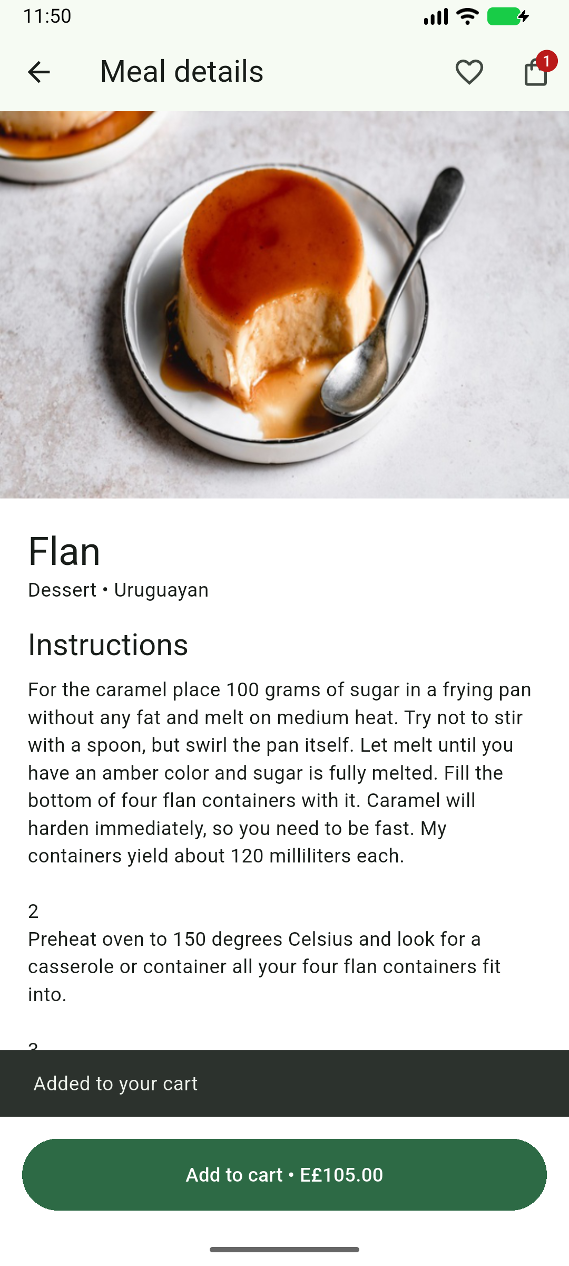
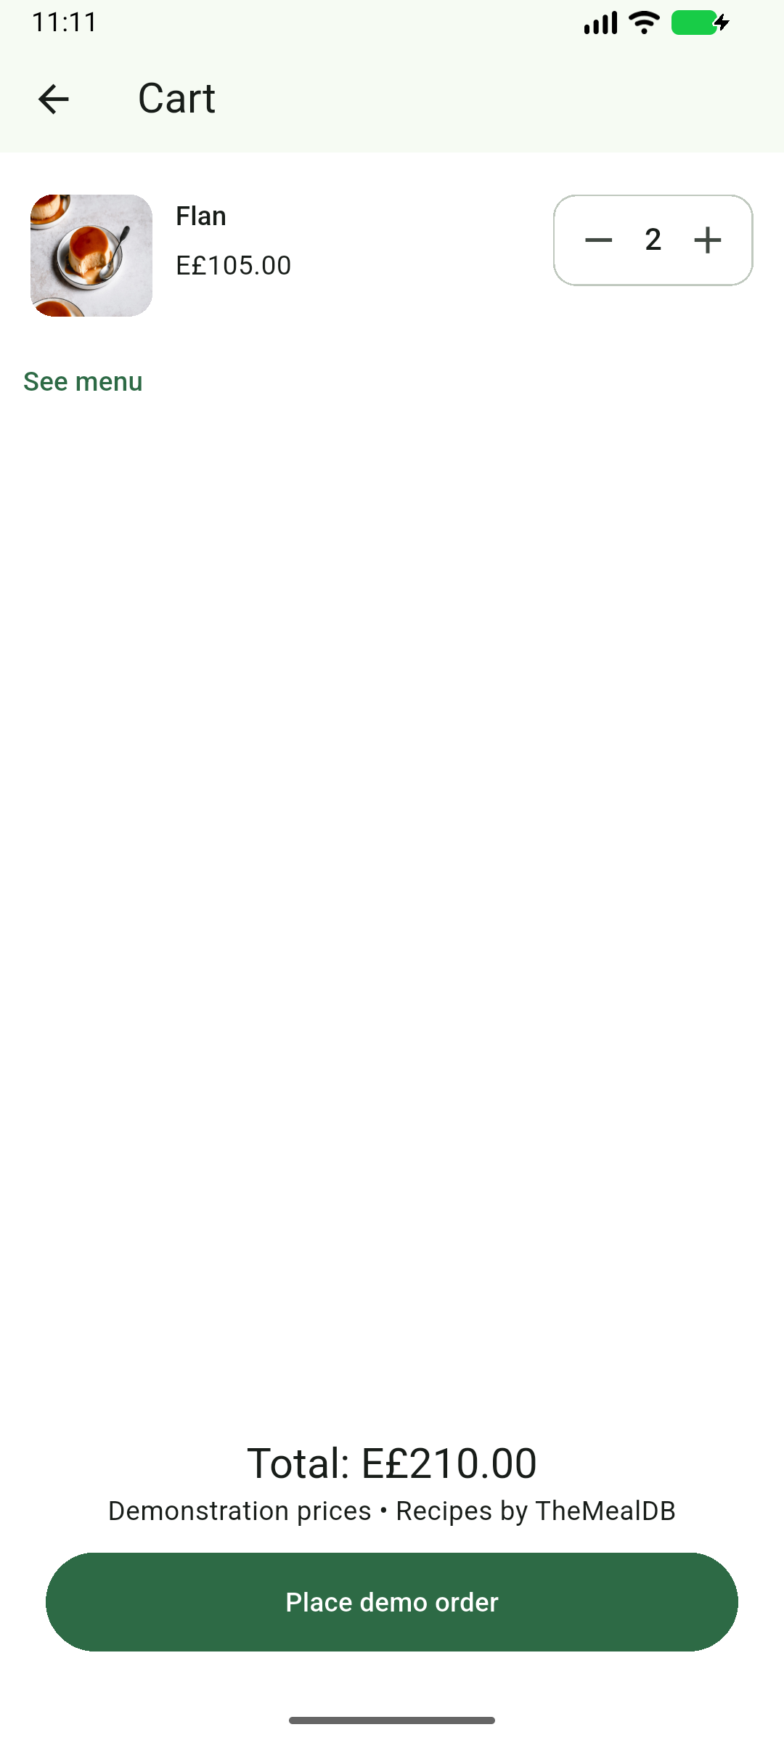
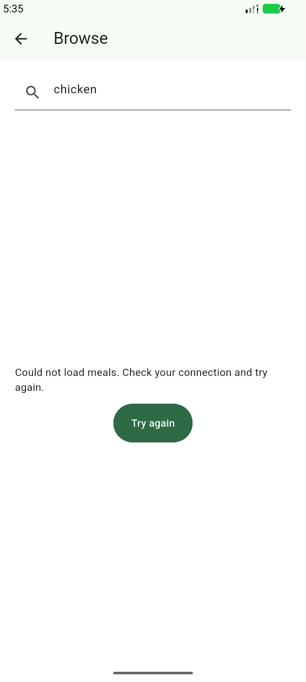
Meal details, cart and search
Meal details
Reactive cart
Search recovery
Notes:
Implementation and screenshots: https://github.com/MohammedNasser0/streetbite. Captured from the Android emulator on 12 October 2026. Figma reference: https://www.figma.com/community/file/1352761962360670057/food-delivery-mobile-app-ui-kit by Vlad Solomakha, CC BY 4.0. Recipe data: https://www.themealdb.com/api.php. Prices, vendors and payment results are demonstration data. Cart prices are educational demonstration data. No real payment or restaurant dispatch is performed.

Slide 7
Verification and release status
31
Android beta 1.0.0 (11)
Firebase build 11 shared with two testers.
Search recovery verified on emulator.
unit and layout tests passed
5
Scope and remaining work
physical Appium cases (build 9)
Figma fidelity remains partial.
Bonus map-tile diagnosis is deferred.
Notes:
Build 11 final APK SHA256 e596c3ff1b5897f3a18e121f53d4f5f310f6158f7158405bf5573398c2125a8f. Firebase release 3clm3j8ki2bng uploaded and distributed to the same two authorized testers on 14 October 2026. All 31 Flutter tests passed and analyzer clean. Native BrowseRetryTest failed once before onboarding because Android System UI showed an ANR. After QA emulator recovery and a 720x1600 / density 280 override preserving the logical viewport, the offline-to-online query-preserving retry passed in 52 seconds. A separate repeated passing run captured settled visual evidence. Connection state restored in finally. Full physical five-case suite remains build 9; full profile/photo/restart remains build 4. Slide 6 details/cart are genuine build 9 captures; search retry is genuine build 11. Manual cases remain scoped to their actual executions. Figma fidelity partial, bonus map tiles deferred, tester acceptance unverified. Demo payments only; no restaurant dispatch.

