Slide 1
PIP4004 - INTERNSHIP(Tech Mahindra) Review-4 Presentation
Group-15 SCHOLARSHIP MANAGEMENT SYSTEM USING SPRINGBOOT
Student Details
NAME | ROLL NUMBER
Safia Rafi | 20211CAI0159
Adnan Talha Adil | 20211CDV0054
Dibbagalla Joy | 20211CDV0066
Mohammed Nihal A | 20211CSE0367
Madhu Kumar V | 20211CSE0363
Hanfaa Khanum | 20211CSD0106
Under the Supervision of,
Dr. Jayanthi Kamalasekaran
Associate Professor
Presidency School of CSE(PSCS)
Presidency University
Name of the Program: B. Tech
Name of the HoD: Dr. Asif Mohamed H B
Name of the Program Internship Coordinator: Mr.Md Zia ur Rahman
Name of the School Project Coordinators: Dr. Sampath A K / Dr. Muthuraj/ Mr. Md Zia ur Rahman

Slide 2
Content
About Company Or Oganisation
Working domain or the technology
Challenges Faced in Internship
Objectives of the work
Literature Review
Proposed System
System Design And Implementation
Advantages of Proposed System/Work
Internship Roadmap
Screenshots
Github Link

Slide 3
About Company or Organization
Company Overview
Name: Tech Mahindra
Founded: 1986
Headquarters: Pune, Maharashtra, India
Global Presence: Global Presence in over 90 countries
Employees: Approximately 145,000
Industry: Information Technology (IT)Services and Consulting
Website: www.techmahindra.com

Slide 4
Working domain or the technology
Tech Mahindra Limited is a leading global IT services and consulting company that operates across a wide range of industry domains and technological areas. It serves key sectors including Telecommunications, Banking and Financial Services (BFSI), Manufacturing, Healthcare and Life Sciences, Retail, Energy and Utilities, Automotive, Media and Entertainment, and the Public Sector. The company is renowned for delivering digital transformation, consulting, and business reengineering services to clients worldwide.
In terms of technology, Tech Mahindra works with cutting-edge innovations such as Artificial Intelligence (AI), Machine Learning (ML), 5G network solutions, Cloud Computing (including AWS, Azure, and Google Cloud), Cybersecurity, Internet of Things (IoT), Blockchain, and Robotic Process Automation (RPA). Additionally, the company is involved in application development and maintenance, enterprise resource planning (ERP) systems like SAP and Oracle, DevOps, Agile development practices, and emerging areas such as Augmented Reality (AR), Virtual Reality (VR), and the Metaverse. It also leverages low-code/no-code development platforms to deliver scalable and efficient business solutions.

Slide 5
Key Challenges & Issues
1. Static Form Handling: Without a back-end, all data submissions remain local and non functional. This limited the testing of complete form workflows.
2. Mobile Responsiveness: While partially responsive, the interface needs improvement for optimal rendering on smaller devices.
3. Validation and Security: The absence of client-side JavaScript validation and server side protection presents data quality and security issues that will be resolved in the full stak
version.

Slide 6
Objectives of the Work
1. Automate Scholarship Application Process: Enables students to apply online, reducing
paperwork and errors. Improves efficiency for both students and administrators.
2. Centralize Data Management: Consolidates all scholarship data into one system for easy access. Reduces redundancy and improves collaboration and reporting.
3. Improve Eligibility Verification:Automates eligibility checks using predefined rules. Ensures fair, fast, and accurate application screening.
4. Improve Transparency: Provides real-time application status updates and audit logs. Promotes trust and accountability in the selection process.
5. Streamline Document Verification: Uses OCR and automation to verify uploaded documents. Speeds up review and reduces manual errors.

Slide 7
6. Facilitate Timely Fund Disbursement: Ensures fast and secure fund transfers via DBT or gateways. Supports tracking, installments, and transparent disbursal.
7. Enable Role-Based Access: Grants different access levels to students, reviewers, and admins. Enhances data security and policy compliance.
8. Support for Mobile and Web Access: Offers responsive design for mobile, tablet, and desktop use. mproves accessibility for students in all regions.
9. Ensure Data Security and Privacy: Implements encryption, authentication, and secure backups. Ensures compliance with GDPR and protects user data.
10. Endorse Multi-Scholarship and Multi-Institution Management: Supports multiple schemes with unique rules under one platform. mproves scalability and centralized program monitoring.

Slide 8
Literature Review
Gawas & Deshmukh (2018): Developed a web-based system to automate scholarship application and review. Focuses on core functionality but lacks scalability and integration.
Kumar et al. (2018): Created a user-friendly system for application and status tracking. Improves transparency but lacks focus on security and mobile access.
Singh & Mishra (2019): Proposed online automation with document upload and eligibility checks. Prototype lacks user testing and performance analysis.
Garg & Sharma (2018): Developed a role-based web system for application and distribution. Highlights efficiency but misses cloud and backup features.
Ahmad et al. (2018): Cloud-based system enhancing scalability and remote access with automated notifications. Lacks comparative analysis with traditional systems.

Slide 9
Hossain et al. (2017): Simplified web-based solution improving usability and reducing manual tasks. Does not address security features like encryption or RBAC.
Smith & Brown (2019): Automates the end-to-end workflow through a web portal. Enhances processing but omits backend and ERP integration details.
Jain & Singh (2017): Examines cloud deployment benefits such as reliability and backup. Lacks deep performance evaluation.
Kaur & Singh (2017): Built a PHP-MySQL system for application tracking using open-source tools. Cost-effective but limited on scalability and security.
Ali & Khan (2019): Introduced a mobile app for scholarship management with notifications and scanning. Strong on accessibility, weak on backend design.

Slide 10
Proposed System
System Architecture
The system is divided into two access modes:
• Student Access: Features tabs such as Home, About, Schemes, Apply Now, and Contact, offering a simplified scholarship discovery experience.
• Admin Access: A dashboard that allows administrators to add/delete scholarships, track applications, and analyze statistics.
ion with the database

Slide 11
Methodology Workflow
Phase 1: Secure Authentication
Two login options: Admin & Student
Spring Security & JWT ensure encrypted authentication
Phase 2: Scholarship discovery and application
• Home Tab: Displays new schemes dynamically
• Schemes Tab: Provides a filtered list based on eligibility criteria
• Apply Now: Allows students to submit applications
Phase 3: Administrative Control Dashboard
• Scholarship Management: Admins can add or remove scholarships
• Application Tracking: Displays the number of students who have applied
Scholarship Management System: Presidency School of Computer Science and Engineering, Presidency University.

Slide 12
Phase 4: Technologies Used
The application uses Spring Boot as a backend framework, Spring Security and JSON Web
Tokens (JWT) for secure authentication, Thymeleaf and HTML/CSS for UI development, and
MySQL for database management.
1. Spring Boot: This acts as the foundation of the application, providing a simplified and
streamlined approach to building Spring-based applications . It handles the configuration and
setup of various components, making development easier and faster.
2. Spring Security & JWT: Spring Security is used to secure the application . It integrates
seamlessly with JWT (JSON Web Tokens), a standard for creating access tokens used for
authentication and authorization. JWTs are stateless, enhancing scalability and reducing the
burden on the server . These tokens are typically passed in the Authorization header of HTTP
requests . The system likely implements role-based authorization, controlling access based
on user roles stored in the MySQL database .
3. Thymeleaf & HTML/CSS: Thymeleaf provides server-side templating capabilities for
creating dynamic HTML pages . Combined with HTML and CSS, it forms the user interface,
enabling interactions with the secured backend. The JWT token is likely managed within the
UI using Thymeleaf, possibly allowing user login and logout functionality .
4. MySQL: This relational database system stores persistent data, including user credentials
and potentially other application data . Spring Data JPA (Java Persistence API) likely
simplifies interact

Slide 13
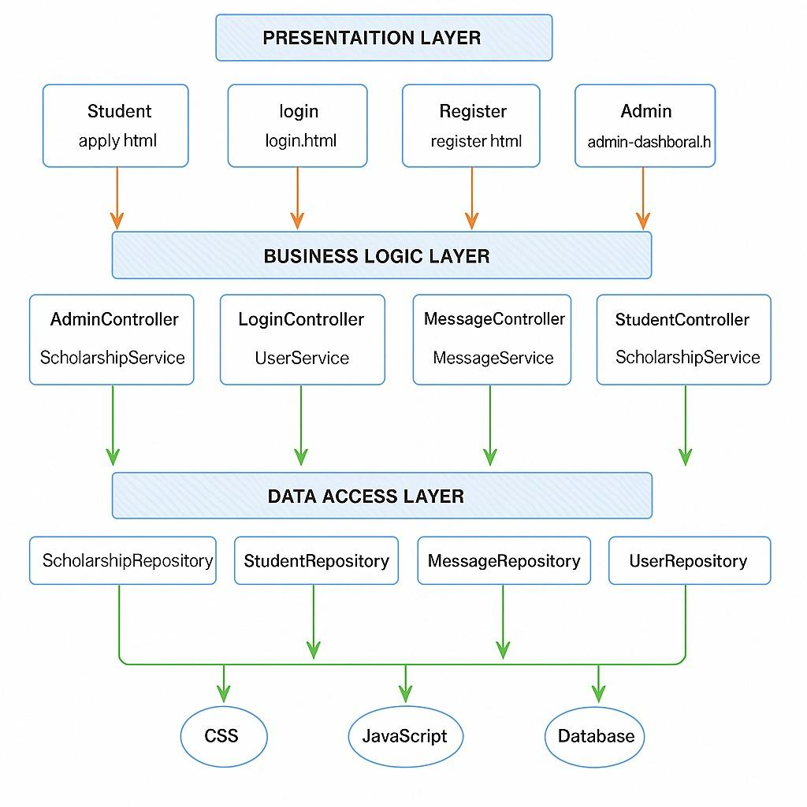
System Design And Implementation

Slide 14
Workflow Description
• User Interaction Phase: Users interact with the application through the Thymeleaf_x0002_based interface.
Authentication & Authorization: On login, Spring Security verifies credentials and assigns roles using JWT tokens.
• Data Processing & Business Logic Execution: The system processes requests and executes business logic through service layers.
• Database Management & Logging: Spring Data JPA interacts with MySQL,
ensuring efficient data persistence while maintaining logs for monitoring.
• Session Management: Implements stateless authentication for secure and scalable user access

Slide 15
Advantages of Proposed System/Work
Several enhancements are planned to convert this prototype into a fully functional system:
● Backend Integration: Using Java Spring Boot to handle user authentication, data persistence, and scholarship logic.
● Database Management: Integration with MySQL for managing user profiles and
applications.
● Security Implementation: Adding encrypted login credentials and data protection mechanisms.
● Admin Features: Incorporating filters, sorting, and decision-making workflows in
the admin panel.
● Notification System: Sending updates to students via email/SMS regarding
application status.

Slide 16
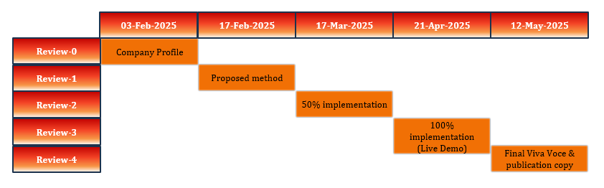
Internship Road Map

Slide 17
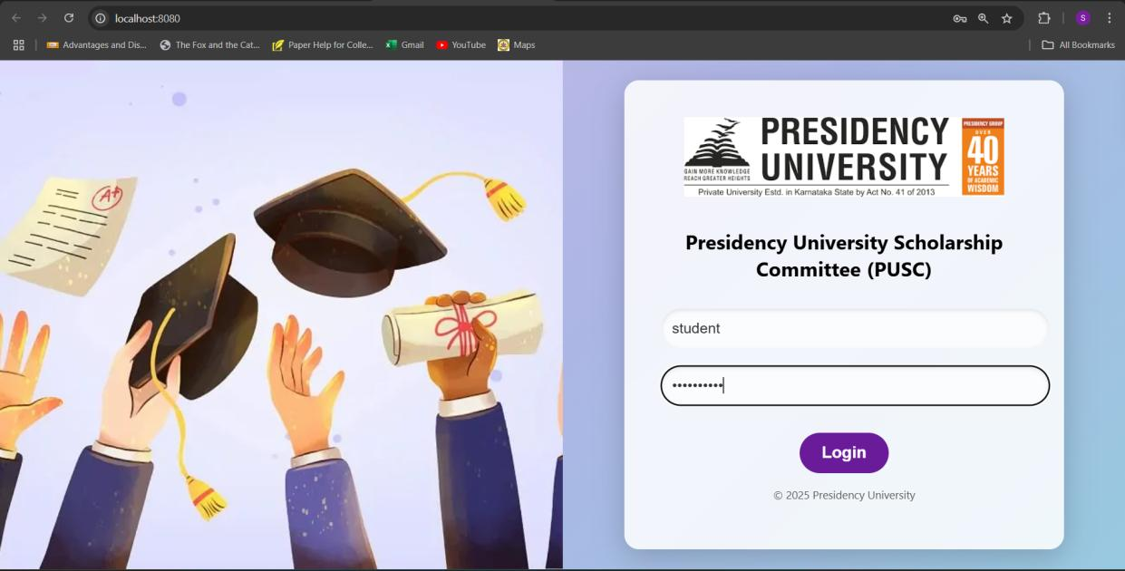
Screenshots

Slide 18
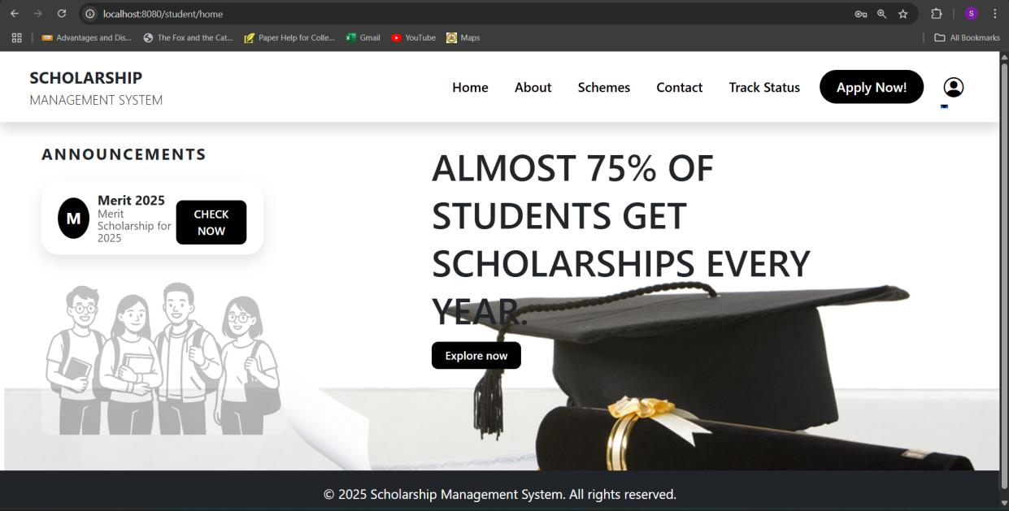
Screenshots

Slide 19
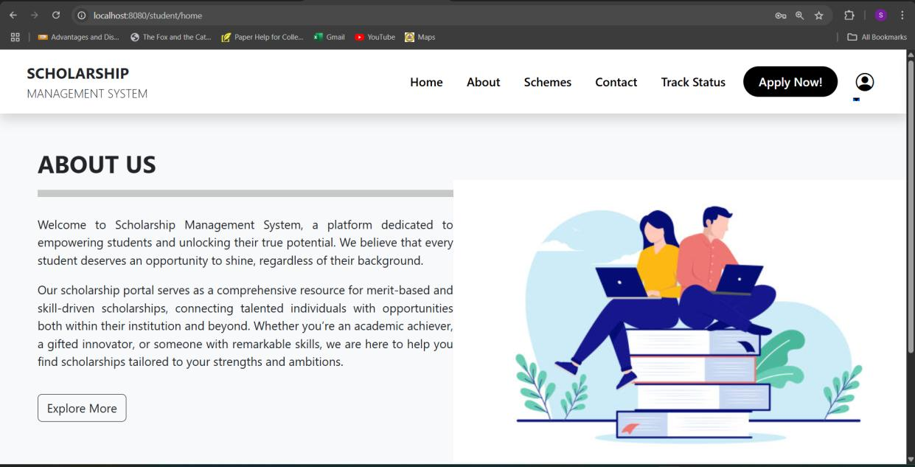
Screenshots

Slide 20
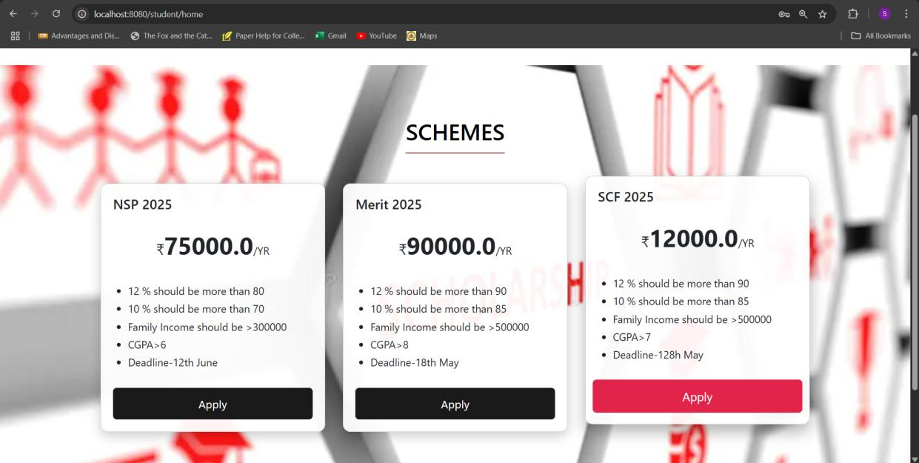
Screenshots

Slide 21
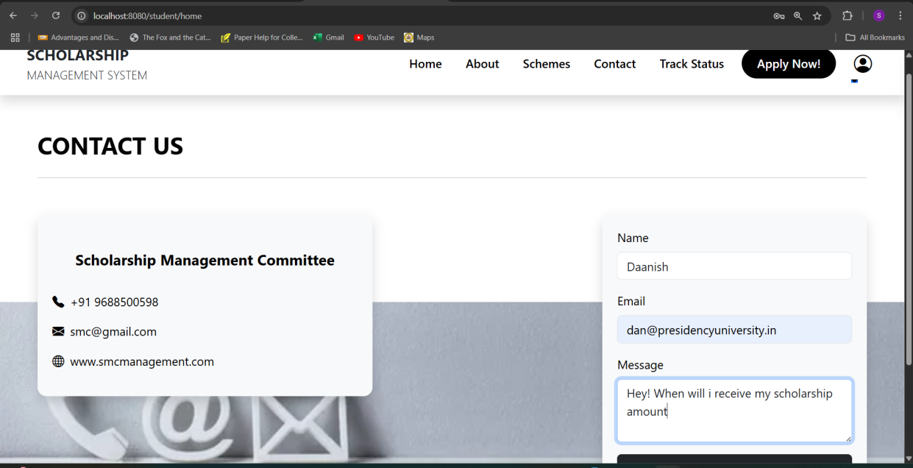
Screenshots

Slide 22
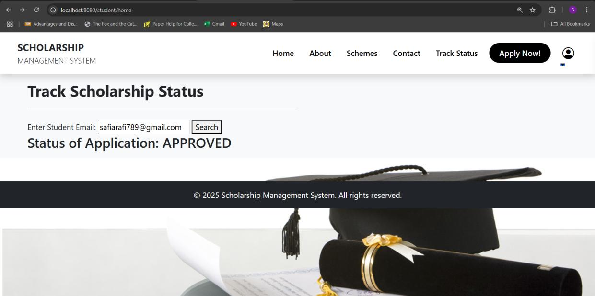
Screenshots

Slide 23
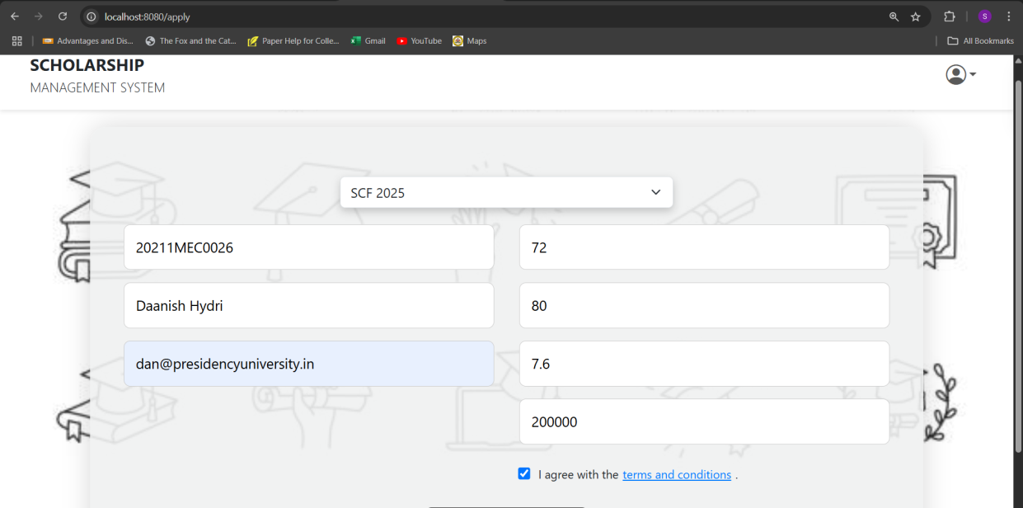
Screenshots

Slide 24
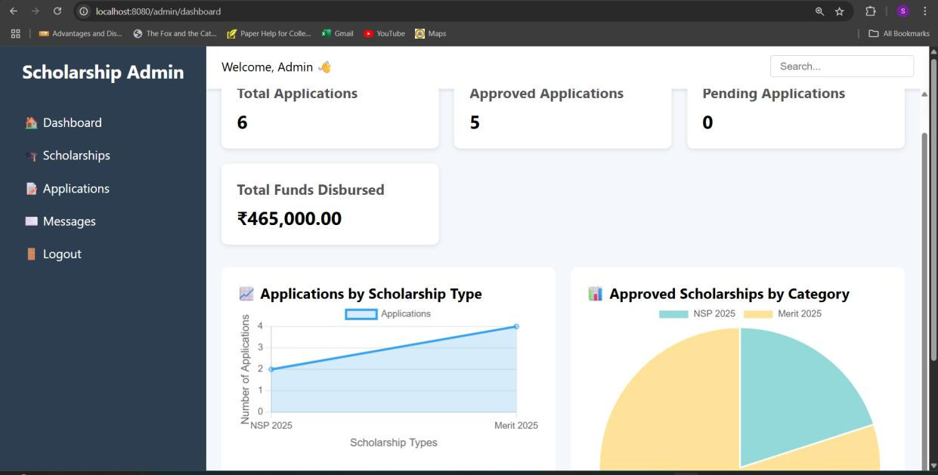
Screenshots

Slide 25
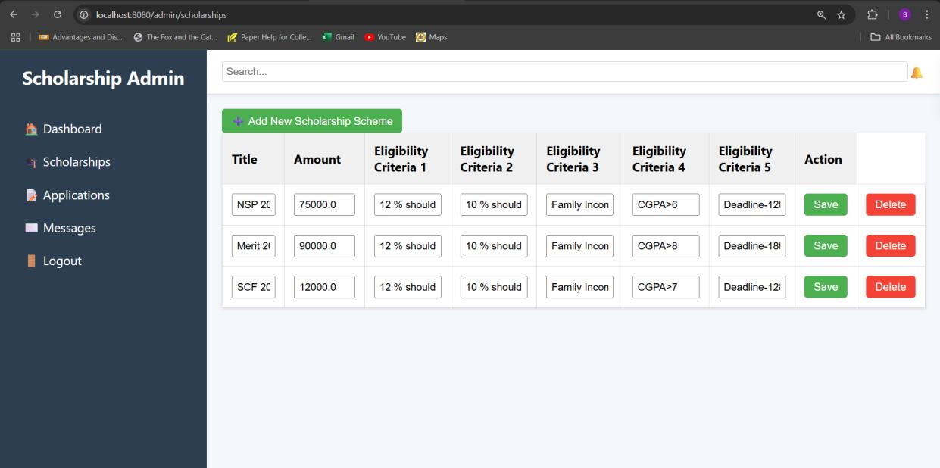
Screenshots

Slide 26
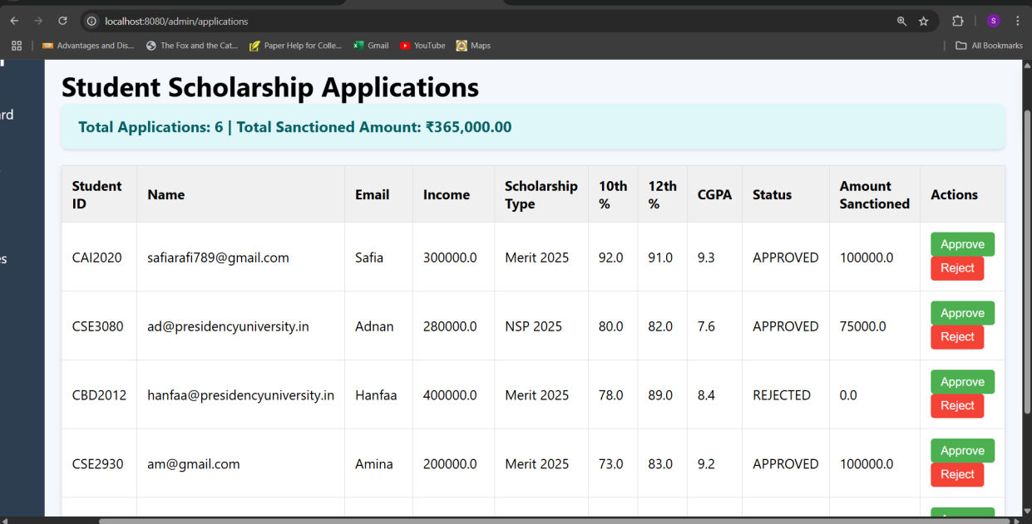
Screenshots

Slide 27
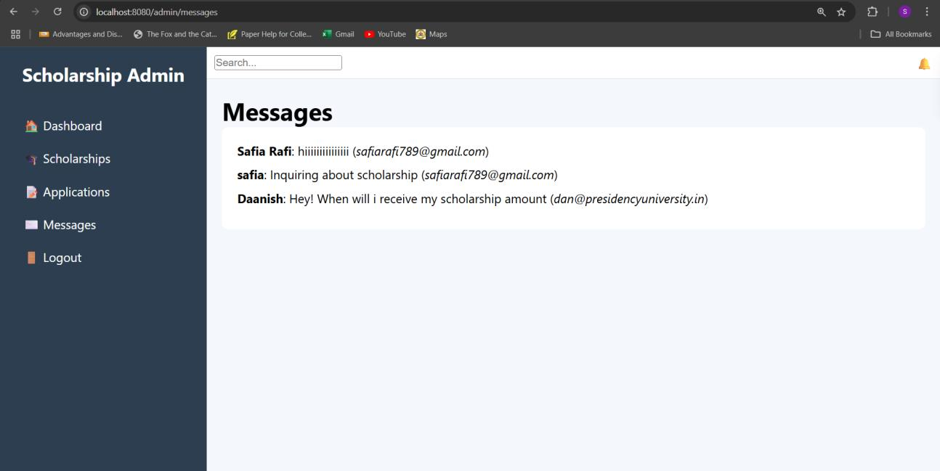
Screenshots

Slide 28
Github Link
Link: MohammedNihal6/TechM

Slide 29
Thank you !!

