Slide 1
Partner Revenue OS
Pre-Seed Runway — 13-Week Weekly + 12-Month Cash-Flow Model
Zero-revenue base case + illustrative upside · SAR · KSA/GCC-calibrated
June 2026 · Built only from founder-provided cost data (Pillars 1-3) and the repo's regulatory reference.
No invented figures: every number is founder input (real) or a clearly-flagged assumption.
Notes:
This deck answers: once the SAR 2.0M lands, how long does it last, which week/month gets tight, and what must change. Base case assumes zero revenue (the honest survival view). The upside is illustrative, built from the repo's pricing ranges, and clearly flagged.

Slide 2
THE BOTTOM LINE
Executive summary
▪ Starting cash is SAR 0. The clock starts when the first capital lands. Raise = SAR 2.0M (timing not yet decided).
▪ The SAR 2.0M is ~95.7% pre-committed: Setup + 4 founders + 6 execution hires + cloud = SAR 1,913,590. Only SAR 86,410 (4.3%) is uncommitted.
▪ Average burn ≈ SAR 159,466/month. Month 1 is front-loaded at SAR 227,193 (setup + first payroll).
▪ BASE CASE (zero revenue, lump sum): cash lasts the year but ends at SAR 86,410 — BELOW the SAR 150k floor, breached around Month 12. Runway-to-zero ≈ 12.6 months.
– This is 'default-dead' on cost alone: the raise funds the team for ~a year with no cushion, no tax line, and no marketing budget.
▪ ILLUSTRATIVE UPSIDE (3-5 mid-market logos in H2): ends the year at ~SAR 614,410, stays above the floor — revenue is the difference between survival and stall.
▪ If funded in tranches, the FIRST tranche must be ≥ ~SAR 377,193 or Month 1 breaches the floor; tranche 2 must land by ~Month 6.
▪ Recommendation: front-load the raise (lump sum or a large first tranche), itemize taxes + GTM, and treat H2 revenue as the gating milestone for survival and the seed round.
Partner Revenue OS · Pre-Seed Runway · SAR · figures from founder cost data (Pillars 1-3); revenue base=0, upside illustrative
2
Notes:
One-screen verdict for a board. The headline tension: the cost plan is fully specified and consumes almost the entire raise; survival past ~month 11-12 depends on revenue and/or more capital.

Slide 3
METHOD & DISCIPLINE
How to read this model
▪ This is a CASH model — it tracks money in and money out of the bank, week by week and month by month.
– Opening cash + cash in − cash out = ending cash. Ending cash carries to the next period. Repeat.
▪ Every figure is tagged: REAL (founder-provided cost data) or ASSUMPTION (clearly flagged, editable).
– No invented numbers. Where an input isn't decided yet, the model uses a stated assumption you can overwrite.
▪ Four things kept separate: bookings ≠ invoices ≠ recognised revenue ≠ CASH COLLECTED. This model = cash only.
– VAT is treated as working capital, never revenue. Currency = SAR.
▪ Sources: founder cost sheet (Pillars 1-3, the verified financial model) + the repo's KSA/GCC regulatory reference for rates and timing.
▪ Scope: all 12 months sit inside Phase 1 'Capture' (the software product) — no money-movement / settlement in this window.
Partner Revenue OS · Pre-Seed Runway · SAR · figures from founder cost data (Pillars 1-3); revenue base=0, upside illustrative
3
Notes:
Sets expectations: cash not accounting profit; real vs assumed; the no-hallucination discipline from the repo's own model prompt.

Slide 4
WHAT GOES IN
Inputs & assumptions register
Input | Value | Tier | Note
Starting cash | SAR 0 | REAL | Clock starts at first capital injection
Raise | SAR 2,000,000 | REAL | Instrument (shares/SAFE) & timing undecided
Inflow timing | Lump sum @ M1 | ASSUMPTION | Base case; tranche stress shown separately
Cash floor | SAR 150,000 | REAL | Do-not-breach line
Team | 4 founders (M1) + 6 hires (M2) | REAL | 10 people by Month 2; mixed Saudi/expat
Pillar 1 (setup) | SAR 158,083.75 | REAL | One-time, Month 1
Pillar 2 (founders+cloud) | SAR 829,306.25 / yr | REAL | Payroll 715k + GOSI 58.5k + cloud 55.8k
Pillar 3 (execution) | SAR 926,200 / 11 mo | REAL | SAR 84,200/mo from Month 2
Revenue (base) | SAR 0 | ASSUMPTION | Honest survival view; nothing signed
Revenue (upside) | ~SAR 132k/deal, H2 | ILLUSTRATIVE | 110k ARR prepay + 22k impl; repo pricing ranges
Taxes (Zakat/VAT/WHT) | Not yet modelled | GAP | Need ownership split, VAT status, foreign vendors
Partner Revenue OS · Pre-Seed Runway · SAR · figures from founder cost data (Pillars 1-3); revenue base=0, upside illustrative
4
Notes:
The single editable control panel. REAL = founder data. ASSUMPTION/ILLUSTRATIVE/GAP are what to refine.

Slide 5
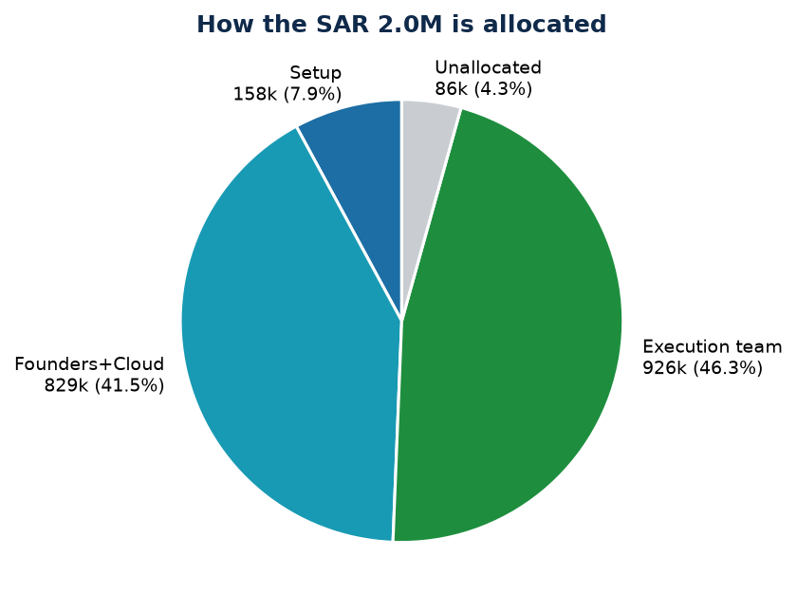
PILLARS 1-3
The cost structure: where the SAR 2.0M goes
▪ Setup (Pillar 1): SAR 158,084 one-time — CR/MISA, visas & Iqamas, portals, office, accounting+insurance.
▪ Founders + cloud (Pillar 2): SAR 829,306/yr — 4 founders, GOSI/levies, Riyadh cloud.
▪ Execution team (Pillar 3): SAR 926,200 — 6 hires from Month 2 (architect, DevOps, integration, sales, CSM, support).
▪ Committed = SAR 1,913,590 = 95.7% of the raise.
▪ Unallocated = SAR 86,410 (4.3%) — the only cushion.
▪ Not yet in any pillar: marketing/GTM spend, taxes, travel, contingency.
Partner Revenue OS · Pre-Seed Runway · SAR · figures from founder cost data (Pillars 1-3); revenue base=0, upside illustrative
5
Notes:
Visual of the commitment problem: nearly the whole raise is people + setup; no discretionary room.

Slide 6
THE BURN
Monthly run-rate: how fast cash leaves
Cost line | SAR / month | When
Founder payroll (4) | 59,583.33 | Every month, M1-12
GOSI & statutory levies | 4,875.52 | Every month, M1-12
Cloud infrastructure | 4,650.00 | Every month, M1-12
Execution team (6) | 84,200.00 | From Month 2 (M2-12)
Setup (one-time) | 158,083.75 | Month 1 only
— Run-rate Month 1 | 227,192.60 | Front-loaded (setup + payroll)
— Run-rate Months 2-12 | 153,308.85 | Steady monthly burn
— Average burn / month | 159,465.83 | Across the 12 months
Partner Revenue OS · Pre-Seed Runway · SAR · figures from founder cost data (Pillars 1-3); revenue base=0, upside illustrative
6
Notes:
Two regimes: a heavy Month 1 (setup lands at once), then a flat ~153k/month once the team is on.

Slide 7
MONTHLY
12-month runway — base case (zero revenue, lump sum)
Month | Cash in | Cash out | Ending cash | Status
M1 | 2,000,000 | 227,193 | 1,772,807 | OK
M2 | 0 | 153,309 | 1,619,499 | OK
M3 | 0 | 153,309 | 1,466,190 | OK
M4 | 0 | 153,309 | 1,312,881 | OK
M5 | 0 | 153,309 | 1,159,572 | OK
M6 | 0 | 153,309 | 1,006,263 | OK
M7 | 0 | 153,309 | 852,954 | OK
M8 | 0 | 153,309 | 699,645 | OK
M9 | 0 | 153,309 | 546,337 | OK
M10 | 0 | 153,309 | 393,028 | OK
M11 | 0 | 153,309 | 239,719 | OK
M12 | 0 | 153,309 | 86,410 | BELOW FLOOR
Partner Revenue OS · Pre-Seed Runway · SAR · figures from founder cost data (Pillars 1-3); revenue base=0, upside illustrative
7
Notes:
With the full 2.0M up front and no revenue, cash declines steadily, drops below the 150k floor in Month 12, and ends the year at SAR 86,410. It never hits zero inside 12 months, but only just (runway-to-zero ~12.6 months) — and this ignores tax and GTM.

Slide 8
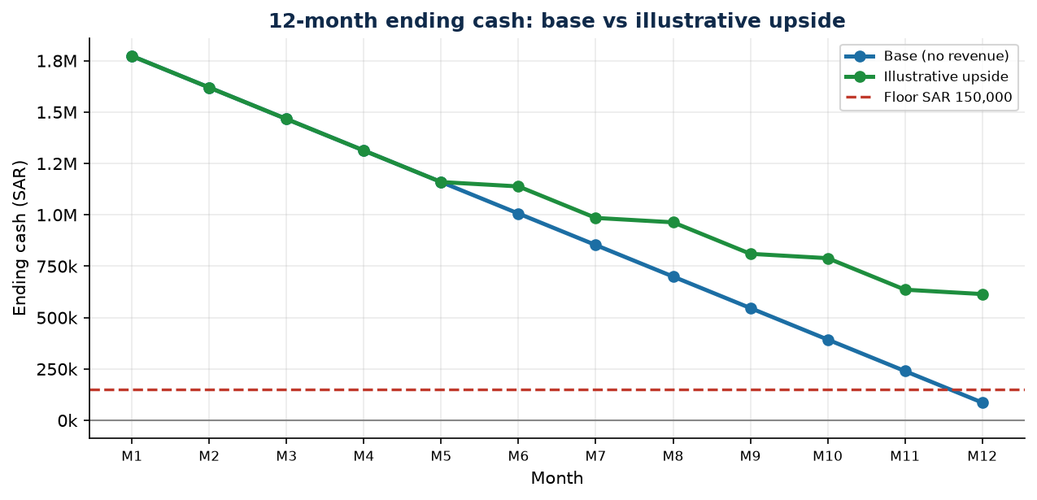
12-MONTH ENDING CASH
Base vs illustrative upside
▪ Red dashed line = SAR 150k floor.
▪ Base (no revenue) ends at SAR 86,410 — below floor.
▪ Upside ends at SAR 614,410 — above floor.
▪ Upside = 4 mid-market logos landing in H2 (illustrative, from the repo's pricing ranges).
▪ Takeaway: a handful of paid logos is the difference between stalling and reaching the seed bar.
Partner Revenue OS · Pre-Seed Runway · SAR · figures from founder cost data (Pillars 1-3); revenue base=0, upside illustrative
8
Notes:
The visual case for prioritising revenue in H2. Upside deliberately conservative on timing (long enterprise cycles).

Slide 9
WEEKLY
13-week weekly cash (the near-term liquidity view)
Week | Cash in | Cash out | Ending cash | Status
W1 | 2,000,000 | 158,084 | 1,841,916 | OK
W2 | — | — | 1,841,916 | OK
W3 | — | — | 1,841,916 | OK
W4 | — | 69,109 | 1,772,807 | OK
W5 | — | — | 1,772,807 | OK
W6 | — | — | 1,772,807 | OK
W7 | — | — | 1,772,807 | OK
W8 | — | — | 1,772,807 | OK
W9 | — | 153,309 | 1,619,499 | OK
W10 | — | — | 1,619,499 | OK
W11 | — | — | 1,619,499 | OK
W12 | — | — | 1,619,499 | OK
W13 | — | 153,309 | 1,466,190 | OK
Partner Revenue OS · Pre-Seed Runway · SAR · figures from founder cost data (Pillars 1-3); revenue base=0, upside illustrative
9
Notes:
Lump-sum case: setup hits in W1, payroll at month-ends (W4/W9/W13). The 13-week window is the calm early period; the crunch (in the tranche case) comes later, around month 5-6.

Slide 10
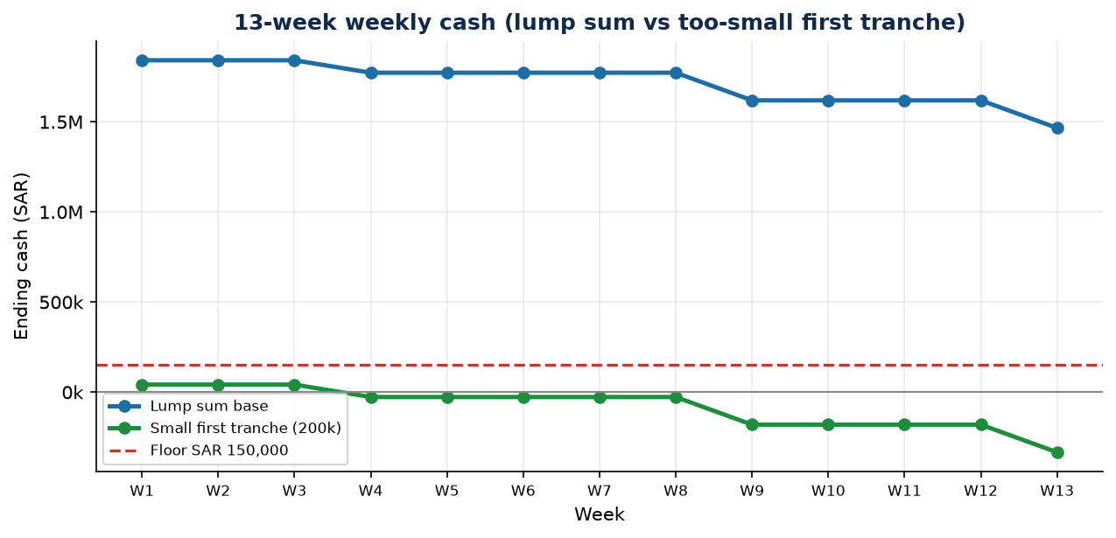
WEEKLY
13-week weekly cash — why the first tranche size matters
▪ Lump sum: setup in W1 leaves ~SAR 1.84M; calm through the quarter (ends ~SAR 1.47M).
▪ A too-small first tranche (e.g. SAR 200k) breaches the floor in Week 1 (ends SAR 41,916).
▪ First tranche must clear setup + 1 month payroll + floor ≈ SAR 377,193.
▪ This is the near-term liquidity early-warning the weekly view exists to give.
Partner Revenue OS · Pre-Seed Runway · SAR · figures from founder cost data (Pillars 1-3); revenue base=0, upside illustrative
10
Notes:
Weekly chart visualising the first-tranche threshold and the immediate breach if it's too small.

Slide 11
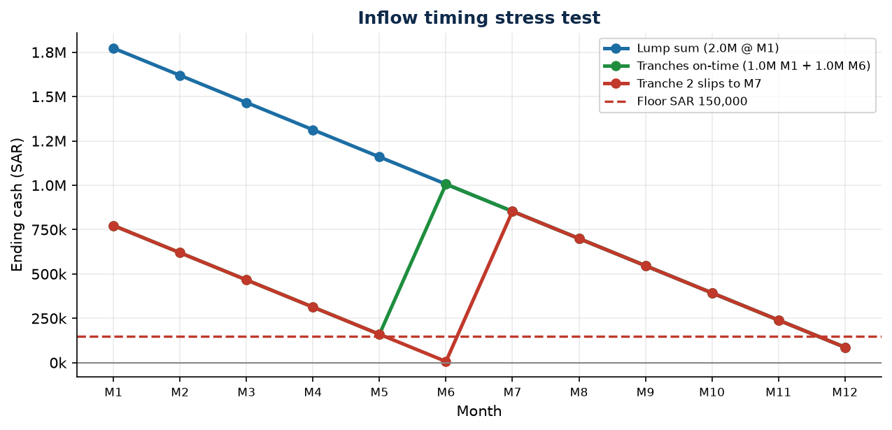
STRESS TEST
Inflow timing: the single biggest risk
▪ Start cash is zero, so survival depends entirely on WHEN the 2.0M arrives.
▪ Minimum first tranche ≈ SAR 377,193 (setup + 1 month payroll + floor).
▪ A too-small first tranche breaches the floor in Week 1 (see weekly chart).
▪ With a 50/50 split, tranche 2 must land by ~Month 6.
▪ If tranche 2 slips one month to M7, cash nearly hits zero (breach at Month 6).
▪ Mitigation: lump sum, or a large front-loaded first tranche with wide spacing.
Partner Revenue OS · Pre-Seed Runway · SAR · figures from founder cost data (Pillars 1-3); revenue base=0, upside illustrative
11
Notes:
Quantifies why front-loading matters. Tranche assumptions are illustrative (50/50) to show sensitivity.

Slide 12
SCENARIO (FLAGGED)
Illustrative upside — what revenue does
▪ ALL figures here are illustrative assumptions from the repo's pricing ranges — nothing is signed.
▪ Assumed motion: the Inside Sales Executive (hired M2) + founders land mid-market logos in H2 after ramp + sales cycle.
▪ Deal economics (illustrative): SAR ~110,000 annual contract, paid up front (GCC norm) + ~SAR 22,000 implementation = ~SAR 132,000 cash per logo.
▪ Timing: one logo each in Months 6, 8, 10, 12 (≈ the repo's 3-5 paid design-partner seed milestone).
▪ Cash impact: +SAR 528,000 across H2 → year-end cash ~SAR 614,410 (vs 86,410 base).
▪ Year-end ARR ≈ SAR 440,000 (4 logos) — entering seed-ready territory.
▪ Reality check: enterprise cycles are long; treat these dates as optimistic and pressure-test pilot→paid conversion.
Partner Revenue OS · Pre-Seed Runway · SAR · figures from founder cost data (Pillars 1-3); revenue base=0, upside illustrative
12
Notes:
Keeps the upside honest: clearly labelled illustrative, conservative on count and timing, tied to the repo's own seed milestone.

Slide 13
WHAT'S MISSING
Gaps to close (ranked by impact)
# | Gap | Why it matters | Impact
1 | Inflow timing of the 2.0M | Zero start cash → survival hinges on when money lands | HIGH
2 | Revenue (none decided) | Sets the real cash-out month; flips default-dead → alive | HIGH
3 | Taxes & timing (Zakat/VAT/WHT) | Real cash outflows; need ownership %, VAT status, vendors | MED-HIGH
4 | Pillar 3 burden inclusion | Do role budgets include GOSI/levies, or are they on top? | MEDIUM
5 | Missing GTM / contingency budget | No marketing/travel line; 86k is the only cushion | MEDIUM
6 | Exact pay dates / week timing | Refines the weekly view (currently month-end default) | LOW
7 | 715k vs 720k salary; Saudi/expat split | Minor reconciliations | LOW
Partner Revenue OS · Pre-Seed Runway · SAR · figures from founder cost data (Pillars 1-3); revenue base=0, upside illustrative
13
Notes:
The honest 'to make this board-defensible' list. Items 1-3 move the conclusion; the rest refine accuracy.

Slide 14
WHAT TO DO
Recommendations & decision gates
▪ CAPITAL: take the 2.0M as a lump sum or a large front-loaded first tranche (≥ ~SAR 377k); avoid thin/late tranches.
▪ RUNWAY: plan to the floor, not to zero — at current burn the 150k floor hits around Month 11-12 with no revenue.
▪ REVENUE: make H2 paid logos the gating milestone; even 3-5 mid-market deals change survival and unlock the seed round.
▪ BUDGET: itemize the missing lines (taxes, GTM, contingency) and decide if GTM comes from this raise or the next.
▪ RAISE PLAN: this round funds ~12 months with no cushion → start the seed raise by ~Month 6-7 (MENA processes run 6-9 months).
▪ VERIFY: confirm ownership split (Zakat vs CIT), VAT registration, and WHT on foreign cloud/SaaS before filing.
▪ GOVERNANCE: review cash weekly for the first 6 months; re-run this model monthly against actuals.
Partner Revenue OS · Pre-Seed Runway · SAR · figures from founder cost data (Pillars 1-3); revenue base=0, upside illustrative
14
Notes:
Actionable close: capital structure, the revenue milestone, the missing budget, and when to start the next raise.

Slide 15
APPENDIX
Appendix — monthly detail (illustrative upside)
Month | Revenue cash | Total in | Cash out | Ending cash | Status
M1 | — | 2,000,000 | 227,193 | 1,772,807 | OK
M2 | — | 0 | 153,309 | 1,619,499 | OK
M3 | — | 0 | 153,309 | 1,466,190 | OK
M4 | — | 0 | 153,309 | 1,312,881 | OK
M5 | — | 0 | 153,309 | 1,159,572 | OK
M6 | 132,000 | 132,000 | 153,309 | 1,138,263 | OK
M7 | — | 0 | 153,309 | 984,954 | OK
M8 | 132,000 | 132,000 | 153,309 | 963,645 | OK
M9 | — | 0 | 153,309 | 810,337 | OK
M10 | 132,000 | 132,000 | 153,309 | 789,028 | OK
M11 | — | 0 | 153,309 | 635,719 | OK
M12 | 132,000 | 132,000 | 153,309 | 614,410 | OK
Partner Revenue OS · Pre-Seed Runway · SAR · figures from founder cost data (Pillars 1-3); revenue base=0, upside illustrative
15
Notes:
Full month-by-month for the illustrative upside, for reference.

