Slide 1
Bootstrap and Cross-Validation
Data Modeling Metrics

Slide 2
The Bootstrap standard error
Described by Bradley Efron (Stanford) in 1979.
Allows you to calculate the standard errors when no formulas are available.
Allows you to calculate the standard errors when assumptions are not met (e.g., large sample, normality)

Slide 3
Where do these formulas for standard error come from?
Mathematical theory, such as the central limit theorem.
Maximum likelihood estimation theory (standard error is related to the second derivative of the likelihood; assumes sufficiently large sample)
In recent decades, computer simulation…

Slide 4
The sampling distribution of the sample mean:
1. Pick any probability distribution and specify a mean and standard deviation.
2. Tell the computer to randomly generate 1000 observations from that probability distributions
  E.g., the computer is more likely to spit out values with high probabilities
3. Plot the “observed” values in a histogram.
4. Next, tell the computer to randomly generate 1000 averages-of-2 (randomly pick 2 and take their average) from that probability distribution. Plot “observed” averages in histograms.
5. Repeat for averages-of-10, and averages-of-100.
Notes:
IF the true mean was 128 with an average variability of 15 lbs….

Slide 5
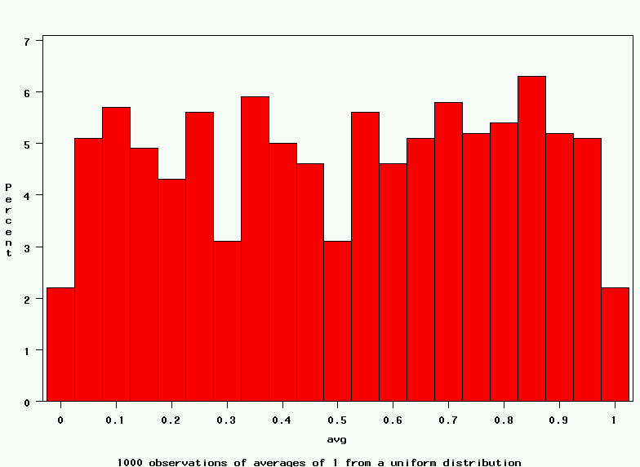
Uniform on [0,1]: average of 1
(original distribution)
Notes:
It turns out that if you were to go out and sample many, many times, most sample statistics that you could calculate would follow a normal distribution.
What are the 2 parameters (from last time) that define any normal distribution?
Remember that a normal curve is characterized by two parameters, a mean and a variability (SD)
What do you think the mean value of a sample statistic would be? The standard deviation?
Remember standard deviation is natural variability of the population
Standard error can be standard error of the mean or standard error of the odds ratio or standard error of the difference of 2 means, etc. The standard error of any sample statistic.

Slide 6
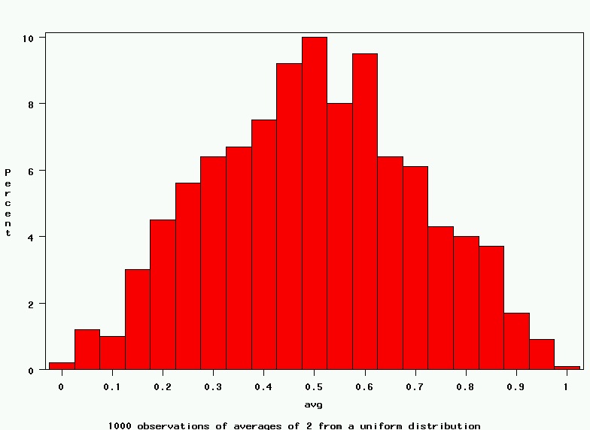
Uniform: 1000 averages of 2
Notes:
It turns out that if you were to go out and sample many, many times, most sample statistics that you could calculate would follow a normal distribution.
What are the 2 parameters (from last time) that define any normal distribution?
Remember that a normal curve is characterized by two parameters, a mean and a variability (SD)
What do you think the mean value of a sample statistic would be? The standard deviation?
Remember standard deviation is natural variability of the population
Standard error can be standard error of the mean or standard error of the odds ratio or standard error of the difference of 2 means, etc. The standard error of any sample statistic.

Slide 7
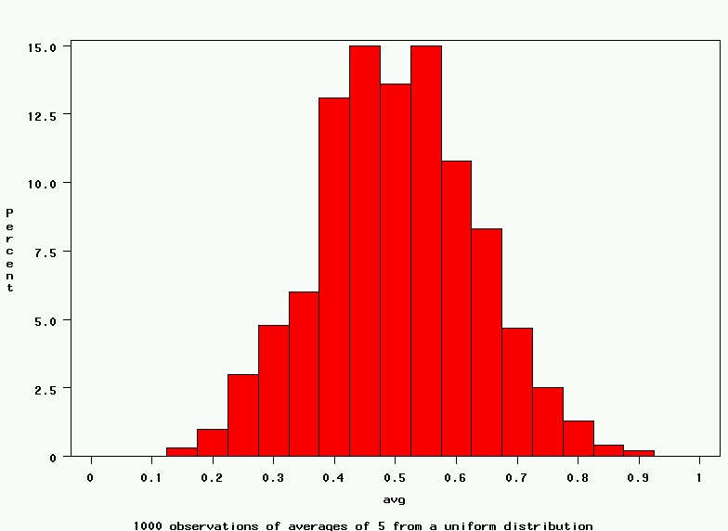
Uniform: 1000 averages of 5
Notes:
It turns out that if you were to go out and sample many, many times, most sample statistics that you could calculate would follow a normal distribution.
What are the 2 parameters (from last time) that define any normal distribution?
Remember that a normal curve is characterized by two parameters, a mean and a variability (SD)
What do you think the mean value of a sample statistic would be? The standard deviation?
Remember standard deviation is natural variability of the population
Standard error can be standard error of the mean or standard error of the odds ratio or standard error of the difference of 2 means, etc. The standard error of any sample statistic.

Slide 8
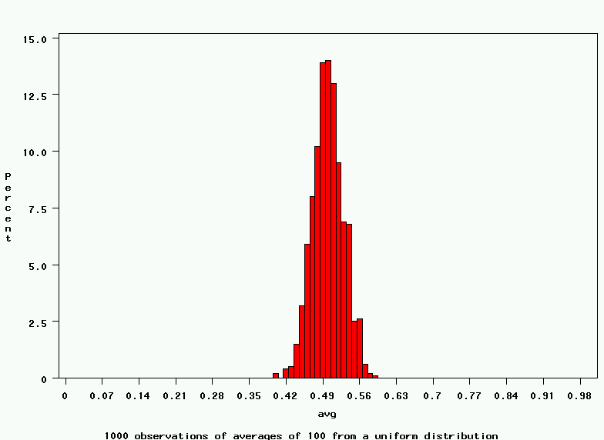
Uniform: 1000 averages of 100
Notes:
It turns out that if you were to go out and sample many, many times, most sample statistics that you could calculate would follow a normal distribution.
What are the 2 parameters (from last time) that define any normal distribution?
Remember that a normal curve is characterized by two parameters, a mean and a variability (SD)
What do you think the mean value of a sample statistic would be? The standard deviation?
Remember standard deviation is natural variability of the population
Standard error can be standard error of the mean or standard error of the odds ratio or standard error of the difference of 2 means, etc. The standard error of any sample statistic.

Slide 9
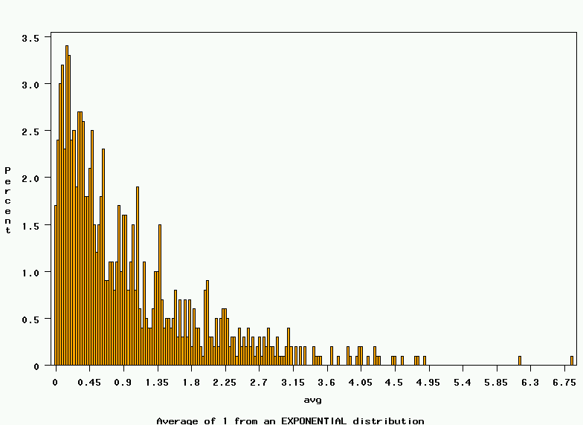
~Exp(1): average of 1
(original distribution)
Notes:
It turns out that if you were to go out and sample many, many times, most sample statistics that you could calculate would follow a normal distribution.
What are the 2 parameters (from last time) that define any normal distribution?
Remember that a normal curve is characterized by two parameters, a mean and a variability (SD)
What do you think the mean value of a sample statistic would be? The standard deviation?
Remember standard deviation is natural variability of the population
Standard error can be standard error of the mean or standard error of the odds ratio or standard error of the difference of 2 means, etc. The standard error of any sample statistic.

Slide 10
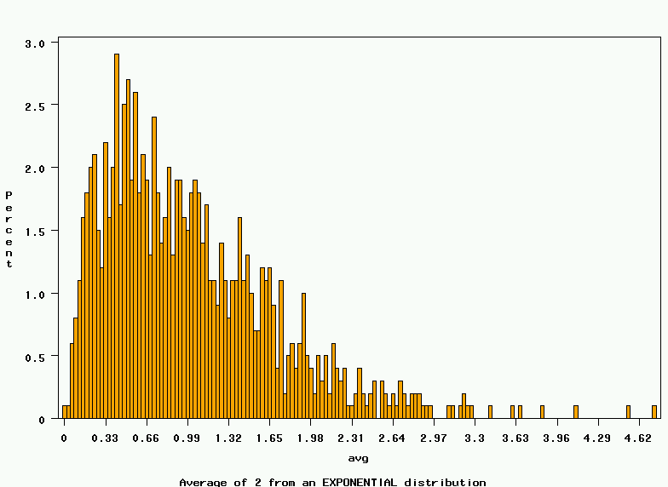
~Exp(1): 1000 averages of 2
Notes:
It turns out that if you were to go out and sample many, many times, most sample statistics that you could calculate would follow a normal distribution.
What are the 2 parameters (from last time) that define any normal distribution?
Remember that a normal curve is characterized by two parameters, a mean and a variability (SD)
What do you think the mean value of a sample statistic would be? The standard deviation?
Remember standard deviation is natural variability of the population
Standard error can be standard error of the mean or standard error of the odds ratio or standard error of the difference of 2 means, etc. The standard error of any sample statistic.

Slide 11
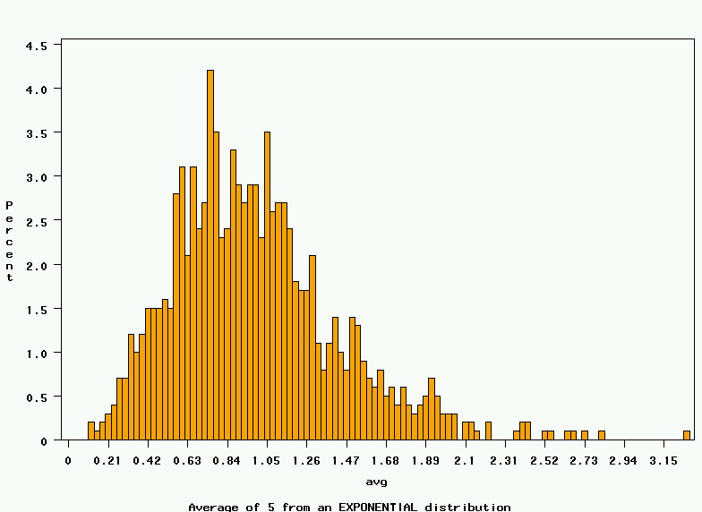
~Exp(1): 1000 averages of 5
Notes:
It turns out that if you were to go out and sample many, many times, most sample statistics that you could calculate would follow a normal distribution.
What are the 2 parameters (from last time) that define any normal distribution?
Remember that a normal curve is characterized by two parameters, a mean and a variability (SD)
What do you think the mean value of a sample statistic would be? The standard deviation?
Remember standard deviation is natural variability of the population
Standard error can be standard error of the mean or standard error of the odds ratio or standard error of the difference of 2 means, etc. The standard error of any sample statistic.

Slide 12
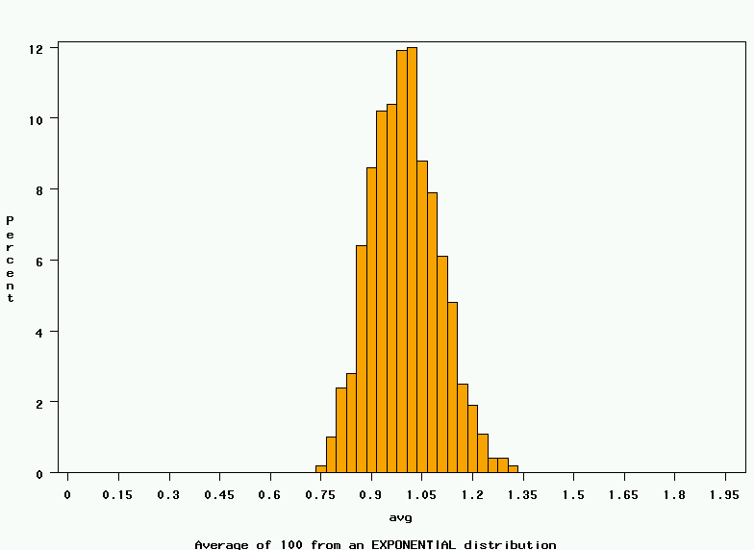
~Exp(1): 1000 averages of 100
Notes:
It turns out that if you were to go out and sample many, many times, most sample statistics that you could calculate would follow a normal distribution.
What are the 2 parameters (from last time) that define any normal distribution?
Remember that a normal curve is characterized by two parameters, a mean and a variability (SD)
What do you think the mean value of a sample statistic would be? The standard deviation?
Remember standard deviation is natural variability of the population
Standard error can be standard error of the mean or standard error of the odds ratio or standard error of the difference of 2 means, etc. The standard error of any sample statistic.

Slide 13
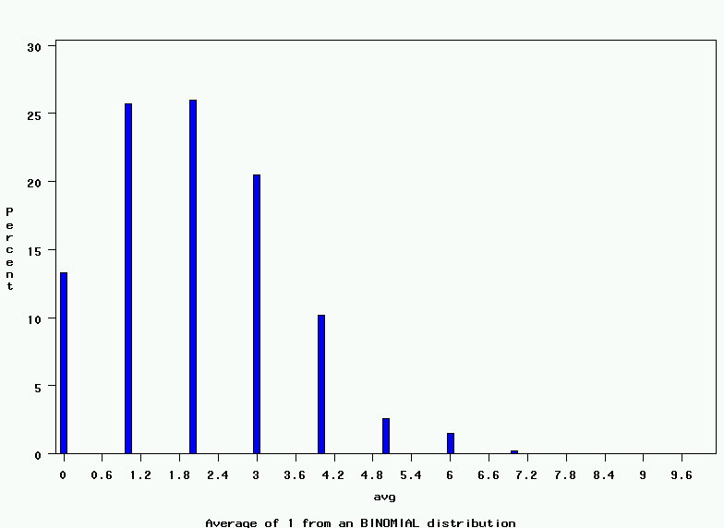
~Bin(40, .05): average of 1
(original distribution)
Notes:
It turns out that if you were to go out and sample many, many times, most sample statistics that you could calculate would follow a normal distribution.
What are the 2 parameters (from last time) that define any normal distribution?
Remember that a normal curve is characterized by two parameters, a mean and a variability (SD)
What do you think the mean value of a sample statistic would be? The standard deviation?
Remember standard deviation is natural variability of the population
Standard error can be standard error of the mean or standard error of the odds ratio or standard error of the difference of 2 means, etc. The standard error of any sample statistic.

Slide 14
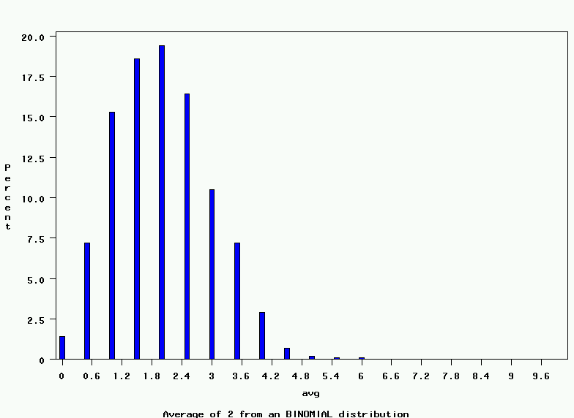
~Bin(40, .05): 1000 averages of 2
Notes:
It turns out that if you were to go out and sample many, many times, most sample statistics that you could calculate would follow a normal distribution.
What are the 2 parameters (from last time) that define any normal distribution?
Remember that a normal curve is characterized by two parameters, a mean and a variability (SD)
What do you think the mean value of a sample statistic would be? The standard deviation?
Remember standard deviation is natural variability of the population
Standard error can be standard error of the mean or standard error of the odds ratio or standard error of the difference of 2 means, etc. The standard error of any sample statistic.

Slide 15
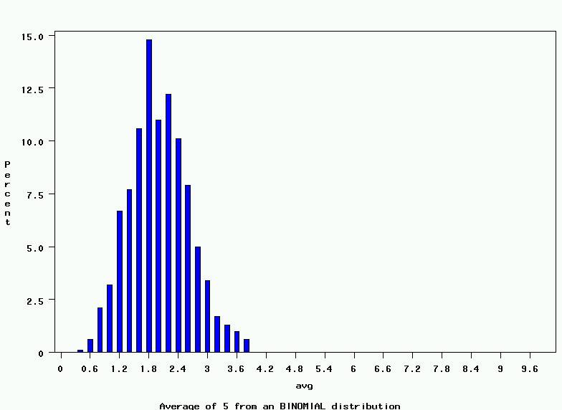
~Bin(40, .05): 1000 averages of 5
Notes:
It turns out that if you were to go out and sample many, many times, most sample statistics that you could calculate would follow a normal distribution.
What are the 2 parameters (from last time) that define any normal distribution?
Remember that a normal curve is characterized by two parameters, a mean and a variability (SD)
What do you think the mean value of a sample statistic would be? The standard deviation?
Remember standard deviation is natural variability of the population
Standard error can be standard error of the mean or standard error of the odds ratio or standard error of the difference of 2 means, etc. The standard error of any sample statistic.

Slide 16
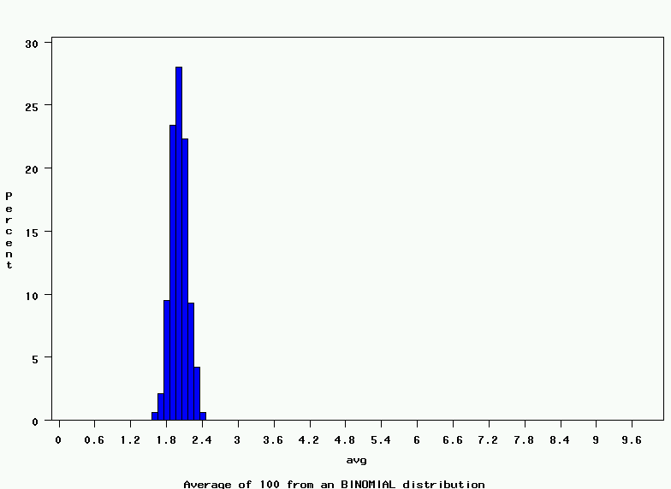
~Bin(40, .05): 1000 averages of 100
Notes:
It turns out that if you were to go out and sample many, many times, most sample statistics that you could calculate would follow a normal distribution.
What are the 2 parameters (from last time) that define any normal distribution?
Remember that a normal curve is characterized by two parameters, a mean and a variability (SD)
What do you think the mean value of a sample statistic would be? The standard deviation?
Remember standard deviation is natural variability of the population
Standard error can be standard error of the mean or standard error of the odds ratio or standard error of the difference of 2 means, etc. The standard error of any sample statistic.

Slide 17
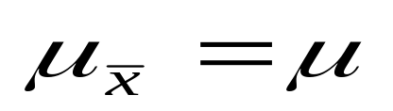
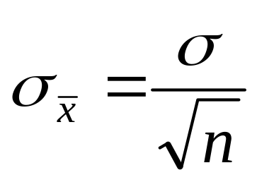
The Central Limit Theorem:
If all possible random samples, each of size n, are taken from any population with a mean μ and a standard deviation σ, the sampling distribution of the sample means (averages) will:
1. have mean:
2. have standard deviation:
3. be approximately normally distributed regardless of the shape of the parent population (normality improves with larger n)
Notes:
It turns out that if you were to go out and sample many, many times, most sample statistics that you could calculate would follow a normal distribution.
What are the 2 parameters (from last time) that define any normal distribution?
Remember that a normal curve is characterized by two parameters, a mean and a variability (SD)
What do you think the mean value of a sample statistic would be? The standard deviation?
Remember standard deviation is natural variability of the population
Standard error can be standard error of the mean or standard error of the odds ratio or standard error of the difference of 2 means, etc. The standard error of any sample statistic.

Slide 18
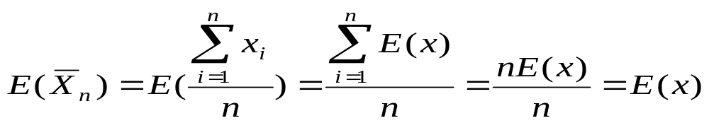
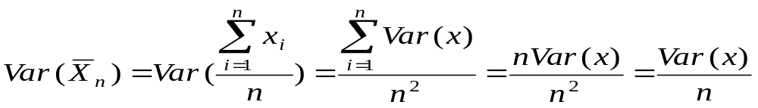
Mathematical Proof
If X is a random variable from any distribution with known mean, E(x), and variance, Var(x), then the expected value and variance of the average of n observations of X is:

Slide 19
Why Bootstrap?
The bootstrap draws observations only from your own sample (not a hypothetical world)
  makes no assumptions about the underlying distribution in the population.

Slide 20
Bootstrap re-sampling…getting something for nothing!
The standard error is the amount of variability in the statistic if you could take repeated samples of size n.
How do you take repeated samples of size n from n observations??
Here’s the trick→Sampling with replacement!

Slide 21
Sampling with replacement
Sampling with replacement means every observation has an equal chance of being selected (=1/n), and observations can be selected more than once.

Slide 22
Sampling with replacement
Original sample of n=6 observations.
Possible new samples:
A
B
C
D
E
F
A
A
A
D
C
C
B
A
C
E
Re-sample with replacement
D
C
B
C
D
F
E
F
**What’s the probability of each of these particular samples discounting order?

Slide 23
Bootstrap Procedure
1. Number your observations 1,2,3,…n
2. Draw a random sample of size n WITH REPLACEMENT.
3. Calculate your statistic (mean, beta coefficient, ratio, etc.) with these data.
4. Repeat steps 1-3 many times (e.g., 500 times).
5. Calculate the variance of your statistic directly from your sample of 500 statistics.

Slide 24
When is bootstrap used?
If you have a new-fangled statistic without a known formula for standard error.
  e.g. male: female ratio.
If you are not sure if large sample assumptions are met.
  Maximum likelihood estimation assumes “large enough” sample.
If you are not sure if normality assumptions are met.
  Bootstrap makes no assumptions about the distribution of the variables in the underlying population.

Slide 25
CROSS-VALIDATION AND MODEL SELECTION

Slide 26
Validation
Validation addresses the problem of over-fitting.
Internal Validation: Validate your model on your current data set (cross-validation)
External Validation: Validate your model on a completely new dataset

Slide 27
How to check if a model fit is good?
The R² statistic has become the almost universally standard measure for model fit in linear models.
What is R²?
It is the ratio of error in a model over the total variance in the dependent variable.
Hence the lower the error, the higher the R² value.

Slide 28
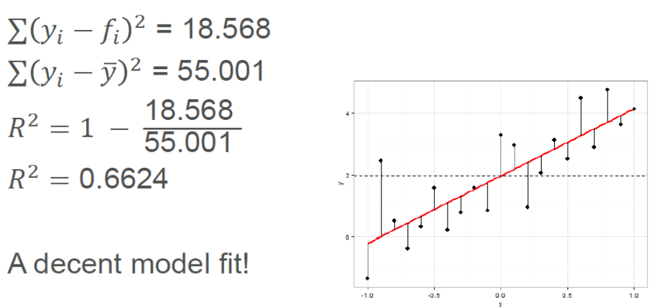
How to check if a model fit is good?

Slide 29
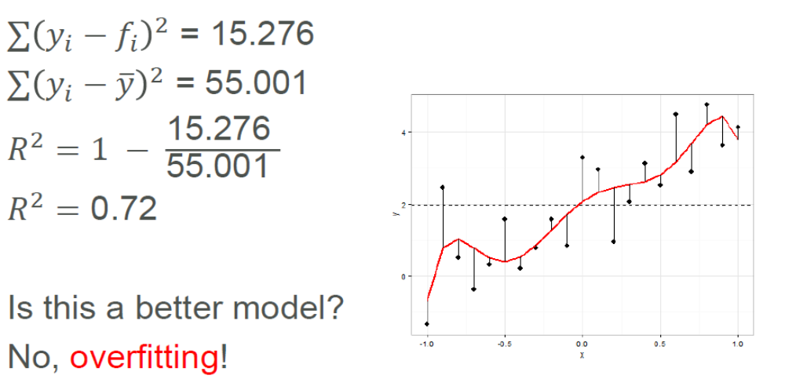
How to check if a model fit is good?

Slide 30
OVERFITTING
Modeling techniques tend to overfit the data.
Multiple regression:
Every time you add a variable to the regression, the model’s R² goes up.
Naïve interpretation: every additional predictive variable helps to explain yet more of the target’s variance. But that can’t be true!
Left to its own devices, Multiple Regression will fit too many patterns.
A reason why modeling requires subject-matter expertise.

Slide 31
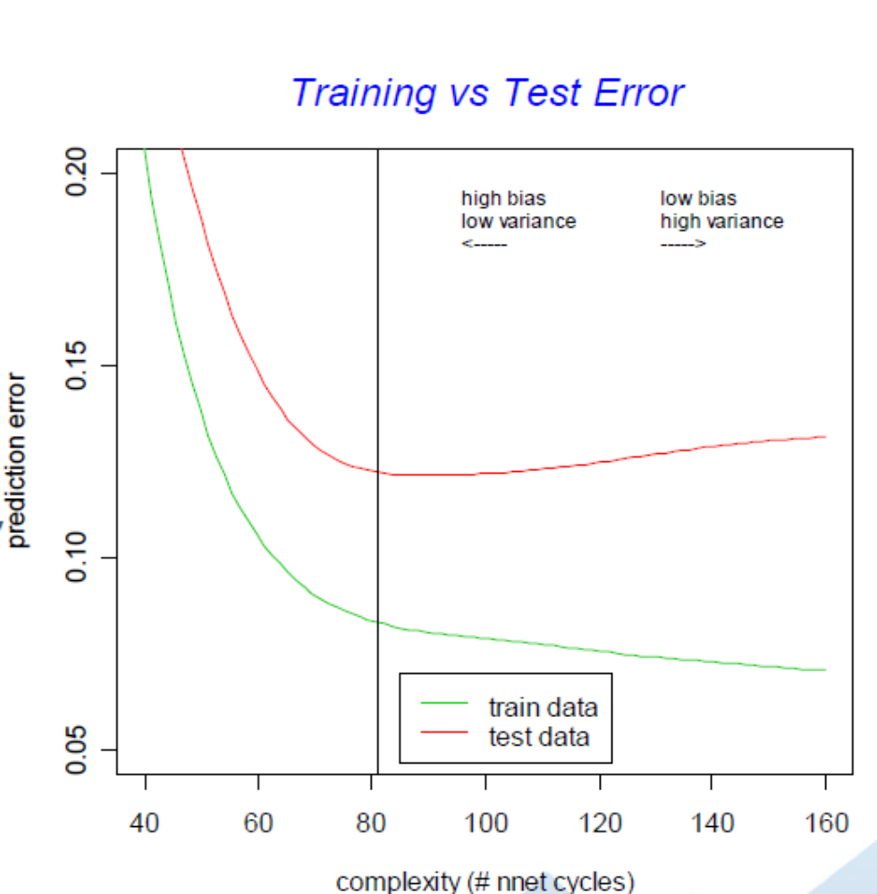
OVERFITTING
Error on the dataset used to fit the model can be misleading
› Doesn’t predict future performance.
Too much complexity can diminish model’s accuracy on future data.
› Sometimes called the Bias-Variance Tradeoff.

Slide 32
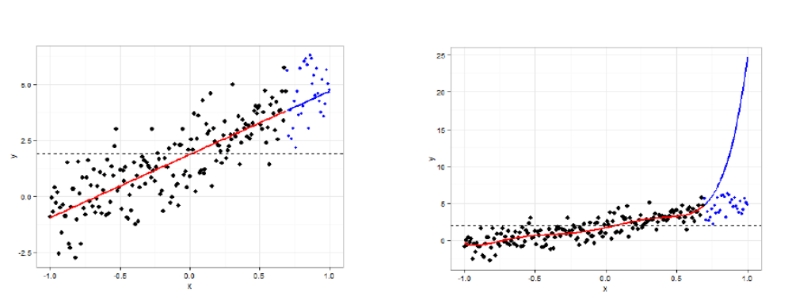
OVERFITTING
What are the consequences of overfitting?
›“Overfitted models will have high R² values, but will perform poorly in predicting out-of-sample cases”

Slide 33
WHY WE NEED CROSS-VALIDATION?
R², also known as coefficient of determination, is a popular measure of quality of fit in regression. However, it does not offer any significant insights into how well our regression model can predict future values.
An alternative, more practical procedure is cross-validation.

Slide 34
When is cross-validation used?
Very important in microarray experiments (“p is very larger than N”). N=number of cases sampled for the study and p=true proportion exposed in all cases in the larger population.
Anytime you want to prove that your model is not over-fit, that it will have good prediction in new datasets.

Slide 35
CROSS-VALIDATION
In cross-validation the original sample is split into two parts. One part is called the training (or derivation) sample, and the other part is called the validation (or validation + testing) sample.
What portion of the sample should be in each part?
If sample size is very large, it is often best to split the sample in half. For smaller samples, it is more conventional to split the sample such that 2/3 of the observations are in the derivation sample and 1/3 are in the validation sample.

Slide 36
CROSS-VALIDATION
2) How should the sample be split?
The most common approach is to divide the sample randomly, thus theoretically eliminating any systematic differences. One alternative is to define matched pairs of subjects in the original sample and to assign one member of each pair to the derivation sample and the other to the validation sample.
Modeling of the data uses one part only. The model selected for this part is then used to predict the values in the other part of the data. A valid model should show good predictive accuracy.
One thing that R-squared offers no protection against is overfitting. On the other hand, cross validation, by allowing us to have cases in our testing set that are different from the cases in our training set, inherently offers protection against overfitting.

Slide 37
Holdout validation
One way to validate your model is to fit your model on half your dataset (your “training set”) and test it on the remaining half of your dataset (your “test set”).
If over-fitting is present, the model will perform well in your training dataset but poorly in your test dataset.
Of course, you “waste” half your data this way, and often you don’t have enough data to spare…

Slide 38
Alternative strategies:
Leave-one-out validation (leave one observation out at a time; fit the model on the remaining training data; test on the held out data point).
K-fold cross-validation

Slide 39
10-fold cross-validation (one example of K-fold cross-validation)
1. Randomly divide your data into 10 pieces, 1 through k.
2. Treat the 1st tenth of the data as the test dataset. Fit the model to the other nine-tenths of the data (which are now the training data).
3. Apply the model to the test data (e.g., for logistic regression, calculate predicted probabilities of the test observations).
4. Repeat this procedure for all 10 tenths of the data.
5. Calculate statistics of model accuracy and fit (e.g., ROC curves) from the test data only.

Slide 40
Robust Model
  If a model has no predictive power, you have a 50-50 chance of correctly classification.
  For example a model with 79% chance of correct classification can be considered quite an improvement over 50%.
AUC=Area Under Curve (ROC Curve) Since we don’t have extra data lying around, we can use 10-fold cross-validation to get a better estimate of the AUC…
Before cross validation AUC=0.79 and After cross-validation, the AUC was 0.78.
This shows that the model is robust.

Slide 41
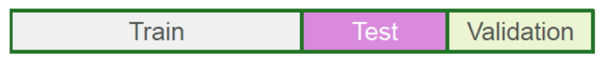
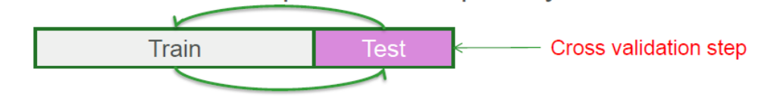
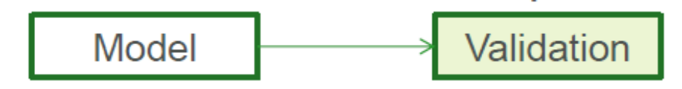
CROSS VALIDATION – THE IDEAL PROCEDURE
1.Divide data into three sets, training, validation and test sets
2.Find the optimal model on the training set, and use the test set to check its predictive capability
3.See how well the model can predict the test set
4.The validation error gives an unbiased estimate of the predictive power of a model

Slide 42
TRAINING/TEST DATA SPLIT
Talked about splitting data in training/test sets
• training data is used to fit parameters
• test data is used to assess how classifier generalizes to new data
What if classifier has “non‐tunable” parameters?
• a parameter is “non‐tunable” if tuning (or training) it on the training data leads to overfitting

Slide 43
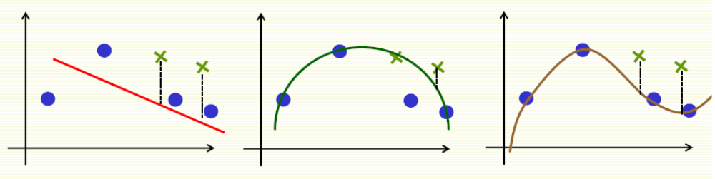
TRAINING/TEST DATA SPLIT
What about test error? Seems appropriate
• degree 2 is the best model according to the test error
Except what do we report as the test error now?
• Test error should be computed on data that was not used for training at all
• Here used “test” data for training, i.e. choosing model

Slide 44
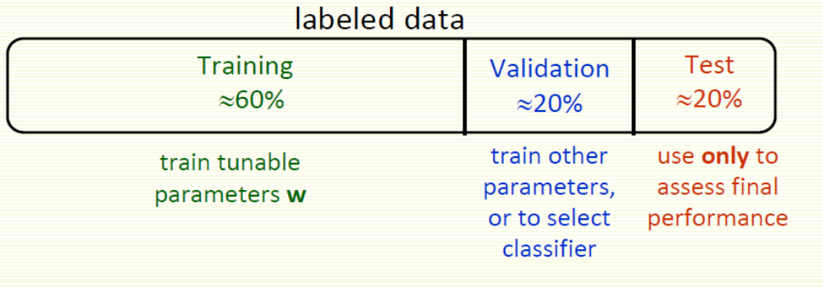
VALIDATION DATA
Same question when choosing among several classifiers
• our polynomial degree example can be looked at as choosing among 3 classifiers (degree 1, 2, or 3)
• Solution: split the labeled data into three parts

Slide 45
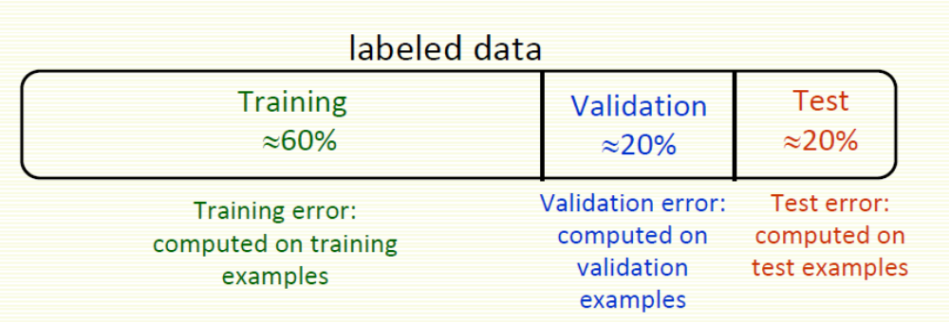
TRAINING/ VALIDATION

Slide 46
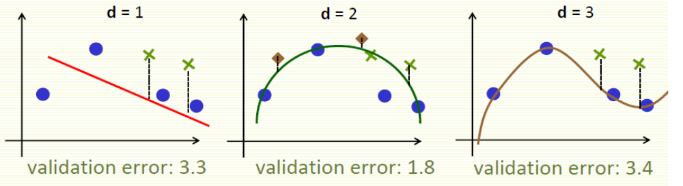
Training/Validation/Test Data
Training Data
Validation Data
d = 2 is chosen
Test Data
1.3 test error computed for d = 2

Slide 47
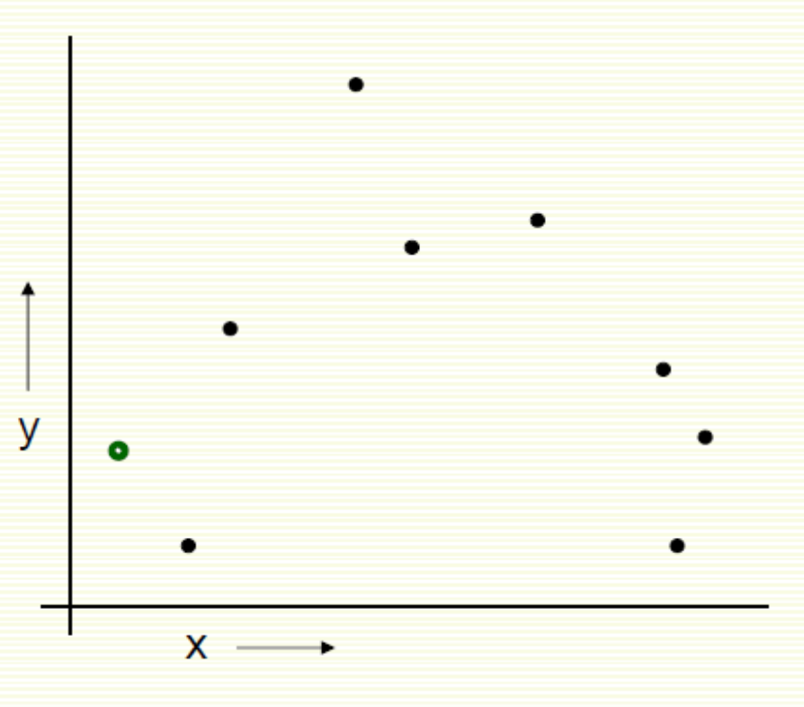
LOOCV (Leave‐one‐out Cross Validation)
For k=1 to R
1. Let (x^{k},y^{k}) be the k example

Slide 48
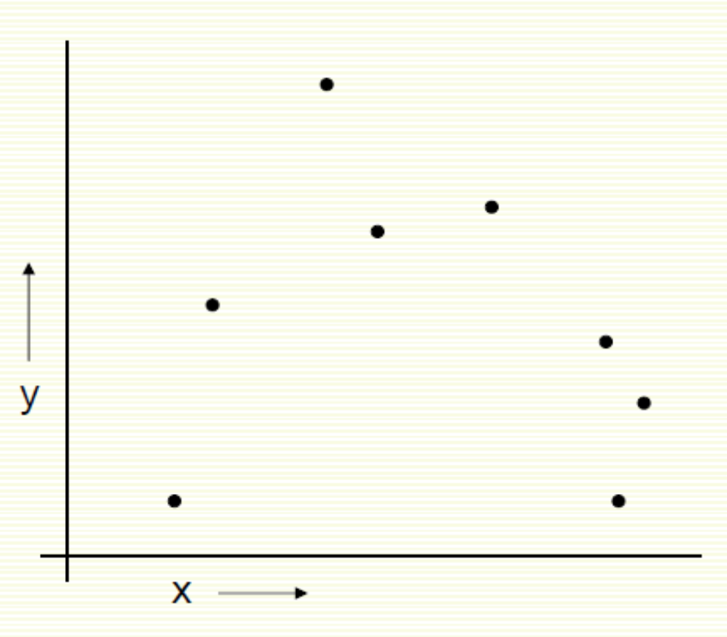
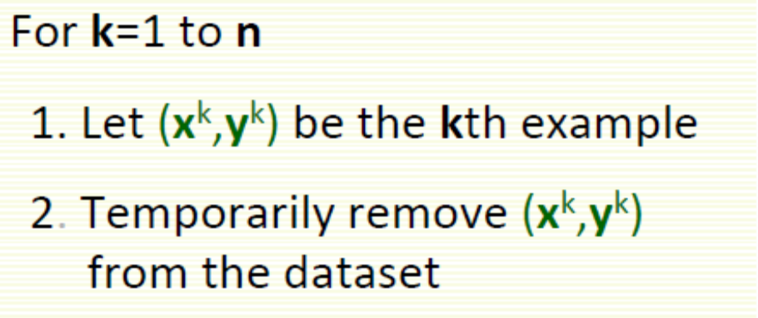
LOOCV (Leave‐one‐out Cross Validation)

Slide 49
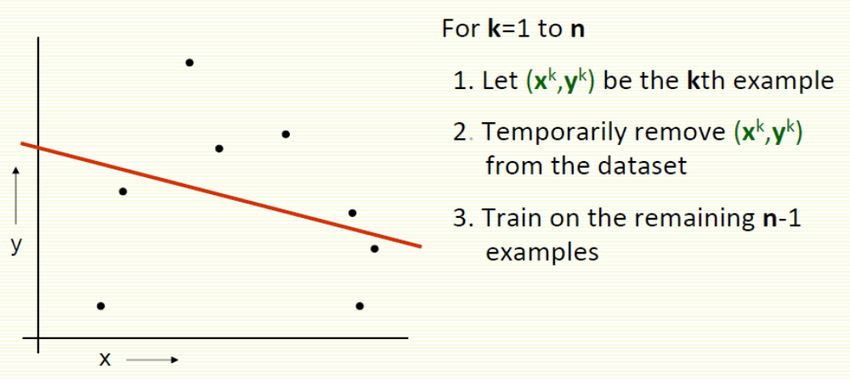
LOOCV (Leave‐one‐out Cross Validation)

Slide 50
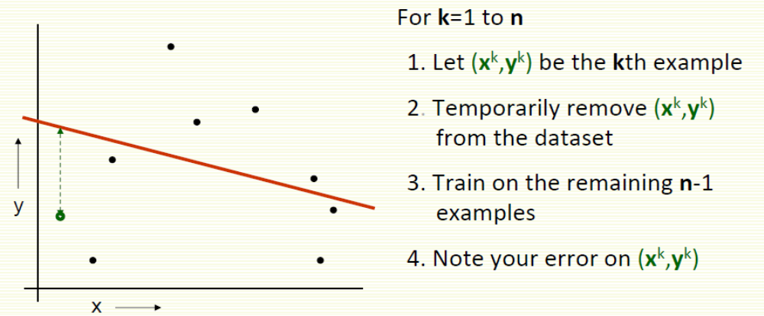
LOOCV (Leave‐one‐out Cross Validation)

Slide 51
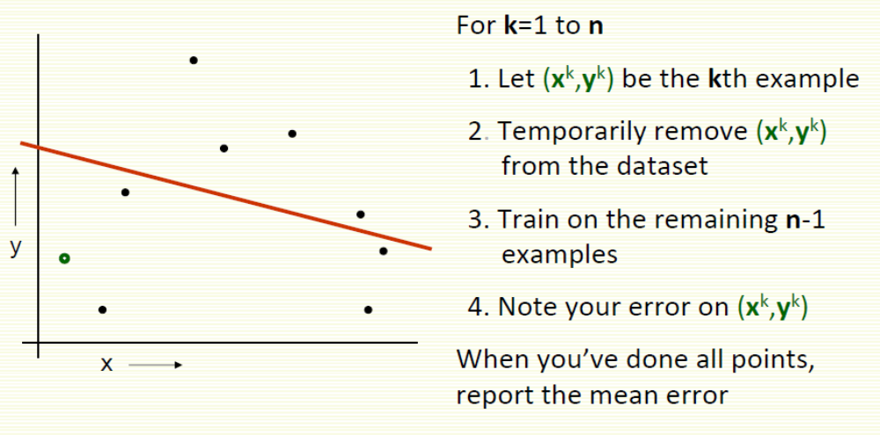
LOOCV (Leave‐one‐out Cross Validation)

Slide 52
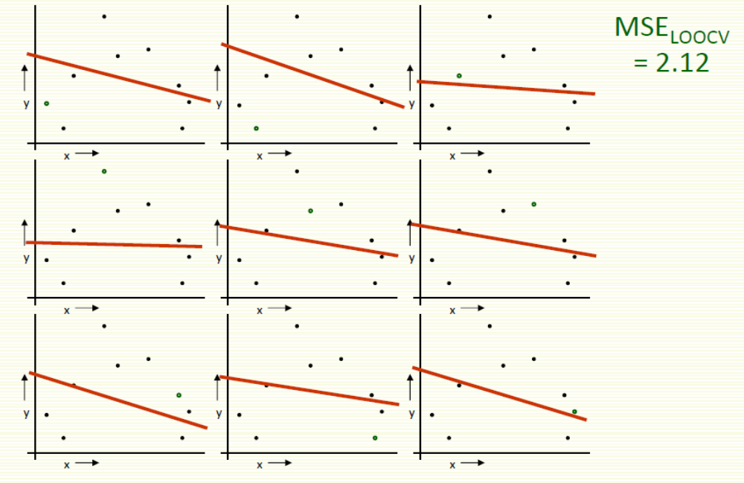
LOOCV (Leave‐one‐out Cross Validation)

Slide 53
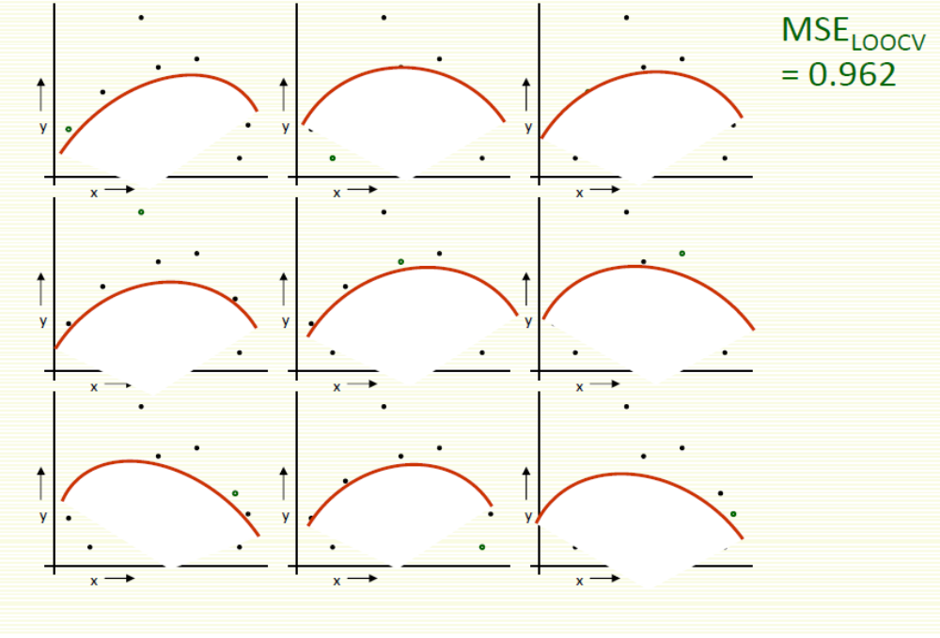
LOOCV for Quadratic Regression

Slide 54
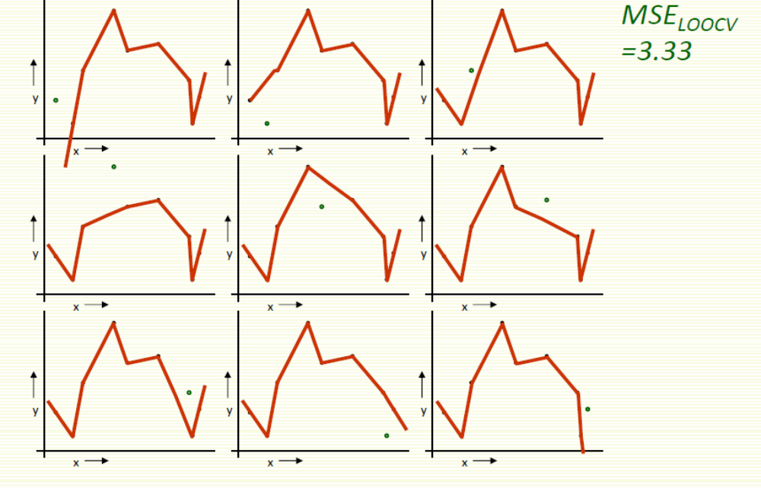
LOOCV for Join The Dots

Slide 55
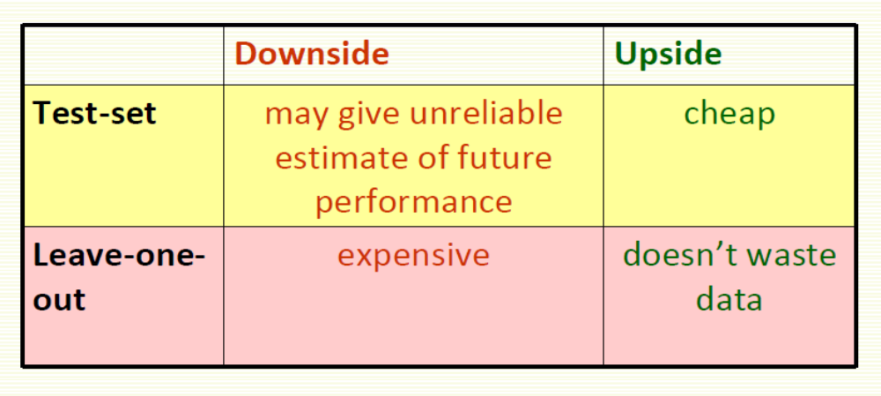
Which kind of Cross Validation?

Slide 56
K-FOLD CROSS VALIDATION
›Since data are often scarce, there might not be enough to set aside for a validation sample
›To work around this issue k-fold CV works as follows:
1. Split the sample into k subsets of equal size
2. For each fold estimate a model on all the subsets except one
3. Use the left out subset to test the model, by calculating a CV metric of choice
4. Average the CV metric across subsets to get the CV error
›This has the advantage of using all data for estimating the model, however finding a good value for k can be tricky

Slide 57
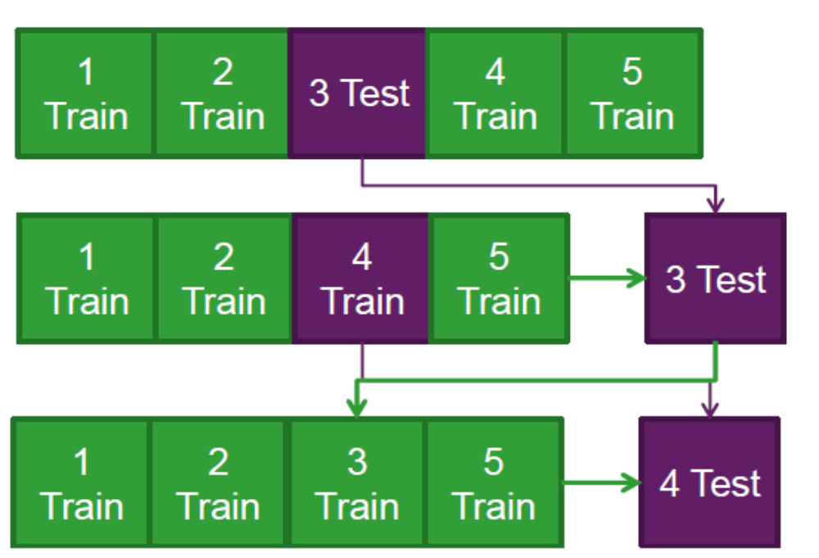
K-fold Cross Validation Example
Split the data into 5 samples
Fit a model to the training samples and use the test sample to calculate a CV metric.
Repeat the process for the next sample, until all samples have been used to either train or test the model

Slide 58
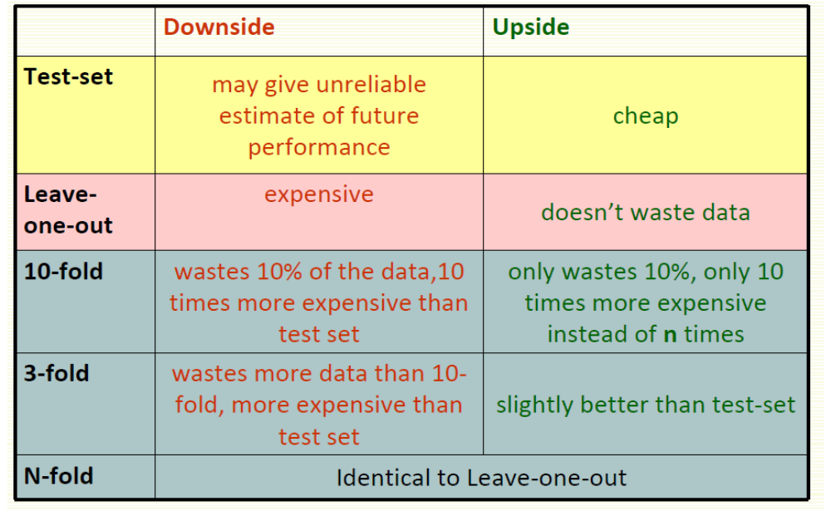
Which kind of Cross Validation?

Slide 59
Improve cross-validation
Even better: repeated cross-validation
Example:
10-fold cross-validation is repeated 10 times and results are averaged (reduce the variance)

Slide 60
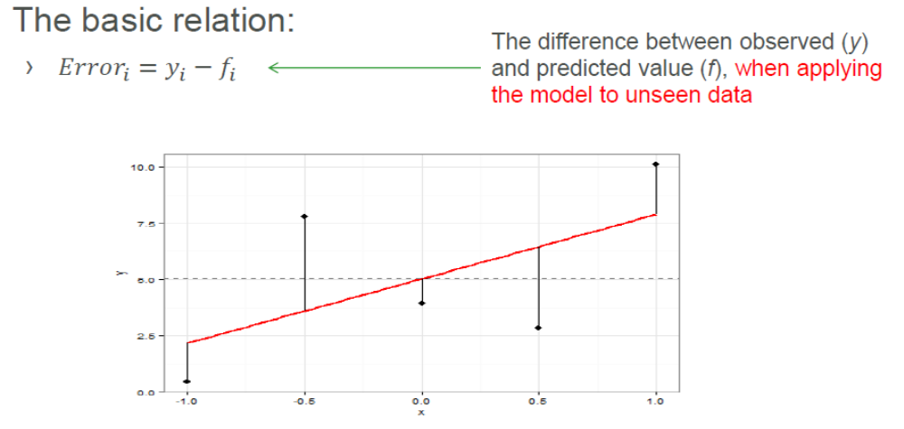
Cross Validation - Metrics
How do we determine if one model is predicting better than another model?

Slide 61
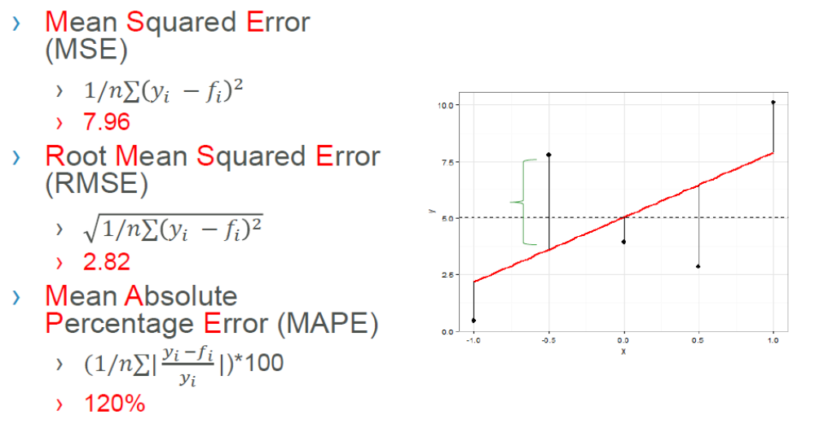
Cross Validation Metrics

Slide 62
Best Practice for Reporting Model Fit
1.Use Cross Validation to find the best model
2.Report the RMSE and MAPE statistics from the cross validation procedure
3.Report the R Squared from the model as you normally would.
The added cross-validation information will allow one to evaluate not how much variance can be explained by the model, but also the predictive accuracy of the model. Good models should have a high predictive AND explanatory power!

Slide 63
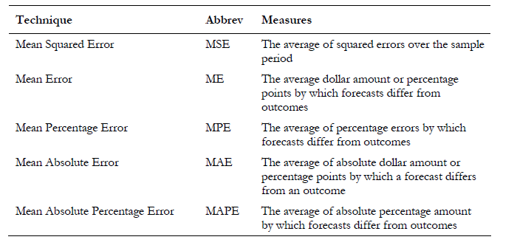
MEASURING THE MODEL ACCURACY

Slide 64
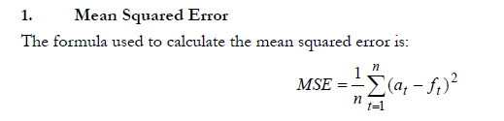
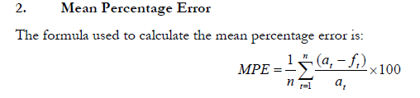
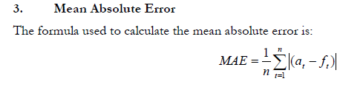
MEASURING THE MODEL ACCURACY

Slide 65
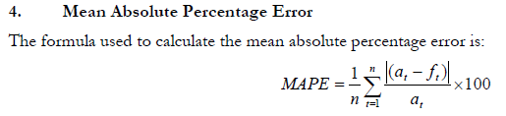
MEASURING THE MODEL ACCURACY

