Slide 1
Imposter
Mohammed Raghib

Slide 2
🤔 Problem Statement
This project focuses on building a machine learning model that detects fake news, addressing the growing problem of misinformation spreading rapidly across digital platforms. False information often appears credible due to subtle wording, emotional tone, or biased phrasing, making it difficult to identify manually. To tackle this, the model analyzes news statements using natural language processing techniques and classifies them into multiple truthfulness categories based on the LIAR dataset.

Slide 3
📂 Dataset
This project uses the LIAR dataset, a publicly available benchmark collected by William Yang Wang (UCSB) for fake news classification. It contains over 12,000 short political statements labeled into six categories — pants-fire, false, barely-true, half-true, mostly-true, and true. Each record includes additional metadata such as the speaker, context, and source, providing valuable linguistic and contextual variety. The data is divided into training, validation, and test sets, ensuring fair evaluation. This dataset was chosen because it reflects the complexity of real-world misinformation and supports the development of multi-class classification models.

Slide 4
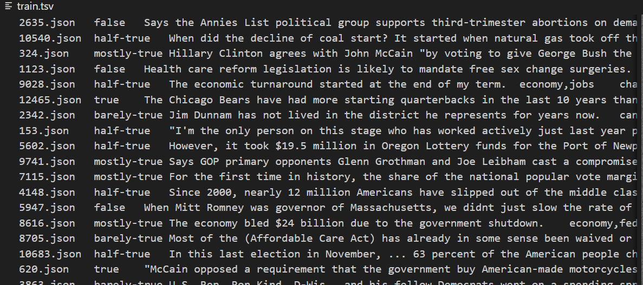

Slide 5
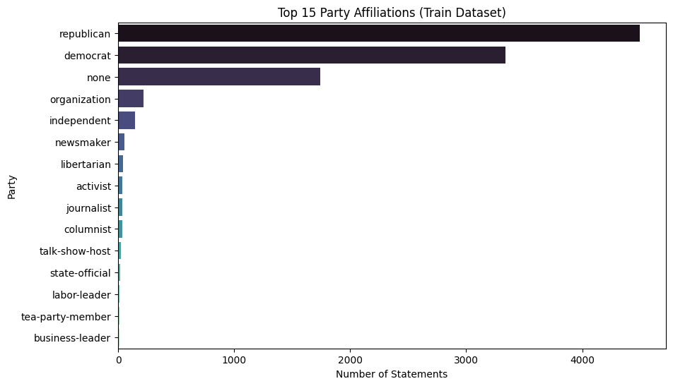
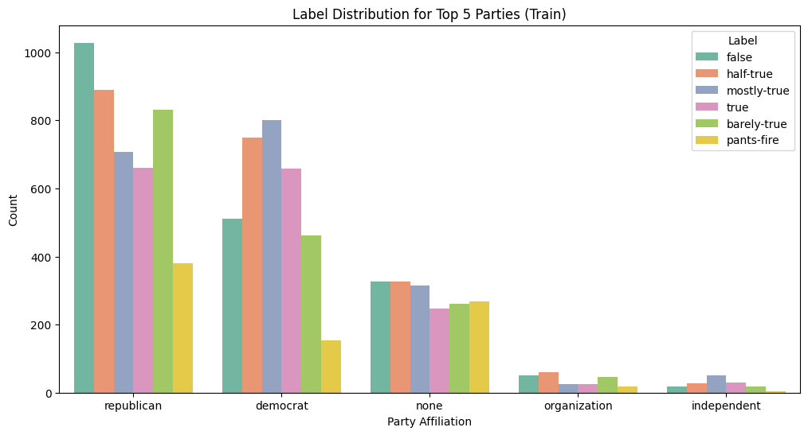
EDA Visualizations
the dataset is highly concentrated among a few prominent individuals (like Barack Obama), which is critical for modeling. The most useful insight is not the speakers themselves, but the need to properly leverage the historical credibility counts associated with them.
Party Affiliation is an extremely powerful, non-textual feature for fake news detection, as the distribution of labels is highly non-uniform across the groups. Claims associated with Republicans are statistically skewed towards the least credible categories, showing the highest counts in 'false', 'barely-true', and 'half-true', while statements linked to Democrats cluster heavily in the more credible 'mostly-true' and 'true' labels.

Slide 6
🛠️ Methodology
Download Flow Chart HTML File
OR
View Flow Chart Online

Slide 7
Preprocessing
Basic
"The PRESIDENT is running!!! For Re-election 2024."
"president running re election"
Stemming
["running", "elections", "happily"]
["run", "elect", "happi"]
TF-IDF
["president", "running", "election"]
[0.32, 0.12, 0.56]

Slide 8
Cont…
One Hot Encoder
Party: ["Democrat", "Republican", "Independent"]
Democrat: [1, 0, 0]
Republican: [0, 1, 0]
Independent: [0, 0, 1]
Lemmatization
["running", "elections", "was", "better"]
["run", "election", "be", "good"]
["The", "president", "is", "running", "for", "re", "election", "in", "the", "upcoming", "general", "election"]
Tokenization
"The president is running for re-election in the upcoming general election!"

Slide 9
Model Explanation
Logistic Regression
Gradient Boosting
Random Forest
A simple linear baseline that works well with TF-IDF features. Used to establish initial performance and interpret feature importance.
Builds models sequentially to correct previous errors. Chosen for its ability to capture complex patterns and improve accuracy.
An ensemble model combining many decision trees to reduce overfitting and improve robustness over simple models.

Slide 10
Cont…
Linear SVM
Naïve Byes
LSTM
GRU
Effective for high-dimensional text data. It finds the optimal boundary between fake and true news with strong generalization.
A deep neural network that captures long-term dependencies in word sequences, useful for understanding contextual meaning.
A fast, probabilistic text classifier that uses word frequency patterns, serving as a reliable lightweight benchmark.
A simpler alternative to LSTM, faster to train while maintaining good performance on sequence-based text tasks.

Slide 11
Experimentation Results:
Model | Preprocessing | Vectorizer | Train Accuracy | Validation Accuracy | F1-Macro
Gradient Boosting | Basic | TF-IDF (Standard) | 0.5527 | 0.3832 | 0.3313
Gradient Boosting | Basic | TF-IDF (Large) | 0.5534 | 0.3816 | 0.3295
Gradient Boosting | Stemming | TF-IDF (Standard) | 0.5342 | 0.3808 | 0.3180
Random Forest | Basic | TF-IDF (Standard) | 0.9997 | 0.3808 | 0.3121
Random Forest | Basic | TF-IDF (Large) | 0.9997 | 0.3746 | 0.2929
Gradient Boosting | Stopwords | TF-IDF (Standard) | 0.5380 | 0.3731 | 0.3121
Random Forest | Stopwords | TF-IDF (Standard) | 0.9997 | 0.3692 | 0.3008
Random Forest | Stemming | TF-IDF (Standard) | 0.9997 | 0.3676 | 0.2978
Logistic Regression | Basic | TF-IDF (Standard) | 0.4456 | 0.3622 | 0.3547
Logistic Regression | Stemming | TF-IDF (Standard) | 0.4421 | 0.3606 | 0.3511
Logistic Regression | Basic | TF-IDF (Large) | 0.4495 | 0.3606 | 0.3524
Logistic Regression | Stopwords | TF-IDF (Standard) | 0.4449 | 0.3575 | 0.3488
More Experimentation Results:
Model | Accuracy | Precision | Recall | F1-Score
Logistic Regression | 0.2478 | 0.2535 | 0.2478 | 0.2389
Naive Bayes | 0.2396 | 0.2531 | 0.2396 | 0.2184
Linear SVM | 0.2378 | 0.2365 | 0.2378 | 0.2367
LSTM | 0.1957 | 0.0385 | 0.1957 | 0.0643
GRU | 0.2049 | 0.0420 | 0.2049 | 0.0697

Slide 12
📊 Results & Discussion
The Gradient Boosting model achieved the most reliable results among all tested approaches, reaching an accuracy of around 30–40% on the test set. While this indicates that the model is underfitting and not yet capturing deeper linguistic patterns.
Parameter | Details
Model | Gradient Boosting
Preprocessing | Basic
Vectorizer | TF-IDF (Standard)
Training Accuracy | 0.3572
Validation Accuracy | 0.3450
F1-Macro Score | 0.2248

Slide 13
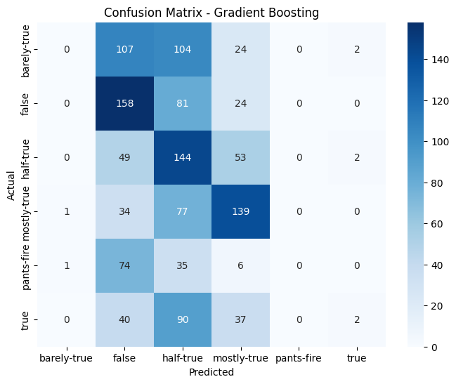
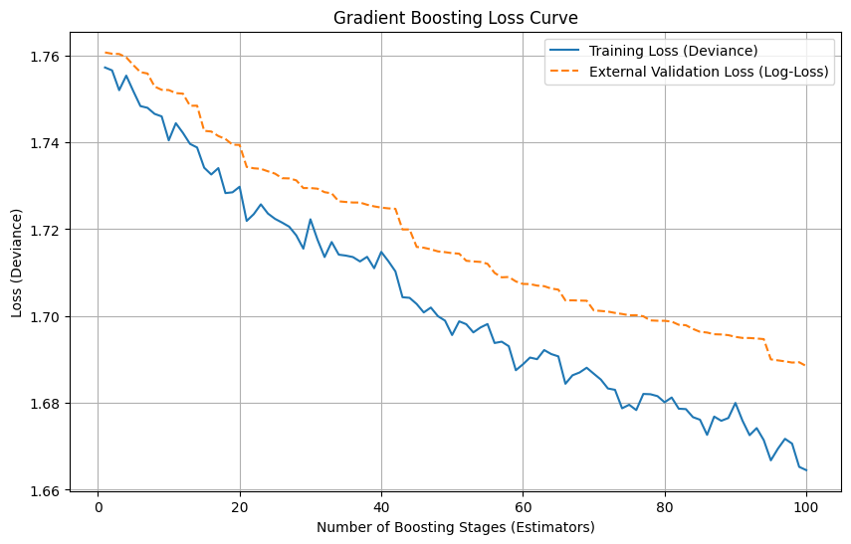
Error Analysis
model's low performance (around 35% accuracy) is due to severe underfitting (high bias), which stems from a fundamental mismatch between the model and the feature engineering. Specifically, the use of One-Hot Encoding (OHE) on high-cardinality categorical features (like Speaker and Context) and the TF-IDF text features creates an extremely high-dimensional and sparse feature space. Gradient Boosting Classifiers struggle significantly to find meaningful patterns in this type of data, causing the model to fail to learn effectively and achieve low accuracy on both training and validation sets.

Slide 14
Deployed URL
Click to open

Slide 15
THANK YOU

