Slide 1
Imposter
Mohammed Raghib

Slide 2
🤔 Problem Statement
This project focuses on building a machine learning model that detects fake news, addressing the growing problem of misinformation spreading rapidly across digital platforms. False information often appears credible due to subtle wording, emotional tone, or biased phrasing, making it difficult to identify manually. To tackle this, the model analyzes news statements using natural language processing techniques and classifies them into multiple truthfulness categories based on the LIAR dataset.

Slide 3
📂 Dataset
This project uses the LIAR dataset, a publicly available benchmark collected by William Yang Wang (UCSB) for fake news classification. It contains over 12,000 short political statements labeled into six categories — pants-fire, false, barely-true, half-true, mostly-true, and true. Each record includes additional metadata such as the speaker, context, and source, providing valuable linguistic and contextual variety. The data is divided into training, validation, and test sets, ensuring fair evaluation. This dataset was chosen because it reflects the complexity of real-world misinformation and supports the development of multi-class classification models.

Slide 4
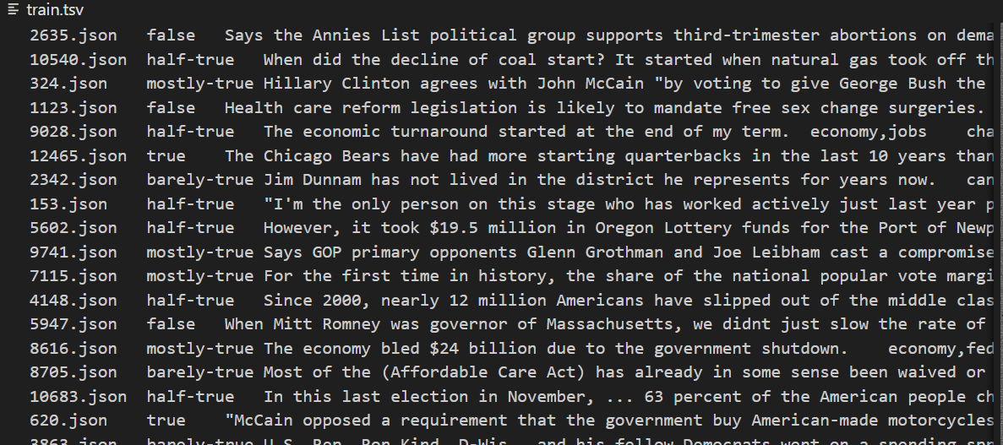

Slide 5
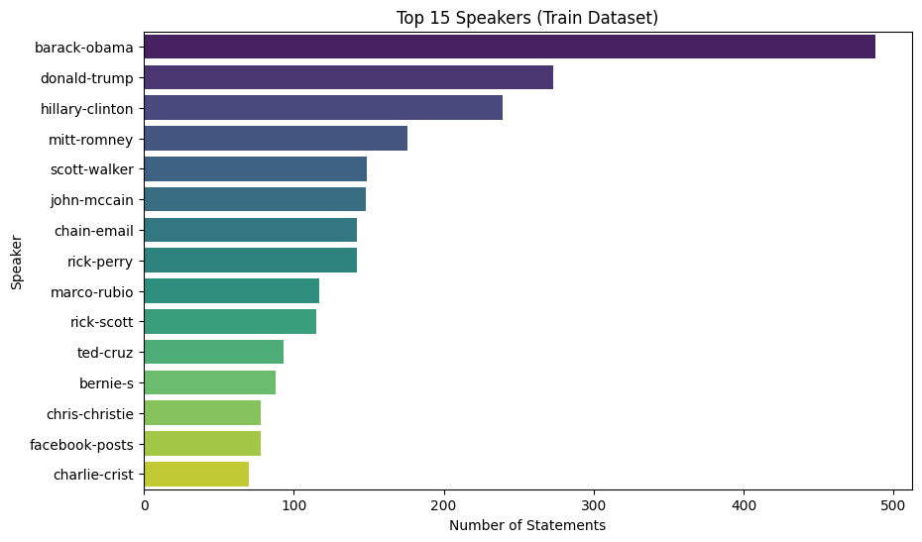
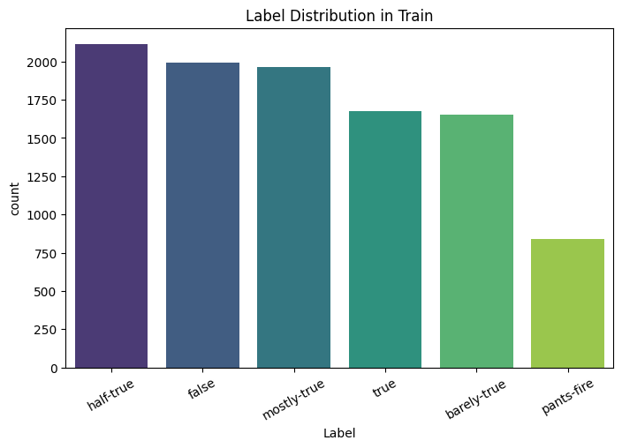
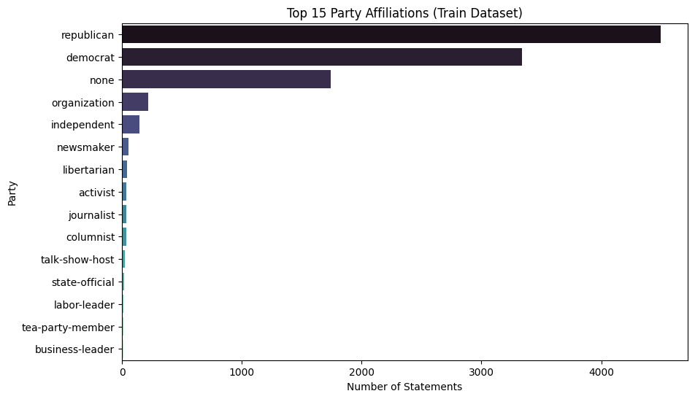
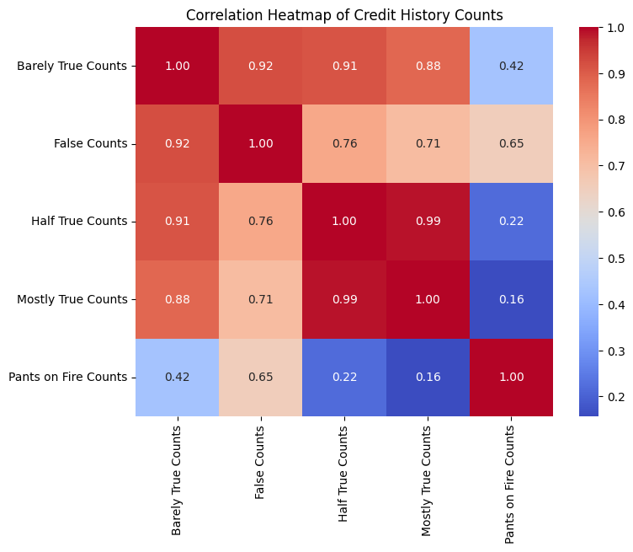
EDA Visualizations

Slide 6
🛠️ Methodology
Download Flow Chart HTML File
OR
View Flow Chart Online

Slide 7
Experimentation Results:
Model | Preprocessing | Vectorizer | Train Accuracy | Validation Accuracy | F1-Macro
Gradient Boosting | Basic | TF-IDF (Standard) | 0.5527 | 0.3832 | 0.3313
Gradient Boosting | Basic | TF-IDF (Large) | 0.5534 | 0.3816 | 0.3295
Gradient Boosting | Stemming | TF-IDF (Standard) | 0.5342 | 0.3808 | 0.3180
Random Forest | Basic | TF-IDF (Standard) | 0.9997 | 0.3808 | 0.3121
Random Forest | Basic | TF-IDF (Large) | 0.9997 | 0.3746 | 0.2929
Gradient Boosting | Stopwords | TF-IDF (Standard) | 0.5380 | 0.3731 | 0.3121
Random Forest | Stopwords | TF-IDF (Standard) | 0.9997 | 0.3692 | 0.3008
Random Forest | Stemming | TF-IDF (Standard) | 0.9997 | 0.3676 | 0.2978
Logistic Regression | Basic | TF-IDF (Standard) | 0.4456 | 0.3622 | 0.3547
Logistic Regression | Stemming | TF-IDF (Standard) | 0.4421 | 0.3606 | 0.3511
Logistic Regression | Basic | TF-IDF (Large) | 0.4495 | 0.3606 | 0.3524
Logistic Regression | Stopwords | TF-IDF (Standard) | 0.4449 | 0.3575 | 0.3488
More Experimentation Results:
Model | Accuracy | Precision | Recall | F1-Score
Logistic Regression | 0.2478 | 0.2535 | 0.2478 | 0.2389
Naive Bayes | 0.2396 | 0.2531 | 0.2396 | 0.2184
Linear SVM | 0.2378 | 0.2365 | 0.2378 | 0.2367
LSTM | 0.1957 | 0.0385 | 0.1957 | 0.0643
GRU | 0.2049 | 0.0420 | 0.2049 | 0.0697

Slide 8
📊 Results & Discussion
The Gradient Boosting model achieved the most reliable results among all tested approaches, reaching an accuracy of around 30–40% on the test set. While this indicates that the model is underfitting and not yet capturing deeper linguistic patterns.
Parameter | Details
Model | Gradient Boosting
Preprocessing | Basic
Vectorizer | TF-IDF (Standard)
Training Accuracy | 0.3572
Validation Accuracy | 0.3450
F1-Macro Score | 0.2248

Slide 9
Deployed URL
Click to open

Slide 10
THANK YOU

