Slide 1
A COMPARISON OF DEEP LEARNING
METHODS FOR OBJECT IDENTIFICATION IN AUTONOMOUS OUTDOOR CLEANING ROBOT
Guided by, Presented by,
Dr. Sreeni K G Mohammed Raheem P
Dept. Of Electronics and Comm. Robotics and Automation
CET, Trivandrum Reg No: TVE16ECRA15

Slide 2
CONTENTS
Introduction
Literature Review
Objectives
Proposed Methods
Experimental Results
Contribution of Thesis
Publication based on Thesis
Problems faced during works
Conclusions
References

Slide 3
INTRODUCTION
Visual system is introduced for proposed cleaning vehicle to optimize the power consumption during cleaning tasks.
Object identification and classification can be more accurately done with the help of deep learning frameworks.
Keras-Tensorflow based approach and YOLO mark object detection methods are compared in this work.

Slide 4
LITERATURE REVIEW
Paper | Methodology | Advantages | Disadvantages
"Convolutional neural networks for image classification." (International Conference on Advanced Systems and Electric Technologies (IC_ASET). IEEE Jmour, Nadia, Sehla Zayen, and Afef Abdelkrim. (2018.) | Fine tuning technique. Transfer learning. Imagenet. | Very effective. Accurate | Long time for training. Need more training images.
"Implementation of deep-learning based image classification on single board computer." (Electronics and Smart Devices (ISESD) International Symposium on. IEEE) Shiddieqy, Hasbi Ash, Farkhad Ihsan Hariadi, and Trio Adiono( 2017) | Used tflearn 5 hidden layers used. | Model deploy and running in three platform CPU, GPU and Single Board Computer. Improve accuracy with increase size of network. | Not used deep network for real time application using simple computers.

Slide 5
LITERATURE REVIEW (C0NTD...)
Paper | Methodology | Advantages | Disadvantages
“You only look once: Unified, real-time object detection.” (Proceedings of the IEEE conference on computer vision and pattern recognition.) 2016. | YOLO marking methods. | Easy to construct Fast 45 FPS | Struggles with small objects. Each grid cells only predicts two objects with one class.
“YOLO9000: better, faster, stronger” Redmon, Joseph, and Ali Farhadi. (2017). | YOLO marking methods. | Faster Better | Only for high classification over 9000 classes. Not use for few classes.

Slide 6
OBJECTIVES
Classification of waste materials and obstacles from real time video.
Marking and locating the objects.
Comparative study between Keras-Tensorflow method and Yolo mark object detection method.

Slide 7
PROPOSED METHODS
Using the Keras-Tensorflow based classification
Keras is used to model the architecture. This can be model in the top of Tensorflow backend.
Convolutional neural network is used in this work.
Image dataset of waste particles and ground alone are created for the training process.

Slide 8
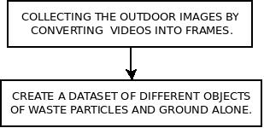
PROPOSED METHODS (CONTD...)
Input images are collected from different environments such as college and hostel campuses, roads etc.
Plastic covers, leafs, papers etc are taught as waste particles using the algorithm.

Slide 9
PROPOSED METHODS (CONTD...)
5 hidden layers are used in the proposed method to classify objects and grounds.
Format of layers:
CONV – POOL – CONV – POOL – CONV – POOL – CONV – POOL – CONV – POOL – FC -FC
CONV = Convolution + ReLu
CONV + POOL = HIDDEN LAYER

Slide 10
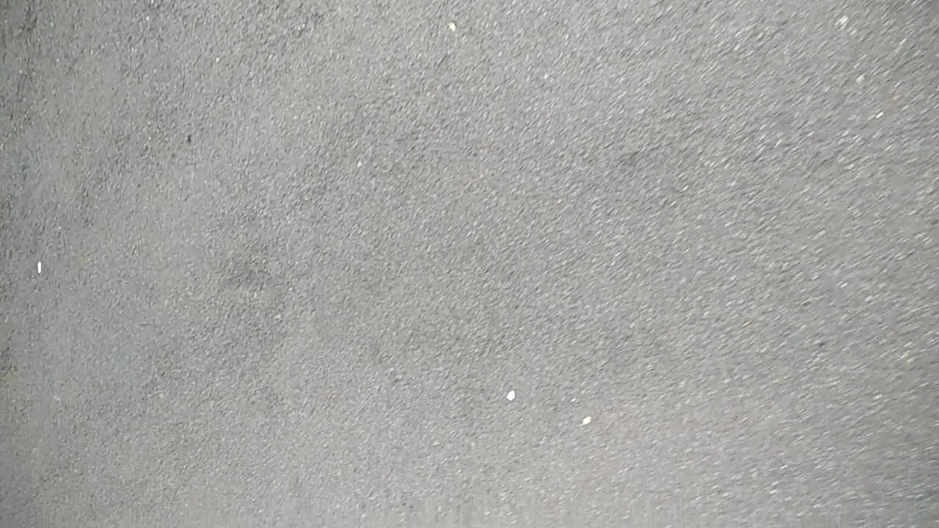
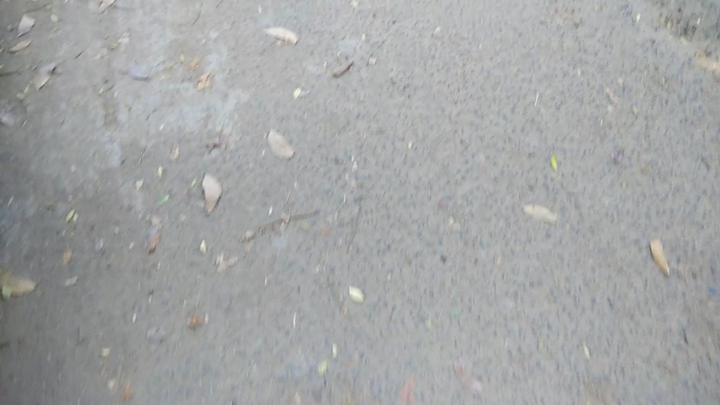
PROPOSED METHODS (CONTD...)
Image showing the class of ground alone.(15000 similar images is used).
Image showing the class of waste particle. (15000 similar images is used).

Slide 11
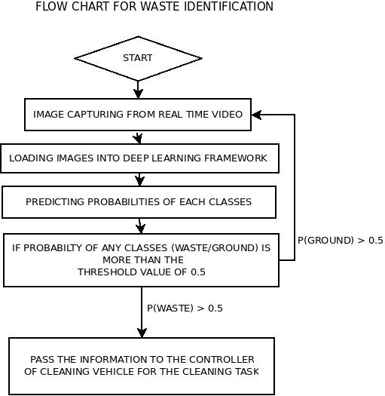
PROPOSED METHODS (CONTD...)

Slide 12
PROPOSED METHODS (CONTD...)
Advantages of keras model :
Allows for easy and fast prototyping (through user friendliness, modularity, and extensibility).
Supports both convolutional networks and recurrent networks, as well as combinations of the two.
Runs seamlessly on CPU and GPU

Slide 13
PROPOSED METHODS (CONTD...)
(2) Using YOLO object detection method
YOLO Object Mark :
Training is carried out by marking objects and obstacles on every images. After,
A text file that contains object locations on the every images is created (Annotation).
Marked objects and text files are moved to Darknet for training purposes.

Slide 14
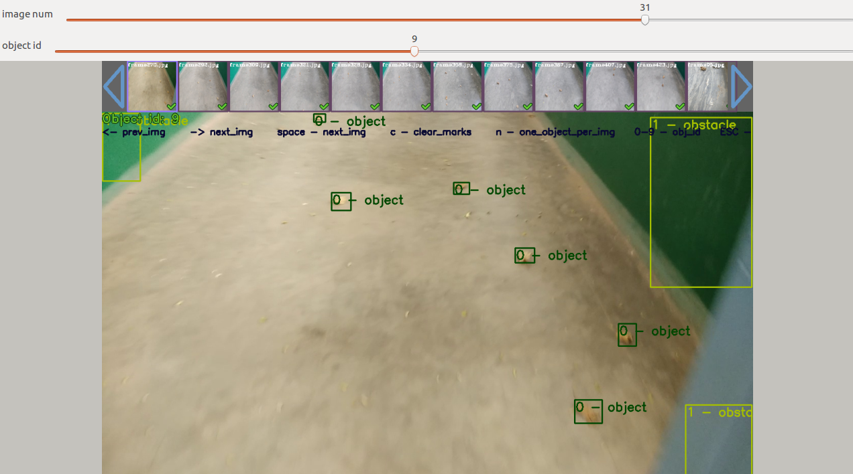
PROPOSED METHODS (CONTD...)
YOLO Marking Method

Slide 15
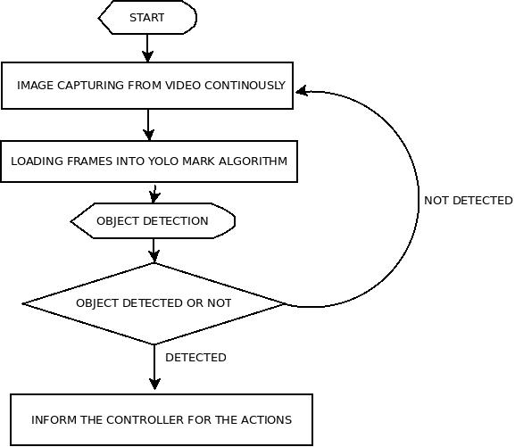
PROPOSED METHODS (CONTD...)
Algorithm to detect objects from images

Slide 16
PROPOSED METHODS (CONTD...)
Training Using Darknet
Used to understand the objects and obstacles from images using Convolutional Neural Networks.
31 hidden layer is used in this work ( 24 CONV + 7 POOL).
The annotation file and images from yolo mark detection for the training process are obtained.

Slide 17
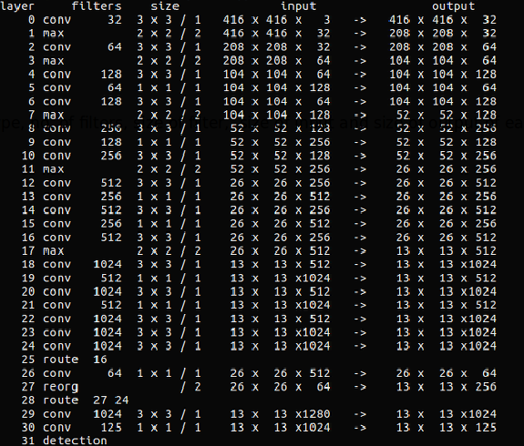
PROPOSED METHODS (CONTD...)
Training process

Slide 18
PROPOSED METHODS (CONTD...)
Epoch vs Batch size vs Iterations
Epoch : One Epoch is said to occur when an entire dataset is passed forward and backward through the neural network only once.
Batch size : Total number of training examples present in a single batch.
Iterations : Iterations is the number of batches needed to complete one epoch.

Slide 19
PROPOSED METHODS (CONTD...)
COMPARISON BETWEEN TWO DIFFERENT DEEP LEARNING FRAMEWORKS
KERAS-TENSORFLOW | YOLO MARK DETECTION
Keras is used for the modelling the network and the tensorflow used for the executing the neural network. Easy to construct the model Need more input images to create dataset Getting outputs in the form of probabilities | Graphical based learning with deep neural network. (Bounding box is used) Difficult to mark the objects on the images. Need less number of images to learn the inputs as compared to the keras based model Output is getting bounding box of every classes.

Slide 20
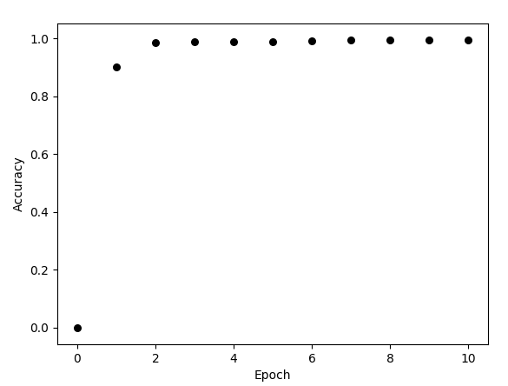
EXPERIMENTAL RESULTS
(1)Keras model (during training process)
a) Graph between accuracy and epoch

Slide 21
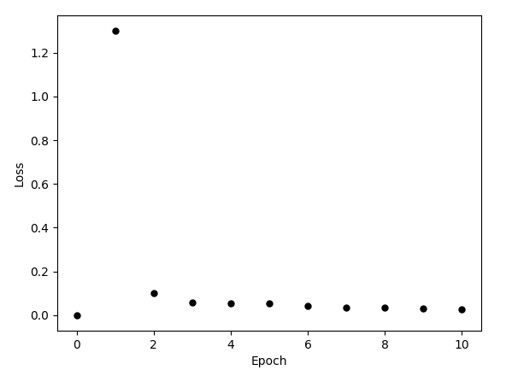
EXPERIMENTAL RESULTS (CONTD...)
b) Graph between Loss vs epoch

Slide 22
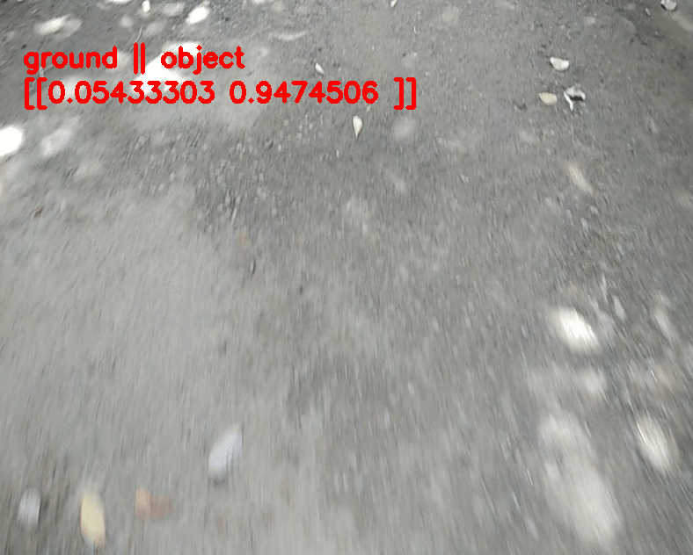
EXPERIMENTAL RESULTS (CONTD...)
Predicted image for
an input frame.
P(object) > 0.5
P(object)>P(waste)

Slide 23
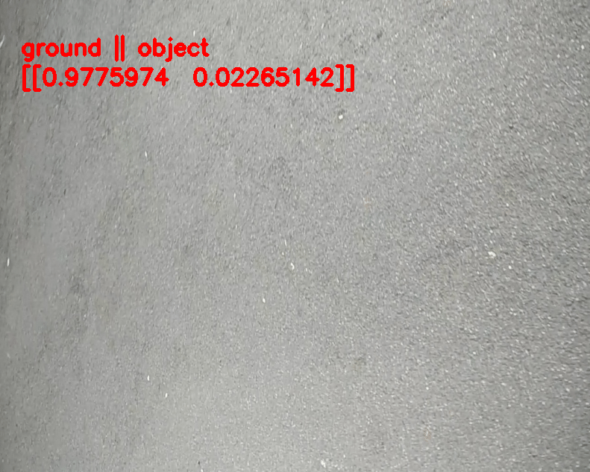
EXPERIMENTAL RESULTS (CONTD...)
For a ground alone
input image
P(ground) > 0.5
P(ground)>P(object)

Slide 24
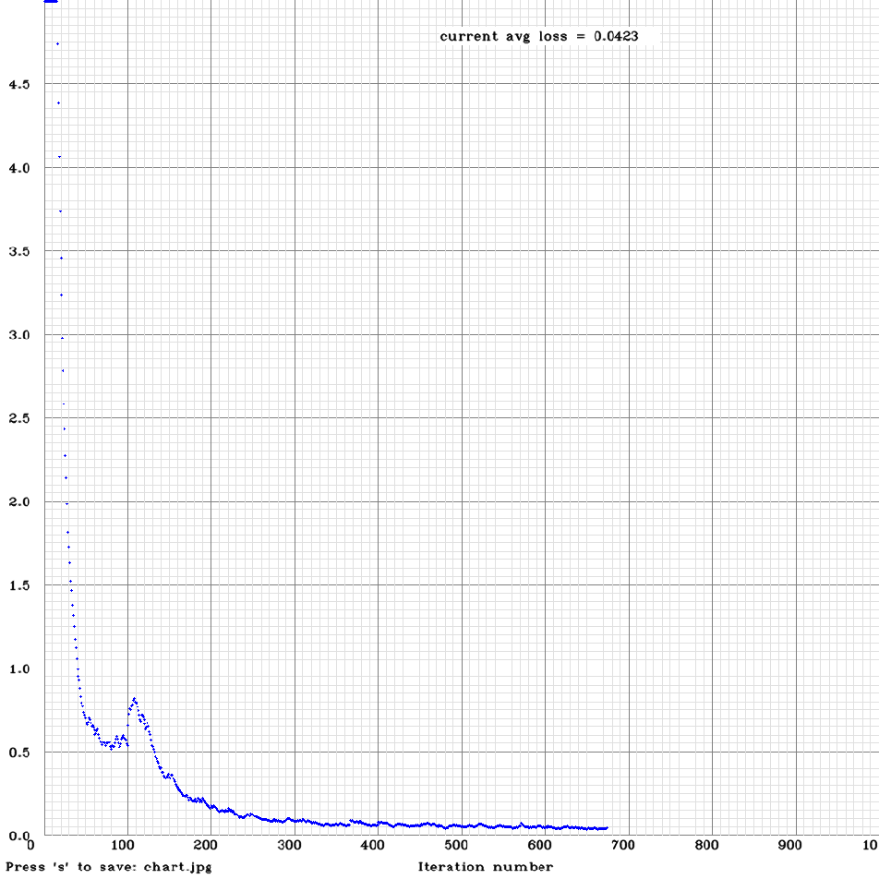
EXPERIMENTAL RESULTS (CONTD...)
(2) For the YOLO mark detection
Losses during Training
loss
Graph shows that loss is gradually decreasing with increasing number of Iterations.
Number of Iterations =1000
Number of images used for training = 1000
Average loss = 0.0423
Iterations
Graph between Number of Iterations and Losses.

Slide 25
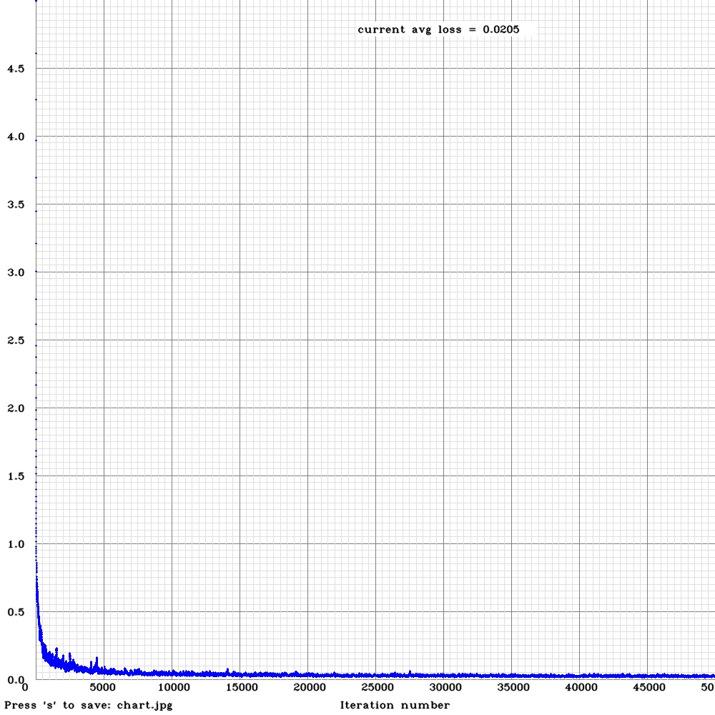
EXPERIMENTAL RESULTS (CONTD...)
Losses for different Iterations
Number of Iterations =50000
Number of images used for training = 1000
Average loss = 0.0205
Loss
Iterations
Graph between Number of Iterations and Losses.

Slide 26
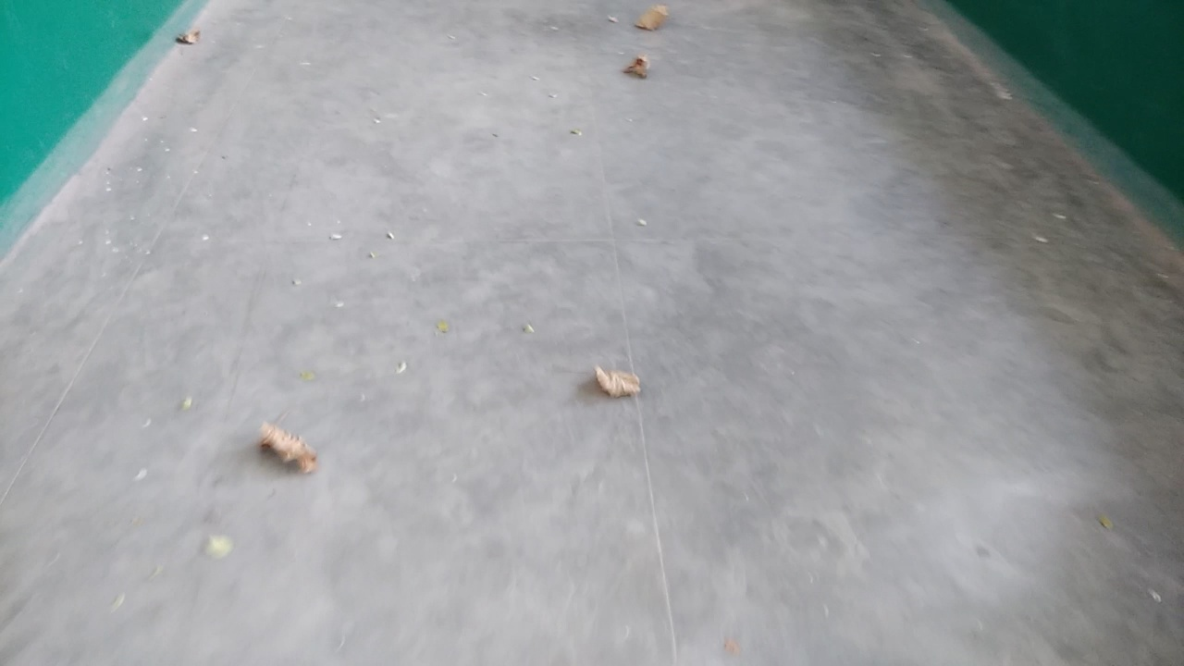
EXPERIMENTAL RESULTS (CONTD...)
Test data with same environment condition of train data
Test Input Image

Slide 27
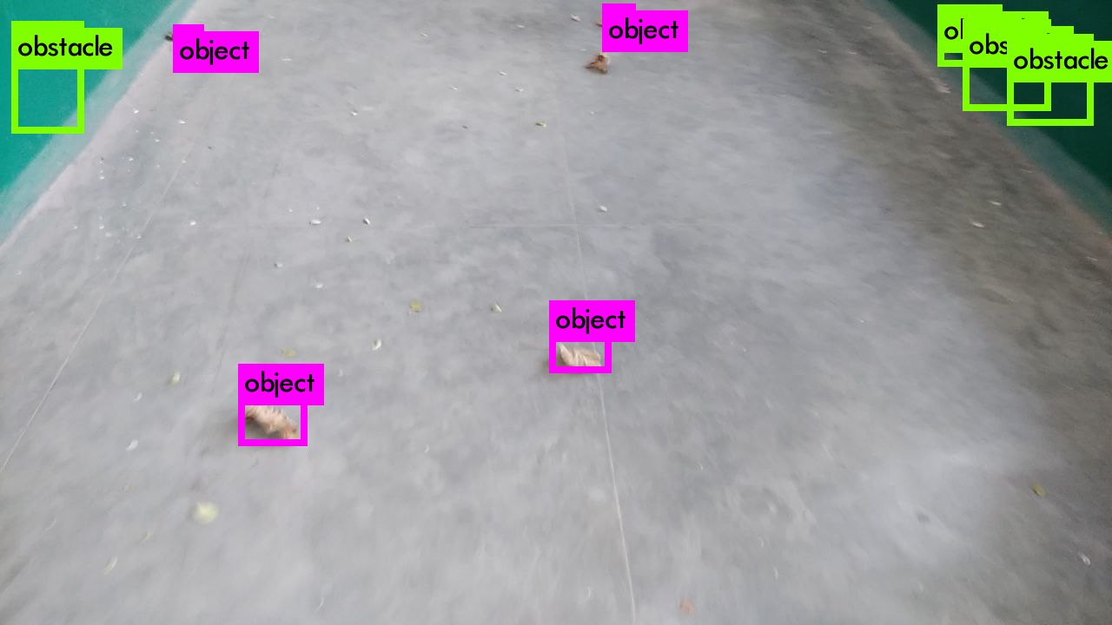
EXPERIMENTAL RESULTS (CONTD...)
Output Image

Slide 28
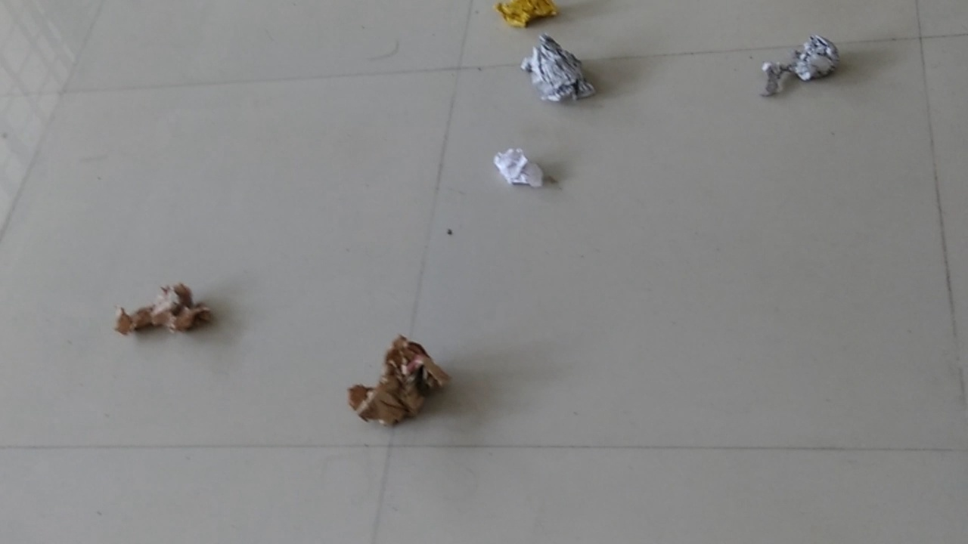
EXPERIMENTAL RESULTS (CONTD...)
Test data with different environment condition of train data
Fig 3 : Test Input Image

Slide 29
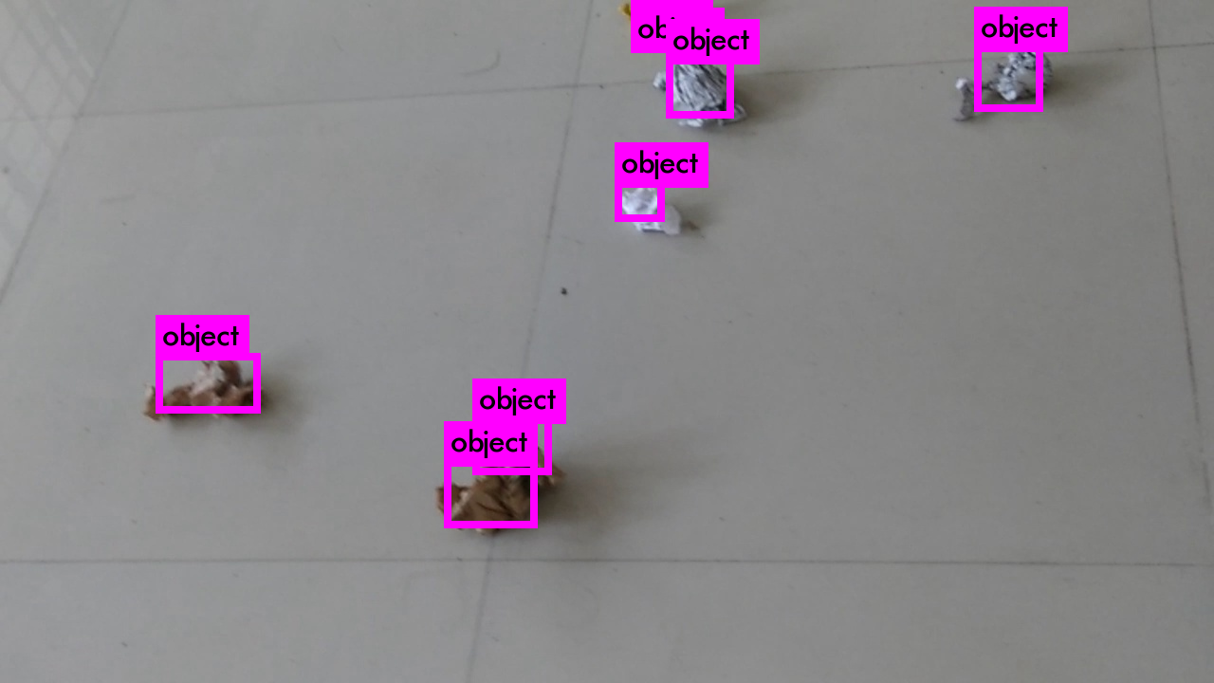
EXPERIMENTAL RESULTS (CONTD...)
Fig 4 : Output Image

Slide 30
EXPERIMENTAL RESULTS (CONTD...)
Detection Accuracy Comparison
Input Data Environment | Total Detected | Wrong Detection | Total Input Images used | Accuracy
Same Environment (seen) | 19 | 1 | 20 | 95 %
Different Environment (unseen) | 17 | 3 | 20 | 85 %
Table 1 : Inputs and Accuracies

Slide 31
EXPERIMENTAL RESULTS (CONTD...)
OUTPUT COMPARISON BETWEEN DIFFERENT DEEP LEARNING FRAMEWORKS
KERAS-TENSORFLOW | YOLO MARK DETECTION
Less accuracy as compared with the YOLO mark detection method Need more images for training to get more accuracy. No any idea about location of objects without using depth sensors Probability based output prediction | High accuracy Less number of input images needed as compared with the keras model to get good accuracy It can locate the objects and getting depth of objects Bounding box based output

Slide 32
CONTRIBUTION OF THESIS
Real time object detection within small duration.
Adding different environments into inputs to get more accurate results.
Avoid the obstacles easily.
Can detect even detect small objects.
Comparison of different Deep learning frameworks used for classifying objects.

Slide 33
PUBLICATION BASED ON THESIS
Submitted to 11th Indian conference on Computer Vision, Graphics and Image Processing (ICVGIP) IIIT Hyderabad.

Slide 34
PROBLEMS FACED DURING THE WORK
Training of the dataset take more time.
YOLO based marking of input images is very difficult.
Collection of images from different environment was a difficult task.
In certain conditions, stones were also detected as waste particles (Which can be avoided by putting more similar input images to learning the dataset).

Slide 35
CONCLUSIONS
All objects were identified for unseen and seen environments.
Compared the different models.
Obtained good accuracy for the real time detection problem.
Detection within less time.

Slide 36
REFERENCES
Jmour, Nadia, Sehla Zayen, and Afef Abdelkrim. "Convolutional neural networks for image classification." 2018 International Conference on Advanced Systems and Electric Technologies (IC_ASET). IEEE, 2018.
Shiddieqy, Hasbi Ash, Farkhad Ihsan Hariadi, and Trio Adiono. "Implementation of deep-learning based image classification on single board computer." Electronics and Smart Devices (ISESD), 2017 International Symposium on. IEEE, 2017.
Redmon, Joseph, et al. "You only look once: Unified, real-time object detection." Proceedings of the IEEE conference on computer vision and pattern recognition. 2016.
Redmon, Joseph, and Ali Farhadi. "YOLO9000: better, faster, stronger." arXiv preprint (2017).

Slide 37
Thank You

