Slide 1


Information Retrieval from 10-K Filings
Mohammed Momin

Slide 2
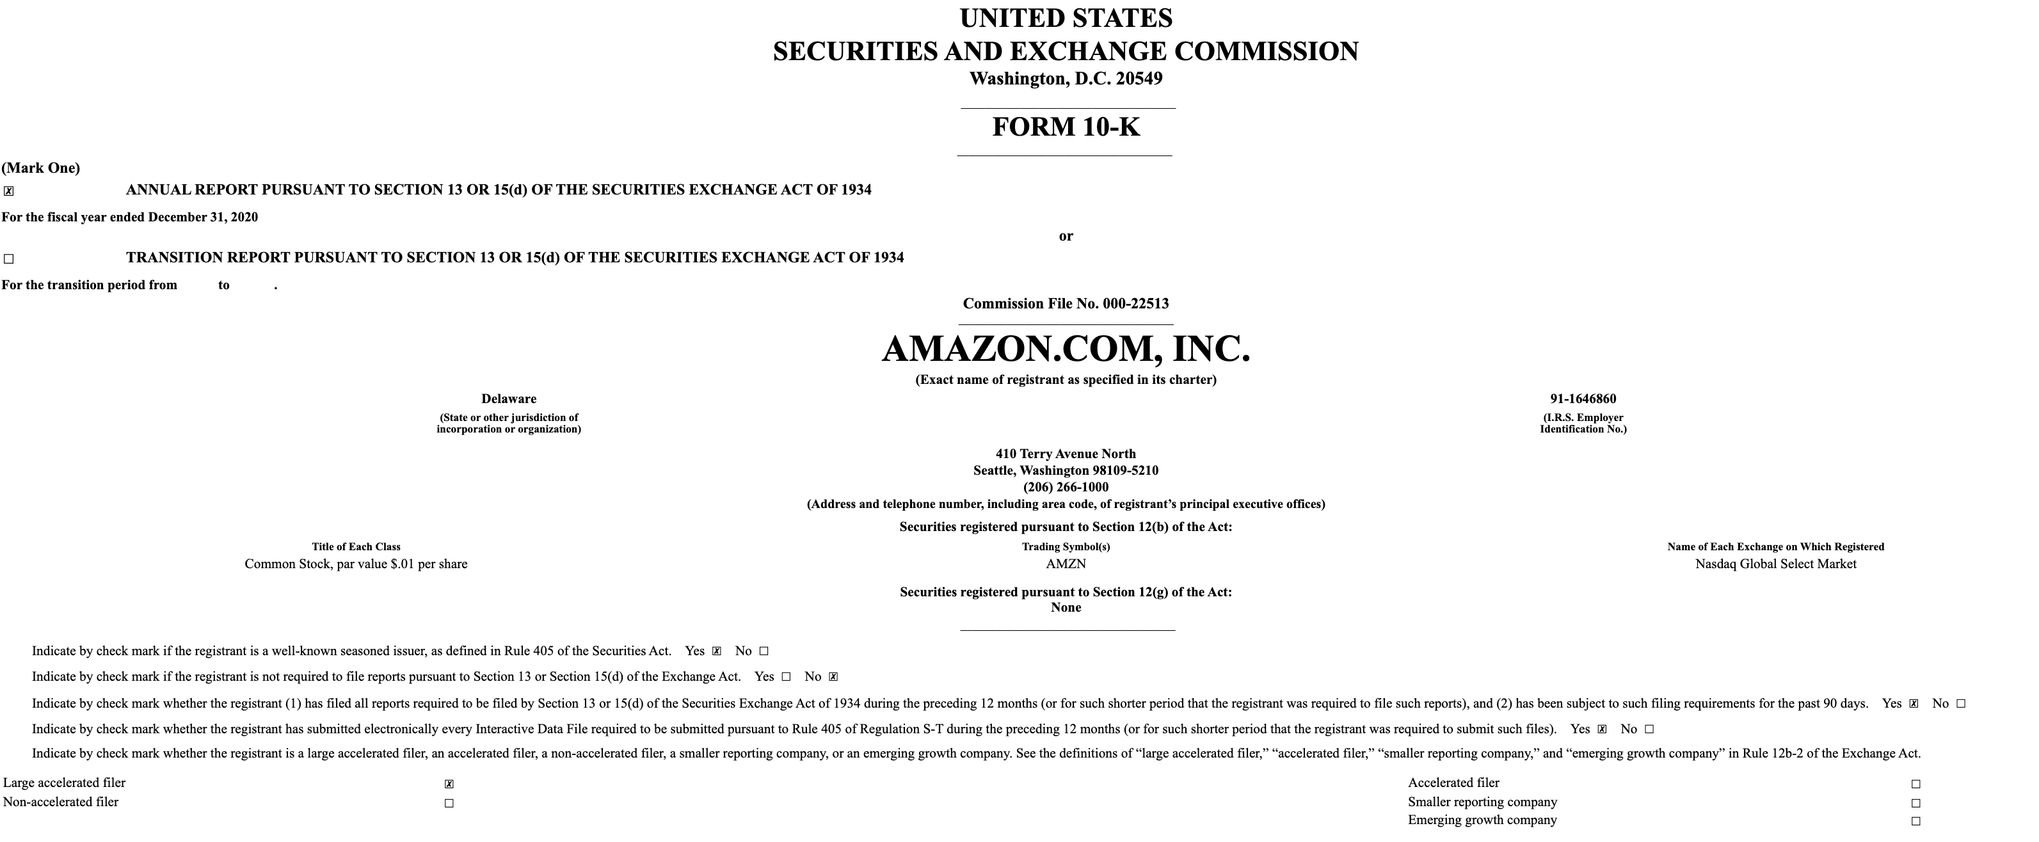
10-K Documents
1 - Business
1A - Risk Factors
1B - Unresolved Staff Comments
2 - Properties
3 - Legal Proceedings
4 - Mine Safety Disclosures
5 - Market for Registrant’s Common Equity, Related Stockholder Matters and Issuer Purchases of Equity Securities
6 - Selected Financial Data (prior to February 2021)
7 - Management’s Discussion and Analysis of Financial Condition and Results of Operations
7A - Quantitative and Qualitative Disclosures about Market Risk
8 - Financial Statements and Supplementary Data
9 - Changes in and Disagreements with Accountants on Accounting and Financial Disclosure
9A - Controls and Procedures
9B - Other Information
10 - Directors, Executive Officers and Corporate Governance
11 - Executive Compensation
12 - Security Ownership of Certain Beneficial Owners and Management and Related Stockholder Matters
13 - Certain Relationships and Related Transactions, and Director Independence
14 - Principal Accountant Fees and Services

Slide 3

Purpose
To develop an algorithm that prompts buy and sell signals of a stock based on sentiment analysis from 10-K filings of the company being traded.

Slide 4
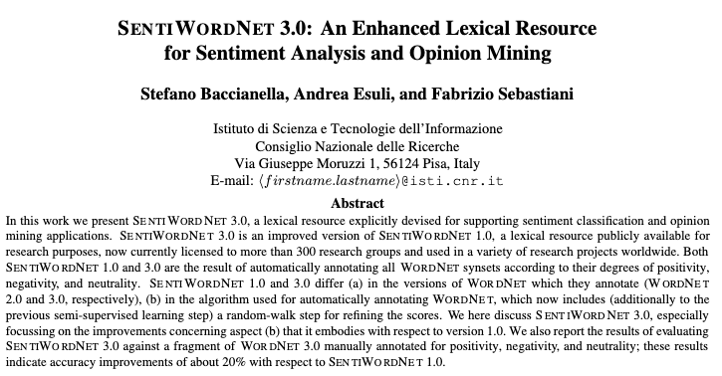
Prior Work
Categories
Positive
Negative
Objective

Slide 5
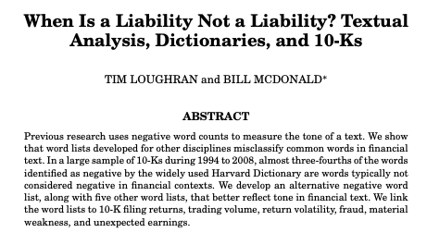
Prior Work
Categories
Negative
Positive
Uncertainty
Litigious
Strong_Modal
Weak_Modal
Constraining
Complexity

Slide 6
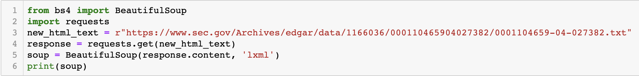
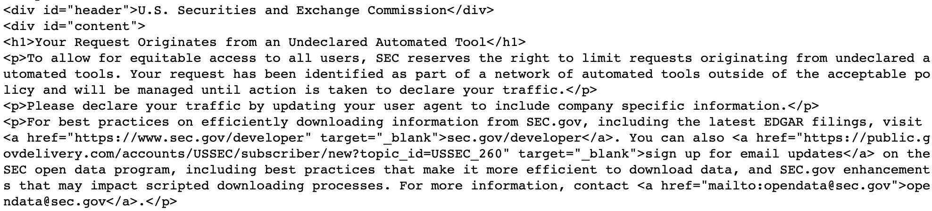
Pain Points

Slide 7
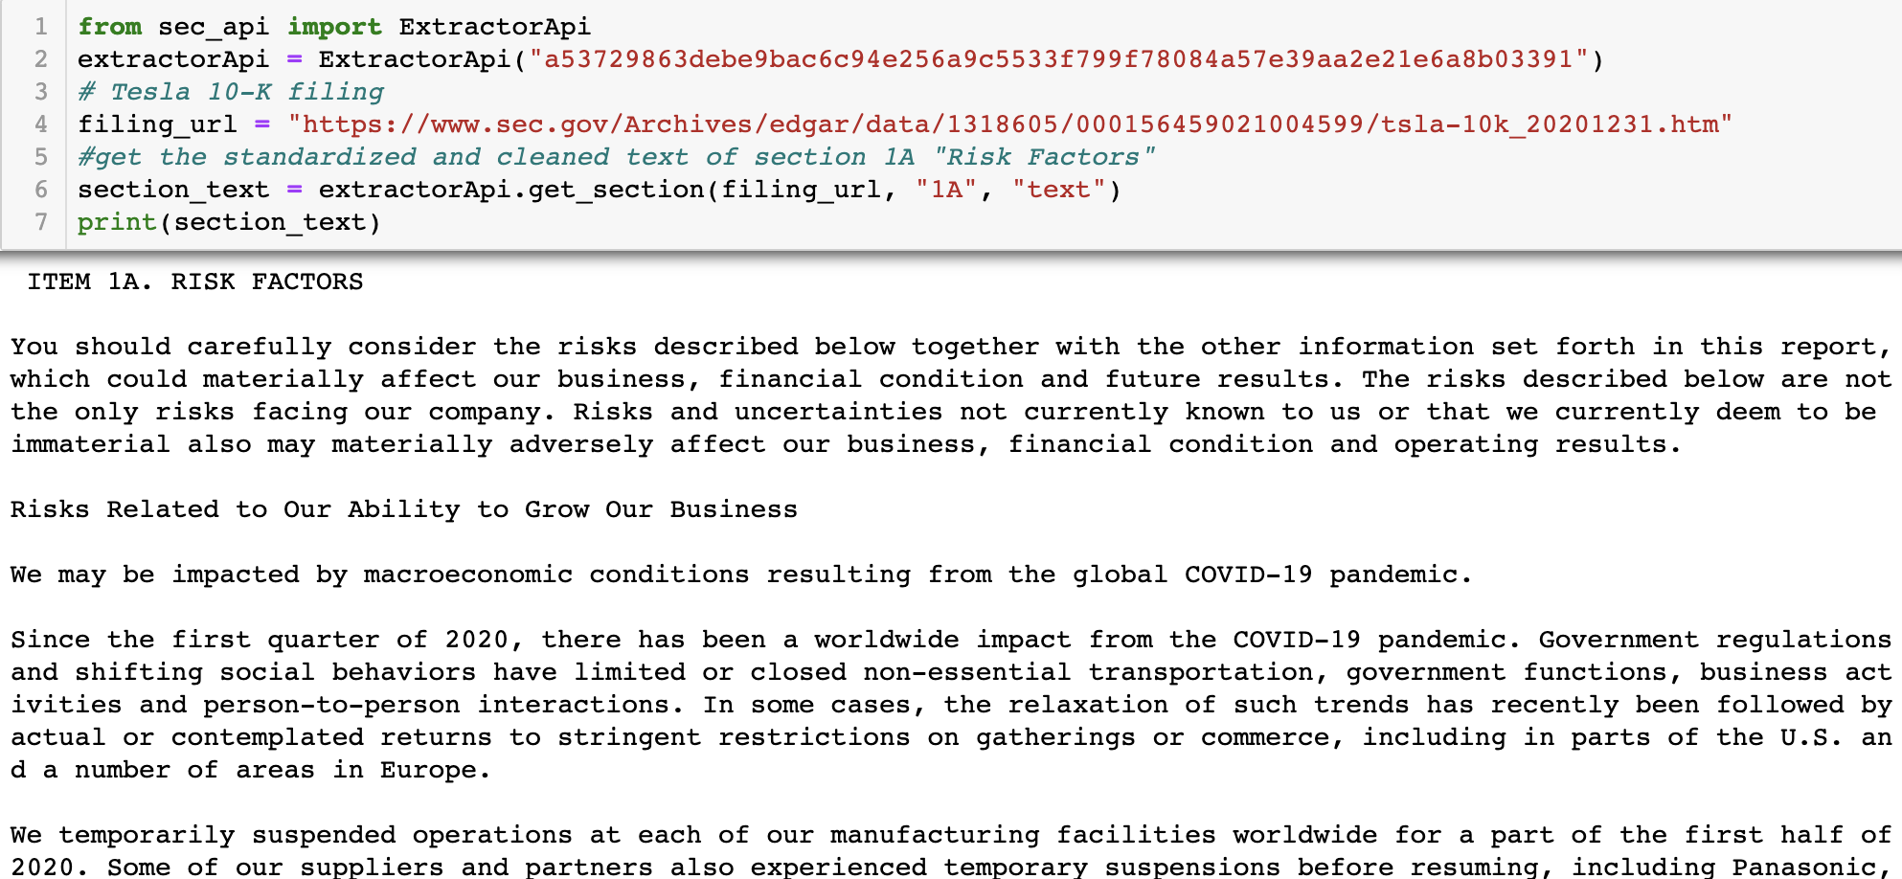
Solution

Slide 8
Algorithm
Select a list of stocks (AMZN, IBM, BA, GE, DIS)
Find each company’s unique CIK (Central Index Key) to retrieve their 10-Ks
Find all 10-K filings from 2010-2020 for the given set of stocks using the CIK and store them in a dictionary
Preprocess the 10-K filings and tokenize the words like in previous projects
Generate sentiment bag of words from the 10-k documents using the sentiment word lists (Loughran-McDonald and SentiWordNet).
From the sentiment word lists, generate sentiment term frequency–inverse document frequency (TFIDF) from the 10-K documents
From the TFID weights, calculate the cosine similarity and plot it over time for each sentiment category
Compare positive and negative cosine similarity to create a trading strategy of buying and selling

Slide 9
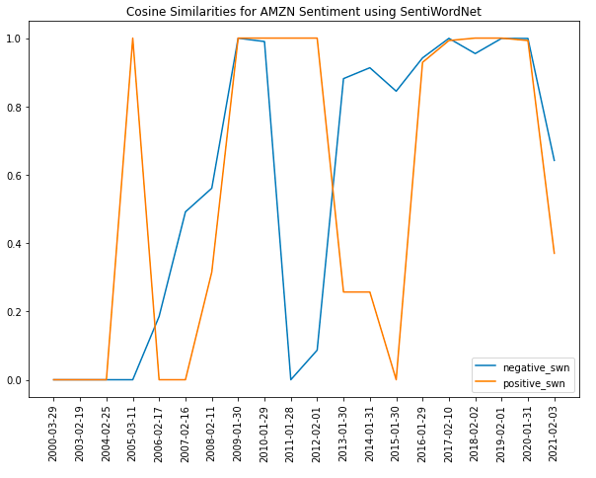
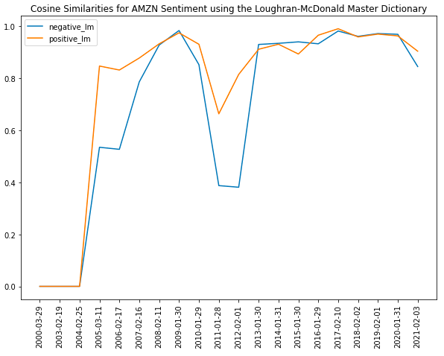
AMAZON

Slide 10
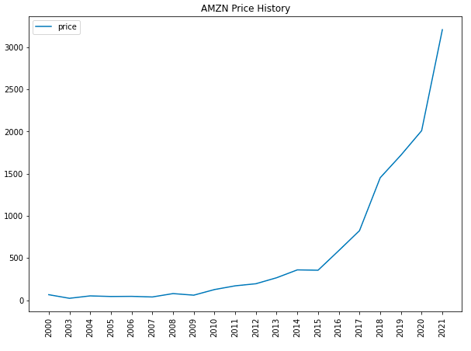
AMAZON
SentiWordNet Accuracy: 58.82%
Loughran-McDonald Accuracy: 47.06%

Slide 11
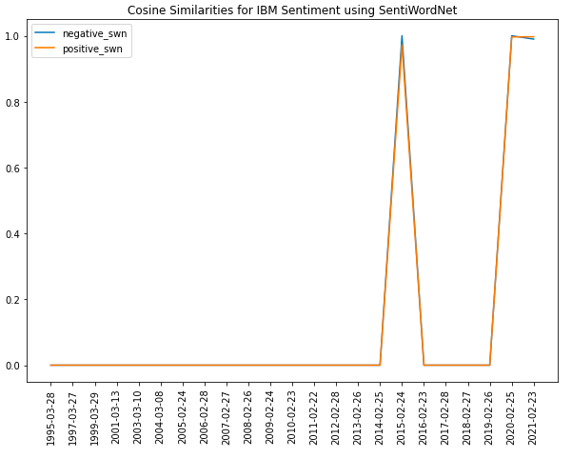
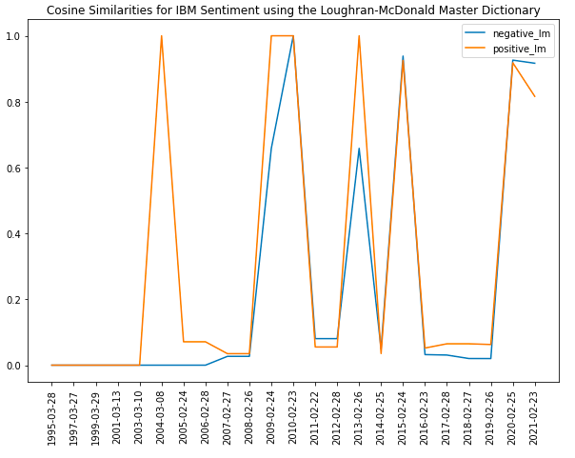
IBM

Slide 12
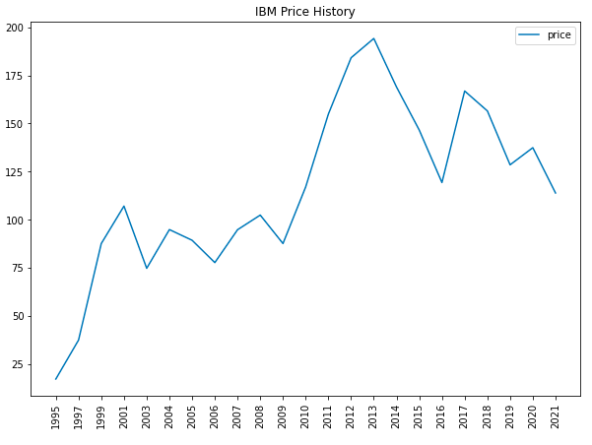
IBM
SentiWordNet Accuracy: 66.67%
Loughran-McDonald Accuracy: 44.44%

Slide 13
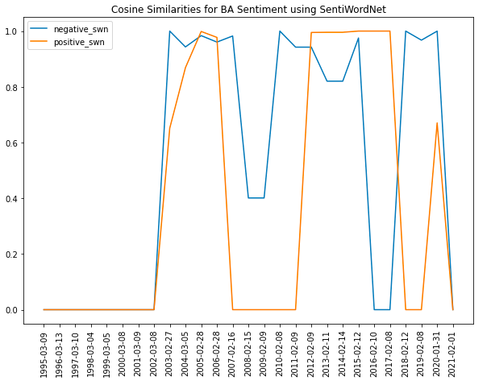
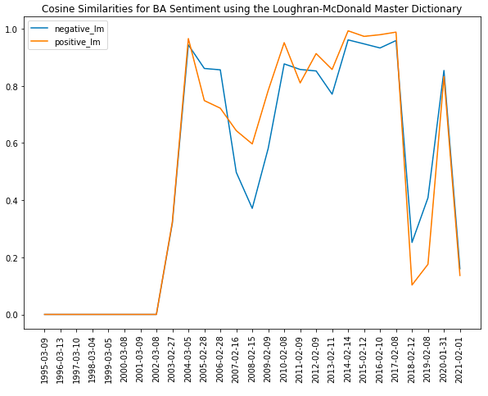
Boeing

Slide 14
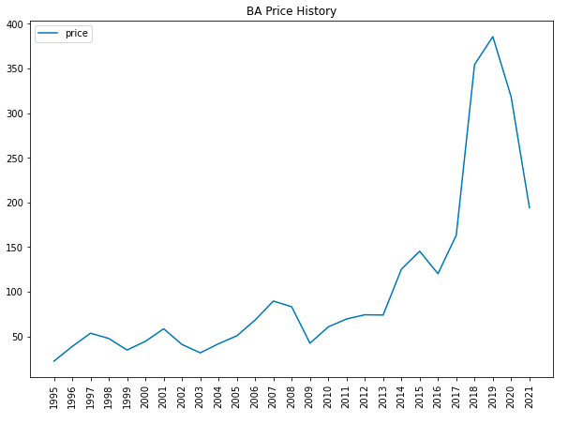
Boeing
SentiWordNet Accuracy: 55.56%
Loughran-McDonald Accuracy: 52.63%

Slide 15
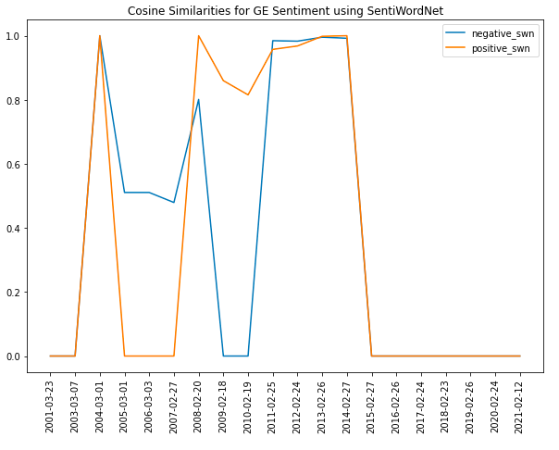
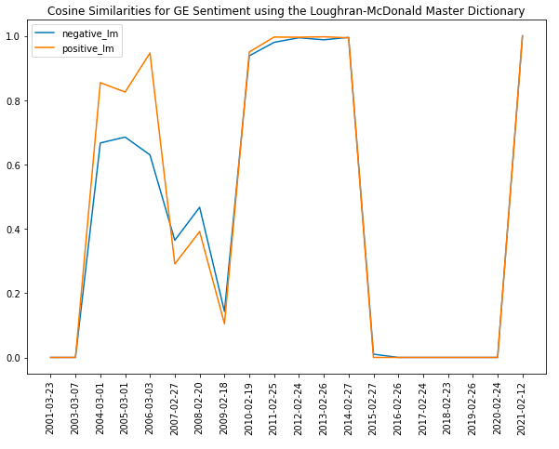
General Electric

Slide 16
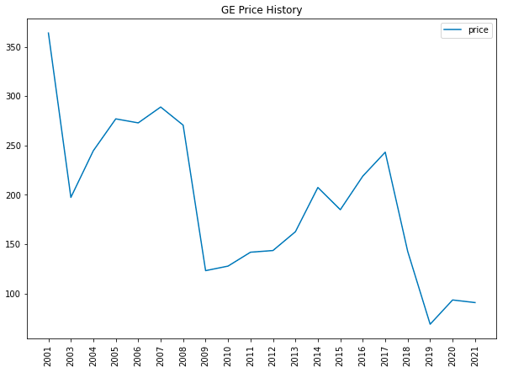
General Electric
SentiWordNet Accuracy: 45.45%
Loughran-McDonald Accuracy: 69.23%

Slide 17
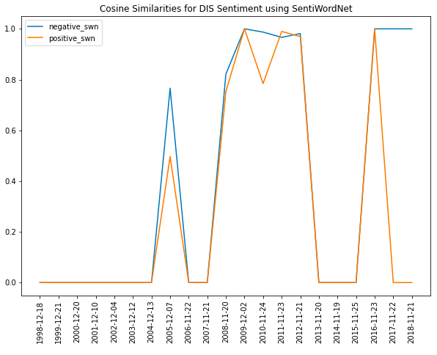
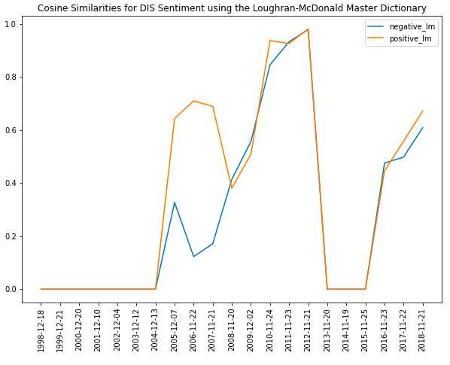
Disney

Slide 18
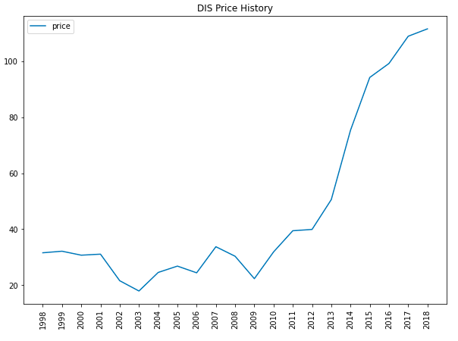
Disney
SentiWordNet Accuracy: 33.33%
Loughran-McDonald Accuracy: 45.45%

Slide 19
Comparison between algorithms

Slide 20
Conclusion, Things to improve
SentiWordNet worked better for some stocks while Loughran-McDonald performed better for other stocks
Why are there not sentiment scores for documents from certain years for a stock?
‘actual’ signal to compare predictions to can be based on beating the market
Assign different weights to each section of the 10-K filing based on importance
Analyze 10-Q filings

