Slide 1
AI STORY GENERATOR
Presented By:
Mohammed Riyan N
513121104022
THANTHAI PERIYAR GOVERNMENT INSTITUTE
OF TECHNOLOGY VELLORE

Slide 2
PROJECT TITLE AI STORY GENERATOR
3/21/2024 Annual Review

Slide 3


AGENDA
Problem Statement
Project overview
End Users
Solution and its proposition
The WOW in the solution
Modeling
Results
Conclusion
3/21/2024 Annual Review

Slide 4

PROBLEM STATEMENT Design an AI-powered story generator that can create engaging and coherent narratives across various genres (e.g., fantasy, science fiction, mystery). The system should be able to take user inputs such as themes, characters, and settings, and generate original and compelling storylines with well-developed plots, realistic dialogues, and consistent narrative structure. The AI should also have the ability to learn from user feedback to improve its storytelling capabilities over time. The goal is to create a versatile and user-friendly tool that can be used by writers, educators, and enthusiasts to spark creativity and explore new story ideas.

Slide 5

PROJECT OVERVIEW
User Interface: The project will include a user-friendly interface where users can input their preferences such as themes, characters, settings, and desired storyline elements.
Natural Language Processing (NLP): The system will leverage NLP techniques to understand and interpret user inputs, extract relevant information, and generate coherent sentences and dialogues.
Machine Learning (ML): ML algorithms will be used to analyze and learn from existing stories and literary works to generate new and unique storylines.
Deep Learning (DL): DL models like recurrent neural networks (RNNs) or transformer models (e.g., GPT-3) will be employed to generate long-form narratives with realistic and engaging plots.
Feedback Mechanism: The system will incorporate a feedback mechanism where users can provide feedback on generated stories, helping the AI improve its storytelling capabilities over time.
Genre Flexibility: The AI Story Generator will be designed to work across multiple genres such as fantasy, science fiction, mystery, romance, etc., ensuring versatility and creativity.
Quality Control: The project will implement quality control measures to ensure that generated stories are grammatically correct, logically coherent, and free from biases or offensive content.

Slide 6

WHO ARE THE END USERS?
Educators and Students
Content Creators
Story Enthusiasts and Hobbyists
Publishers and Storytelling Platforms
Language Learners
3/21/2024 Annual Review

Slide 7

YOUR SOLUTION AND ITS VALUE PROPOSITION
Advanced AI Algorithms: Our platform utilizes state-of-the-art AI algorithms, including transformer models like GPT-3, to generate rich and immersive stories with realistic dialogues, well-developed characters, and engaging plots.
User-Centric Design: The user interface is designed to be intuitive and user-friendly, allowing writers, educators, and enthusiasts to easily input their preferences, explore different story elements, and customize generated stories to their liking
Personalized Storytelling: Our AI Story Generator can personalize stories based on user inputs such as themes, characters, settings, and desired narrative arcs. This level of customization ensures that each story is unique and tailored to the user's creative vision.
Feedback Loop: The platform includes a feedback mechanism where users can provide input on generated stories, helping the AI learn and improve its storytelling capabilities over time. This iterative process ensures continuous enhancement and adaptation to user preferences

Slide 8

THE WOW IN YOUR SOLUTION
My solution for an AI Story Generator involves developing a sophisticated platform that integrates advanced natural language processing (NLP), machine learning (ML), and deep learning (DL) algorithms. This platform will allow users to input their preferences such as themes, characters, and settings, and generate original and engaging stories with well-developed plots and realistic dialogues. The system will also include a feedback mechanism to continuously improve its storytelling capabilities over time.
.
3/21/2024 Annual Review
8

Slide 9
MODELLING
Natural Language Processing (NLP):
Tokenization: Breaking down text into individual words or tokens.
Part-of-Speech Tagging: Identifying the grammatical parts of speech for each token.
Machine Learning (ML):
Text Generation Models: Using ML models like Recurrent Neural Networks (RNNs), Long Short-Term Memory (LSTM) networks, or Transformer models (e.g., GPT-3) for generating coherent and context-aware text.
Deep Learning (DL):
Transformer Models: Utilizing pre-trained transformer models like GPT-3 for generating long-form narratives with diverse and realistic content.
3/21/2024 Annual Review
9

Slide 10
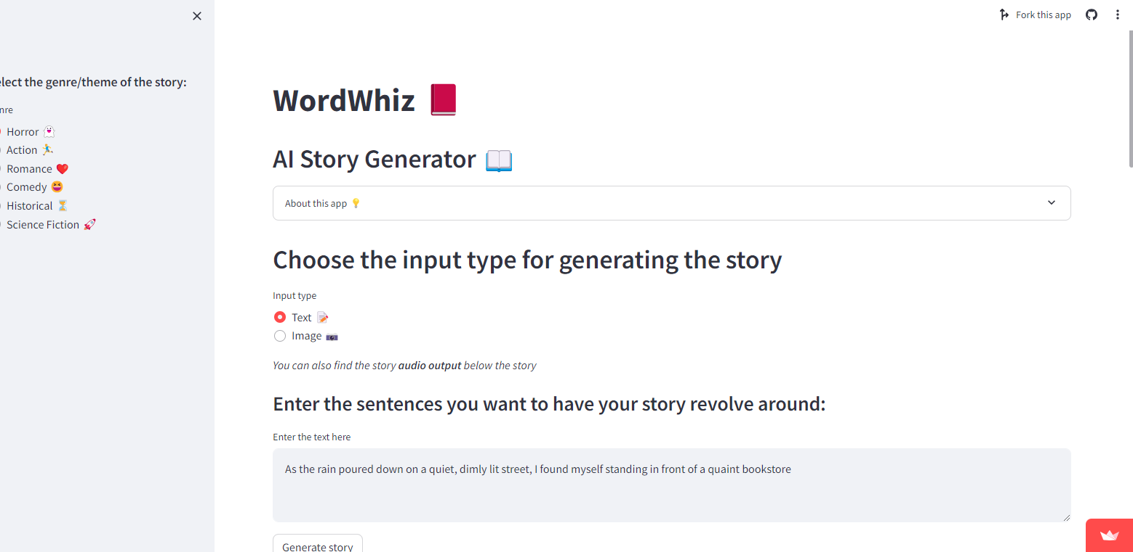
RESULTS
10

Slide 11


