Slide 1

Mental Health in the Tech Industry

Slide 2

Comparing Attitudes Towards Mental Health in the Tech & Non-Tech Industries
1

Slide 3
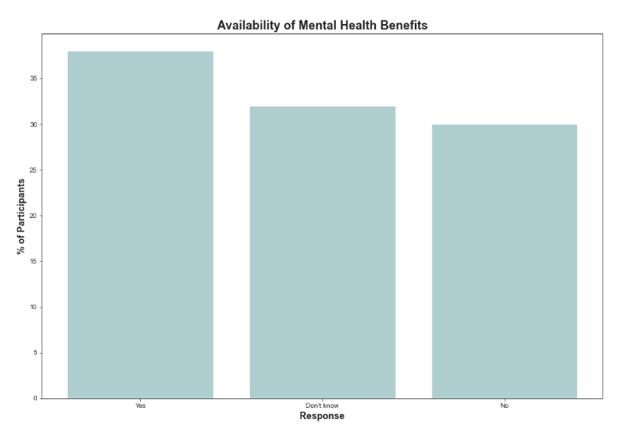
Availability of Mental Health Benefits
38% of companies offer mental health benefits
30% of companies do not offer any benefits
32% are unsure whether companies offer any benefits
Not enough communication and awareness.
Organisations do not wish employees to utilise these resources, or it is not a priority for them.

Slide 4
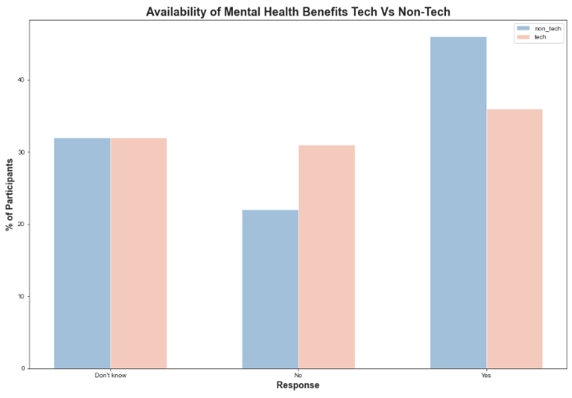
Availability of Mental Health Benefits
46% of non-tech companies provide mental health benefits compared to
36% of tech companies provide mental health benefits compared to
32% of employees from both tech and non-tech industries were not aware if their companies provided mental health benefits.

Slide 5
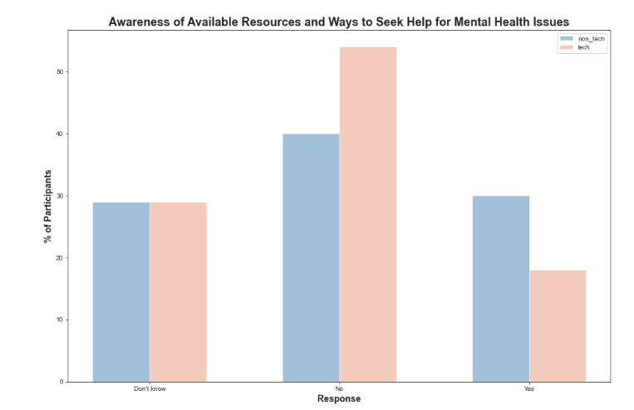
Employee Awareness Regarding Available Resources and how to seek help
Only 18% of employees in tech companies aware of available resources compared to 30% in non-tech companies
In both industries nearly 30% of the employees are unaware of whether there are any benefits or how to reach out to them.

Slide 6
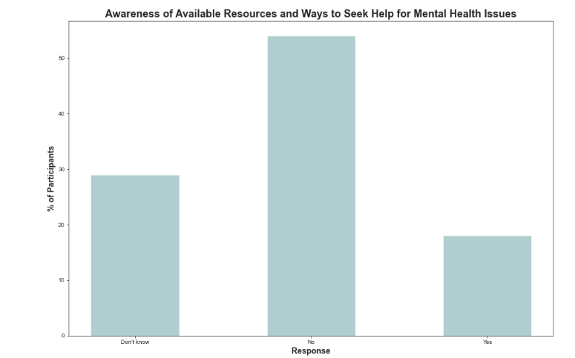
Employee Awareness Regarding Available Resources and how to seek help
54% of employees are not aware of available resources or how to seek help.
Awareness of the benefits offered by the company has to be raised.
Including having discussions about such issues and resources for additional help are quite limited in the tech workplaces and have room for improvement.

Slide 7
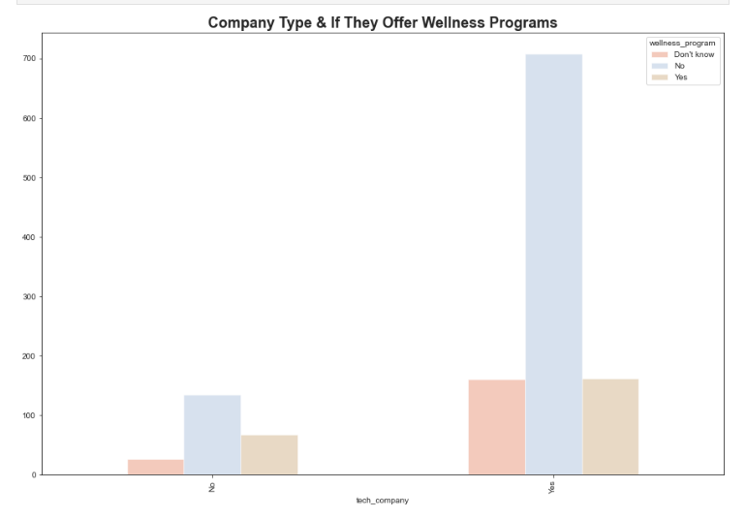
Difference between tech companies and non-tech companies that offer wellness programs
Tech companies proportionally offer wellness programs more than non-tech companies.
15.7 % of Tech Companies offered wellness programs
29.4 % of Non-Tech offered wellness programs

Slide 8
Recommendations for companies who offer Mental Health benefits:
Include a description of the mental health benefits available in newsletters, emails, meetings, posters etc. to raise more awareness.
Open discussions into mental health awareness.
The tech industry could learn from non-tech companies for inspiration to evaluate what mental health benefits are being offered, how they are budgeting this and try to implement more benefits.

Slide 9
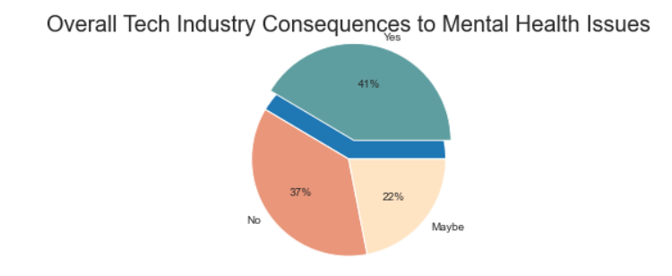
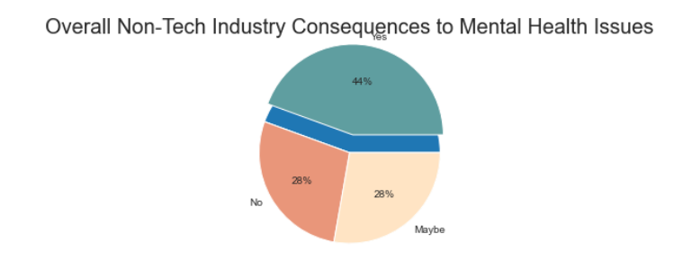
Consequences on employee’s mental health within tech companies and non-tech companies
The tech industry seems to have slightly fewer negative consequences for mental health compared to non-tech industries
41% of tech employees stated that there consequences for mental health leave compared to a 44% of non-tech employees.
Both industries have been shown to have a high chance of negative consequences for mental health.
Regulations and laws protecting employee mental health should be put in place to reduce these figures, as well and union representatives, news , social media and a combined societal pressures should help removing consequences too
Notes:
Eliyza

Slide 10
Attitudes Towards Mental Health in the Tech Industry
2

Slide 11
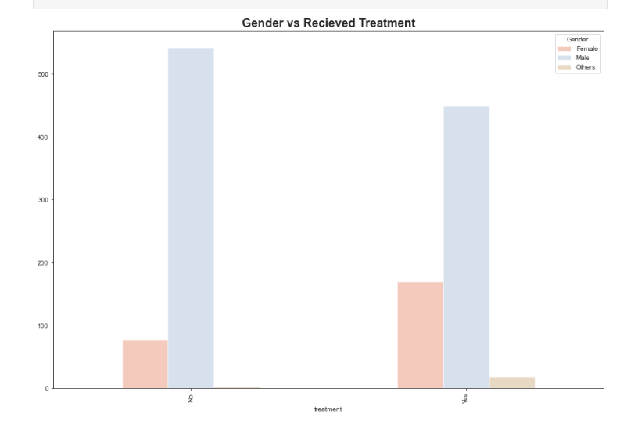
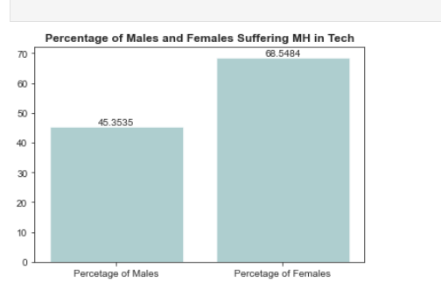
Gender differences in mental health treatment and struggles within the tech industry
The number of males who received treatment almost tripled in comparison to females
Interestingly, 68.5% of Females in the Tech industry suffer from Mental Health whereas only 45.35% of men do.

Slide 12
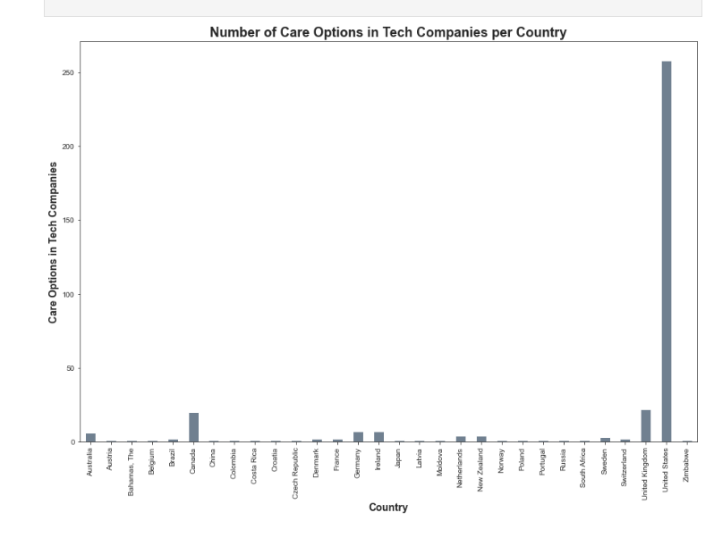
North America and Europe offer more mental health programs compared to other world counterparts.
North American countries and Europe offer increased care options for their employees.
The United States is the highest in the dataset, followed closely by the United Kingdom and Canada.
The reason for this could be the presence of a higher number of tech.
Countries that are more open with conversations about mental health have more facilities than those countries that don’t.
A possible bias could be caused by the fact that the survey might have been shared more within western countries than eastern ones.

Slide 13
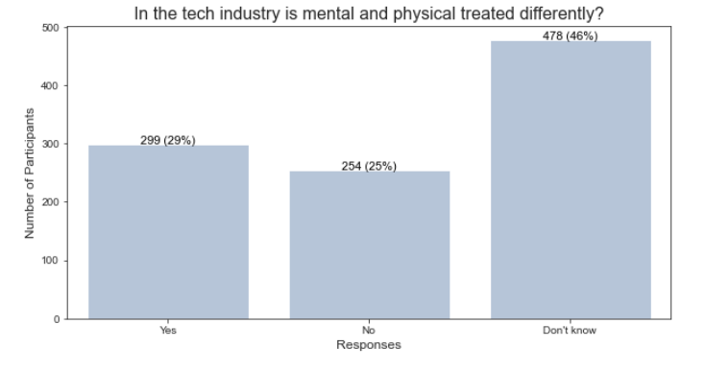
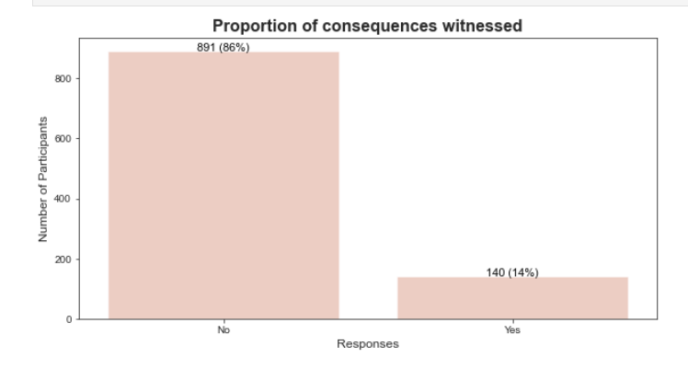
Is mental and physical health treated differently?
29% of the industry seems to have differences in mental and physical health. A high majority of 46% concluded not to know, but this may be because employees are very good at hiding or concealing their attitudes and consequences and comments can be made slyly and in a passive aggressive manner.
Although a high proportion of 86% said they did not witness first hand and negative consequences, this could just indicate it was hidden or done behind closed doors.
From the results, and generic research I conclude that there is a mix response. Although employers don’t express consequences and attitudes toward mental health as negative, does not necessarily mean it is how it truly is or it doesn’t affect employee management .
Notes:
Eliyza

Slide 14
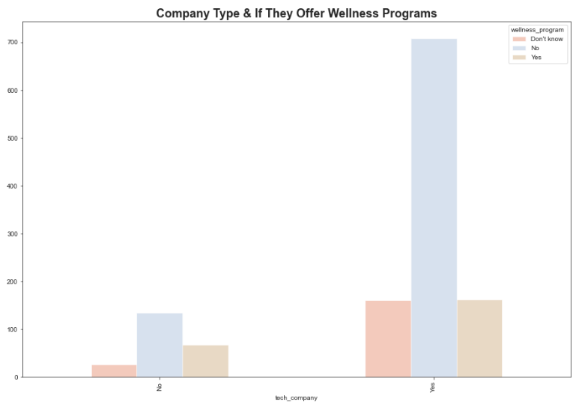
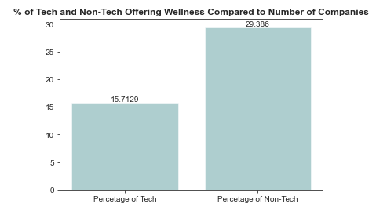
Tech industry supports the overall mental health and wellbeing of their employees
The Survey Data which was analysed provided the following conclusions:
Tech companies offer more wellness programs than non-tech
Tech companies also have the highest volume of companies not offering wellness programs
However further analysis considering the volume of companies demonstrates, the volume of non-tech and tech companies accurate data analysis demonstrates:
Only 15.7 % of Tech Companies offered wellness programs when compared to the quantity of tech companies
However 29.4 % of Non-Tech offered wellness programs when compared to the quantity of non-tech companies
Therefore the tech industry requires development to be able to compete with non-tech companies offering wellness programs to employees.
Notes:
Rizwan

Slide 15

Recommendations
for the Tech Industry
to Improve
3

Slide 16
Recommendations to aid employees
Companies, in specific tech companies can offer a variety of aid to support their employee's mental health:
Presence of Mental Health First Aiders within each team to allow employees to have points of contact when support is needed.
Presence of Mental Health days, which are days employees can take throughout the year to look after themselves.
Investing in programs such as help@hand or betterhelp, which are online platforms where employees can get support from certified doctors and psychologists.
Offering an adequate salary and a flexible working schedule can widely support the employees mental health.

Slide 17

Mental
Health
M
H
Matters
Too
M
T

Slide 18

TEAM PRESENTATION
Fazeleh Arjmandilari
Tharusha Heenatigala
Eliza Shafaq
Rizwan Nawaz

Slide 19
Thank you for listening
Any Questions?

