Slide 1
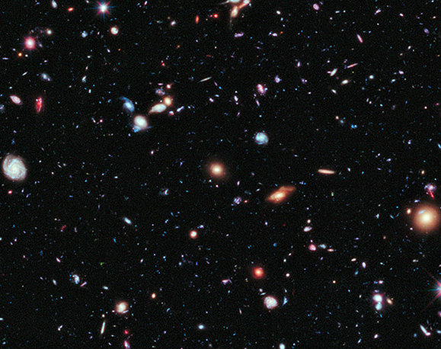
Classifying Galaxy Morphology Using Convolutional Neural Networks
Mohammed Baharoon
T5 Bootcamp
1/13/2022

Slide 2
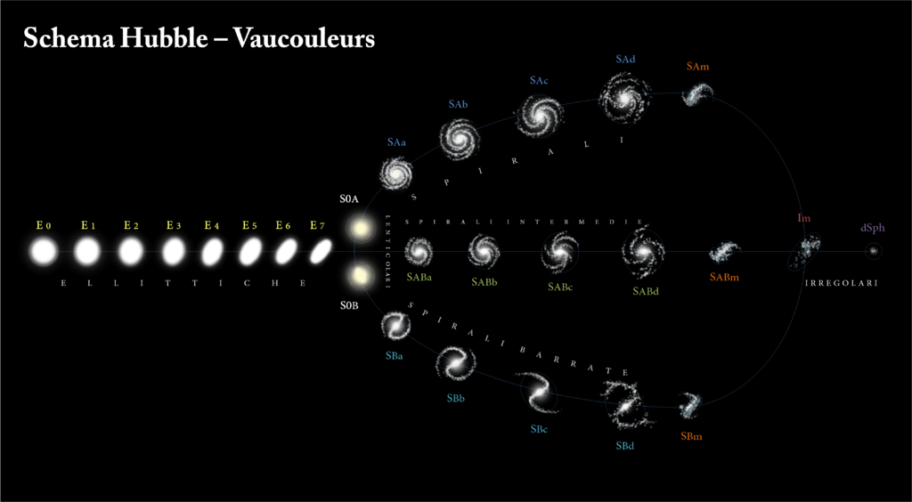
The Problem

Slide 3
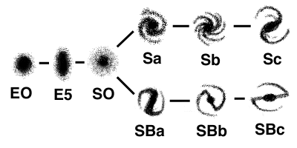
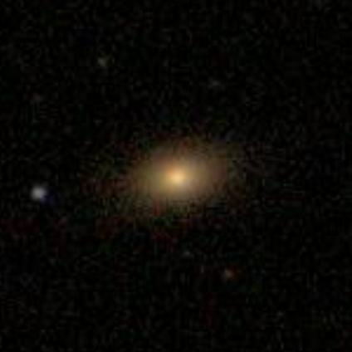
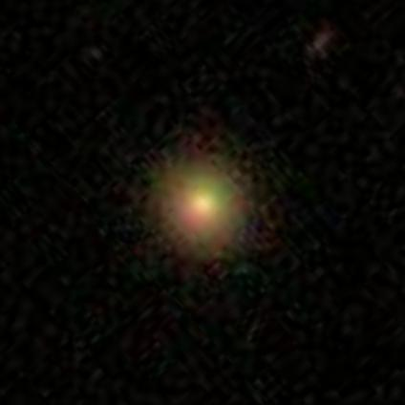
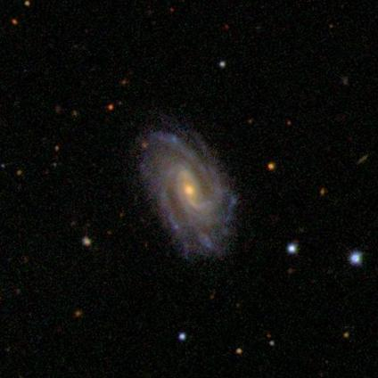
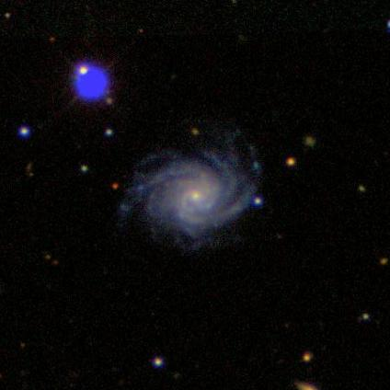
Reducing into Two Labels
“Elliptical”
“Spiral”

Slide 4
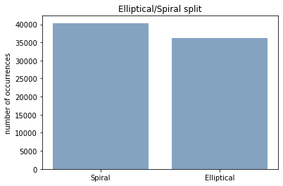
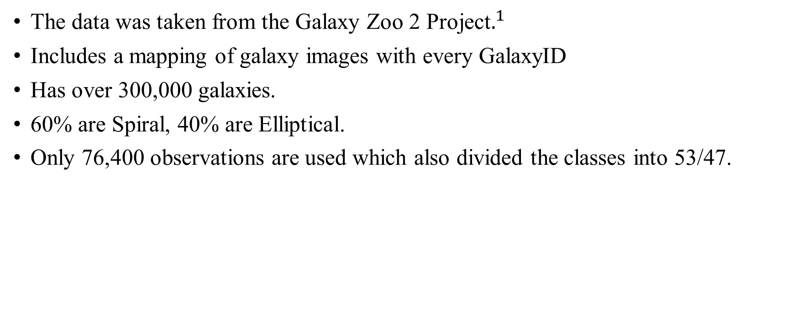
Dataset
The data was taken from the Galaxy Zoo 2 Project$.^{1}$
Includes a mapping of galaxy images with every GalaxyID
Has over 300,000 galaxies.
60% are Spiral, 40% are Elliptical.
Only 76,400 observations are used which also divided the classes into 53/47.
[1] arXiv:1308.3496 [astro-ph.CO]

Slide 5

The Model
Used PyTorch to build a Convolutional Neural Network
3 Convolutional layers, 3 Connected layers
Used ReLU activation function.
Binary Cross Entropy as a cost function.
Adam as an optimizer
Trained on 20 epochs

Slide 6

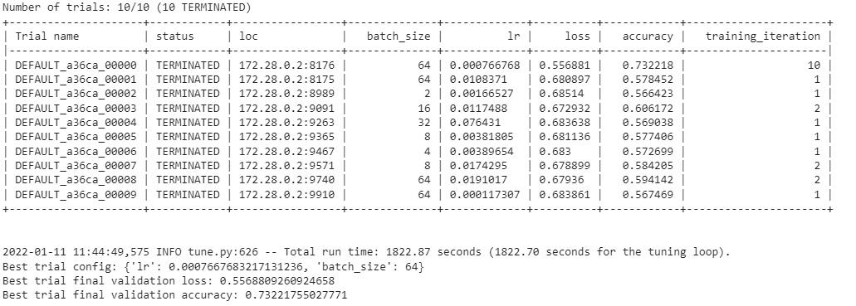
Ray Tune Optimize Hyperparameters
Adjusted learning rate and batch size

Slide 7
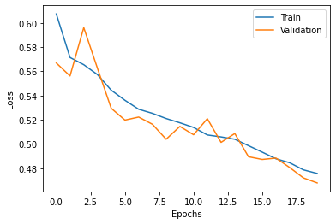
Results
Baseline accuracy is: 53%
Model metrics are:
Accuracy 77.65%
Precision 83.38%
Recall 71.63%

Slide 8
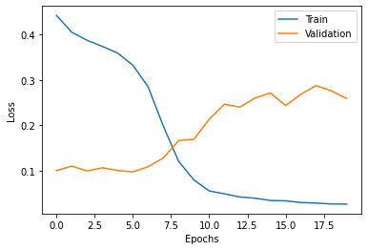
How does that compare to Resnet18?
 | Not pretrained | Resnet18
Accuracy | 77.20% | 77.8%
Precision | 80.64% | 79.43%
Recall | 71.63% | 78.87%

Slide 9
Why is this useful?
Can know more about the history of a galaxy
Gain more insight about the aggregation of stars inside a specific galaxy
Give outer space telescopes more autonomy

Slide 10
Thank You For Your Attention

