Slide 1



ALY6070 – Signature Assignment Group Presentation
Presenters: Guancheng Lu, Saif Wasay Mohammed, Akanksha Chapra, Nagarjun Srinivasan

Slide 2

Table of Contents
The Dashboard
Sum of Amount by Customer Name/Sum of Quantity by Category
Sum of Sales by State/Sum of Sales by Payment Methods
Profit by Month/Sum of Profit by Sub-Category

Slide 3
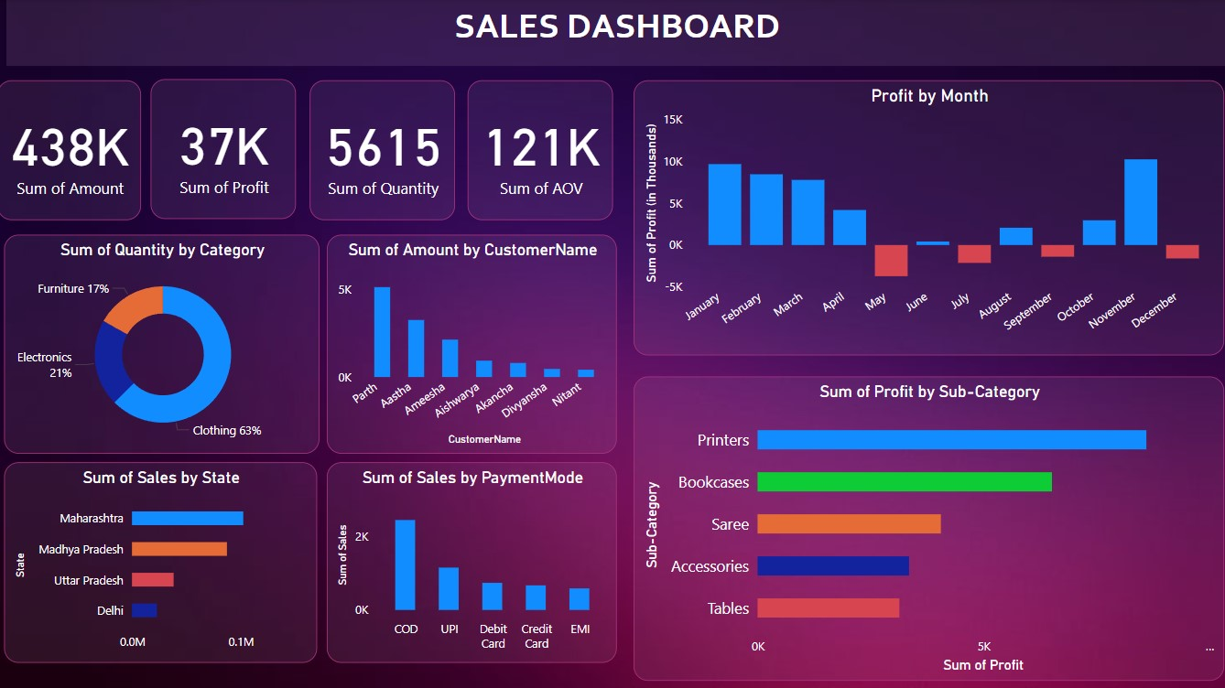
The Dashboard

Slide 4
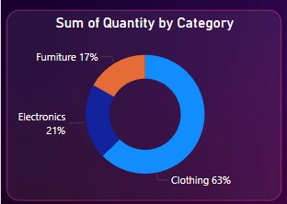
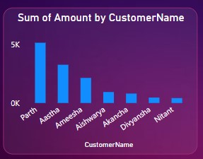
Bar chart demonstrates the quantities of items sold into three categories: Clothing, Electronics, and Furniture.
Clothing accounts for 63%, the largest share of the total quantity.
Furniture contributes 17%, the smallest proportion.
A vertical Bar chart shows the total amount spent by individual customers.
Parth has the highest amount spent, approaching 5K.
Nitant shows the lowest amount spent among the customers.

Slide 5
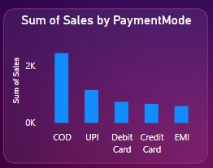
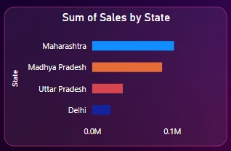

A vertical bar chart showing the total sales by different payment modes: COD, UPI, Debit Card, Credit Card, and EMI.
Cash on Delivery is the most preferred payment mode with sales exceeding 2K.
This is a horizontal bar chart showing sales performance by state: Maharashtra, Madhya Pradesh, Uttar Pradesh, and Delhi.
Maharashtra leads with the highest sales.
Uttar Pradesh and Delhi contribute minimal sales in comparison.

Slide 6
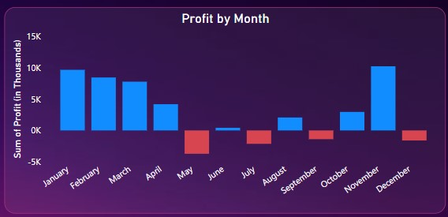
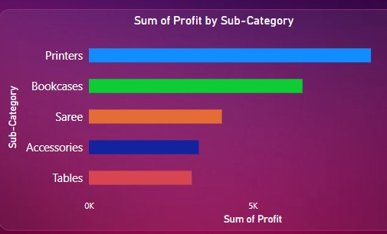
This is a bar chart displaying monthly profits, where profits above zero are in blue and losses are in red.
January to April and December: Profits are significant, with January showing the highest.
May to November: Negative profits in most months, especially May and July.
This is a horizontal bar chart showing profits for various sub-categories: Printers, Bookcases, Saree, Accessories, and Tables.
Printers generate the highest profit, significantly surpassing other sub-categories.

Slide 7

THANK YOU

Slide 8
References
Microsoft Corporation. (n.d.). Power BI (Version 2.115). Retrieved from https://powerbi.microsoft.com/
Kumar, R. (2023). Sales Analytics Dataset [Dataset]. Kaggle. Retrieved from https://www.kaggle.com/datasets/rkumar/sales-analytics

