Slide 1

Data Analysis with R Mohammed Saif Wasay (002815958) Master of Professional Studies in Informatics, Northeastern University ALY 6000: Introduction to Analytics Harpreet Sharma February 5th, 2024

Slide 2
Overview
Dataset used for this project is from a website Cars24.com,it contains information of the cars listed on the website and has about and 8015 records and has 10 total variables. The key attributes of the data are:
Car Name: This contains car name and its brand.
Year: The year when the car was bought.
Distance: Distance travelled by the car in KM
Owner: The number of previous owner of the car
Fuel: Type of fuel the car consumes
Location: Region where the car is registered
Drive: Transmission type of the car
Type: The type of the car like Sedan, SUV, Hatchback etc.
Price: The price of the Car
Aim of the project is to find trends in the cars listed and visualize interesting parameters found.

Slide 3
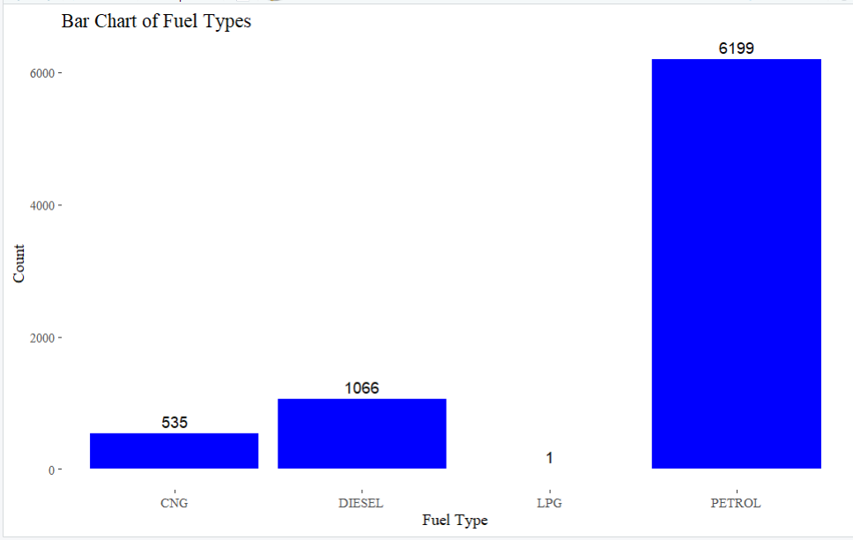
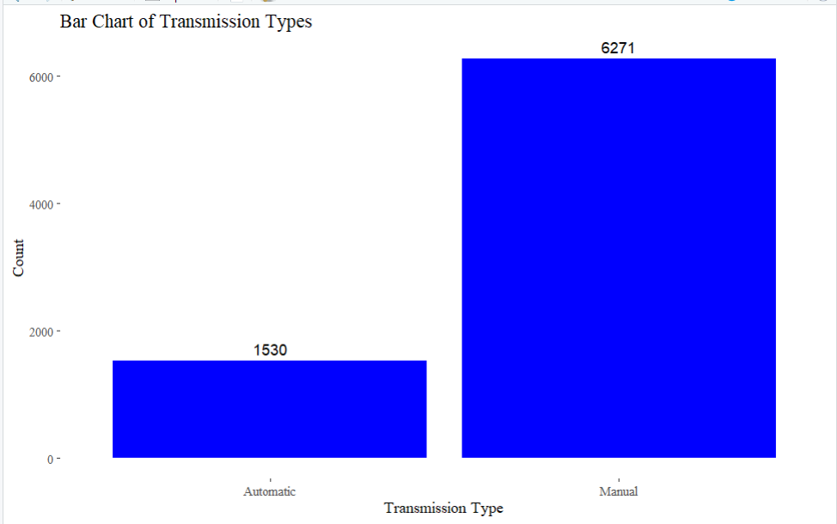
Bar Charts for Fuel and Transmission Types
Notes:
The utilization statistics for various fuel kinds are clearly visible in the left bar chart given above. Petrol is the most widely used fuel, accounting for 6199 units. In contrast, LPG had the lowest consumption, with only one unit consumed, demonstrating a major difference in fuel preference.
The right-hand bar chart above represents transmission types, providing light on a significant trend. It is clear that manual transmissions have seen much more usage than their automatic equivalents, indicating a marked preference for manual autos.

Slide 4
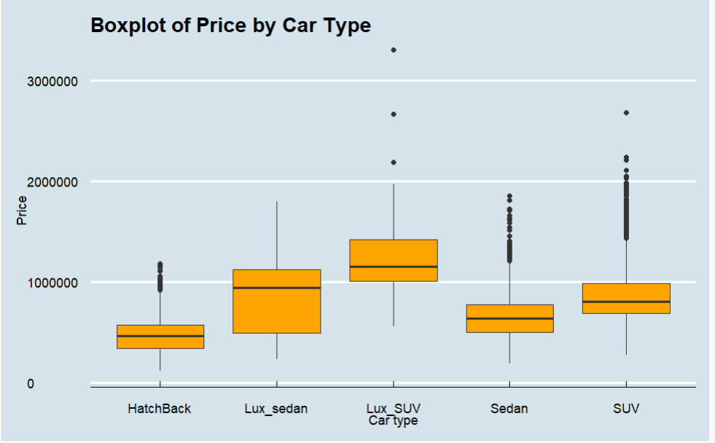
Boxplot plotting Prices for each car type
Notes:
Upon Visualization of Types of Cars and their prices, we can see the quartile ranges of prices for each of the car types. We can also see outliers for each car type and can see there are few SUVs that are more expensive than Luxury SUVs.

Slide 5
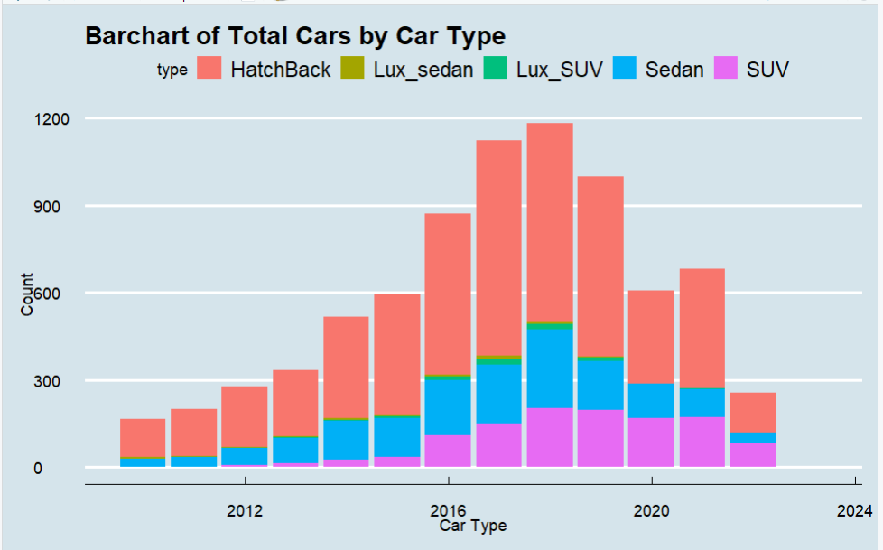
Bar Chart for Cars listed for each Car Type
Notes:
The bar chart above illustrates the total number of cars listed, giving some interesting facts. Notably, hatchbacks continuously lead in automobile listings each year, with the biggest numbers compared to other car categories. Luxury SUVs, on the other hand, have seen the least representation over the years. Furthermore, an interesting pattern appears as SUVs gradually grow their presence in the listings year over year surpassing Sedans as 2nd Most popular car type.

Slide 6
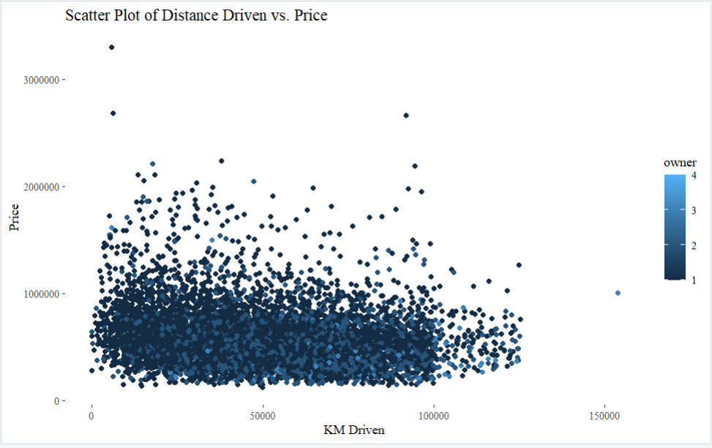
Scatter Plot for KM driven and Price of Cars
Notes:
This graph demonstrates the relationship between the number of kilometers driven and the effect on the vehicle's pricing. We can observe that less driven cars are more expensive. Another measure considered is the number of prior owners. We can tell that cars with fewer past owners have been driven less and are more expensive.

Slide 7
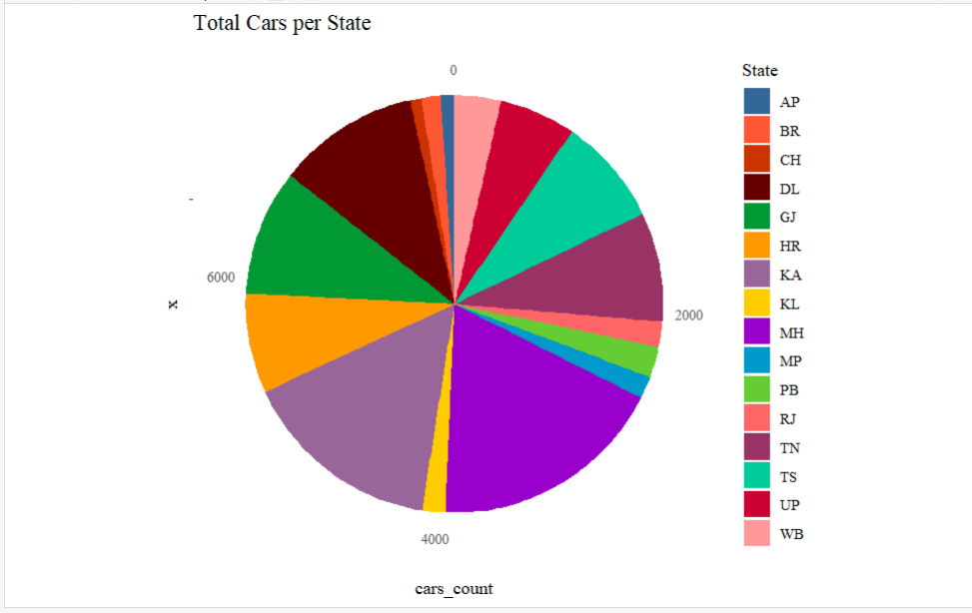
Distribution of Listings over States
Notes:
The above pie chart illustrates the listings of cars for each of the states in India. We can see that majority of the listings are from Maharashtra (MH), followed by Karnataka (KA) and Delhi (DL).

Slide 8
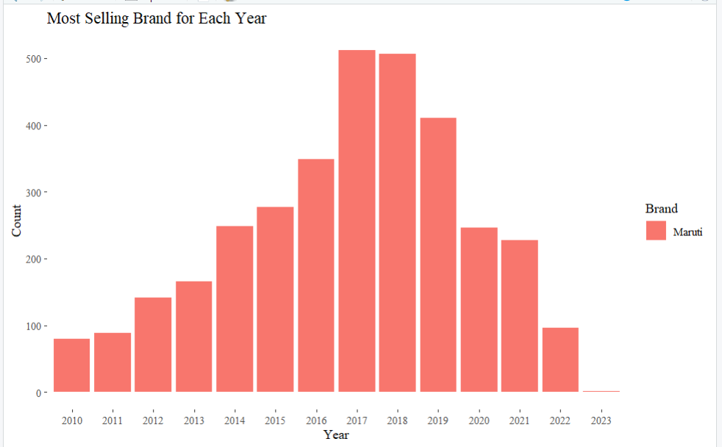
Most selling Brand for each year
Notes:
The above bar chart illustrates the best-selling brand for each year. As we can see, the year 2017 has the biggest number of sales compared to previous years, but the year 2023 has the lowest number of selling cars. This could be due to the fact that we have insufficient data for the year 2023.

Slide 9
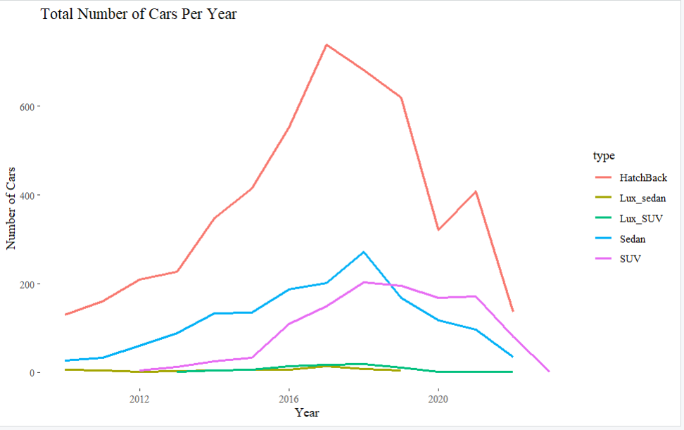
Line chart of Total Cars listed for each type
Notes:
The total number of cars listed over time shows that the popularity of sedans has decreased over time, while SUV listings have increased, and hatchbacks are the most popular.

Slide 10
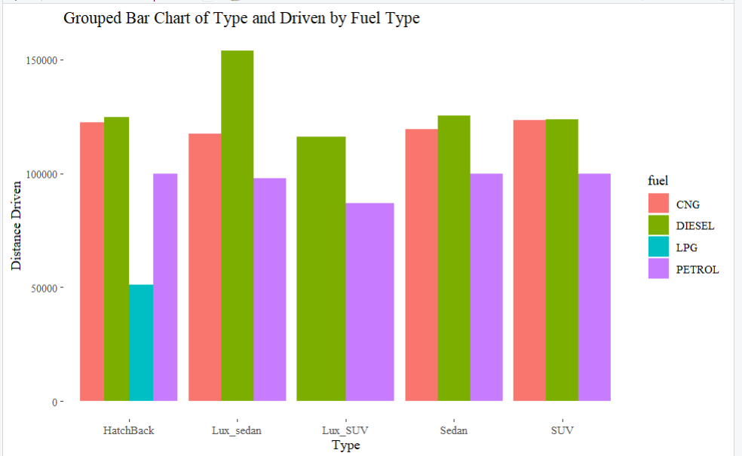
Grouped Bar Chart for Distance Driven and Type for each fuel type
Notes:
We compared the distance driven for each automobile type and fuel type. We can see that, despite the fact that most automobiles are fueled by petrol, diesel cars are the most frequently driven, followed by CNG and then petrol.

Slide 11
Conclusion
Most popular second hand cars listed are from the brand Maruti from 2010.
Most popular cars in the Indian markets are hatchbacks, with sedans and SUVs in second place. Popularity of SUVs have risen in India and have taken over Sedans as second most popular car type.
States with most listings are Maharashtra, Karnataka and Delhi.
There are more Manual cars compared to Automatic in the Indian makert.
Although most of the cars are fuelled by petrol, cars driven the most are fuelled by diesel.
Citations
R Documentation, An introduction to R. Retrieved 5th February 2024 from https://cran.r-project.org/doc/manuals/r-release/R-intro.html#Related-software-and-documentation
Data reference, Kaggle Retrieved 5th February 2024 from https://www.kaggle.com/datasets/ujjwalwadhwa/cars24com-used-cars-dataset
ChatGPT, Version 3.5 Retrieved 5th February 2024

