Slide 1
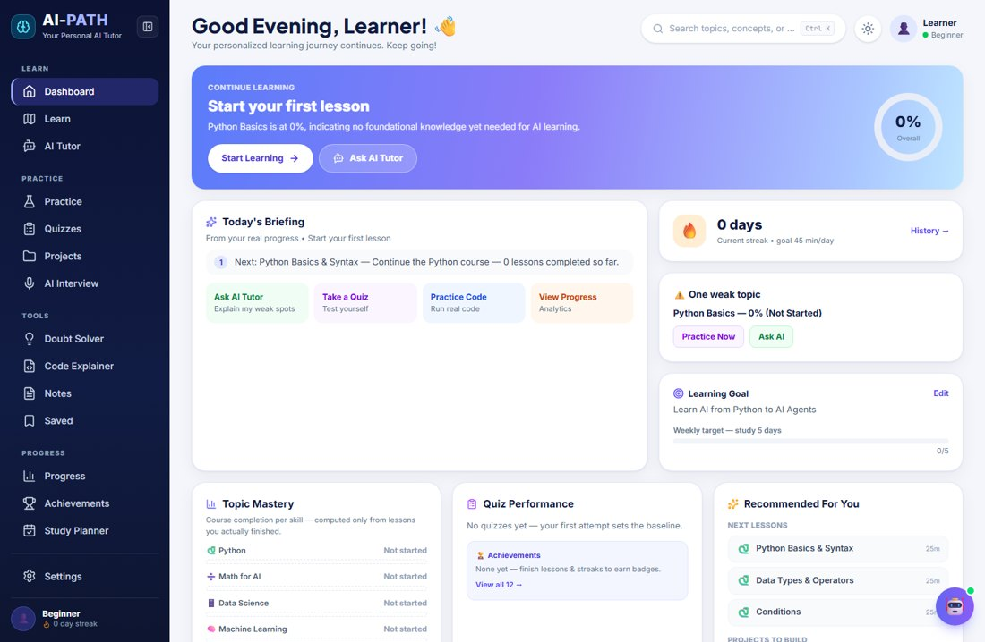
BUILD FAST WITH AI 2026
● ● ●
AI-PATH
Your Personal AI Tutor
An AI tutor that learns how YOU learn.
It doesn’t just answer questions. It helps decide what you should learn next.
Build by:
Mohammed Shakib
AI-PATH

Slide 2
THE PROBLEM
Learning is fragmented.
YouTube
→ Watch
ChatGPT
→ Ask
Coding platform
→ Practice
Mock interview
→ Test
Progress
→ Somewhere else
The learner has to connect everything themselves.
Five tools. No single picture of what to do next.
AI-PATH

Slide 3
THE BIG IDEA
What if your learning system adapted to YOU?
GOAL
LEVEL
AI-PATH
PERSONALIZED LEARNING
LANGUAGE
DAILY TIME
PROGRESS
MISTAKES
Learn
Practice
Test
Analyze
Adapt
AI-PATH

Slide 4
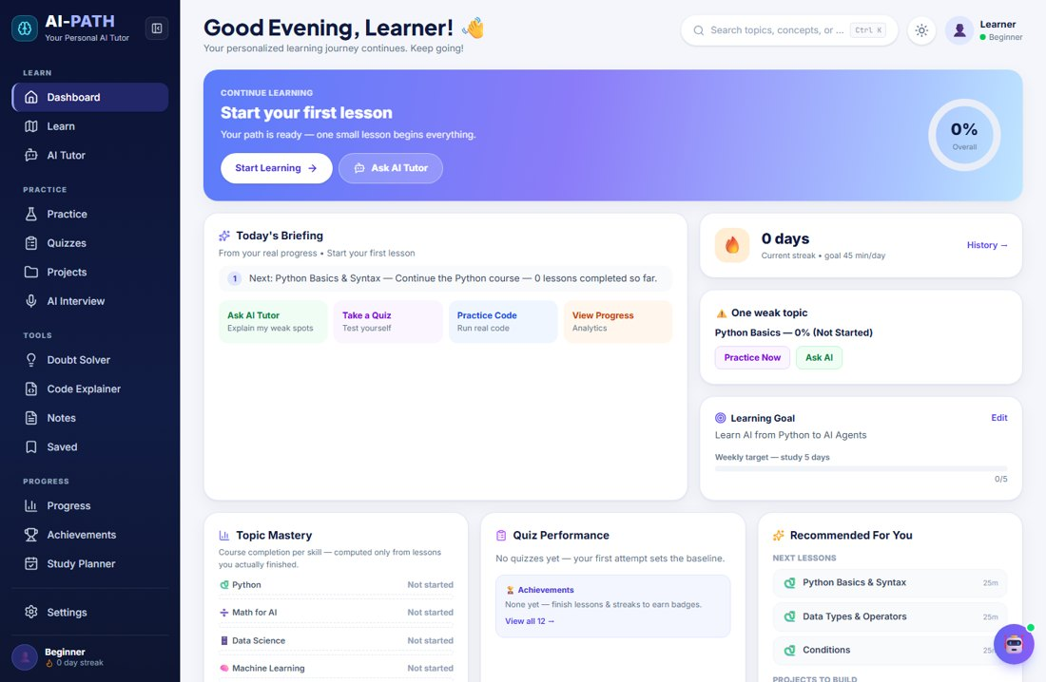
PERSONALIZATION
Your learning path is generated around you.
Goal
● ● ●
Level
Language
Daily time
Personalized 12-unit learning path
AI-PATH

Slide 5
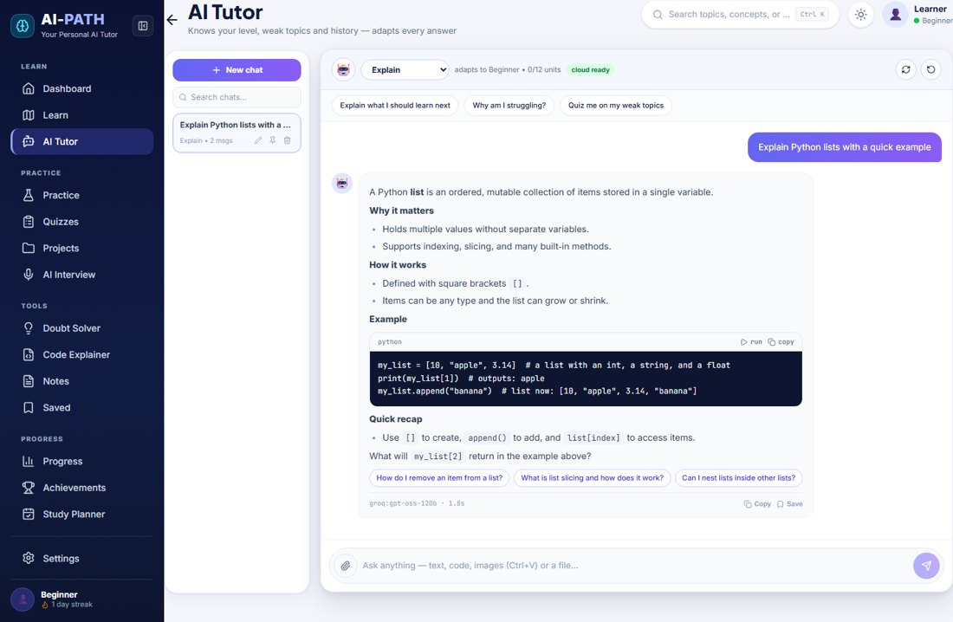
AI TUTOR
A tutor that knows your context.
● ● ●
INSIDE THE TUTOR
Explain
Teach Me
Debug Code
Code Review
Exam Prep
Mentor
Image / PDF
Run Python
Follow-ups
Chat history
Every reply is seeded with your level, weak topics and history.
AI-PATH

Slide 6
CORE DIFFERENTIATOR
AI-PATH learns from your mistakes.
Student makes a mistake
AI analyzes the mistake
Weak topic identified
Dashboard reflects the weakness
Next step updates
Progress changes
Student tries again
Targeted practice
↺ Built on real attempts and tracked mistakes — no fake data.
AI-PATH

Slide 7
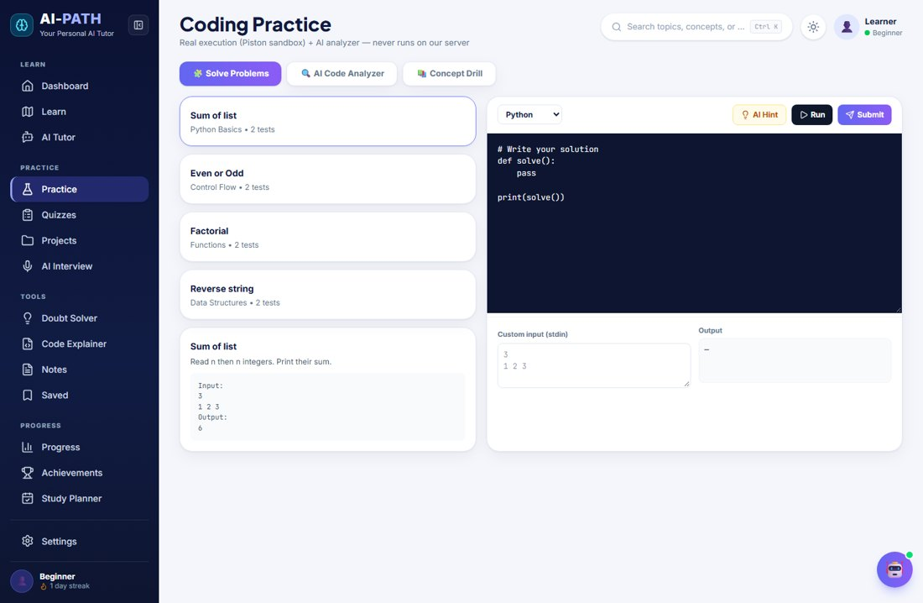
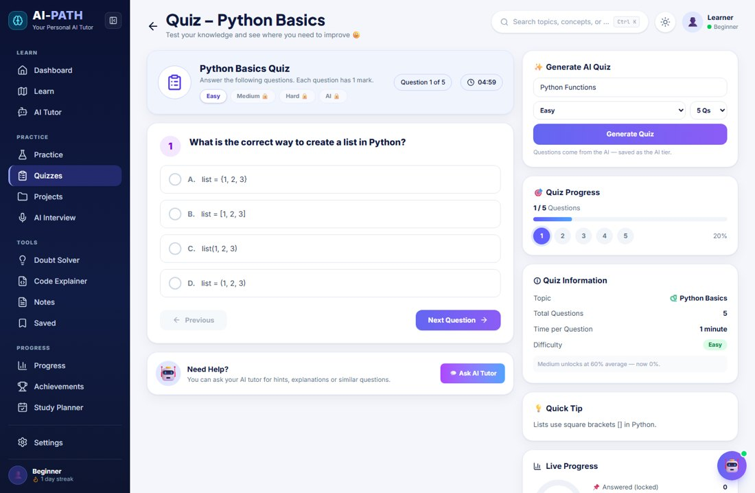
PRACTICE + QUIZZES
Don’t just learn. Prove it.
● ● ●
● ● ●
PRACTICE WRITE → RUN → FAIL → FIX → UNDERSTAND
QUIZ ANSWER → ANALYZE → TRACK MISTAKES → REVISIT
AI-PATH

Slide 8
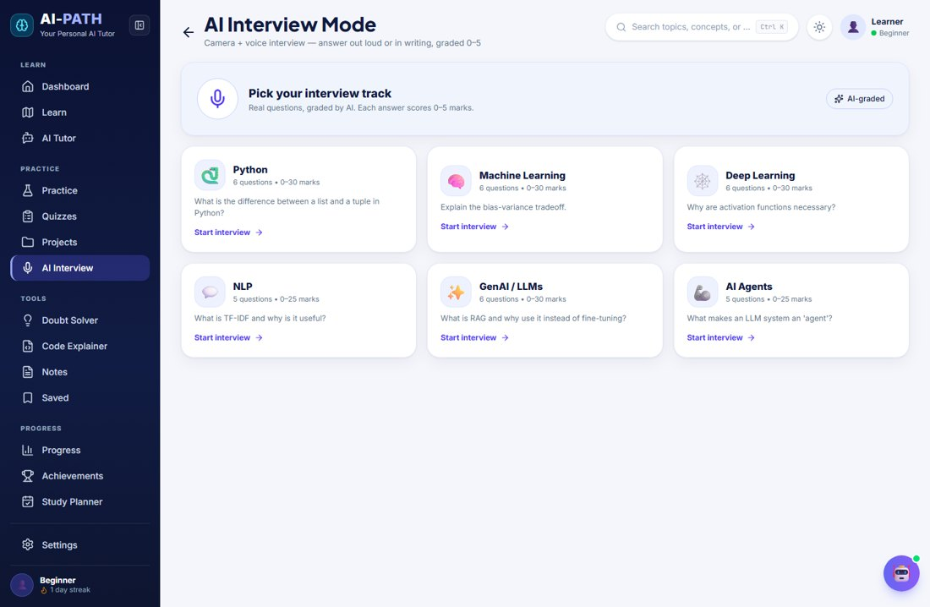
AI INTERVIEW
From learning → interview ready.
● ● ●
AI asks · webcam room
Student answers
Voice or typed
AI evaluates
Feedback + score, spoken
AI-PATH

Slide 9
THE COMPLETE SYSTEM
One continuous learning loop.
1 YOUR GOAL
10 FEEDBACK
2 PERSONALIZED PATH
9 AI INTERVIEW
3 LEARN
ADAPT
8 TARGETED LEARNING
4 PRACTICE
7 WEAK TOPIC
5 QUIZ
6 MISTAKE
AI-PATH

Slide 10
TECHNICAL ARCHITECTURE
Built as a real AI application.
USER EXPERIENCE
Next.js · React · TypeScript
Pyodide (Python in browser)
Web Speech API · getUserMedia
Local progress / app state
SERVER ROUTES
/api/ai/*
API keys stay server-side
1 · Groq 7-key pool · primary
2 · OpenRouter 3-key pool
3 · Google Gemini fallback model
AI FAILOVER
Primary AI
Error classification
Key / model cooldown
Fallback provider
Continue request
AI-PATH

Slide 11
ENGINEERING PROOF
Built. Tested. Deployed.
0
TypeScript errors
0
ESLint errors
14/14
Playwright E2E tests
✓
Production build
Next.js · React · TypeScript · Tailwind · Pyodide · Web Speech API · Playwright · Vercel
Real numbers only — no invented users or benchmarks.
AI-PATH

Slide 12
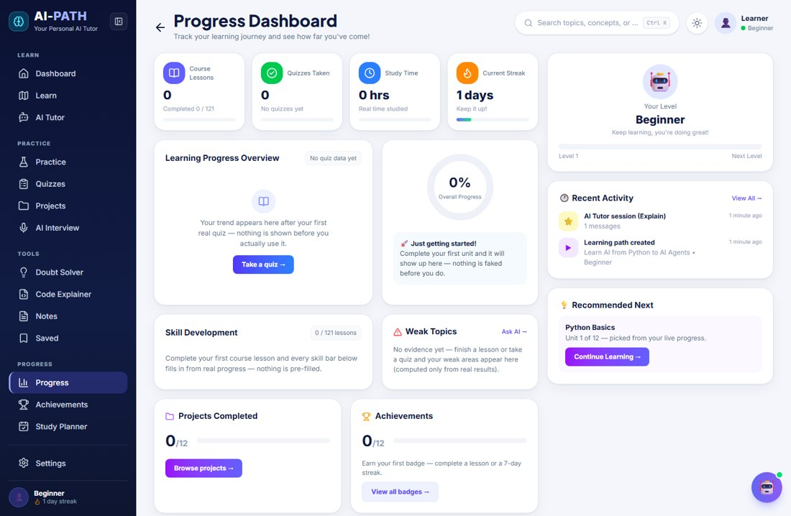
STOP SEARCHING FOR WHAT TO LEARN NEXT.
● ● ●
AI-PATH helps turn learning into an adaptive loop.
Learn → Practice → Prove → Adapt
LIVE DEMO
ai-path-tutor.vercel.app
SOURCE
github.com/MohammedShakib-645/ai-path
AI-PATH

