Slide 1

OPEN SOURCE MENTAL HEALTH INITIATIVE
Mental Health in Tech
A Survey Analysis of Stigma, Treatment, and Employer Support, 2014–2019
236,898 survey responses • 5 annual surveys • 105 questions
Data source: osmihelp.org

Slide 2
About the Dataset
An anonymous survey of tech industry professionals, run annually since 2014
236,898
5
105
Survey answers
Survey years (2014–19)
Distinct questions
Three linked tables
Survey
5
Survey metadata for each year (2014, 2016–2019)
Question
105
Question text and answer-type definitions
Answer
236,898
All respondent answers, linked by SurveyID + UserID + QuestionID
OSMH Survey Analysis
2

Slide 3
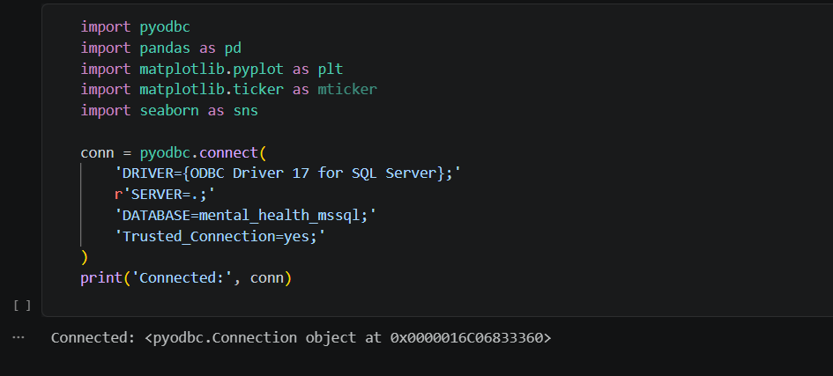
Data Connection with MS SQL
An anonymous survey of tech industry professionals, run annually since 2014
OSMH Survey Analysis
2

Slide 4
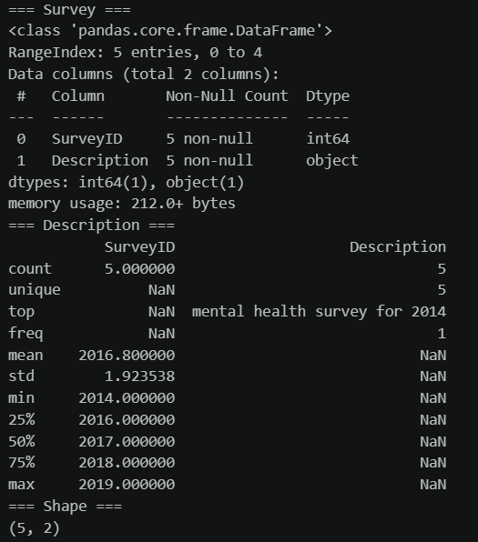
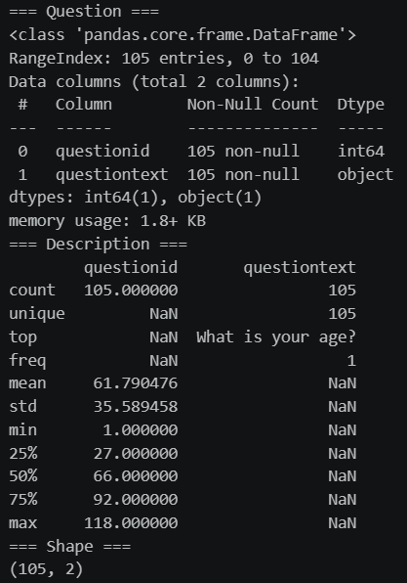
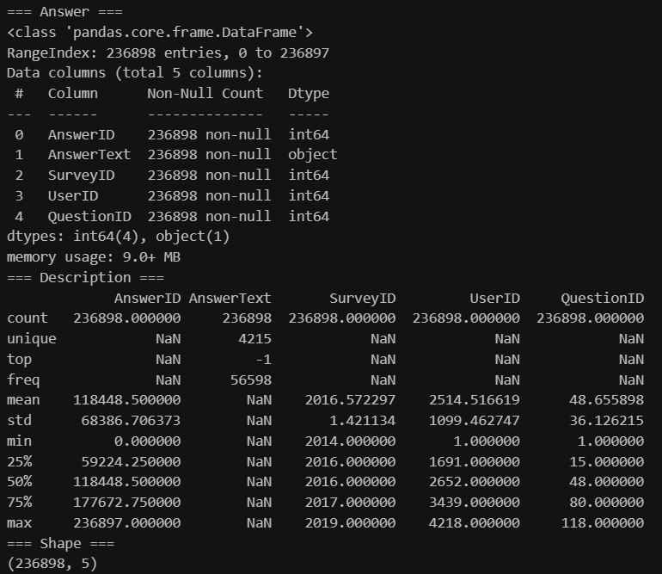
Data Overview & Statistical Summary
An anonymous survey of tech industry professionals, run annually since 2014
OSMH Survey Analysis
2

Slide 5
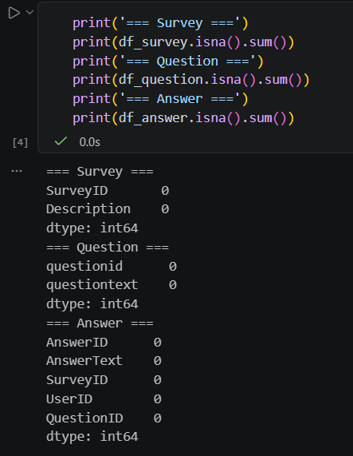
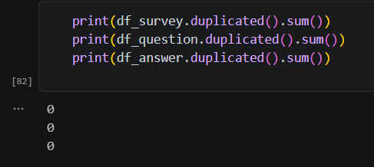
Data Preprocessing
An anonymous survey of tech industry professionals, run annually since 2014
The Dataset was clean had no missing values or duplicates
OSMH Survey Analysis
2

Slide 6
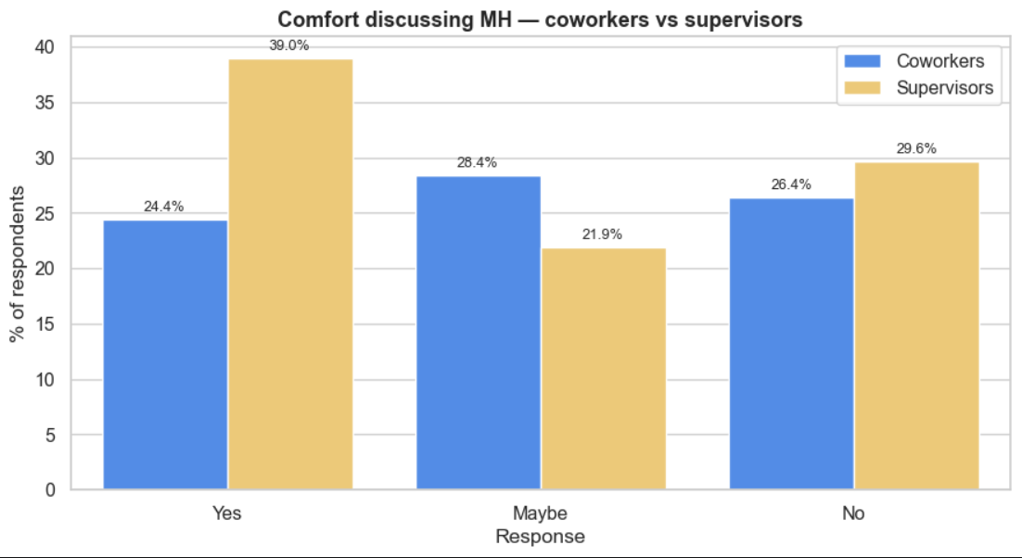
The Stigma Gap
Employees are far less willing to disclose mental health issues than physical ones
~24%
comfortable discussing mental health with coworkers
~39%
comfortable discussing mental health with a supervisor
Takeaway
Workers trust colleagues far more than hiring processes — the interview stage remains the biggest disclosure barrier.
OSMH Survey Analysis — Q12, Q18, Q19, Q29
3

Slide 7
Prevalence & Treatment
Mental health disorders are common in tech — and treatment-seeking is rising
43.6%
of respondents report a current
mental health disorder
Q33 — “Do you currently have a mental health disorder?”
OSMH Survey Analysis — Q7, Q33
4

Slide 8
Employer Support
Benefits coverage varies by company size — and anonymity is the weakest link
Q10
Q11
Q98
Employer-provided benefits
Anonymity protection
Consequences of disclosure
Whether the company offers mental health benefits. Coverage varies widely by company size, and rose from 37.9% to 46.6% between 2014 and 2019.
Whether anonymity is protected when using mental health resources. This is the weakest area — most employees simply don’t know if protections exist.
Whether discussing a mental health issue with the employer is seen as carrying negative consequences for the employee.
OSMH Survey Analysis — Q10, Q11, Q98
5

Slide 9
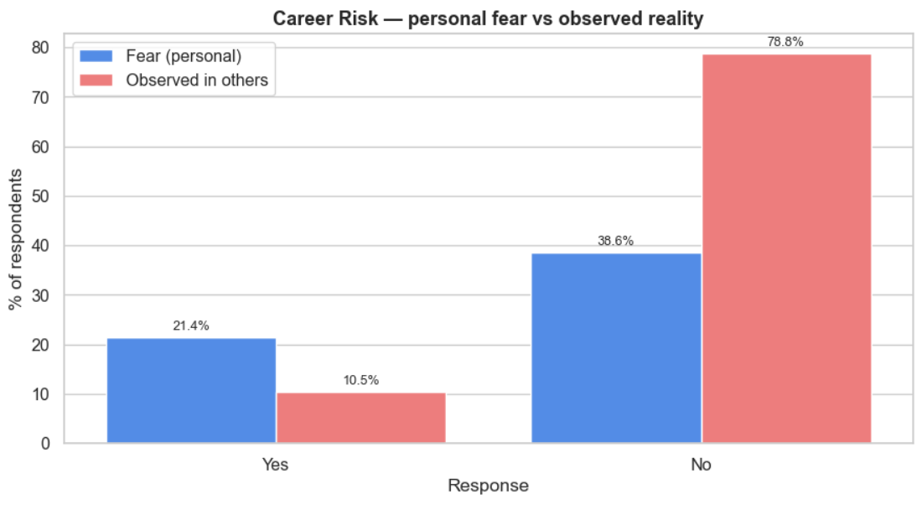
Career Risk: Fear vs. Reality
Anticipated consequences are roughly double what respondents have actually observed
OSMH Survey Analysis — Q98, Q102
6

Slide 10
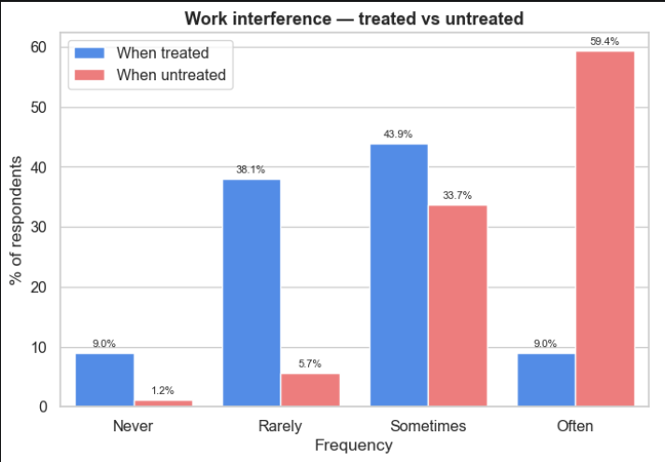
The Impact of Treatment
Effective treatment sharply reduces how often mental health interferes with work
~6.7× difference in frequent work interference between treated and untreated respondents
OSMH Survey Analysis — Q48, Q49
7

Slide 11
Year-over-Year Trends
Support is improving, but interview-stage disclosure hasn’t moved
OSMH Survey Analysis — Q10, Q7, Q12
8

Slide 12
Key Question Reference
Question IDs used throughout this analysis
Have you ever sought treatment?
Employer provide mental health benefits?
Anonymity protected?
Q7
Q10
Q11
Bring up MH issue in interview?
Comfortable discussing MH with coworkers?
Comfortable discussing MH with supervisor?
Q12
Q18
Q19
Bring up physical health issue in interview?
Currently have a mental health disorder?
MH interferes with work when treated?
Q29
Q33
Q48
MH interferes with work when untreated?
Discussing MH with employer → negative consequences?
Observed negative consequences for coworkers?
Q49
Q98
Q102
OSMH Survey Analysis
9

Slide 13
Closing the Gap
Treatment works, employer support is improving — but stigma at the interview stage hasn’t moved in five years of surveys.
Data Source
Open Source Mental Health Initiative (OSMH) — osmihelp.org
Anonymous survey of tech industry professionals about mental health in the workplace, 2014–2019.

