Slide 1

911 DISPATCH ANALYTICS • SEP 2025 – AUG 2026
SF Fire Department & EMS
Emergency Response Data Analysis
Cleaning, enrichment, predictive modeling, and dashboards built from 359,542 unit-dispatch records across San Francisco's 911 emergency medical and fire response system.
359,542
56
6
3
UNIT-DISPATCH ROWS
CLEANED COLUMNS
TEAM MEMBERS
DAY SPRINT
Source: data.sfgov.org/d/nuek-vuh3

Slide 2
PROJECT OVERVIEW
A full-pipeline analytics project
One year of San Francisco Fire Department & EMS dispatch data, taken end-to-end: acquisition, cleaning, web-scraped enrichment, feature engineering, predictive modeling, and reporting across Excel, Power BI, and Tableau.
359,542
56
49%
0.804
Unit-dispatch rows
Cleaned columns
Life-threatening calls
Linear regression R²
API snapshot + web-scraped weather, Sep 2025 – Aug 26, 2026
IDs, classification, timestamps, location, resources, metadata
Largest Call Type Group, ahead of Alarm (25%) and Fire (4%)
Predicting response time from real (uncapped) durations
SF EMS EMERGENCY RESPONSE ANALYSIS
2

Slide 3
TEAM
Six roles, one pipeline
P1
Team Lead
P2
Data Engineer
P3
Web Scraper
Coordination, code review, final QA, Excel workbook
Download, filter, clean, preprocess, export CSV
Weather, holidays & events enrichment via web scraping
P4
ML Analyst
P5
Power BI Dev
P6
Tableau Dev
Linear & logistic regression models in Python
Power BI interactive dashboard — 3 pages
Tableau interactive dashboard — 3 sheets + dashboard
SF EMS EMERGENCY RESPONSE ANALYSIS
3

Slide 4
BUSINESS QUESTIONS
Five questions driving the analysis
1
When do the most emergencies happen?
Excel, Power BI — P1, P5
Hourly, daily and monthly patterns
2
Where are the EMS hotspots?
Tableau, Power BI — P5, P6
By neighborhood, station and battalion
3
What drives response time — can we predict it?
Python — P4
Linear regression on 281k+ calls
4
Will a call need Advanced Life Support?
Python — P4
Logistic classification of ALS need
5
Does weather affect call volume?
Python + scraping — P2, P3
Open-Meteo enrichment + correlation
SF EMS EMERGENCY RESPONSE ANALYSIS
4

Slide 5
DATASET SNAPSHOT
What kind of calls come in
Potentially Life-Threatening
49% — 176,518 calls
Alarm
25% — 89,896 calls
Non Life-Threatening
19% — 69,223 calls
Fire
4% — 14,053 calls
40+ specific Call Types roll up into these 4 groups — the primary lens for volume, geography, and modeling.
SF EMS EMERGENCY RESPONSE ANALYSIS
5

Slide 6
DATASET SNAPSHOT
How calls resolve
Call Final Disposition, all unit-dispatch rows
SF EMS EMERGENCY RESPONSE ANALYSIS
6

Slide 7
PROJECT PIPELINE
Nine phases
1
Data Acquisition
& Cleaning
2
Web Scraping
& Enrichment
3
Feature
Engineering
Download, filter, timestamp conversion, null handling
Open-Meteo weather + holidays merged by date
Response time, dispatch lag, IQR outlier flags
4
Exploratory
Analysis
5
Predictive
Modeling
6
Excel
Analysis
Volume trends, geography, response-time distributions
Linear & logistic regression in scikit-learn
5-sheet workbook: summary, pivots, response stats
7
Power BI
Dashboard
8
Tableau
Dashboard
9
Delivery
3-page interactive report
3 sheets + combined dashboard
Delivering all outputs.
SF EMS EMERGENCY RESPONSE ANALYSIS
7

Slide 8
FEATURE ENGINEERING
Flag outliers — never cap them
Standard 1.5× IQR bounds are computed at runtime and written as flag columns — the raw CSV keeps every real measured time.
Derived column | Upper fence | Flagged | % of rows
response_time_min | 23.77 min | 22,094 | 6.2%
dispatch_lag_min | 2.35 min | 41,976 | 11.7%
transport_time_min | 43.46 min | 2,522 | 0.7%
Core derived features
response_time_min
On Scene − Received — LR target
dispatch_lag_min
Dispatch − Entry — LR feature
is_als
ALS Unit as 0/1 — LogR target
Why flag, not cap?
hour_of_day / day_of_week / month
Capping response times crushed model fit — R² dropped from 0.80 to 0.56. Keeping real values and letting Excel, Power BI, and the ML pipeline filter on is_outlier_* == False preserves both data truth and model performance. Negative durations from data inconsistencies fall below the lower fence and are auto-flagged.
Temporal features for both models
is_weekend
Saturday or Sunday flag
SF EMS EMERGENCY RESPONSE ANALYSIS
8

Slide 9
PREDICTIVE MODELING — LINEAR REGRESSION
Predicting response time
0.804
3.32
5.50
281,553
R²
MAE (MIN)
RMSE (MIN)
ROWS USED
Target & features
Why R² jumped from 0.56 → 0.80
Target: response_time_min (real, uncapped values — outliers flagged, not removed).
Features: call type & group, priority, unit type, hour/day/month, is_weekend, dispatch lag, units per incident, alarms, battalion, neighborhood, plus scraped weather (temperature, precipitation, wind, holiday).
The earlier 0.56 run used the capped dataset, where ~22k rows were pinned to 23.78 minutes — crushing the linear fit. Switching to real, flag-only values recovered the relationship.
Weather adds < 0.001 to R² — response time is driven by logistics and dispatch, not conditions.
SF EMS EMERGENCY RESPONSE ANALYSIS
9

Slide 10
PREDICTIVE MODELING — LOGISTIC REGRESSION
Classifying response speed
3-class model: Fast / Moderate / Slow, split at 5 and 10 minutes
0.745
0.73
0.24
ACCURACY
WEIGHTED F1
RECALL — FAST CLASS
Reading the result
Uses the same feature set as the linear model. Overall accuracy and F1 are solid, but the classifier is weak on the Fast class (recall 0.24) due to class imbalance — most calls fall into Moderate/Slow buckets, so Fast responses are under-represented in training.
Note: the README's original target table predates this final 3-class design (5/10-minute cutoffs); the modeling notebook is the authoritative source for methodology.
SF EMS EMERGENCY RESPONSE ANALYSIS
10

Slide 11
REPORTING & DASHBOARDS
Three ways to explore the data
Excel
Power BI
Tableau
Summary KPIs & top call types/neighborhoods
Overview: KPI cards, monthly trend line
Time Trends: volume bars + response-time line
Pivot: Call Type × Neighborhood
Geography: neighborhood map, drill to station
Priority Heatmap by final priority, filterable
Pivot: Hour of Day × Day of Week
Operations: call type donut, priority mix, hour heatmap, response-time box plot
Call Distribution: type group × battalion
Response-time stats by battalion (P90/P95)
Combined dashboard with filter actions
Monthly trend pivot
SF EMS EMERGENCY RESPONSE ANALYSIS
11

Slide 12
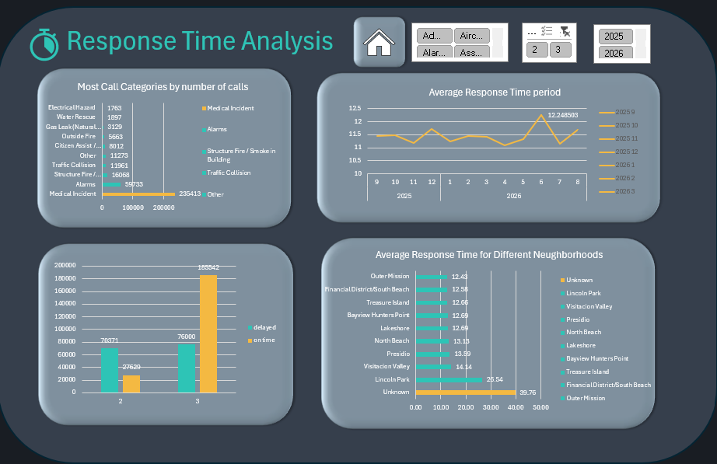
Dashboards
Excel Dashboard
SF EMS EMERGENCY RESPONSE ANALYSIS
12

Slide 13
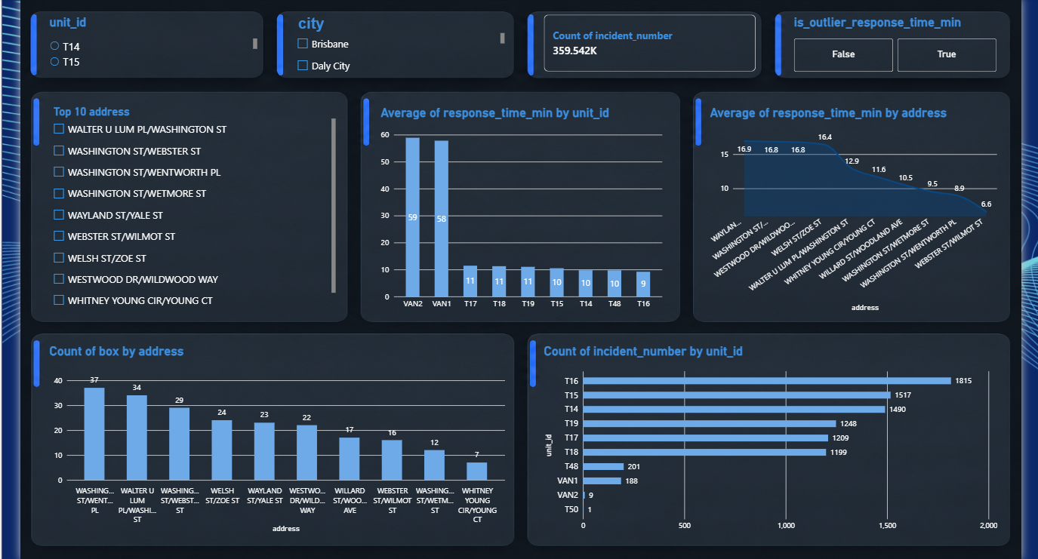
Dashboards
Power BI Dashboard

Slide 14
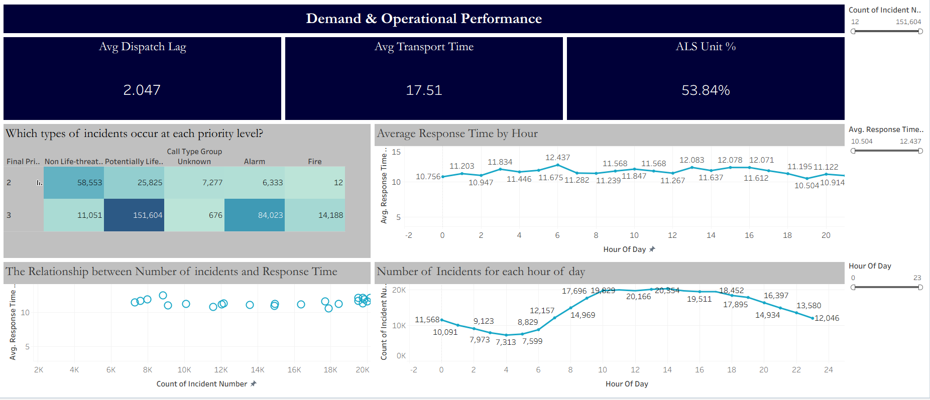
Dashboards
Tableau Dashboard

