Slide 1
IMMIGRATION & CITIZENSHIP SERVICE (ICS) • EXECUTIVE BRIEFING
Digital Document Archive & File Management System
Next-Generation Digital Transformation: Automated AI/OCR Intake, Physical Warehouse Tracking, Multi-Branch Federation, and Tamper-Proof Audit Compliance.
Presented for Senior Leadership & Executive Board Approval | Version 2.0 Enterprise Release

Slide 2
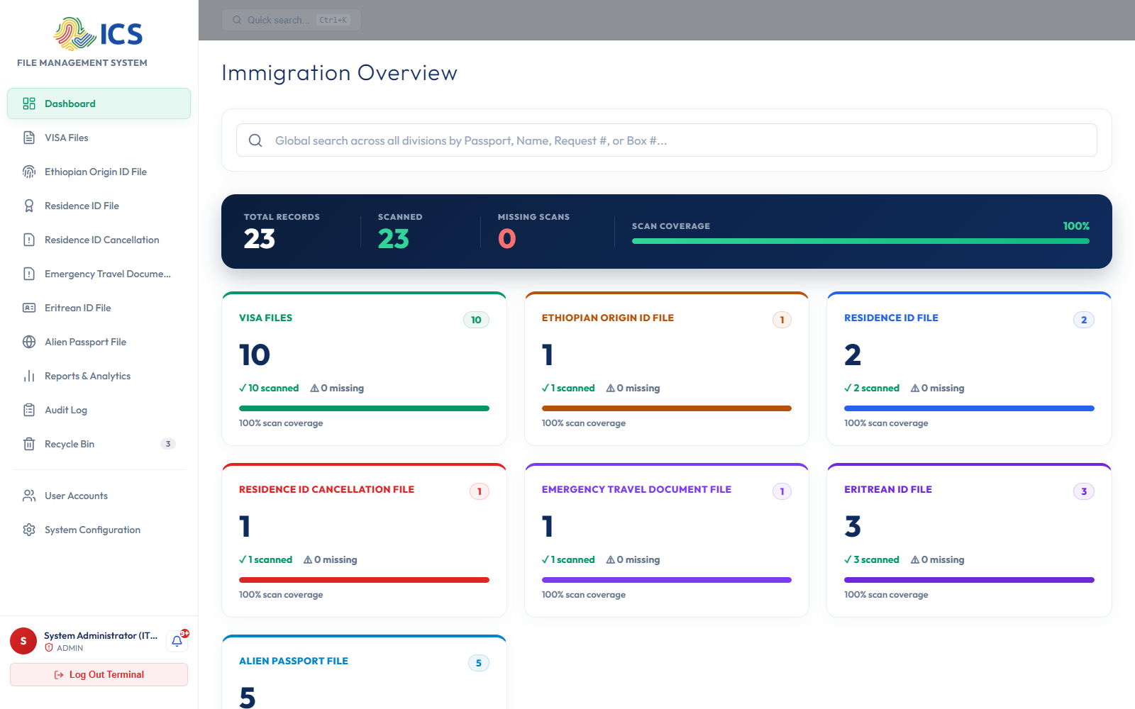
EXECUTIVE OVERVIEW
Modernizing National Immigration Archives
Bridging Digital Intelligence with Physical Warehouse Control
• Replaces slow, vulnerable manual paper registers with an enterprise-grade digital management system.
• Integrates Optical Character Recognition (AI/OCR) to auto-extract Machine Readable Zones (MRZ) from passports and IDs.
• Provides dual-indexing: digital dossiers are linked to physical building, room, shelf, box, and folder coordinates.
• Unifies 14 branch stations nationwide under centralized oversight with strict regional data segregation.
EXECUTIVE VALUE & ROI
Reduces document retrieval time from hours to under 3 seconds while eliminating paper dossier misplacement.

Slide 3
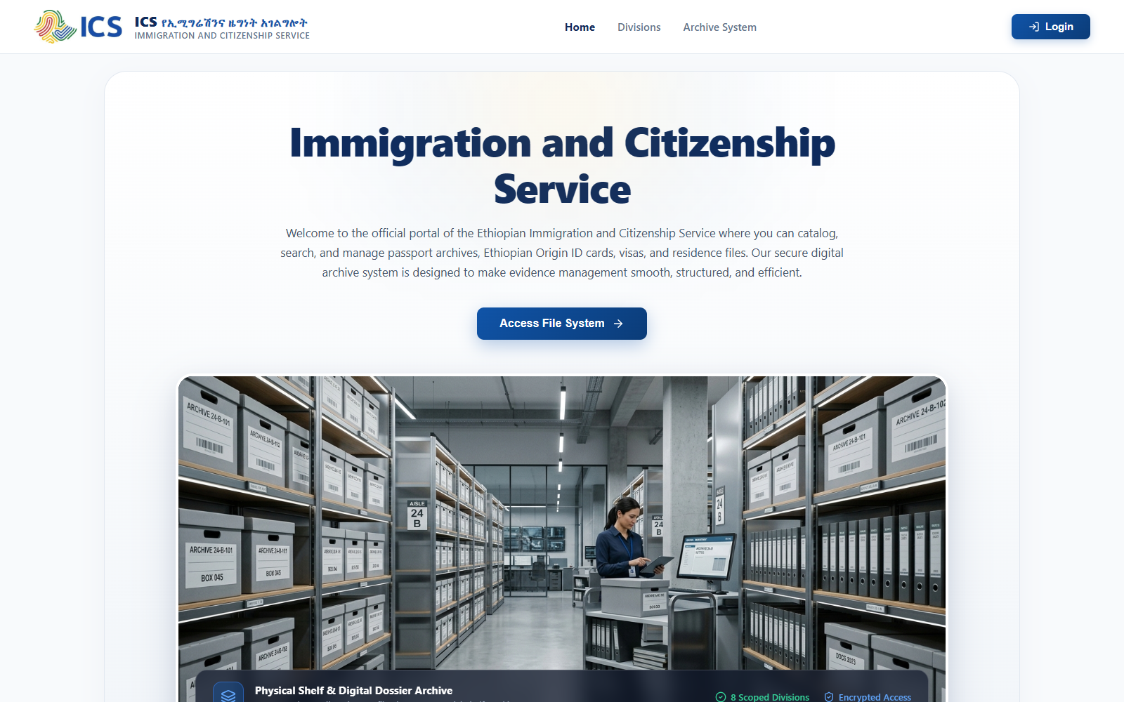
SYSTEM SECURITY
Tiered Authentication & Access Control
Enterprise Security Gate with 15-Minute Session Expiry
• Role-Based Access Control (RBAC) isolating Admin, Supervisor, Officer, Auditor, and Viewer tiers.
• Automatic account lock protection against unauthorized brute-force credential attacks.
• Session expiration strictly enforced after 15 minutes of inactivity to protect sensitive government records.
• Individual user accountability with encrypted authentication and password governance.
EXECUTIVE VALUE & ROI
Complies with national government data security standards and prevents unauthorized identity record tampering.

Slide 4
OPERATIONAL DASHBOARD
Real-Time National Dossier Metrics & KPIs
Instant Strategic Visibility Across All Divisions & Stations
• Real-time counter displaying total indexed files across all categories (Visas, EOID, Residence IDs, ETD).
• Branch filtering enabling leadership to inspect nationwide statistics or drill into specific regional stations.
• Quick access shortcuts for instant document registration and emergency lookups.
• Visual trend tracking showing daily intake velocity and pending archive backlogs.
EXECUTIVE VALUE & ROI
Provides executive leadership with real-time operational transparency to optimize resource allocation across branches.

Slide 5
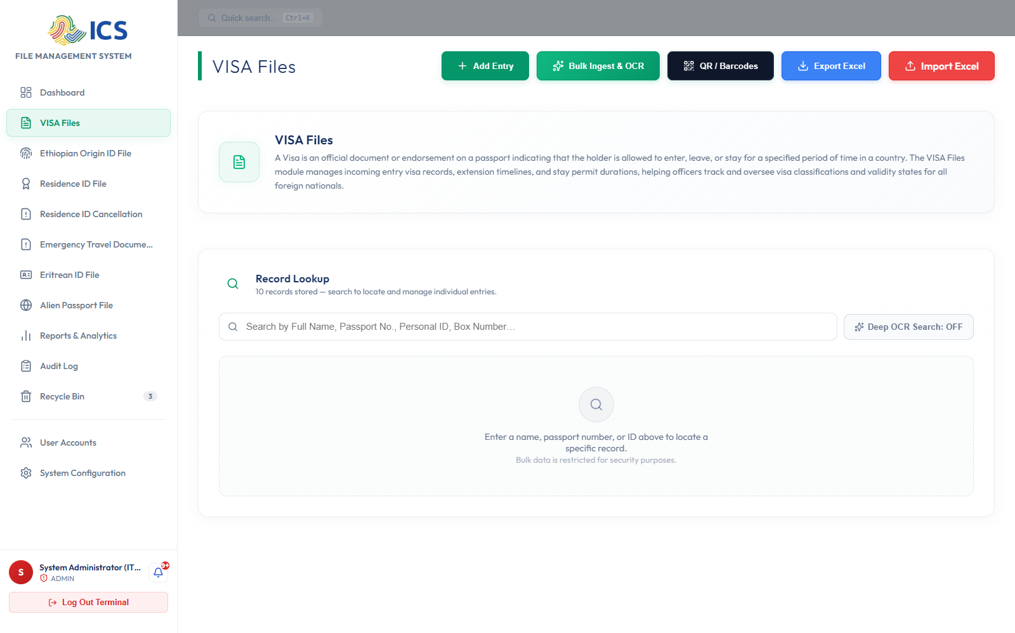
CORE DIVISION
Visa Dossiers & Immigration Processing
End-to-End Tracking of Foreign National Records
• Centralized ledger for all visa classifications (Work, Business, Student, Tourist, Diplomatic, Investment).
• Comprehensive metadata capture: Passport Number, Full Name, Nationality, Sex, and Expiry Dates.
• Complete digital attachment archive preserving scanned visa seals, permits, and correspondence.
• Color-coded status indicators (Active, Pending, Expired, Cancelled) for rapid officer verification.
EXECUTIVE VALUE & ROI
Ensures total legal compliance and seamless verification of legal residency and visa permits nationwide.

Slide 6
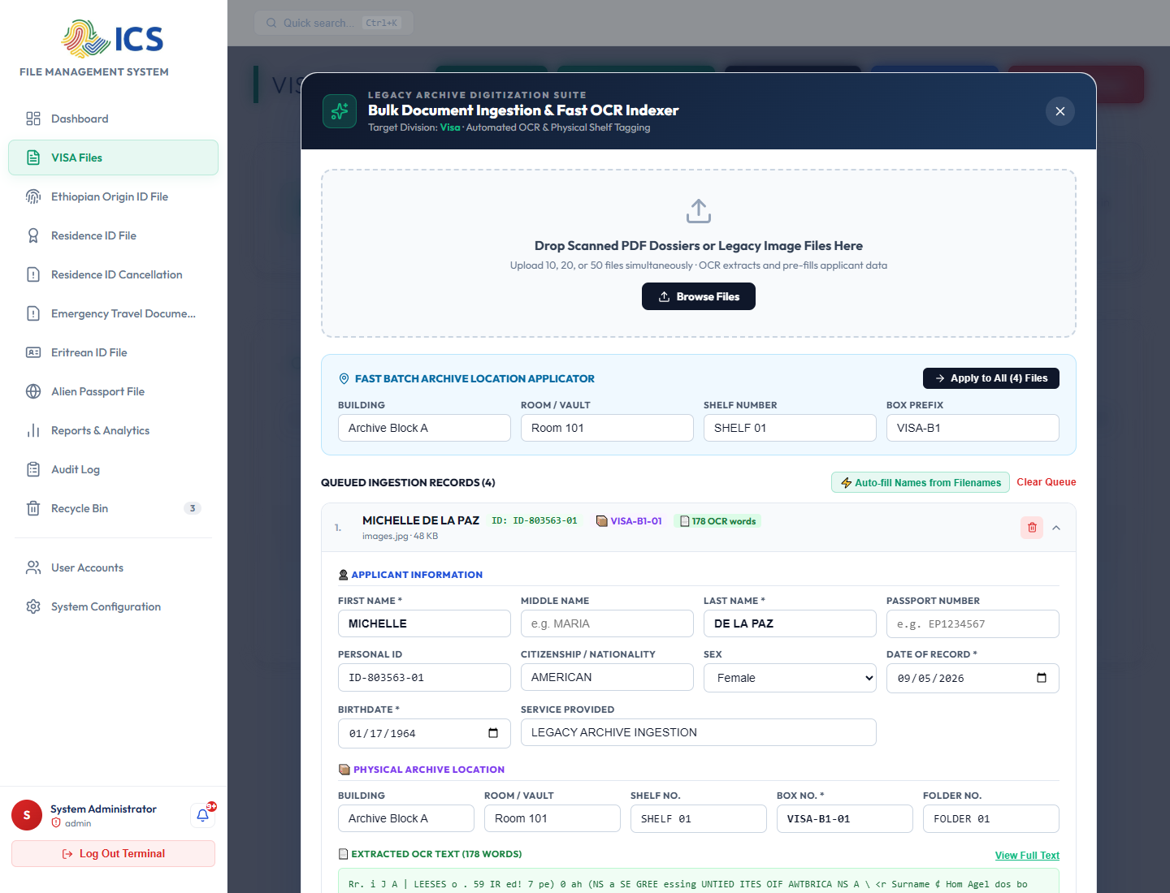
AUTOMATION & AI
Automated Bulk Ingestion & AI/OCR Parsing
Accelerating Dossier Ingestion by 800% Through OCR
• High-accuracy OCR parser extracts Machine Readable Zones (MRZ Lines 1 & 2) and document headers.
• Intelligently filters out background guilloche security watermarks on USA, Canadian, and Ethiopian passports.
• Auto-populates Given Name, Surname, Passport Number, Nationality, and Sex into queue records.
• Batch commit ('Ingest & Index All') validates and stores dozens of scanned files in seconds.
EXECUTIVE VALUE & ROI
Transforms days of manual data typing into minutes of automated optical recognition with zero typing errors.

Slide 7
PHYSICAL ARCHIVE CONTROL
5-Tier Physical Warehouse Mapping
Zero-Loss Guarantee for Physical Paper Dossiers
• Every digital file record links to exact physical warehouse coordinates: Building, Room, Shelf, Box, and Folder.
• Automated File Reference indexing (e.g. VISA-B1-01) for physical box labeling.
• Allows warehouse clerks to locate physical dossiers in shelves within 60 seconds of an inquiry.
• Preserves physical integrity and chain of custody during historical archive relocation or audits.
EXECUTIVE VALUE & ROI
Bridges the critical gap between digital database entries and physical warehouse storage, eliminating lost records.

Slide 8
CITIZEN & DIASPORA SERVICES
Ethiopian Origin ID (Yellow Card) Tracking
Dedicated Management for Diaspora & Residence Permits
• Separate specialized workflows for Normal Ethiopian Origin ID and Under-Age Guardian-linked records.
• Integrated tracking for Residence ID Cards and Residence ID Cancellations with service justification.
• Emergency Travel Documents (ETD) and Eritrean ID dossiers managed under unified search standards.
• Protects sensitive diaspora records while enabling rapid consular verification and renewal processing.
EXECUTIVE VALUE & ROI
Streamlines consular and diaspora services while maintaining rigorous national security verification.

Slide 9
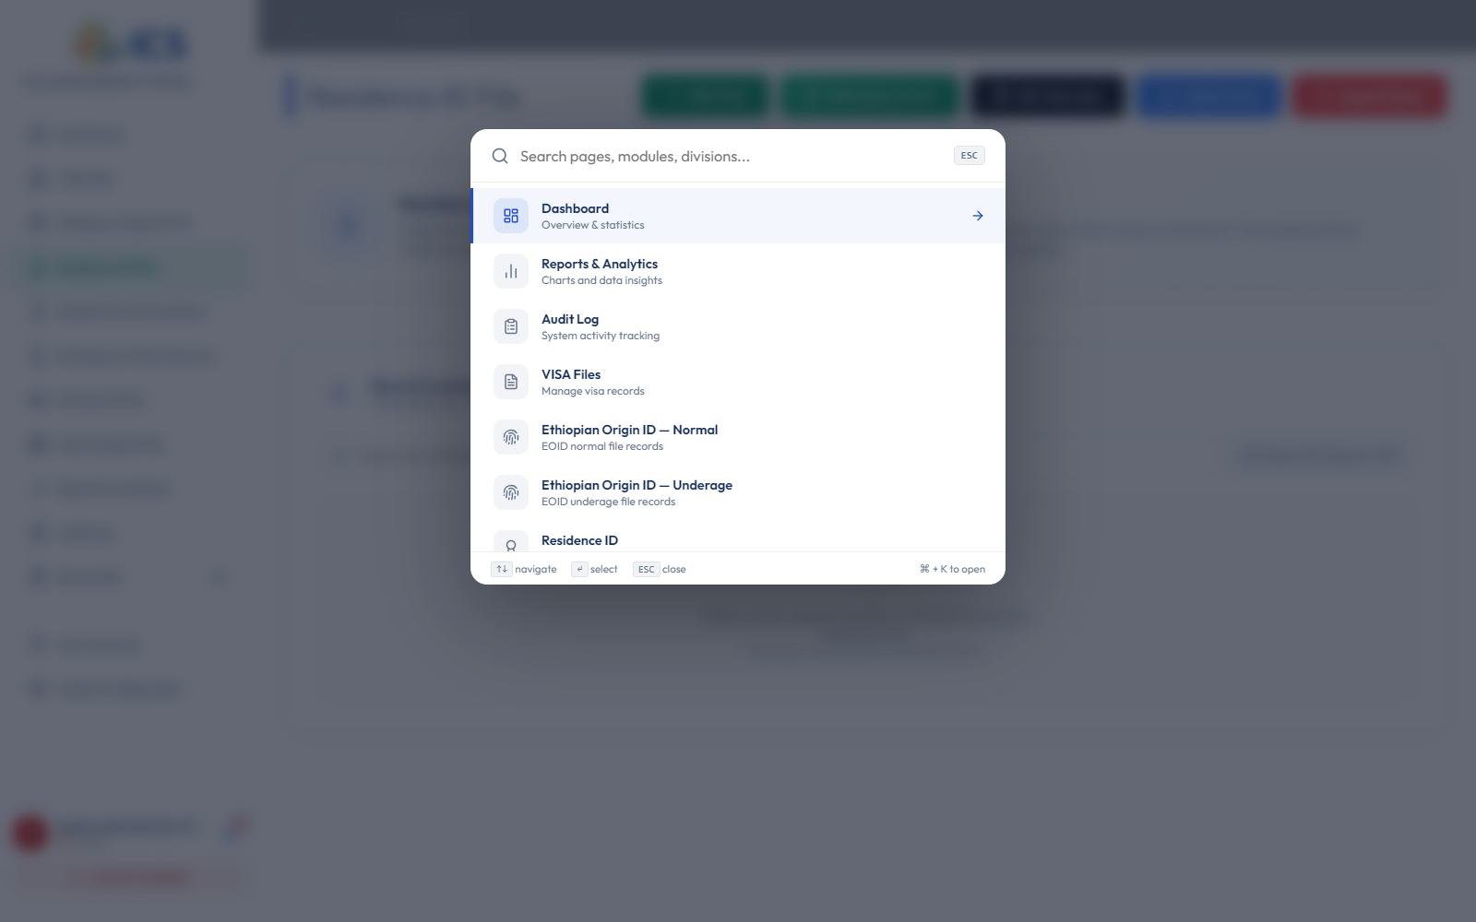
SEARCH & RETRIEVAL
Enterprise Command Palette & Instant Search
Sub-Second Dossier Lookups Across Millions of Records
• Accessible from any screen via 'Ctrl + K' shortcut for lightning-fast officer navigation.
• Global multi-parameter search querying Applicant Name, Passport Number, File ID, or Box Reference.
• Immediate keyboard navigation between modules, divisions, user management, and system reports.
• Reduces front-desk citizen wait times during in-person inquiries and border verification checks.
EXECUTIVE VALUE & ROI
Empowers frontline border and desk officers with instantaneous retrieval, boosting customer satisfaction.

Slide 10
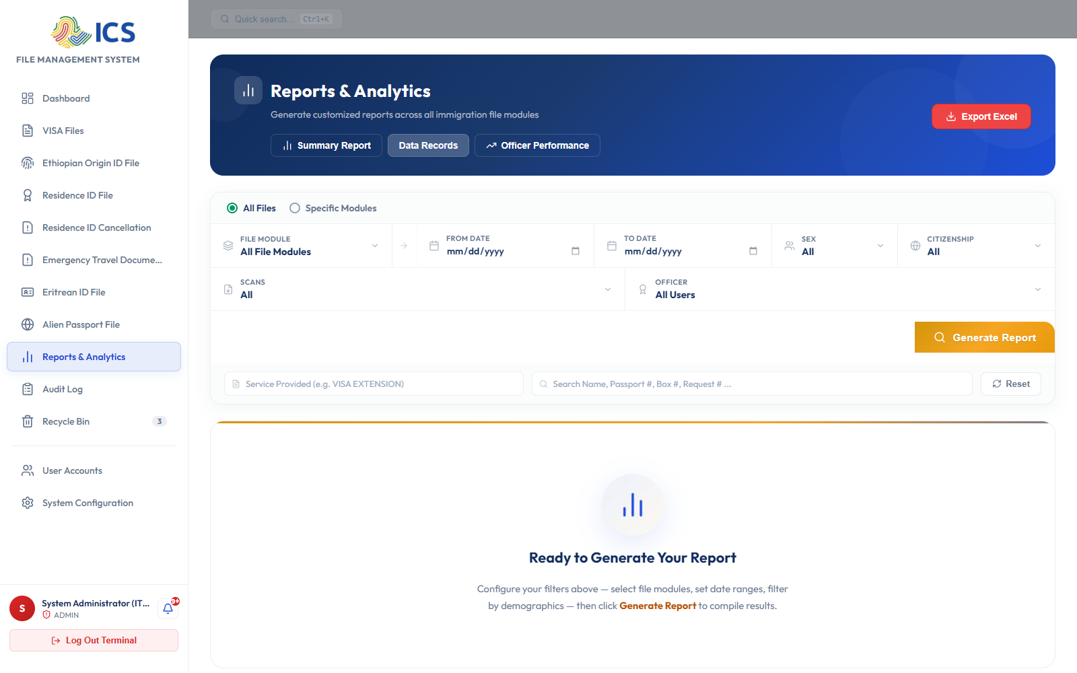
STRATEGIC ANALYTICS
Executive Reports & National Demographics
Data-Driven Decision Making & Trend Forecasting
• Interactive charts analyzing visa issuance distributions, nationality breakdowns, and sex demographics.
• Branch workload comparisons revealing operational bottlenecks and intake surges.
• One-click data export to Excel (XLSX), CSV, and PDF for executive board presentations and ministry reports.
• Configurable date range filters for annual, quarterly, or monthly immigration performance auditing.
EXECUTIVE VALUE & ROI
Equips executive directors with real-time analytics to make proactive policy and staffing decisions.

Slide 11
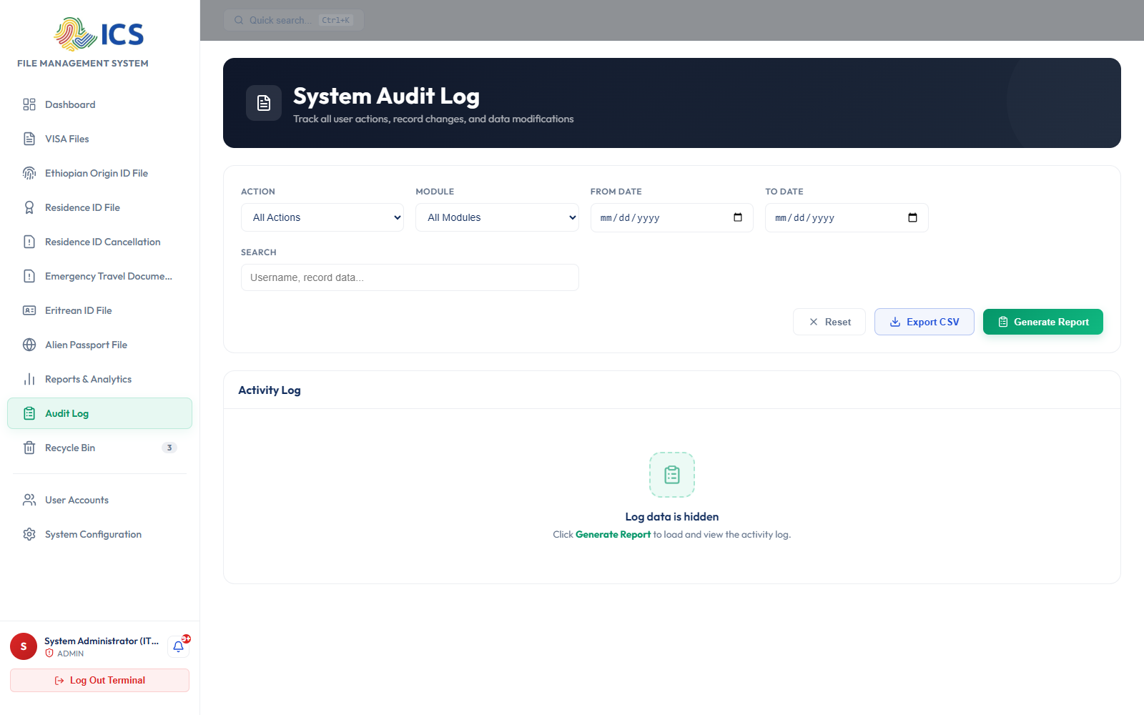
GOVERNANCE & FORENSICS
Tamper-Proof Audit Trail & Regulatory Compliance
Complete Forensic Accountability for Every System Interaction
• Immutable audit log capturing user identity, precise timestamp, IP address, and target record ID.
• Detailed before-and-after change diffs recorded whenever a document is modified or updated.
• Specialized 'AUDITOR' role with read-only inspection access to ensure independent compliance checks.
• Total transparency discouraging insider data manipulation and safeguarding legal records.
EXECUTIVE VALUE & ROI
Guarantees 100% compliance with national archival laws, anti-corruption mandates, and international audit standards.

Slide 12
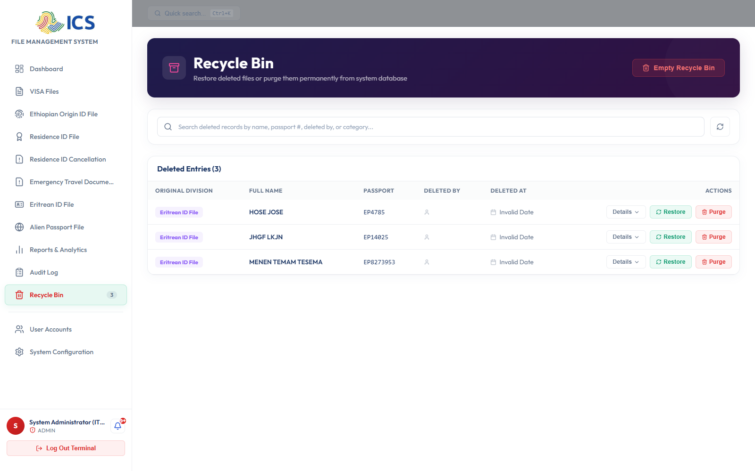
DATA PROTECTION
Enterprise Disaster Recovery & Recycle Bin
Two-Tier Soft Deletion Preventing Accidental Data Loss
• Restricted delete permissions: records are moved to an administrative Recycle Bin rather than permanently wiped.
• One-click instant restoration preserves original file metadata, archive coordinates, and attachments.
• Only Super Administrators possess purge authority, preventing rogue deletions by rogue or compromised accounts.
• PostgreSQL backend automated backups ensure zero business interruption and rapid disaster recovery.
EXECUTIVE VALUE & ROI
Eliminates the catastrophic business risk of accidental document deletion or malicious data destruction.

Slide 13
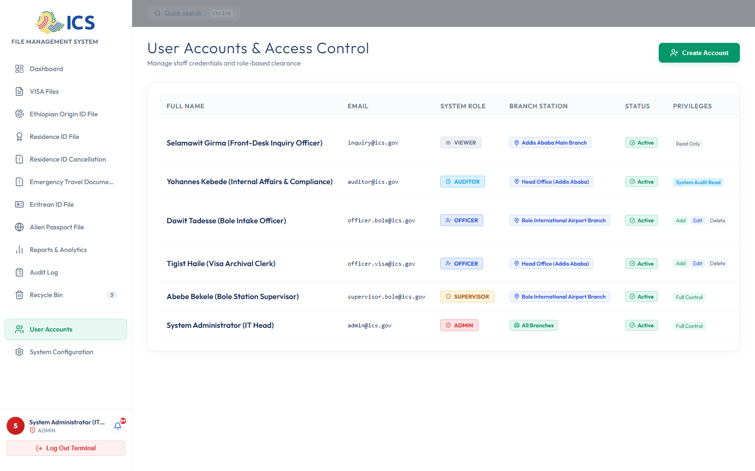
SECURITY ADMINISTRATION
User Accounts & Role-Based Clearance Matrix
Granular Security Governance Across 5 Defined User Tiers
• ADMIN: Nationwide full control over system modules, user credentials, and security policies.
• SUPERVISOR: Branch-level authority over intake, officer task delegation, and station reporting.
• OFFICER: Operational intake, scanning, OCR validation, and physical shelf/box filing.
• AUDITOR: Read-only investigative access across records and tamper-proof audit trails.
• VIEWER: Front-desk read-only inquiry access for physical dossier retrieval and applicant queries.
EXECUTIVE VALUE & ROI
Enforces the Principle of Least Privilege (PoLP), ensuring staff only access files required for their official duties.

Slide 14
SYSTEM EXTENSIBILITY
Dynamic Custom Module Builder & Station Config
Future-Proof Architecture Adapting to Evolving Legislation
• Allows administrators to create new document categories and divisions on-the-fly without developer code changes.
• Configurable document classifications, custom metadata fields, unique prefixes, and icons.
• Dynamic station management: add, configure, or activate regional branch stations across Ethiopia.
• Seamless database schema migration automatically extends backend tables upon module activation.
EXECUTIVE VALUE & ROI
Guarantees long-term sustainability and eliminates expensive software vendor change orders as regulations evolve.

Slide 15
STRATEGIC IMPACT & NEXT STEPS
Business Case & Request for Formal Approval
⚡ OPERATIONAL IMPACT
• 85% Reduction in physical dossier retrieval times (from hours to seconds).
• 800% Faster document ingestion with AI-powered OCR MRZ scanning.
• Zero misplaced paper files through 5-tier warehouse shelf & box coordinates.
🛡️ RISK & COMPLIANCE
• 100% Immutable audit trail tracking every modification with IP and timestamps.
• Multi-branch regional data isolation protecting sensitive citizen data.
• Secure Recycle Bin preventing accidental or unauthorized permanent data loss.
🎯 APPROVAL REQUEST
1. Senior Management Sign-Off on Phase 1 Deployment.
2. Staff Onboarding & Branch Training (HQ & Bole Airport Pilot).
3. Phased Regional Rollout to 12 Branch Stations nationwide.

