Slide 1
SECURE DATA HIDING IN IMAGES USING STEGANOGRAPHY
CAPSTONE PROJECT
Presented By : Mohammed Umair
Student Name : Mohammed Umair
College Name : Kakatiya Institute of Technology and Science
Department : Computer Science Engineering with specialization in Artificial
intelligence and Machine Learning

Slide 2
OUTLINE
Problem Statement
Technology used
Wow factor
End users
Result
Conclusion
Git-hub Link
Future scope

Slide 3
Problem Statement
The project "Secure Data Hiding in Images Using Steganography" focuses on embedding secret messages into digital images in a way that is undetectable to the human eye. By modifying the pixel values of an image, the message is securely hidden, with access restricted by a passcode. The system allows users to encrypt a message within an image and later decrypt it using the correct passcode, ensuring data confidentiality and secure communication. The approach combines image processing with cryptographic principles to protect sensitive information.

Slide 4
Technology used
1.Python: The primary programming language used for developing the steganography system.
2.OpenCV: A library used for image processing, allowing manipulation of pixel values to embed and extract messages from images.

Slide 5
Wow factors
The wow factor of your project lies in the integration of secure data hiding using steganography with a user-friendly graphical interface (GUI). The use of OpenCV to manipulate image pixels for message embedding and the added layer of security with a passcode for decryption makes it a robust and efficient system for confidential communication. The inclusion of a GUI adds an intuitive, accessible experience, allowing users to easily interact with the encryption and decryption process without needing technical expertise. This combination of security, ease of use, and visual appeal makes your project stand out.

Slide 6
End users
Individuals Seeking Secure Communication: Anyone looking for a way to send confidential messages (e.g.,
passwords, personal data) securely over potentially untrusted mediums like email or social media.
Businesses and Professionals: Organizations that need to protect sensitive information when sharing data internally or
externally, such as financial reports, legal documents, or proprietary information.
Cybersecurity Enthusiasts: People interested in learning about data protection, encryption, and steganography as a
method of securing data.
Government or Intelligence Agencies: For secure communication and covert data sharing, where confidentiality is
crucial.
Students and Researchers: Those studying cryptography, data security, or steganography as part of academic
coursework or research projects.

Slide 7
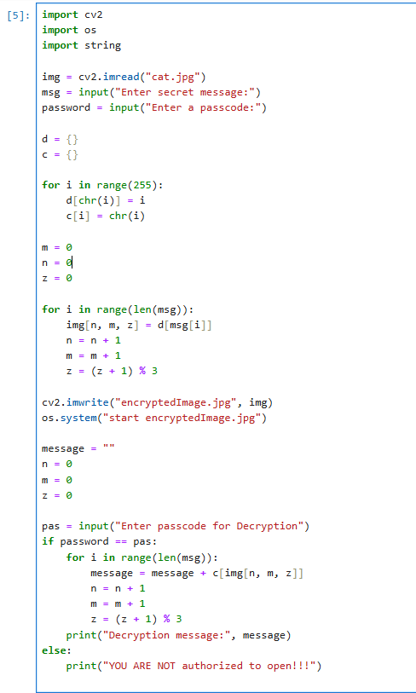
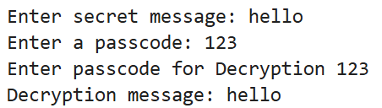


Results
Image
Encrypted Image

Slide 8
Conclusion
In conclusion, the "Secure Data Hiding in Images Using Steganography" project provides a robust and efficient solution for securely embedding and extracting confidential messages within digital images. By combining the power of OpenCV for image processing and encryption with an intuitive GUI, the system ensures both ease of use and data confidentiality. The incorporation of a passcode for message decryption adds an extra layer of security, making it suitable for individuals, businesses, and organizations seeking to protect sensitive information. This project demonstrates the effectiveness of steganography as a secure communication method and showcases the potential for its real-world applications.

Slide 9
GitHub Link
https://github.com/MohammedUmair123/Steganograpghy.git

Slide 10
Future scope(optional)
The "Secure Data Hiding in Images Using Steganography" project has significant potential for future enhancements and applications, including:
Multiple Message Embedding: The system can be extended to support embedding multiple messages or larger volumes of data within a single image, improving its versatility for various use cases.
Support for Other File Formats: In addition to images, the project can be expanded to support hiding messages in other media formats such as audio, video, or PDF files, broadening its applicability.
Stronger Encryption Algorithms: To further enhance data security, the integration of advanced encryption algorithms (e.g., AES, RSA) could be implemented alongside steganography, adding a double layer of protection.
Compression Techniques: Introducing data compression before embedding could enable the system to hide larger messages without significantly altering the image’s quality or size.
Detection and Prevention of Steganalysis: Research can be done into improving the invisibility of the hidden message, making it more resistant to detection through steganalysis techniques used by security experts.

Slide 11
THANK YOU

