Slide 1
Salesforce Leads and Opportunities Analytics
Presented by: Mohammed Waseem
Tools: Power BI, Tableau, MySQL, Excel and Python

Slide 2
Project Objective
Build analytical solution to track sales lifecycle from leads to opportunities.
Integrate and clean data from multiple sources.
Design interactive dashboards for decision-making.
Validate insights using MySQL queries.

Slide 3
Data Preparation & Cleaning
1. Collected datasets from Excel.
2. Verified and standardized data types.
3. Filled null values using pattern matching.
4. Cleaned and corrected country names using VLOOKUP.
5. Removed duplicates and ensured consistency.
6. Loaded cleaned data into Power BI and Tableau.

Slide 4
Data Modeling & Integration
Created relationships between Leads, Accounts, and Opportunities in Power BI.
Added calculated columns and DAX measures for KPIs.
Created calculated fields in Tableau for comparison visuals.
Connected data sets to MySQL via Python.
Wrote SQL queries for validation.

Slide 5
Lead Dashboard (Power BI)
KPIs:
• Total Leads: 10,000
• Converted Accounts: 1,016
• Expected Amount: $39.15M
• Conversion Rate: 10.16%
Insights:
• Inside Sales & Website are top lead sources.
• Safety & Security industry dominates.
• Funnel and Closed Won stages show improvement.

Slide 6
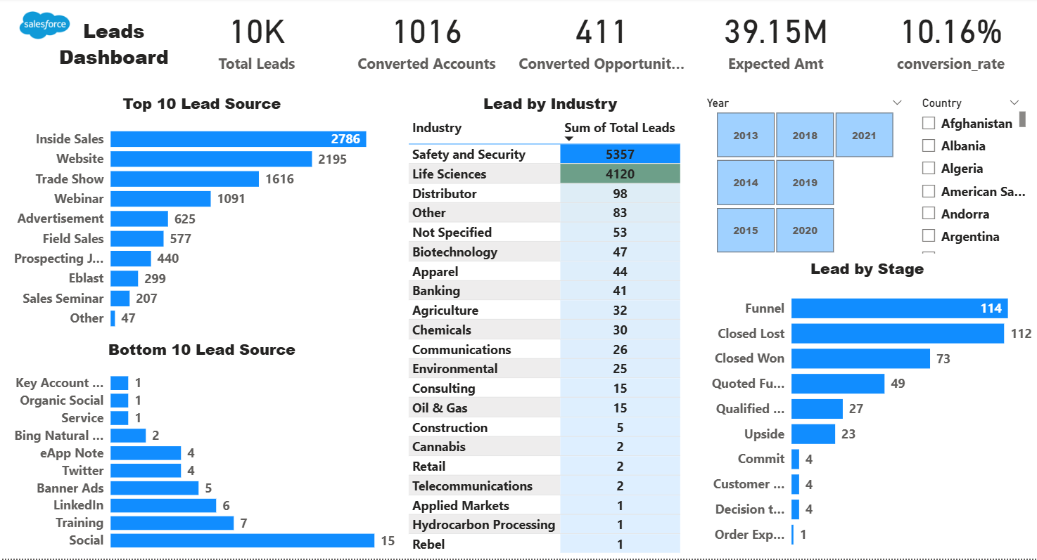

Slide 7
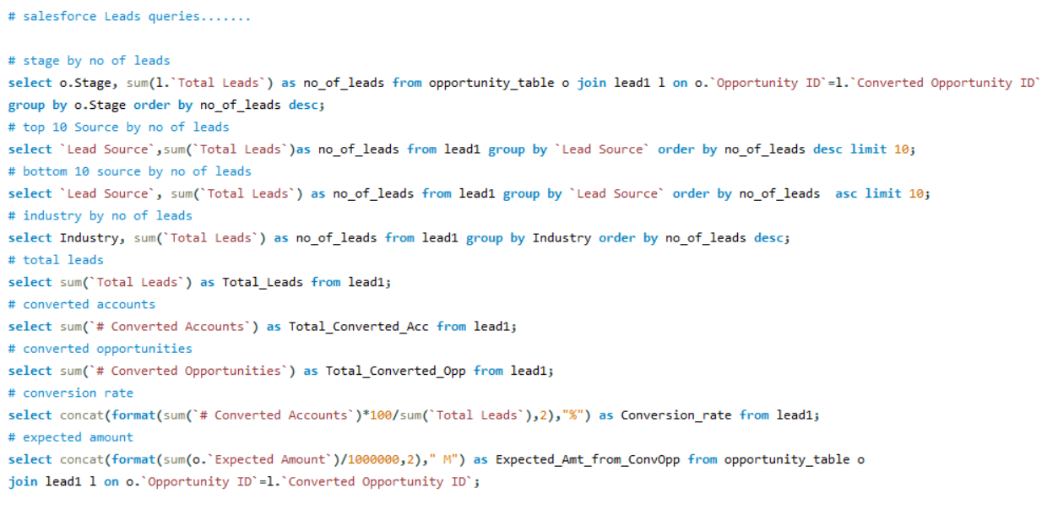

Slide 8
Opportunity Dashboard (Tableau)
KPIs:
• Active Opportunities: 1,272
• Conversion Rate: 31.06%
• Loss Rate: 41.56%
• Expected Amount: $184.1M
Insights:
• Peak performance in 2021.
• Safety & Security had highest expected amount.
• Top industries: Biopharma and State & local.

Slide 9
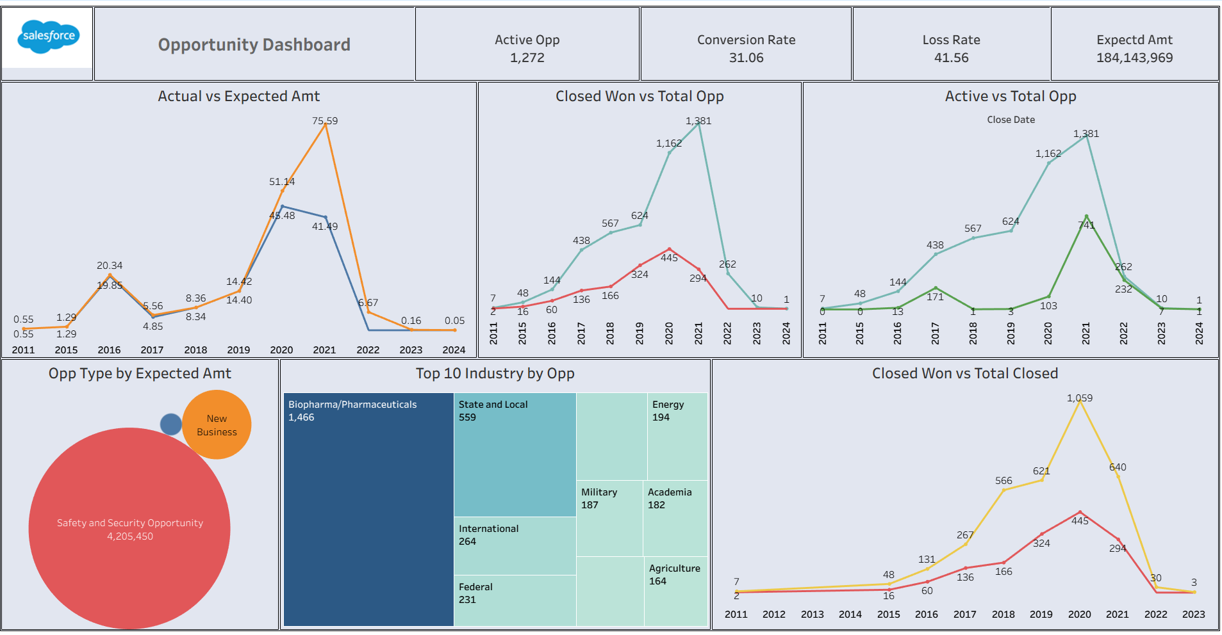

Slide 10
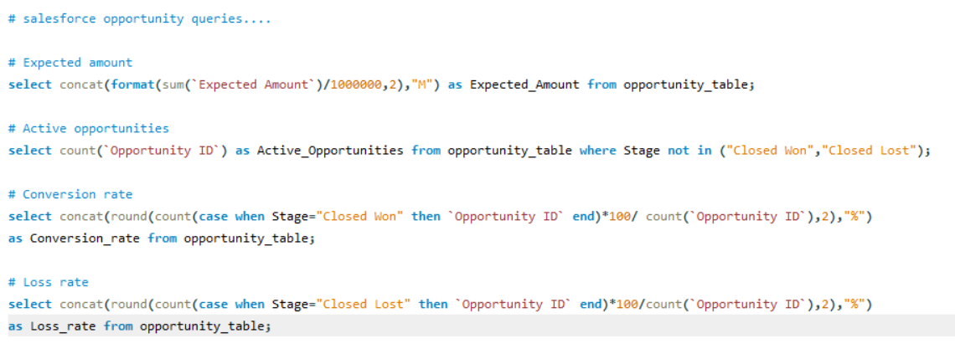

Slide 11
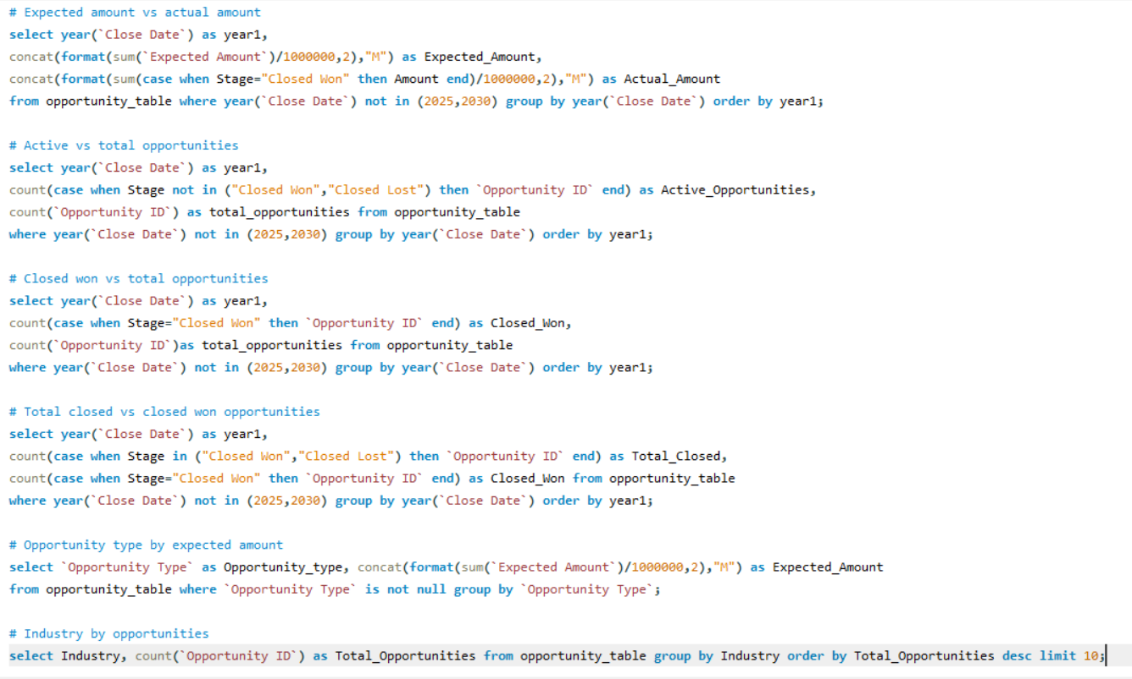

Slide 12
Insights & Findings
Inside Sales & Website generate 50% of leads.
Conversion rate 10.16% indicates improvement potential.
Safety & Security & Life Sciences lead in both dashboards.
2021 peak year for opportunities & revenue.
Biopharma and State & local sectors show growth potential.

Slide 13
Tools & Technologies
• Data Cleaning: Python, Excel
• Visualization: Power BI, Tableau
• Database: MySQL
• Integration: Python (pandas, SQL Alchemy)
• Calculations: DAX, Calculated Fields, SQL Queries

Slide 14
Challenges & Solutions
Challenge: Inconsistent country names → Solved with pattern matching & VLOOKUP.
Challenge: Duplicates → Removed with Power Query.
Challenge: Platform consistency → Validated with SQL queries.

Slide 15
Conclusion
Built two interactive dashboards covering complete sales lifecycle.
Improved accuracy through data cleaning & modeling.
Delivered insights for better decision-making.
Demonstrated integration of Power BI, Tableau, and MySQL.

Slide 16
Thank you!

