Slide 1
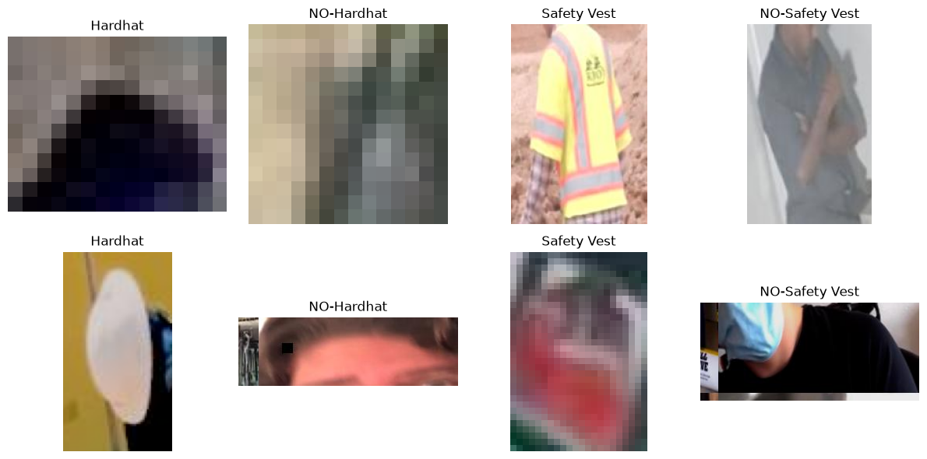
SafeSight
Construction PPE Recognition
Using Neural Networks and Transfer Learning
Course: MLAI 504 — Neural Networks & Deep Learning
Task: 4-class classification of annotated PPE regions
Dataset: Roboflow Universe — Construction Site Safety v27
Best final model: Fine-tuned MobileNetV2
Test accuracy
91.45%
Test macro-F1
90.91%
Unsafe-class recall
92.43%
Prepared from executed notebook results

Slide 2
Project overview
OVERVIEW
What problem was solved and how the work is organized.
Project goal
Classify cropped construction-site PPE regions into 4 classes: Hardhat, NO-Hardhat, Safety Vest, and NO-Safety Vest.
Research question
Does transfer learning improve PPE recognition compared with an MLP baseline and scratch CNN models?
Project workflow
Dataset selection → preprocessing → step-by-step models → tuning → transfer learning → final evaluation.
1) Dataset selection: choose a reputable dataset, describe its size, features and target classes.
2) Data preprocessing: audit annotations, crop regions, normalize images, preserve train/valid/test splits.
3) Step-by-step model creation: start with a simple MLP, then build stronger CNN models.
4) Hyperparameter tuning: random search over learning rate, batch size, activation, filters, dropout, L2 and optimizer.
5) Transfer learning: use MobileNetV2 first as a frozen feature extractor, then fine-tune the last 30 layers.
6) Evaluation and interpretation: compare validation scores, then run a single final held-out test evaluation.
SafeSight • MLAI 504 • Construction PPE Recognition
2

Slide 3
1. Dataset selection
DATASET
Source, justification, features and target variables.
Source: Roboflow Universe — Construction Site Safety, version 27, licensed under CC BY 4.0.
Why this dataset? It addresses a real safety problem and contains labeled examples of both PPE presence and missing PPE.
Original export size: 2,801 images (2,605 train, 114 validation, 82 test).
Input feature for the classifier: cropped image region extracted from each annotated bounding box.
Target variable: one of 4 mutually exclusive classes — Hardhat, NO-Hardhat, Safety Vest, NO-Safety Vest.
Important scope: this project classifies already annotated regions; it does not detect objects in full images.
SafeSight • MLAI 504 • Construction PPE Recognition
3

Slide 4
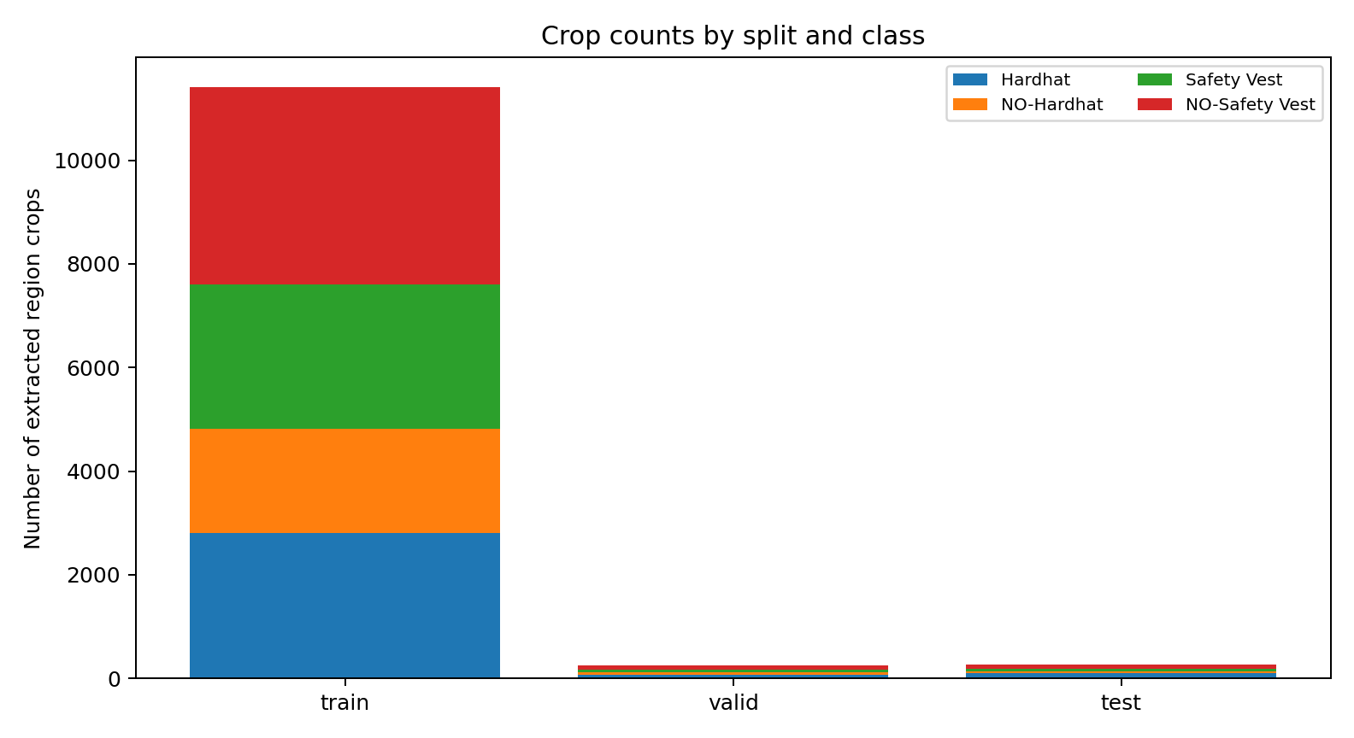
Dataset size and class distribution
DATASET
How many images and how many extracted training examples were used.
Split | Original images | Extracted region crops
Train | 2,605 | 11,415
Validation | 114 | 255
Test | 82 | 269
Total | 2,801 | 11,939
Class | Train | Valid | Test
Hardhat | 2803 | 73 | 102
NO-Hardhat | 2010 | 52 | 29
Safety Vest | 2797 | 38 | 61
NO-Safety Vest | 3805 | 92 | 77
Observation: the dataset is imbalanced. NO-Safety Vest has the largest number of crops, while NO-Hardhat has the fewest. That is why macro-F1 and unsafe-class recall are more informative than accuracy alone.
SafeSight • MLAI 504 • Construction PPE Recognition
4

Slide 5
2. Data preprocessing and cleaning
PREPROCESSING
The preprocessing pipeline used before training.
1
Annotation audit
Checked malformed label rows, invalid class IDs, impossible coordinates, unreadable images and missing labels.
4
Image preparation
Converted BGR to RGB, resized all crops to 160×160, normalized pixel values to [0,1].
2
Crop extraction
Converted YOLO boxes to pixel coordinates and extracted the labeled region from each image.
5
Training-only augmentation
Applied horizontal flip, small rotation and contrast changes inside the model pipeline.
3
Quality control
Rejected tiny crops (<12 px) and clipped boxes to image boundaries.
6
Class balancing
Computed class weights from the training split only.
For MobileNetV2, normalized pixels were additionally remapped to [−1, 1] using a Rescaling layer because that pretrained model expects a different input range.
SafeSight • MLAI 504 • Construction PPE Recognition
5

Slide 6
Experimental design and leakage prevention
METHODOLOGY
How the train/validation/test evaluation remained fair.
Original split preserved
Crops were extracted after respecting Roboflow image partitions. We did not randomly mix crops across train, validation and test.
Duplicate audit
Exact-image SHA256 overlap across partitions was 0 for train/valid, train/test and valid/test.
Model selection rule
Validation macro-F1 was the primary selection metric; test data was touched only once at the end.
Wrong practice
Crop all regions first, then randomly split them.
This leaks highly similar crops from the same source image into different sets.
It would artificially inflate the model performance.
Correct practice used in this project
Keep the original train/validation/test image split fixed.
Then crop the regions inside each split separately.
Use validation for model selection and the untouched test split only for the final report.
SafeSight • MLAI 504 • Construction PPE Recognition
6

Slide 7
3. Step-by-step model creation — baseline MLP
MODELS
The simplest neural-network baseline used for comparison.
Validation accuracy
57.25%
Validation macro-F1
56.79%
Unsafe recall
57.40%
MLP baseline architecture
Input 160×160×3 → resize to 64×64 → Flatten → Dense(128, ReLU) → Dropout(0.35) → Dense(4, Softmax)
The MLP ignores spatial structure because it flattens pixels into a single vector.
It learns some class information, but its score is the weakest among the main model families.
This result supports the idea that image tasks benefit from convolutional feature extraction.
Why start here?
It provides a simple dense-network reference point before adding convolution and transfer learning.
SafeSight • MLAI 504 • Construction PPE Recognition
7

Slide 8
Scratch CNN experiments
MODELS
Moving from dense layers to convolutional feature learning.
Model | Activation / regularization | Val acc | Val macro-F1 | Unsafe recall
CNN (ReLU) | ReLU, filters 24/48/96, dropout 0.30, L2=1e−4 | 70.20% | 69.58% | 77.76%
CNN (ELU + regularization) | ELU, dropout 0.45, L2=5e−4, LR=5e−4 | 69.41% | 68.94% | 69.19%
Common CNN structure
Input 160×160×3 → [Conv2D + BatchNorm + activation + MaxPooling] × 3 → GlobalAveragePooling → Dropout → Softmax(4)
Both CNNs clearly improved over the MLP baseline.
The ReLU CNN achieved the best scratch-model performance: 69.58% validation macro-F1.
The ELU + stronger regularization variant was competitive but slightly worse on this dataset.
Why CNN?
Convolutions preserve spatial locality, share weights and learn edges, textures and patterns that are important for helmets and safety vests.
SafeSight • MLAI 504 • Construction PPE Recognition
8

Slide 9
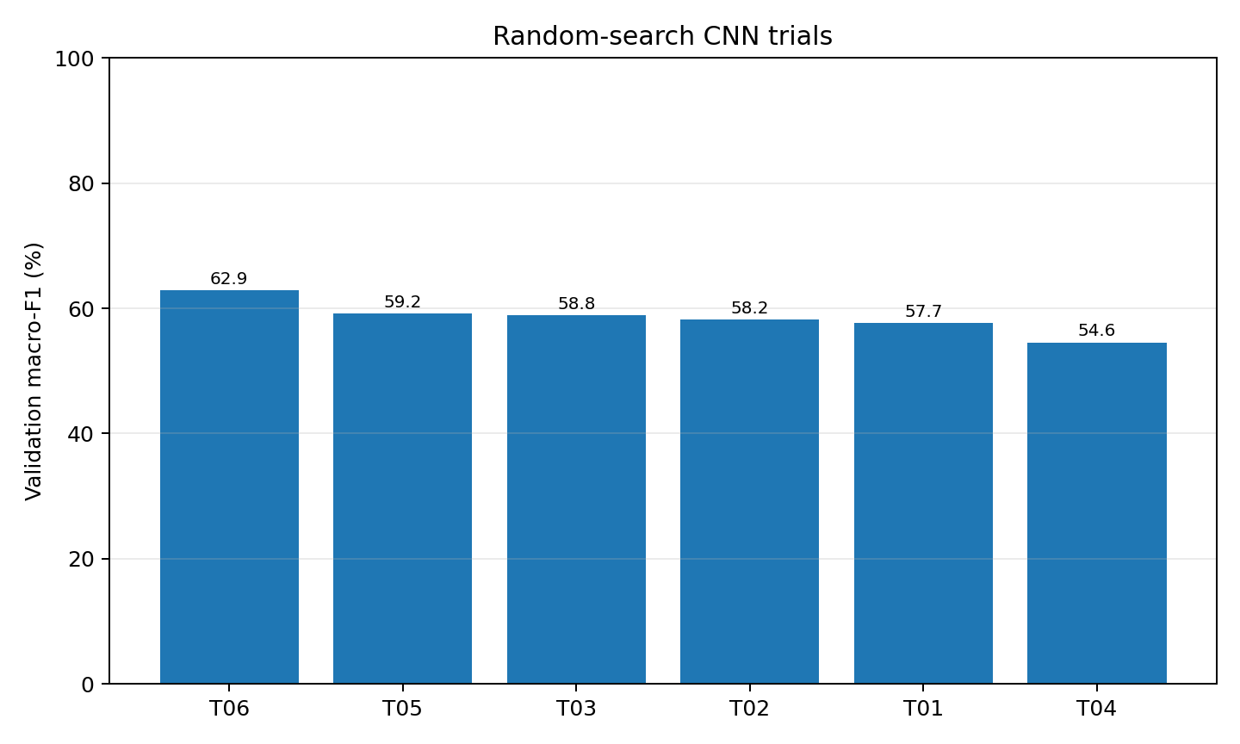
4. Hyperparameter tuning
TUNING
Random-search optimization of the scratch CNN.
Search method: randomized search, 6 seeded trials.
Search space:
  Learning rate: 1e−4, 3e−4, 1e−3
  Batch size: 16 or 32
  Optimizer: Adam or SGD with momentum
  Activation: ReLU, ELU, tanh
  Base filters: 16, 24, 32
  Dropout: 0.20, 0.35, 0.50
  L2 regularization: 1e−5, 1e−4, 5e−4
Each trial had a maximum 9-epoch budget with early stopping and ReduceLROnPlateau.
Best search result
Best trial: 04_search_06
Activation: ELU | Filters: 16
Dropout: 0.50 | L2: 1e-05
LR: 3e-04 | Batch: 32 | Opt: ADAM
Validation macro-F1: 62.86%
SafeSight • MLAI 504 • Construction PPE Recognition
9

Slide 10
5. Transfer learning with MobileNetV2
TRANSFER LEARNING
Using a pretrained CNN and then fine-tuning it.
Transfer-learning architecture
Input → augmentation → rescaling to [−1,1] → MobileNetV2 backbone (ImageNet pretrained, include_top=False) → GlobalAveragePooling → Dense(128, ReLU) → Dropout(0.40) → Dense(4, Softmax)
MobileNetV2 already contains useful visual filters learned from ImageNet.
The frozen model outperformed all scratch models.
Fine-tuning the last 30 layers gave the best overall validation result in the entire project.
Frozen model
84.87%
Fine-tuned model
89.61%
Phase | What was done | Validation macro-F1
Frozen backbone | Train a new classification head while the pretrained backbone remains frozen. LR=1e−3. | 84.87%
Fine-tuned backbone | Unfreeze the last 30 layers (BatchNorm kept frozen), train again at LR=1e−4. | 89.61%
Chosen final model: 06_transfer_finetuned
Reason: highest validation macro-F1, with strong unsafe-class recall.
SafeSight • MLAI 504 • Construction PPE Recognition
10

Slide 11
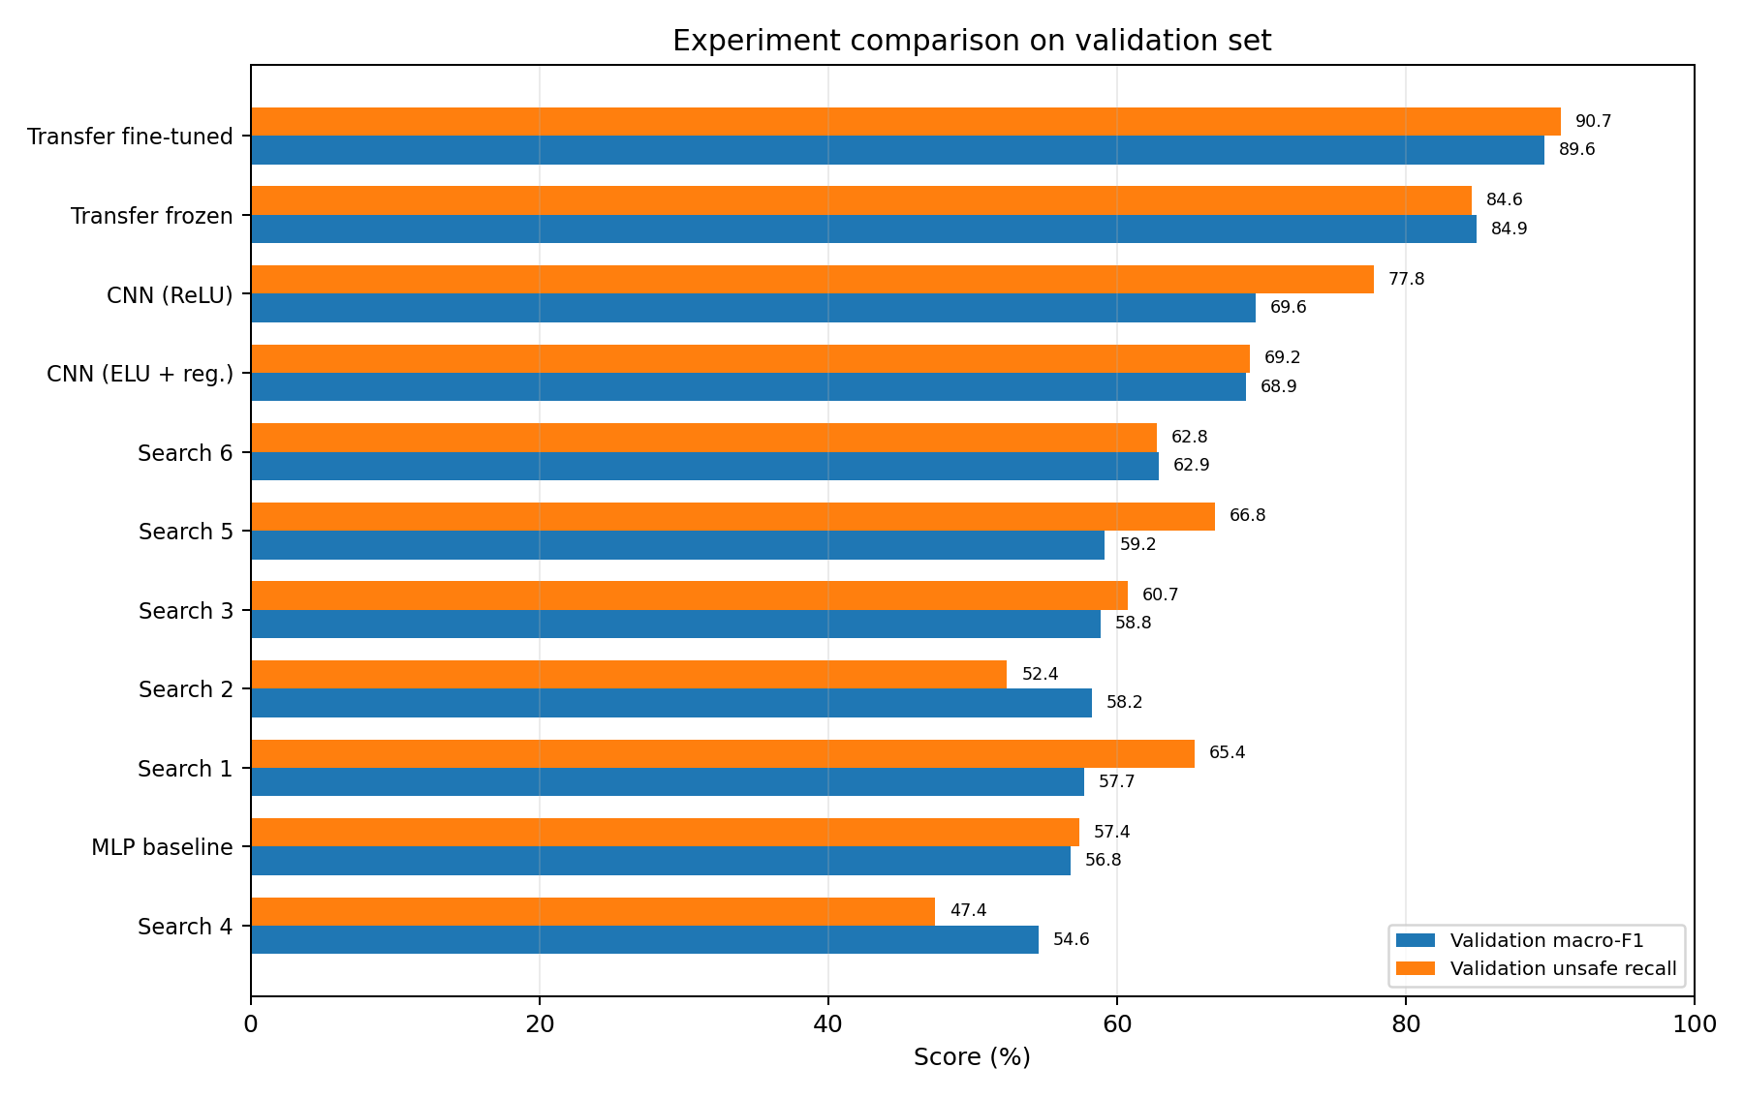
Outcome of every experiment
RESULTS
Validation-set comparison across all model runs.
Model family | Best validation macro-F1 | Main message
MLP baseline | 56.79% | Weakest because flattening loses spatial structure.
Scratch CNNs | 69.58% | Clear gain from convolutional feature learning.
Random-search tuned CNN | 62.86% | Tuning did not beat the best original CNN.
Transfer learning (frozen) | 84.87% | Large jump from pretrained features.
Transfer learning (fine-tuned) | 89.61% | Best model overall.
Key finding
The largest improvement came from transfer learning, not from scratch-CNN hyperparameter tuning.
SafeSight • MLAI 504 • Construction PPE Recognition
11

Slide 12
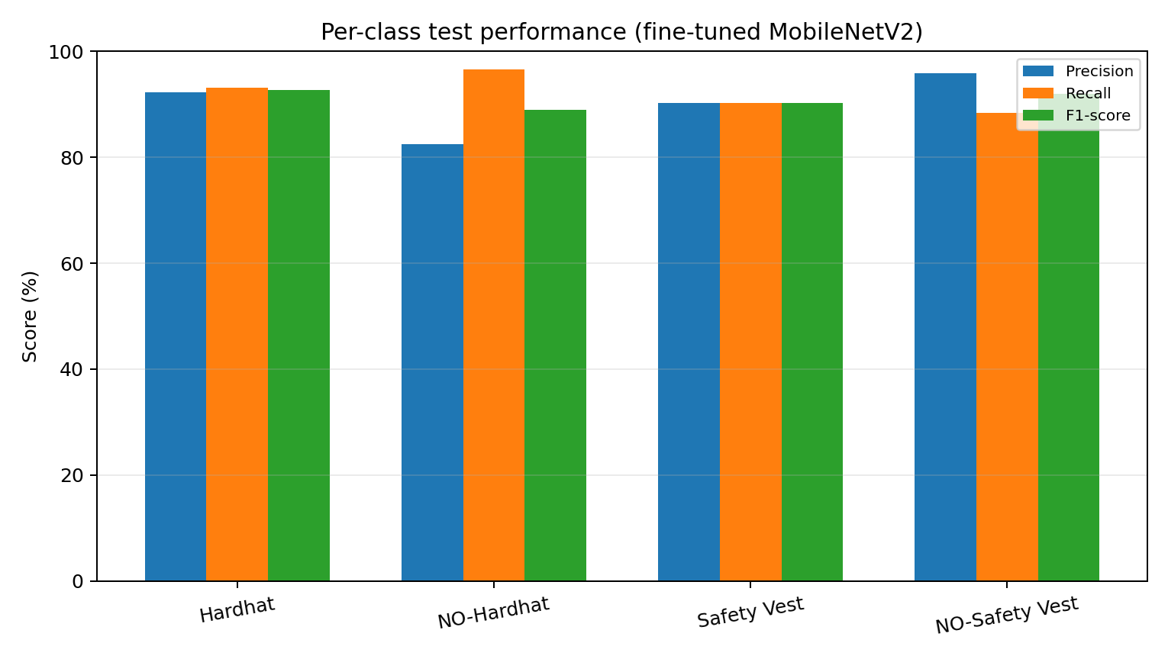
6. Evaluation and interpretation
EVALUATION
Final held-out test results of the selected model.
Accuracy 91.45%
Macro-F1 90.91%
Balanced accuracy 92.04%
Unsafe-class recall 92.43%
Test crops 269
Class | Precision | Recall | F1 | Support
Hardhat | 92.2% | 93.1% | 92.7% | 102
NO-Hardhat | 82.4% | 96.6% | 88.9% | 29
Safety Vest | 90.2% | 90.2% | 90.2% | 61
NO-Safety Vest | 95.8% | 88.3% | 91.9% | 77
Interpretation: the model is especially strong at detecting NO-Hardhat, but NO-Safety Vest remains more difficult than the other unsafe class.
SafeSight • MLAI 504 • Construction PPE Recognition
12

Slide 13
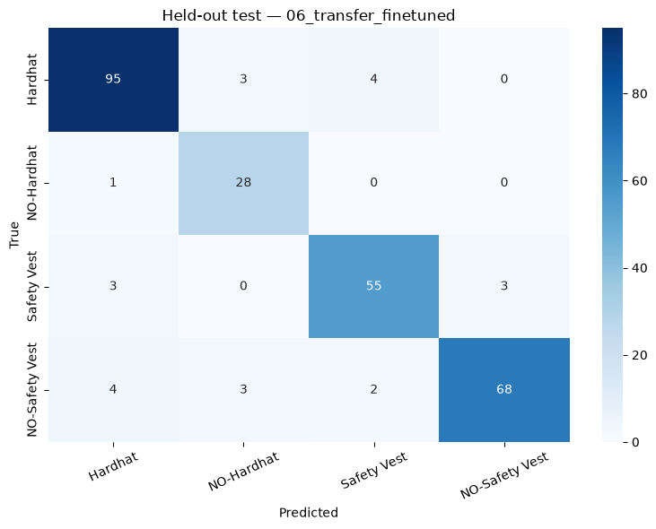
Confusion matrix and test interpretation
EVALUATION
Where the selected model still makes mistakes.
Correct predictions dominate the diagonal, confirming strong overall test performance.
Hardhat errors mostly occur when Hardhat is confused with Safety Vest or NO-Hardhat in difficult crops.
NO-Hardhat recall is very high: 28 of 29 unsafe head-protection regions were correctly identified.
NO-Safety Vest recall is lower: 68 of 77 were correct, with some confusion toward Hardhat or Safety Vest.
The confusion matrix supports the numerical test metrics and highlights realistic failure cases.
SafeSight • MLAI 504 • Construction PPE Recognition
13

Slide 14
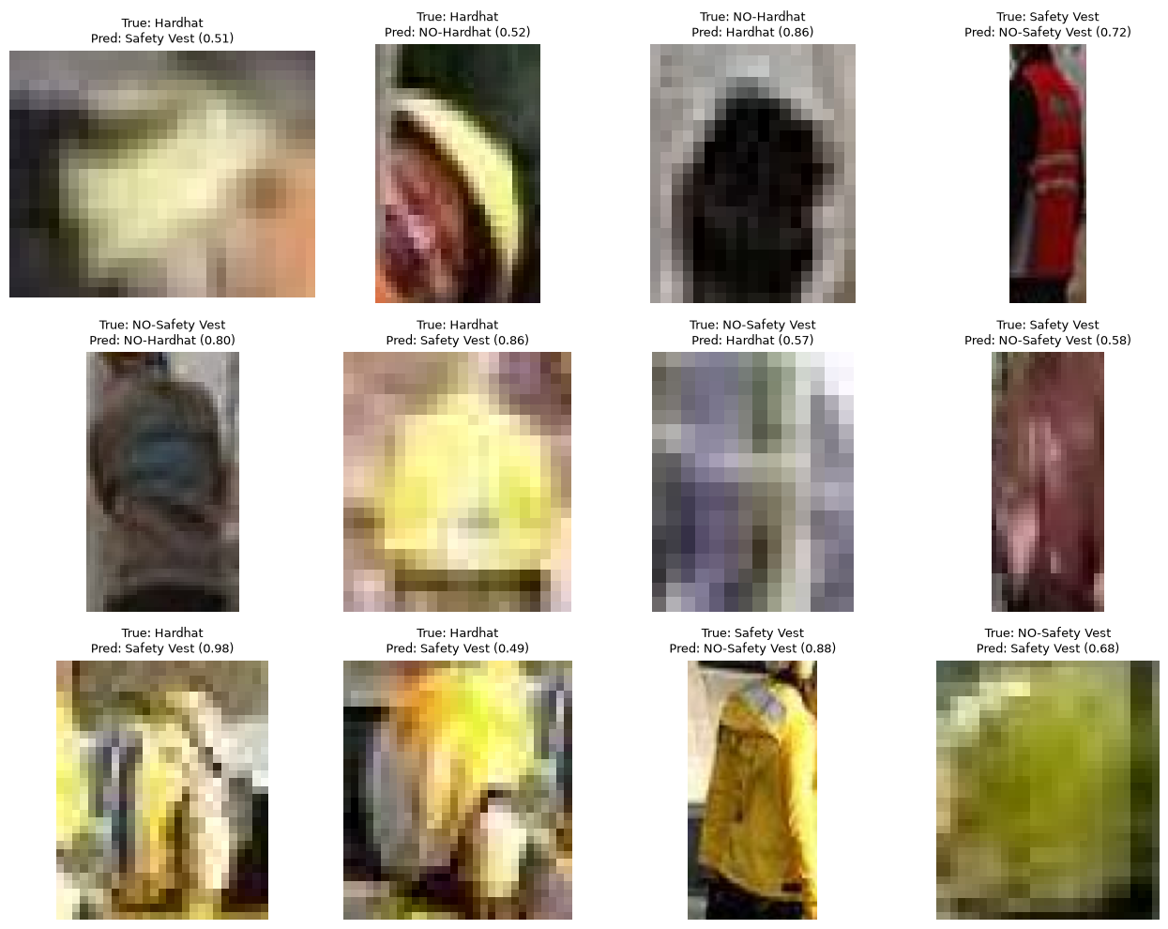
Challenges, limitations and error analysis
DISCUSSION
Examples of difficult cases seen in the held-out test set.
Small or distant objects: the helmet or vest occupies very few pixels.
Occlusion: PPE is partially hidden by the worker, tools or image boundaries.
Blur or poor lighting: color and shape become less reliable.
Ambiguous clothing: some shirts visually resemble safety vests.
Dataset limitation: the task is region classification, not full-scene detection or worker-to-PPE matching.
Generalization limitation: the data comes from one public dataset, so site-to-site domain shift is still possible.
SafeSight • MLAI 504 • Construction PPE Recognition
14

Slide 15
7. Integration of course topics
COURSE INTEGRATION
How the project used concepts from MLAI 504.
Activation functions
Compared ReLU, ELU and tanh in different models and tuning trials.
Loss function
Used sparse categorical cross-entropy because each crop belongs to exactly one class.
Optimization
Compared Adam with SGD + momentum; also reduced learning rate on plateau.
Regularization
Used dropout, L2 weight decay, data augmentation and early stopping.
Advanced architectures
Implemented CNNs and MobileNetV2 transfer learning.
Evaluation tools
Used accuracy, balanced accuracy, macro-F1, unsafe recall and confusion matrices.
SafeSight • MLAI 504 • Construction PPE Recognition
15

Slide 16
Conclusion and future work
CONCLUSION
Final answer to the research question.
The best model was the fine-tuned MobileNetV2.
On the held-out test set it achieved 91.45% accuracy, 90.91% macro-F1 and 92.43% unsafe-class recall.
Therefore, the project hypothesis is supported: transfer learning clearly outperformed the MLP baseline and all scratch CNN variants.
The project also showed that hyperparameter tuning alone did not guarantee improvement over a well-designed base CNN.
Future work
• Collect new site images and use group-wise site holdouts for stronger external validation.
• Move from cropped-region classification to true object detection (for example YOLO).
• Add person-to-PPE association and compliance logic at the worker level.
• Tune decision thresholds and perform human-in-the-loop deployment testing.
Final takeaway: the project successfully built, tuned and evaluated multiple neural-network approaches, and MobileNetV2 transfer learning delivered the strongest and most reliable performance.
SafeSight • MLAI 504 • Construction PPE Recognition
16

Slide 17
Thank you
Questions?
SafeSight — Construction PPE Recognition
This presentation summarized the dataset, preprocessing, neural-network experiments, hyperparameter tuning, transfer learning and final evaluation results from the executed notebook.

