Slide 1
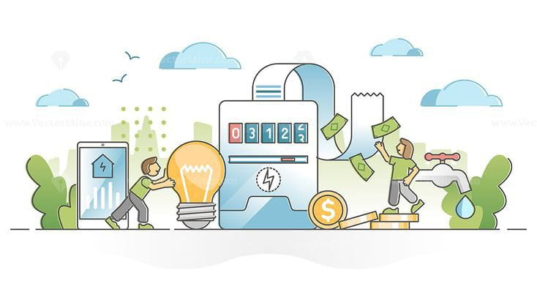
Electricity prices prediction

Slide 2
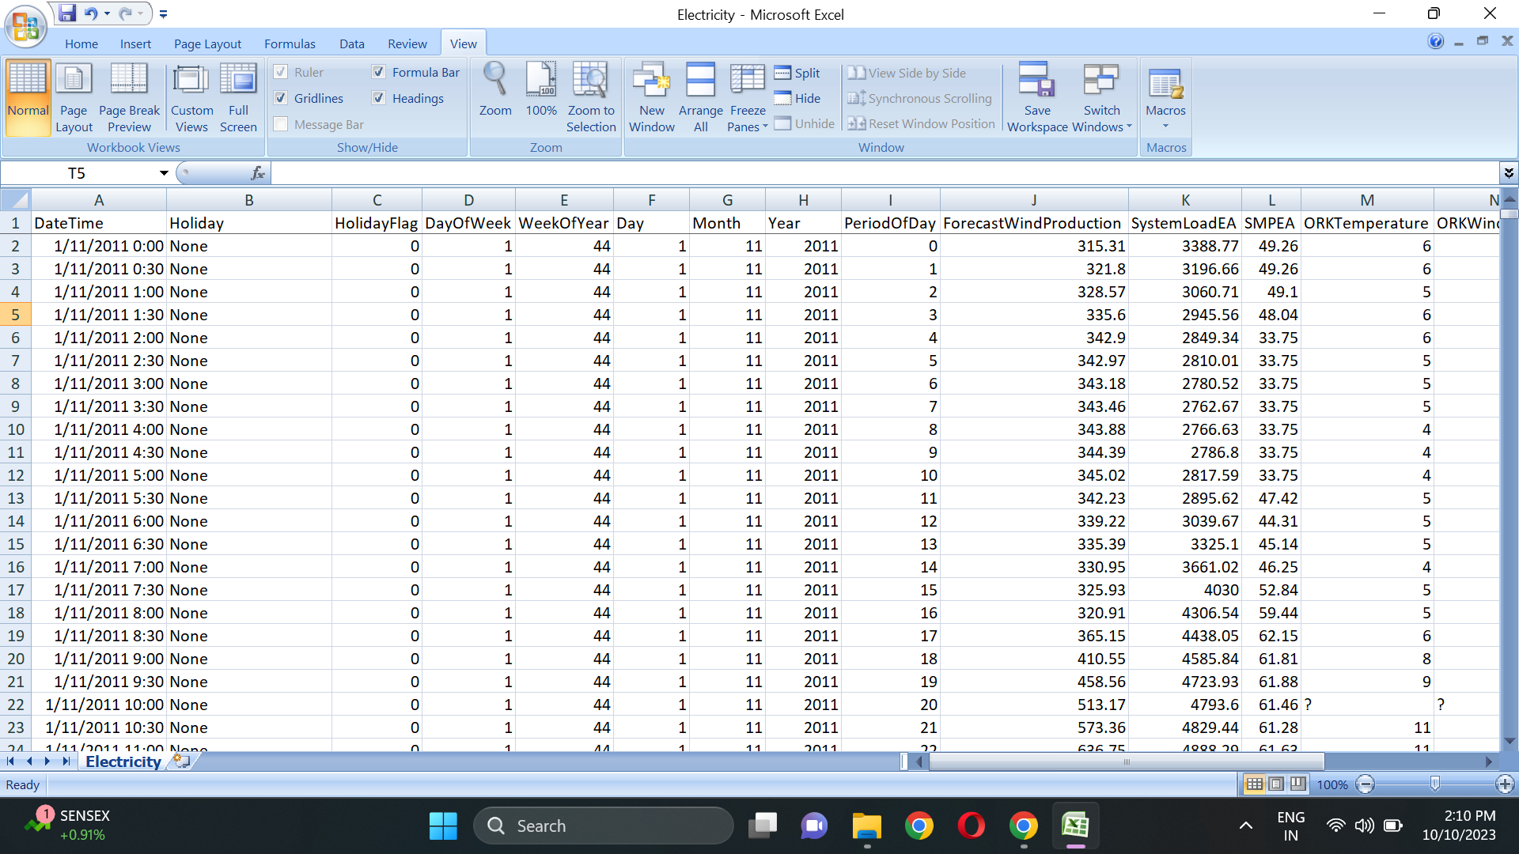
Project definition :
The Electricity Prices Prediction project aims to create a predictive model that forecasts future electricity prices. By analyzing historical electricity market data, environmental factors, and demand patterns, this project will provide accurate price predictions. Such predictions can be invaluable for energy traders, utility companies, and consumers to make informed decisions regarding electricity usage, purchasing, and resource allocation.
Data Analysis:
https://www.kaggle.com/datasets/chakradharmattapalli/electricity-price-prediction

Slide 3
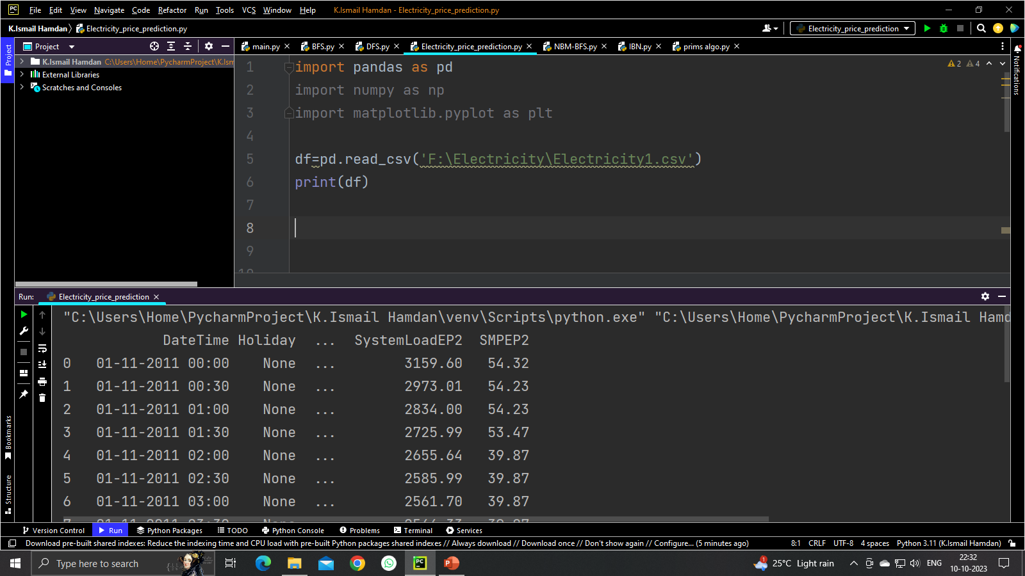
ELECTRICITY PREDICTION ANALYSIS: gather historical data related to electricity consumption or prices. this data may include timestamps, usage patterns, weather conditions, market prices,and other relevant factors data sources can include utility providers, government agencies weather services, market data providers, and sensors Gather historical data related to Gather historical data related to electricity consumption or prices. This data may include timestamps, usage patterns, weather conditions, market prices, and other relevant factors. Data sources can include utility providers, government agencies, weather services, market data providers, and sensors. electricity consumption or prices. This data may include timestamps, usage patterns, weather conditions, market prices, and other relevant factors. Data sources can include utility providers, government agencies, weather services, market data providers, and sensors.

Slide 4
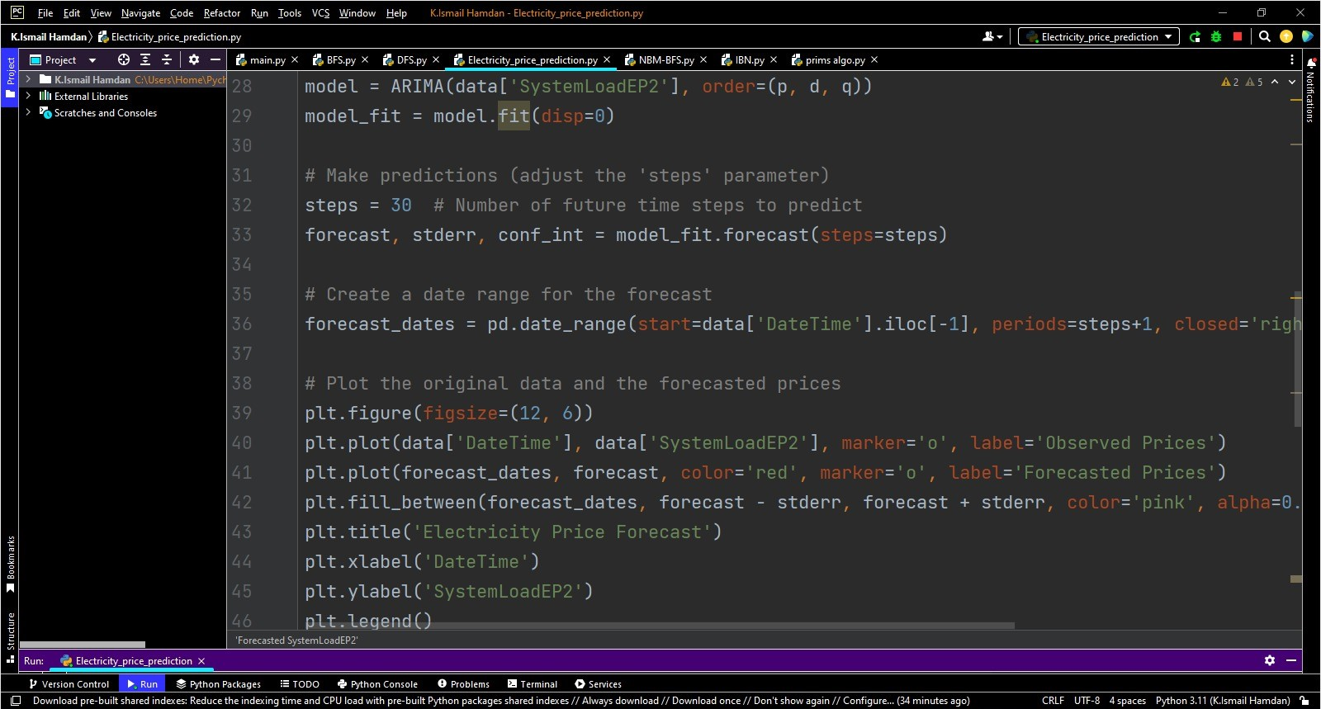

Slide 5
Forecasted Price Line: This line represents the predicted electricity prices generated by a forecasting model. It extends into the future from the historical data. The forecasted prices are based on various factors, including historical price patterns, demand forecasts, generation mix, weather conditions, and market dynamics. Peak and Off-Peak Hours: Vertical lines or shading may highlight peak and off-peak hours. Peak hours typically have higher electricity prices due to increased demand, while off-peak hours have lower prices when demand is lower. Trends and Patterns: Stakeholders can identify recurring patterns, such as daily or seasonal price fluctuations, which can help in making decisions regarding when to consume or generate electricity. Risk Assessment: The confidence intervals help assess the uncertainty in price predictions. Wider intervals indicate higher uncertainty, which may influence risk management strategies. Decision-Making: Based on the predictions, stakeholders can make decisions related to energy consumption scheduling, contract negotiations, investment in renewable energy sources, and energy trading.

Slide 6
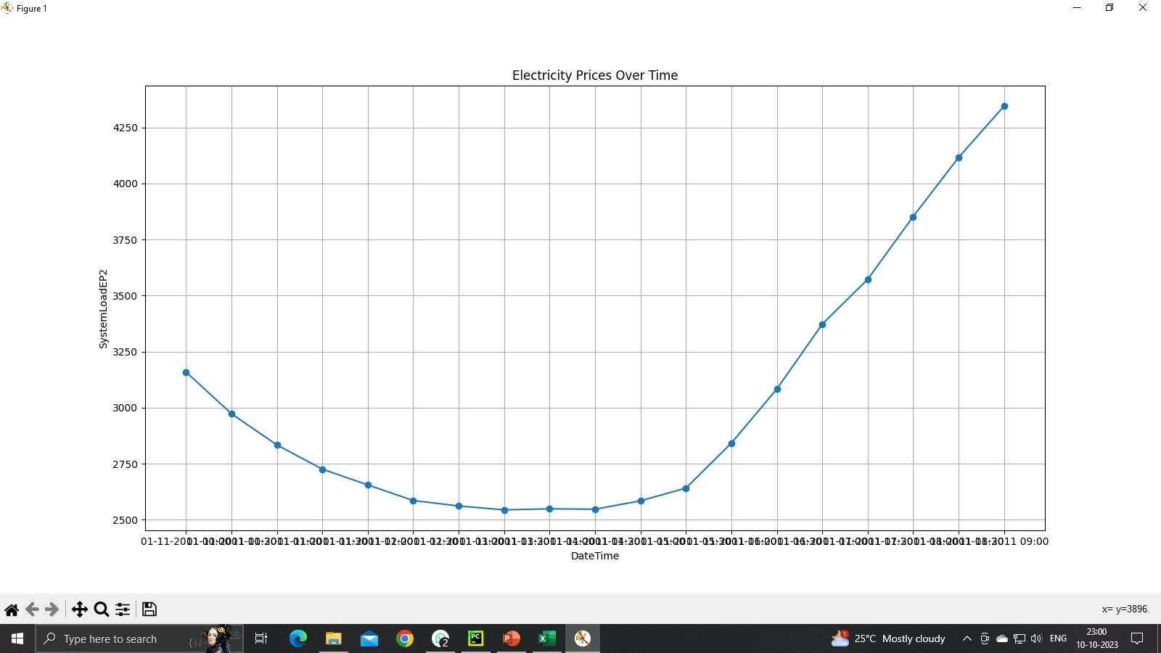

Slide 7
Thank you
TEAM MEMBERS:
LEADER: K.ISMAIL HAMDAN
MEMBER: P.MOHAMMED ZAKWAN
MEMBER: H.IZHAN UR RAHMAN
MEMBER: K.A HASHIR KAMRAN
MEMBER: G.MOHAMMED FAHEEM

