Slide 1
TEAM DMA
Airport queue and staffing
See the waits, the staffing, and the rule that applied.
Fictional training data · Historical analysis

Slide 2
THE PROBLEM
The files do not say if we passed
A manager cannot tell, from the raw files alone, whether that hour broke the rule.
The wait limit changed on 1 January 2026. It was 20 minutes, then 15.
Friday at Terminal 1 needed 5 open counters until 30 June 2026, then 9.
We counted a sample of passengers, not every traveler. A blank roster hour means we do not know the staffing.
An incident at the same time is not proof that it caused the queue.

Slide 3
THE APPROACH
What the app does
1 You choose the terminal and the dates.
2 The app looks up the rule that applied on that date.
3 It shows the waits, the busy hours, and which hours failed.
4 You can ask in English or Arabic, and see the policy line it used.
5 It does not change the roster. A manager decides.

Slide 4
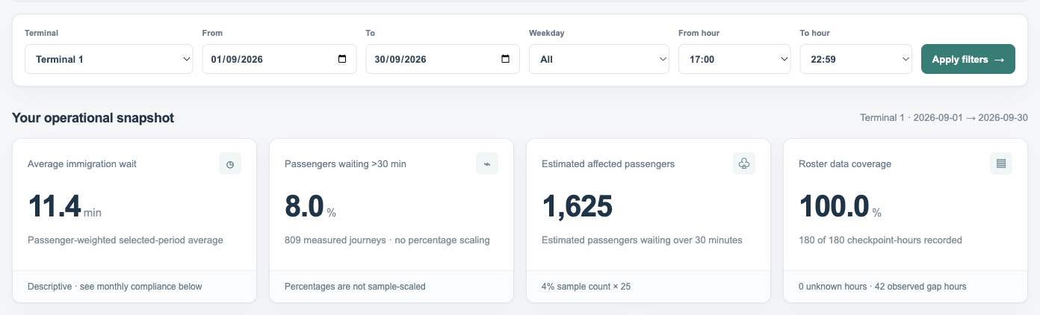
THE SELECTED PERIOD
September 2026, Terminal 1, 17:00–22:59
Averages and the share over 30 minutes are not scaled. The affected-passenger count is the sample times 25.

Slide 5
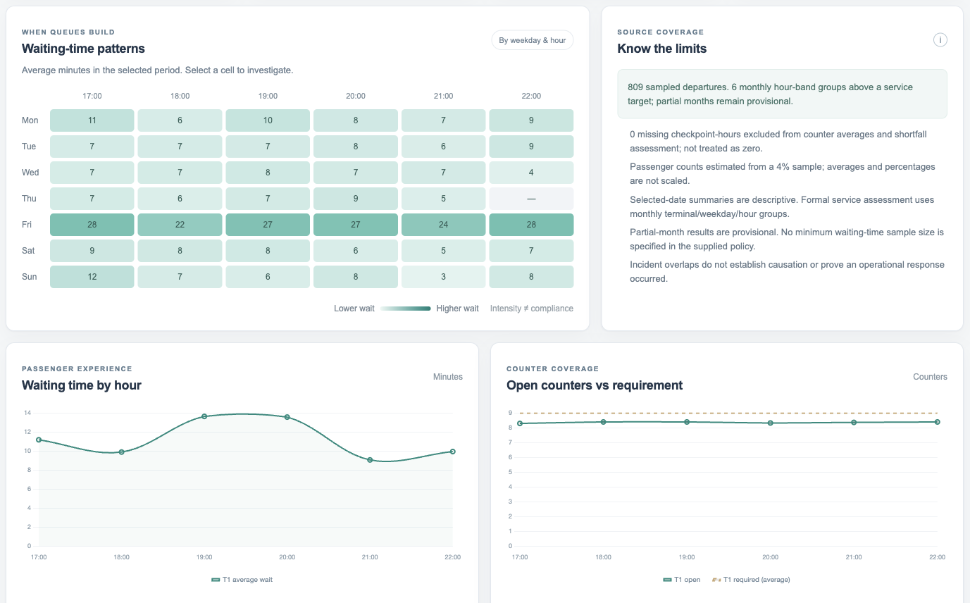
WHERE THE QUEUE BUILDS
A darker cell is a longer average, not a breach
Selecting a cell narrows the review to that weekday and hour. The line is the average wait, not a pass or fail.

Slide 6
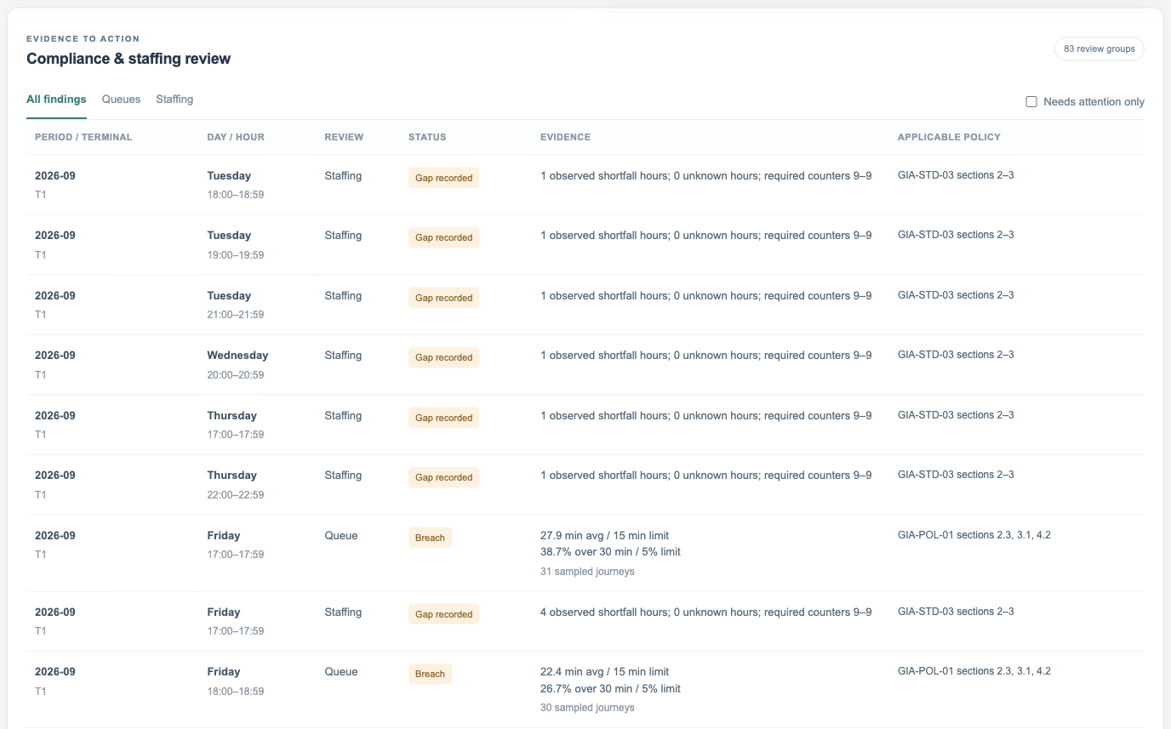
WHAT THE POLICY SAYS
Each row is one month, terminal, weekday and hour
The status is judged against the rule in force then. The policy reference sits on the row.

Slide 7
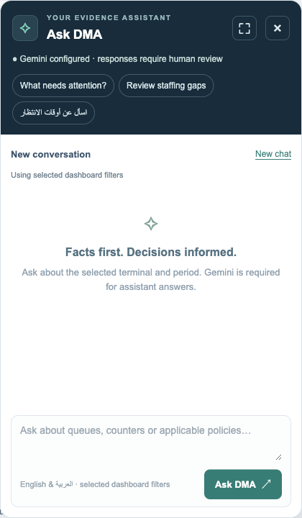
ASK, WITH THE SOURCES
A question stays inside the selected filters
Gemini answers from the verified figures and the retrieved clauses. The exchange is saved with those filters and the sources it used.
English and Arabic, including a follow-up.
The clauses used are shown with the answer.
Nothing here changes the roster.

Slide 8
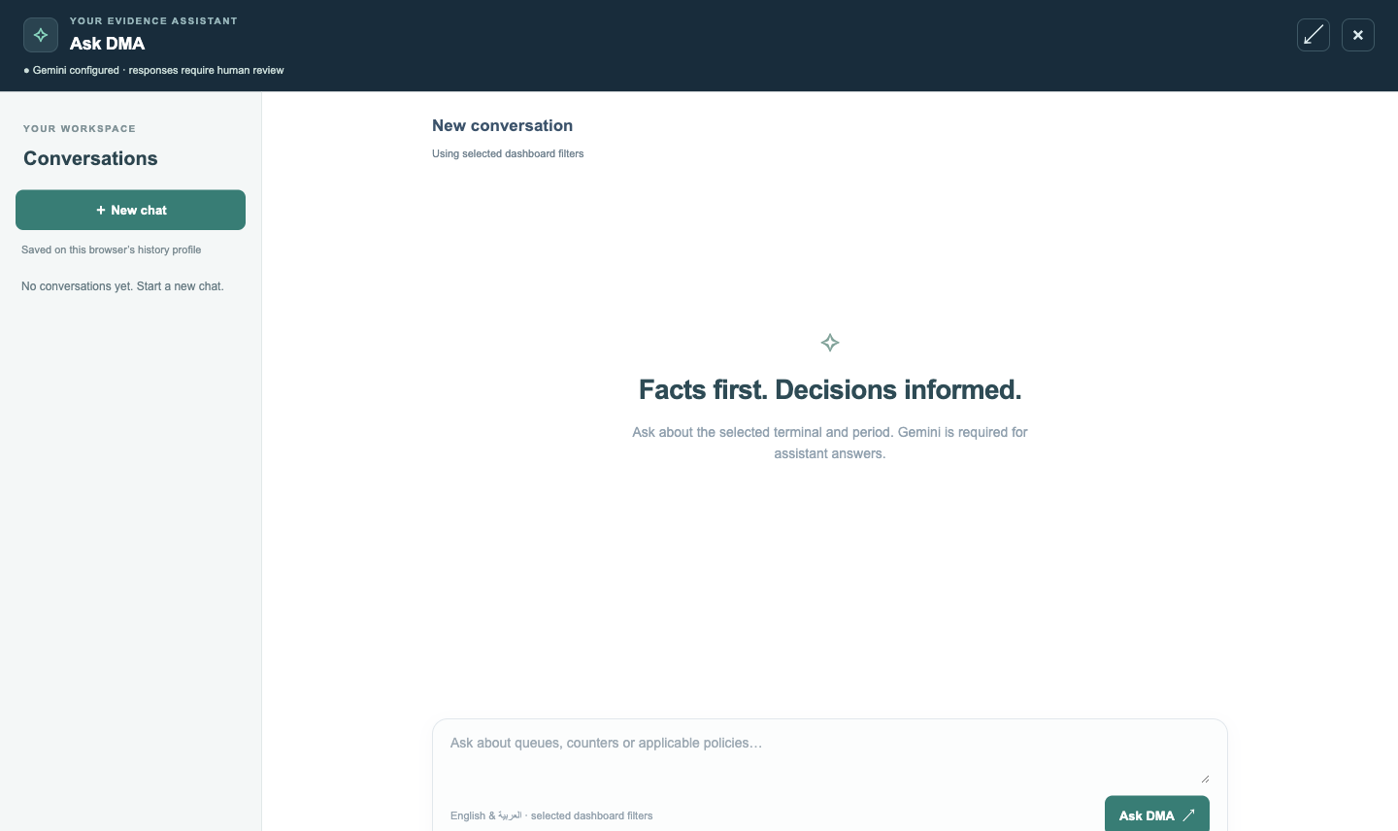
THE WORKSPACE
Saved chats reopen with their filters
Expand Ask DMA for the full-screen workspace. Reopening a conversation restores its last scope. A follow-up keeps the last six exchanges and retrieves fresh evidence.

