Slide 1
Disease Condition Predictor using AI
By
Abdul Rasheed 160321737032
Abdul Rahman 160321737031
Abdu Rahman 160321737046
Guided By : Ms. Juveria Azeem

Slide 2
Table of Content
Abstract
Objective
Present System
Proposed System
System Flow Chart
6. UML Diagram
7. Project Screenshots
8. Future Enhancements
9. Conclusion

Slide 3
Abstract
The "Disease-Condition-Predictor Using AI" project harnesses Natural Language Processing (NLP) and Machine Learning (ML) to predict disease conditions from patient drug reviews. By analyzing textual data, the project aims to enhance personalized healthcare through AI-driven insights. The workflow includes Data Cleaning, Exploratory Data Analysis (EDA), Text Pre-processing, Model Building, Result Visualization, and Web App Development. The core involves transforming text data using TF-IDF and training classification models like Logistic Regression, SVC, and Random Forest. A Streamlit web app was developed to predict disease conditions, demonstrating AI's potential in automating healthcare recommendations

Slide 4
Objective
The objective of the "Disease-Condition-Predictor Using AI" project is to develop an AI-driven system that leverages Natural Language Processing (NLP) and Machine Learning (ML) techniques to predict disease conditions based on patient reviews of specific drugs. By analyzing the textual data from these reviews, the project aims to provide personalized healthcare recommendations, enhancing patient care and outcomes through automated and accurate disease prediction.

Slide 5
Present System
Currently, doctors rely on clinical evaluations, medical history, and diagnostic tests to diagnose diseases, which can be time-consuming and often requires significant patient interaction. While patient reviews on medications exist, they are not systematically analyzed to provide predictive insights. This underutilization of patient feedback limits doctors' ability to quickly assess and understand potential disease conditions based on past patient experiences, leading to possible delays in diagnosis and treatment.

Slide 6
Proposed System
The proposed system addresses these limitations by using AI to predict disease conditions based on patient drug reviews. By applying NLP and ML techniques, this system provides doctors with actionable insights derived from patient feedback, enabling quicker and more accurate assessments. Accessible through a user-friendly web app, the system offers a personalized approach to healthcare, helping doctors better understand and diagnose patients efficiently, enhancing overall patient care.

Slide 7
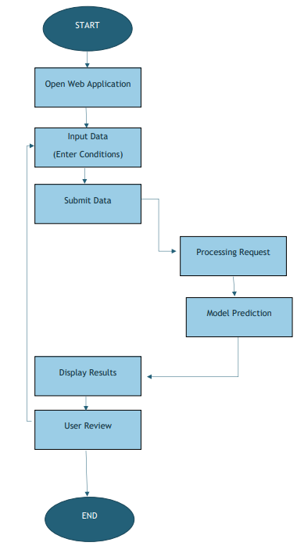
System Flow Chart

Slide 8
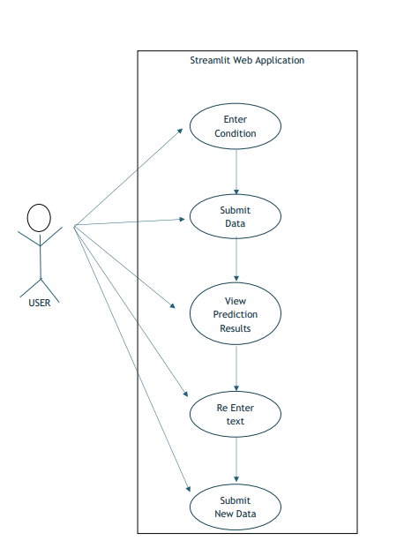
UML Diagrams
Use Case Diagram

Slide 9
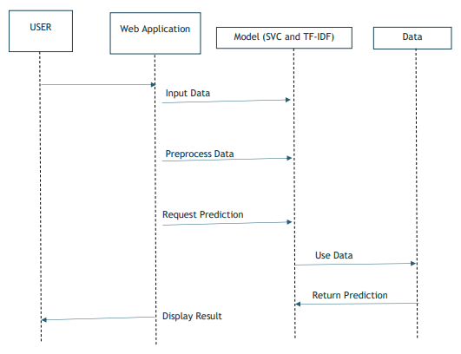
UML Diagrams
Sequence Diagram

Slide 10
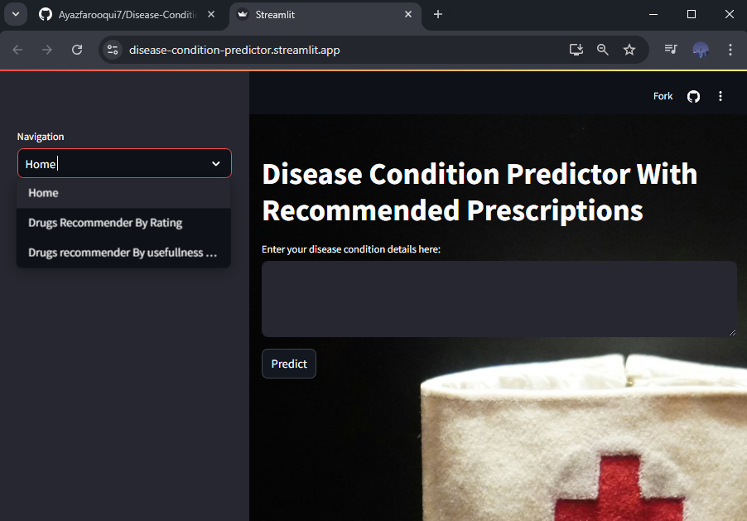
Project Screenshots

Slide 11
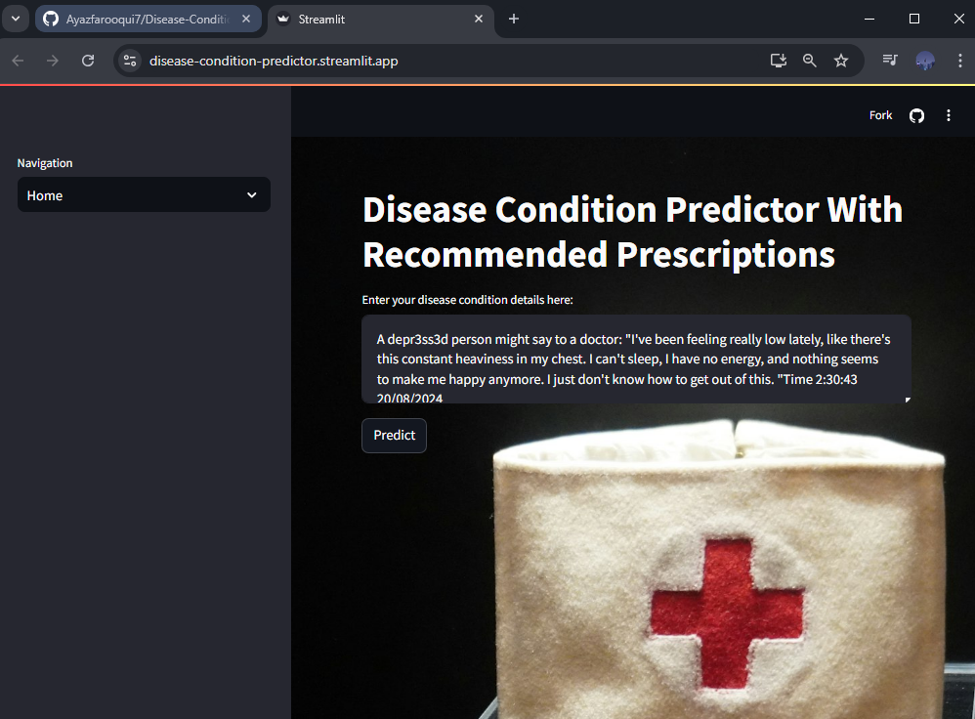
Project Screenshots

Slide 12
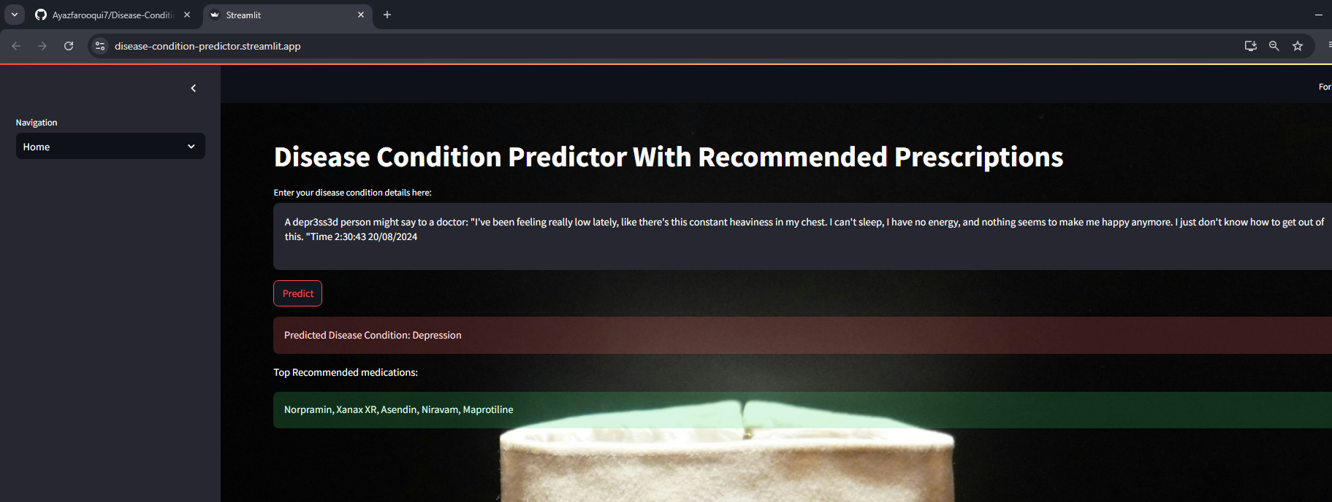
Project Screenshots

Slide 13
Future Enhancements
Integration with Database and Flask Backend: Implement a Flask backend connected to a database for storing patient reviews, predictions, and model updates, enabling scalable and efficient data management.
Enhanced Patient Data Analysis: Incorporate additional data points like patient demographics or treatment history to improve the accuracy and personalization of predictions.
Mobile App Integration: Develop mobile app versions for easier access, allowing doctors to use the prediction system on-the-go during patient consultations.
Advanced Visualization Tools: Introduce interactive dashboards for better interpretation of prediction results, allowing doctors to easily identify trends and key insights.

Slide 14
Conclusion
In conclusion, the Disease-Condition Predictor app successfully demonstrates the potential of combining natural language processing (NLP) and machine learning (ML) techniques to assist in healthcare. By analyzing patient reviews and accurately predicting their related conditions, the app serves as a valuable tool for doctors and healthcare professionals. It streamlines the process of understanding patient experiences and conditions, providing actionable insights that can enhance patient care and treatment outcomes. The app's accuracy, ease of use, and real-time performance suggest its applicability in clinical settings, paving the way for more personalized and data-driven healthcare solutions.

Slide 15
Thank You

