Slide 1



St. MARTIN’S ENGINEERING COLLEGE
UGC Autonomous
NBA & NAAC A+ ACCREDITED
Dhulapally, Secunderabad– 500100
Department of Information Technology
CYBERSHIELD: ML-POWERED DETECTION OF SOCIAL MEDIA
CYBERBULLYING
Batch No: 15
MOHAMMED KAIF - (22K81A12G2)
M. TARUN RUSHIKESH - (22K81A12F7)
Under the Guidance of
K. KOTESWARA RAO
Assistant Professor
Department of Information Technology

Slide 2
OUTLINE
Abstract
Introduction
Existing System
Proposed System
Detail Design
Algorithm
Code Implementation (Source Code)
Results obtained

Slide 3
ABSTRACT
CyberShield is an ML-powered system designed to detect and mitigate cyberbullying on social media. Traditional methods, like manual moderation and keyword-based filtering, lack accuracy and contextual understanding. Using NLP, deep learning, and sentiment analysis, CyberShield enhances detection and minimizes false positives. Trained on extensive datasets, it identifies abusive language, threats, and harassment with high accuracy. This scalable solution fosters a safer and more supportive online environment.

Slide 4
INTRODUCTION
Cyberbullying has emerged as a serious threat on social media platforms, affecting users' mental health and overall digital well-being. Traditional methods like manual moderation and keyword-based filtering often fall short, lacking both accuracy and contextual awareness.To overcome these limitations, our project — CyberShield — leverages advanced technologies including Machine Learning (ML), Natural Language Processing (NLP), Deep Learning (CNN), and Sentiment Analysis to detect and prevent harmful interactions in real time.Trained on well-structured datasets, CyberShield effectively identifies abusive language, threats, and harassment while minimizing false positives. Its automated and scalable architecture reduces the reliance on manual intervention, enabling continuous monitoring and quicker responses.By improving detection precision and offering insightful analytics, CyberShield aims to create a safer, more supportive online environment for all users.

Slide 5
EXISTING SYSTEM
Traditional methods for cyberbullying detection primarily relied on manual moderation by social media companies and keyword-based filtering techniques. Manual moderation was slow, inconsistent, and costly, while keyword-based filters often failed to detect abusive content due to a lack of contextual understanding. These systems could not handle sarcasm, slang, emojis, and indirect threats, leading to both false positives and false negatives. The absence of real-time intervention further reduced their effectiveness, making them impractical for large-scale implementation.

Slide 6
PROPOSED SYSTEM
CyberShield introduces a machine learning-powered cyberbullying detection system that significantly enhances accuracy and efficiency. The system implements Natural Language Processing (NLP), deep learning models, and sentiment analysis to identify and classify cyberbullying patterns in text data.

Slide 7
MACHINE LEARNING IMPLEMENTATION STEPS
To develop a cyberbullying detection system, social media comments, posts, and messages are collected and labeled as either cyberbullying or non-cyberbullying. The text data is then cleaned by removing noise, special characters, and stopwords, followed by tokenization and vectorization. Techniques like TF-IDF and Word2Vec are used to extract meaningful features from the text. Supervised learning models such as LSTM and CNN are trained on this data to learn patterns of cyberbullying. After training, the model can predict whether a new message contains cyberbullying content. Finally, the system is connected through APIs for real-time monitoring and automatic detection of harmful messages.

Slide 8
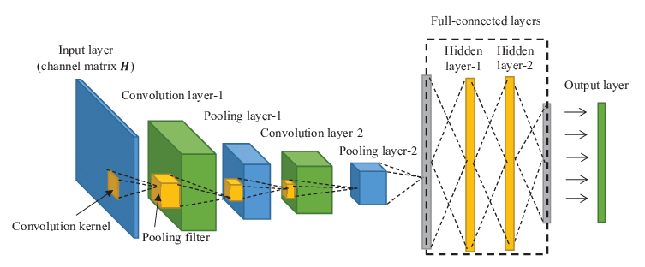
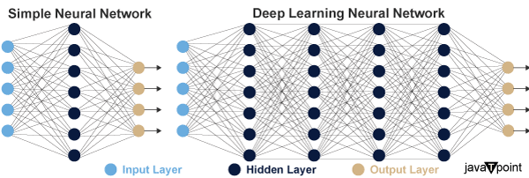


DETAIL DESIGN
CNN
DNN

Slide 9
DETAIL DESIGN
Exploring CNNs and DNNs: Structures, Functions, and Applications
Applications
Structures
Image Classification
Layer Types
Object Detection
CNNs and DNNs
Architecture Design
Facial Recognition
Functionalities
Data Processing
Pattern Recognition

Slide 10
CNN ARCHITECTURE AND APPLICATIONS
CNN Architecture
Core structure of CNN
Convolutional Layers
Extract features from data
Pooling Layers
Reduce dimensionality, maintain features
Fully Connected Layers
Integrate features for classification
Applications
Tasks like image classification and detection

Slide 11
ANATOMY OF DEEP NEURAL NETWORKS
Activation Functions
Functions that introduce non- linearity to capture complex patterns.
Output Layer
Hidden Layers
The final layer that produces the network's predictions.
Multiple layers where complex data transformations occur.
Input Layer
The starting point for data entry into the network.

Slide 12
ALGORITHM
ALGORITHM: CYBERSHIELD CYBERBULLYING DETECTION SYSTEM
Data Acquisition & Preprocessing
Load the dataset containing social media interactions.
Perform Exploratory Data Analysis (EDA) to identify trends and patterns.
Clean the dataset by removing special characters, stopwords, and unnecessary symbols.
Apply N-gram feature extraction to understand contextual patterns.
Train-Test Split
Split the dataset into training and testing sets (e.g., 80%-20% split).
Balance the dataset to mitigate biases in cyberbullying classification.
Feature Engineering
Apply Sentiment Analysis to capture emotional tone.
Utilize Natural Language Processing (NLP) for semantic understanding.
Implement Word Embeddings (e.g., Word2Vec, GloVe) for enhanced text representation.

Slide 13
4.Deep Learning Model Training
Train a Deep Neural Network (DNN) model.
Train a Convolutional Neural Network (CNN) for enhanced accuracy.
Validate models using cross-validation techniques.
Optimize hyperparameters for improved precision.
5.Cyberbullying Detection & Classification
Run the trained model on real-time social media data.
Categorize interactions into classes such as Not Cyberbullying, Religion, Age, Gender, Ethnicity, Other Cyberbullying (as seen in the confusion matrix).
Implement threshold-based classification to refine results.

Slide 14
6.Evaluation & Performance Analysis
Generate confusion matrix to assess model accuracy.
Compute Precision, Recall, F1-score, Sensitivity, Specificity metrics.
Reduce false positives through iterative model fine-tuning.
7.Real-Time Monitoring & Deployment
Deploy CyberShield as an automated moderation system.
Continuously update datasets for adaptability.
Provide actionable analytics for platform administrators.
8.User Feedback & Improvement
Gather insights from flagged content.
Refine the system through user reports and feedback loops.
Strengthen context-aware analysis to handle sarcasm, emojis, and indirect threats.
This structured approach ensures high accuracy, minimal false positives, and scalable cyberbullying prevention. Let me know if you'd like refinements or additional insights!

Slide 15

CODE IMPLEMENTATION (SOURCE CODE)
(SOURCE CODE)

Slide 16
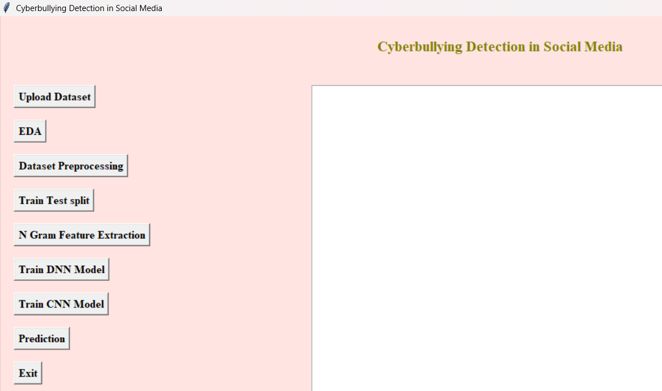
RESULTS OBTAINED

Slide 17
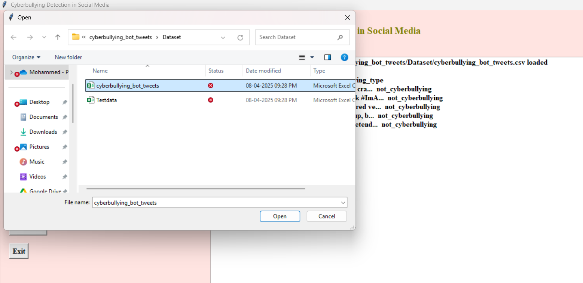
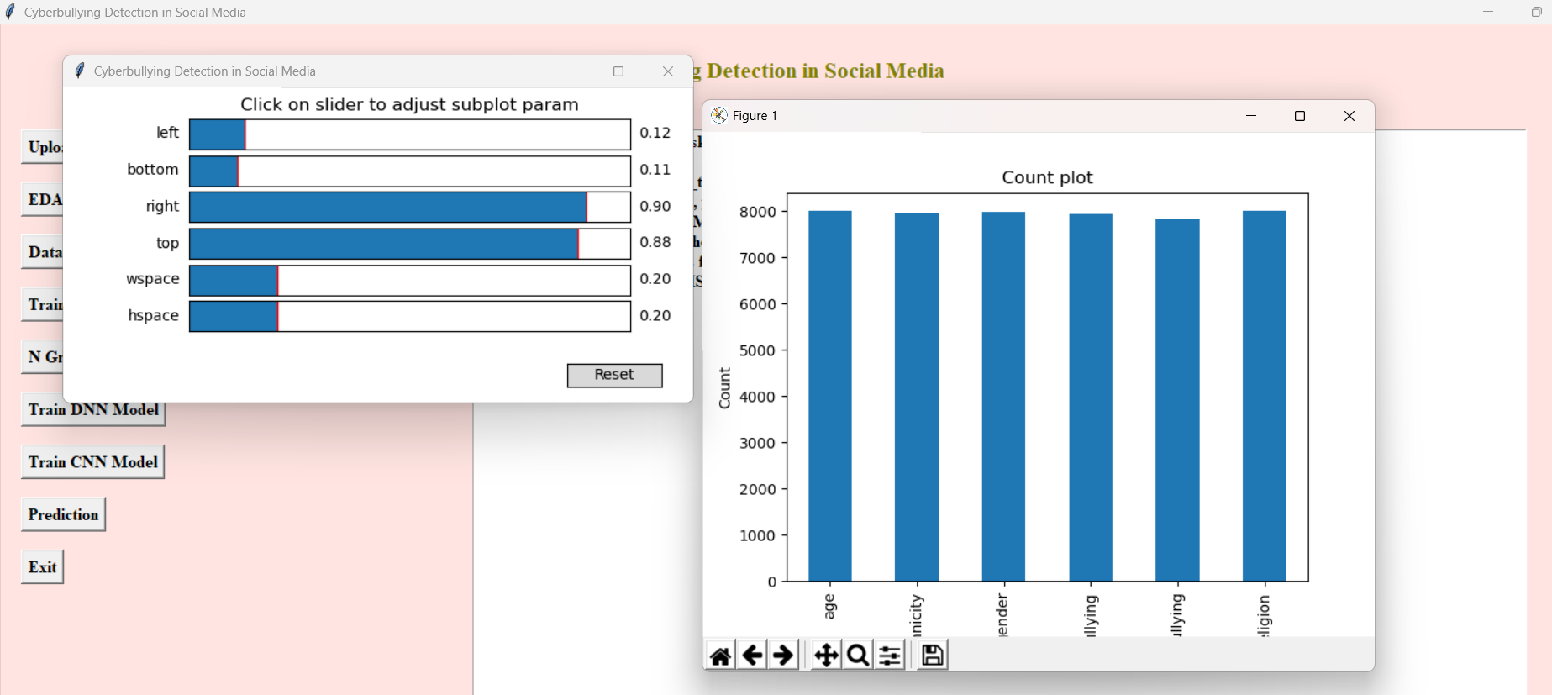
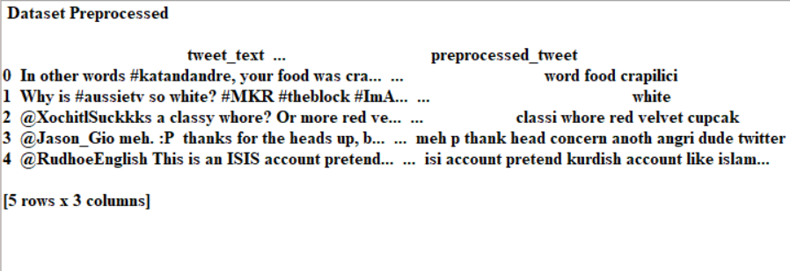

Slide 18
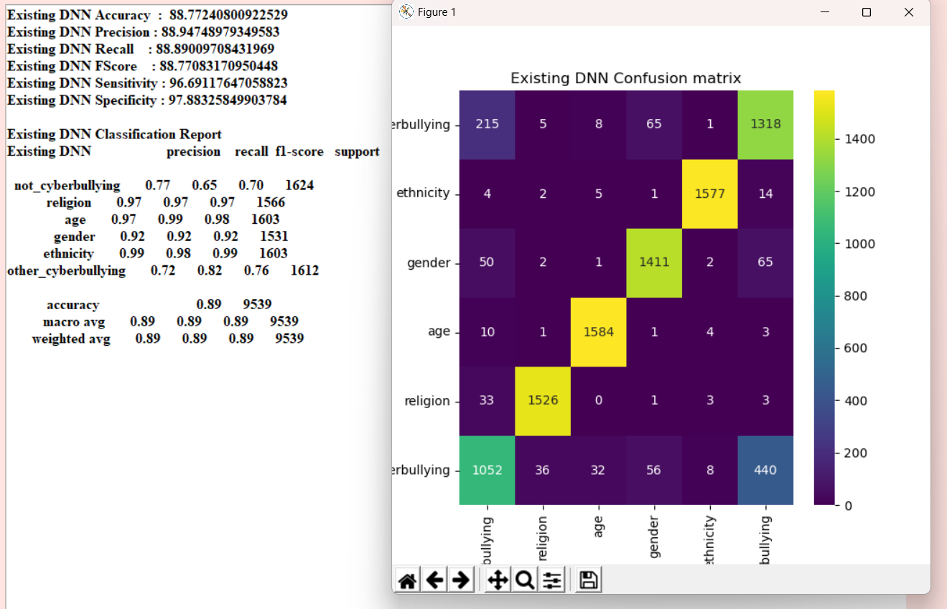

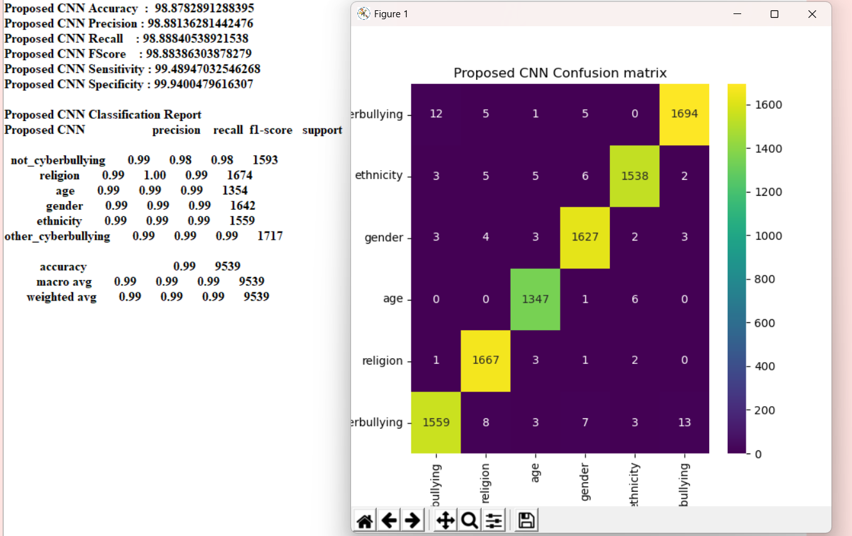

Slide 19
QUESTIONS AND ANSWERS

Slide 20
THANK YOU

