Slide 1
🛰️
Can Satellite Imagery Improve Traffic Prediction?
Weekly Research Update · Mohammed Mostain · March 2026
Notes:
Welcome everyone. This week I focused on testing whether satellite imagery can improve our predictions of Annual Average Weekday Daily Traffic — AAWDT — beyond what Road Class alone tells us. I'll walk through what I did, how it works, and the key results.

Slide 2
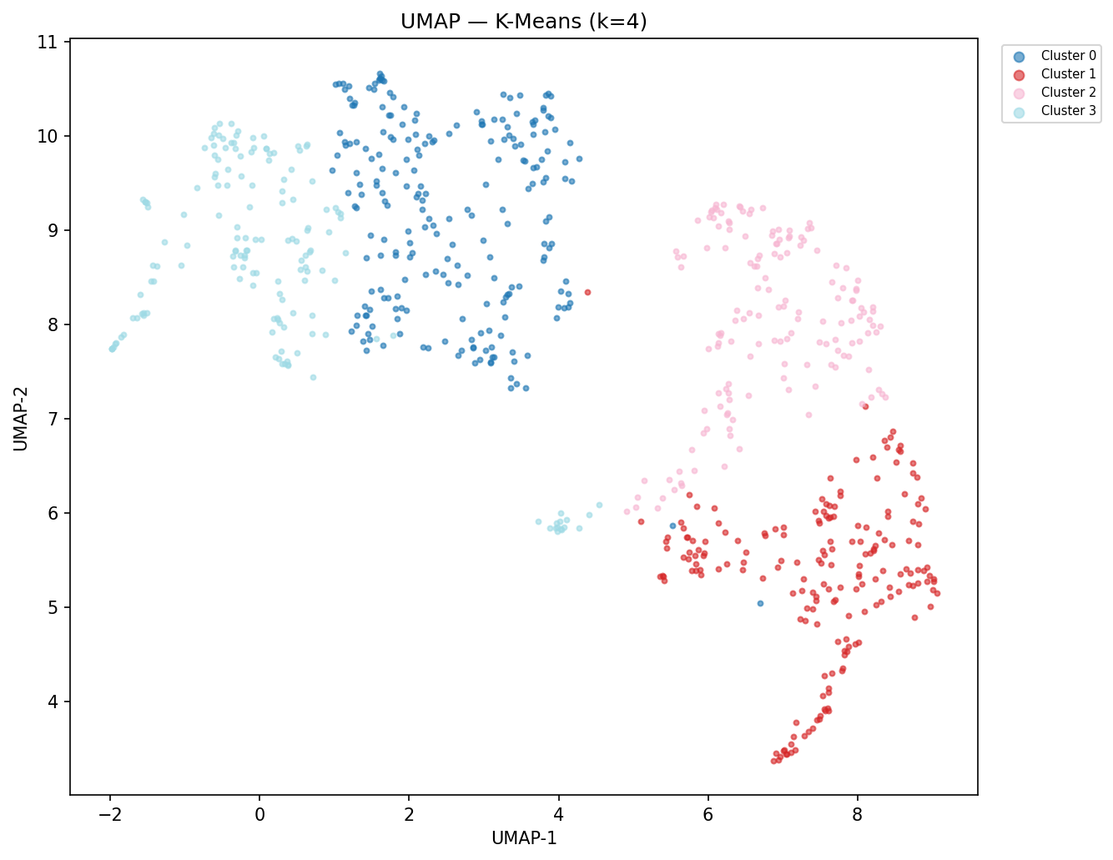
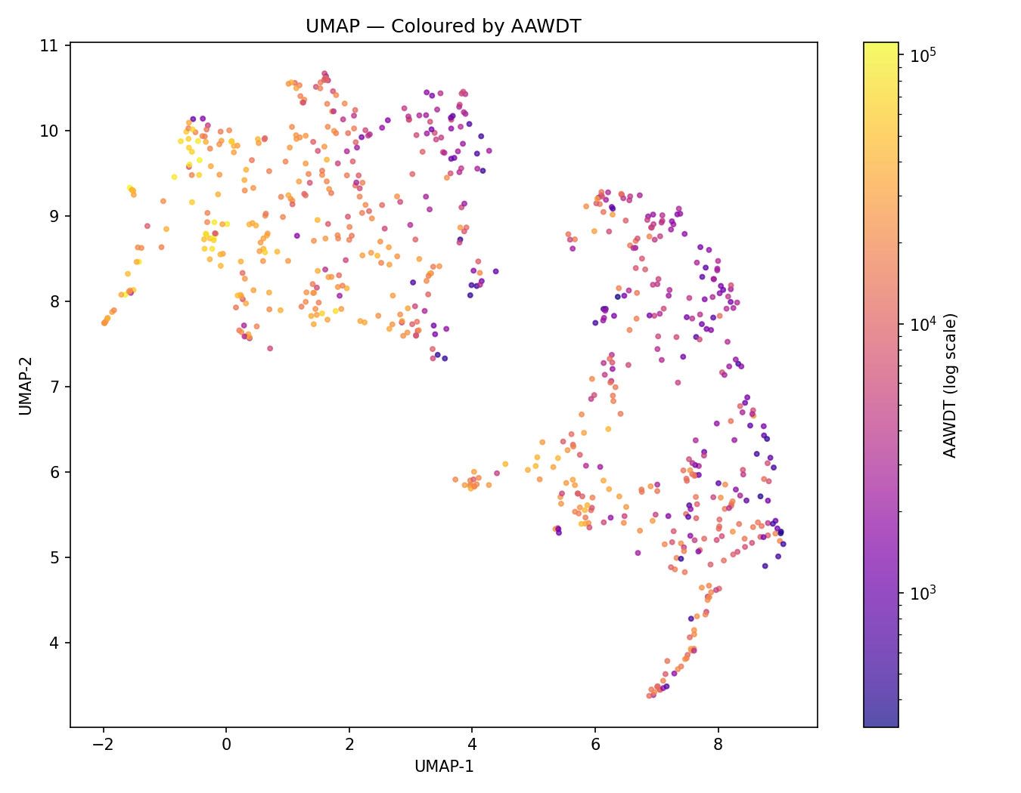
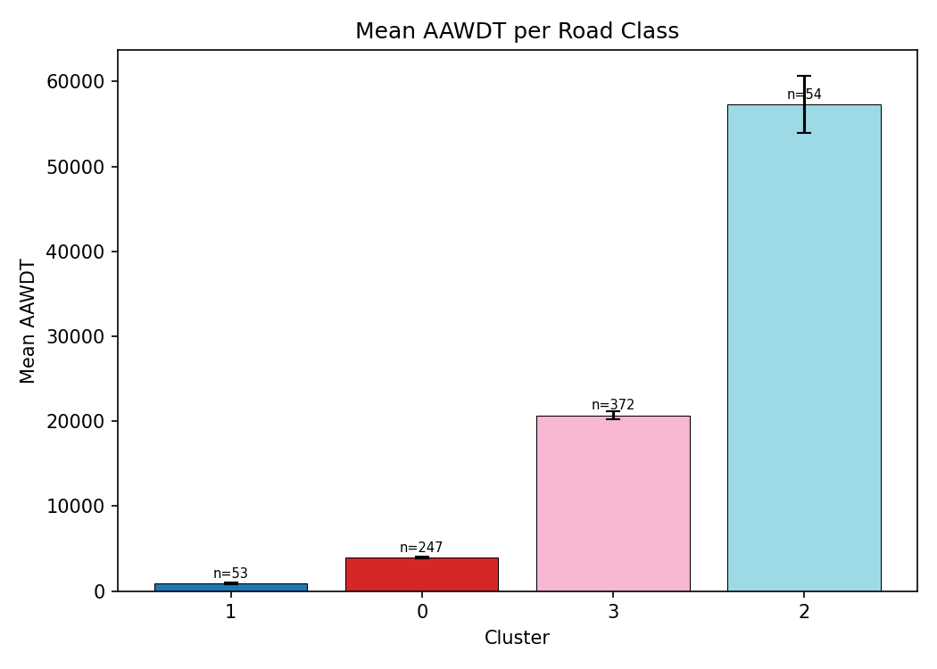
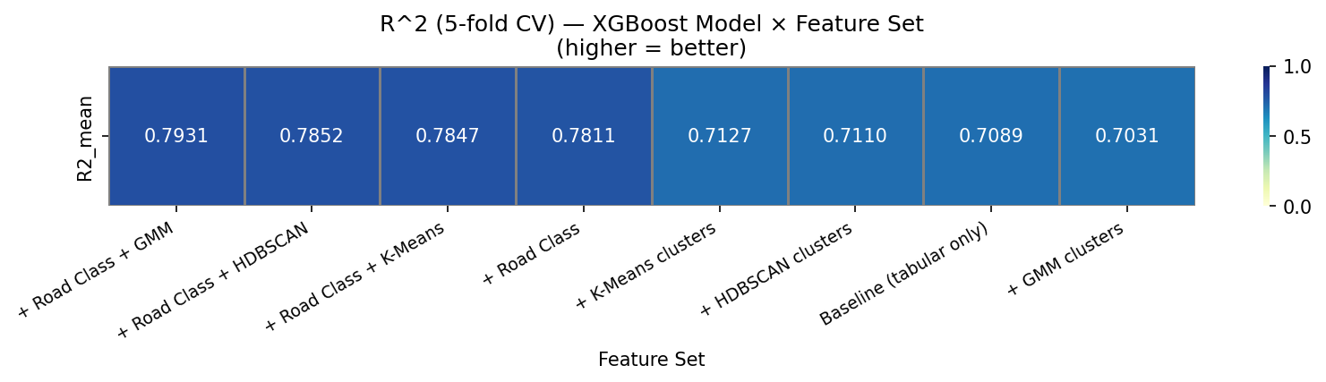
This Week
🛰️
⚙️
📊
🔍
✅
Satellite Clustering
3 Methods Tested
Road Class Comparison
Optimal k Sweep
Stability Checked
Do road segments that look similar from above also carry similar traffic volumes?
Notes:
This week I ran the full pipeline on our 726 road segments. I tested three clustering algorithms — K-Means, HDBSCAN, and GMM — all applied to satellite image embeddings. I then compared each clustering approach against Road Class for predicting AAWDT. I also ran a sweep to find the optimal number of clusters per method, and did a sensitivity analysis to make sure the results are stable.

Slide 3
The Approach
1
2
3
4
🛰️
📐
🔵
📈
Satellite Image
➔
Compress (UMAP)
➔
Group Similar Roads
➔
Predict AAWDT
512 numbers per road
512 → 20 dimensions
K-Means HDBSCAN GMM
XGBoost 5-fold CV
⚠️ Clustering must happen AFTER compression — raw 512-dim distances are nearly uniform (curse of dimensionality)
Notes:
A pre-trained satellite image model converts each road's aerial photo into 512 numbers — essentially a fingerprint of what the road looks like from above. We can't cluster 512 dimensions directly because all points end up equally far apart — this is the curse of dimensionality. UMAP compresses those 512 numbers down to 20 while preserving which roads look similar. We then apply three clustering algorithms to group roads by visual similarity. Finally, we add those cluster labels as features to an XGBoost model and measure whether AAWDT prediction improves.

Slide 4
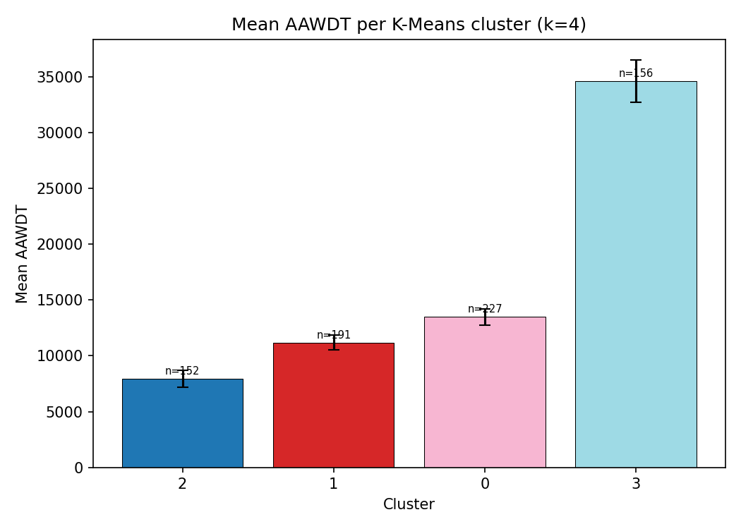
Roads Grouped by Visual Similarity
Clusters
AAWDT
Mean Traffic per Cluster
💡
Clusters that look similar visually also carry similar traffic volumes. The AAWDT heatmap and the cluster map align — this is not a coincidence.
Notes:
Each dot is one road segment. Dots close together look similar from satellite. On the left you can see the clusters found by K-Means. In the middle, I've coloured the same map by actual AAWDT — warmer colours mean higher traffic. Notice how the warm-coloured dots tend to cluster together. On the right, the bar chart shows mean AAWDT per cluster — there are clear differences between groups. This tells us the clusters are capturing something real about traffic, even though they only used imagery.

Slide 5
Results
0.801
0.781
+0.020
Road Class + GMM
Road Class alone
Improvement
Best R² achieved
Baseline R²
From adding clusters
R² by feature set
RC + GMM clusters
0.801
RC + K-Means
0.801
Road Class only
0.781
K-Means only
0.713
HDBSCAN only
0.711
Baseline (no clusters)
0.709
Notes:
The three big numbers at the top tell the story. Road Class alone gives R² of 0.781. Adding GMM satellite clusters on top brings it to 0.801 — breaking the 0.80 barrier. That's a +0.020 improvement. The bars show all six feature combinations. The yellow vertical line marks the Road Class baseline. Anything to the right of that line means satellite clusters added value. Importantly, clusters alone — without Road Class — only reach about 0.71. The clusters supplement Road Class, they don't replace it.

Slide 6
Why Does Imagery Add Value?
🏷️
🛰️
Road Class
Satellite Imagery
Functional hierarchy
VS
✓
Dense urban vs suburban
Design standard
✓
Land use context
Same label everywhere
✓
Road geometry from above
✗
Ignores surroundings
✓
Visual surroundings
Two Minor Arterials — one in a dense city core, one in a quiet suburb — get the same Road Class label but very different AAWDT. Imagery tells them apart.
Notes:
Road Class is a label assigned by planners. It tells you the functional purpose of the road — arterial, collector, local — but it applies that label uniformly regardless of context. A Minor Arterial in the dense Ottawa city core and a Minor Arterial at the edge of the suburbs get the same label, but they carry very different amounts of traffic. Satellite imagery can see the difference. It captures the surrounding built environment — how dense the buildings are, whether there's a big intersection, a shopping centre, or just fields. That visual context directly influences traffic demand, and that's the extra signal the clusters bring.

Slide 7
Next Steps
🔢
📋
Extend GMM Sweep to g=40
Held-Out Test Set
Confirm optimal cluster count
Validate on new data
🗺️
📝
Label Each Cluster
Write Up Methodology
e.g. 'Dense urban arterial'
Thesis chapter prep
Notes:
Four things I plan to do next. First, the GMM benefit curve was still noisy at g=30 — I want to extend to g=40 to confirm g=21 is truly optimal. Second, the current R² is measured on the same 726 segments used to build the clusters, so I need to validate on a held-out set to confirm the gains aren't from overfitting. Third, I want to manually label what each cluster actually represents in civil engineering terms — dense urban, suburban commercial, rural, and so on — to make the clusters interpretable to planners. Fourth, I'll start writing this up as a methodology section for the thesis.

