Slide 1

Stats

Slide 2
Data Types
Qualitive
Discrete
Continuous
Quantitative
Ordinal
Nominal

Slide 3
Central measure of Tendency
Mean
Median
Mode

Slide 4
Measure of Dispersion
Variance
Standard Deviation

Slide 5
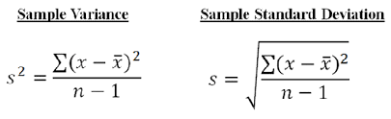
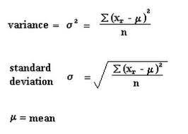

Slide 6
Five Number Summary
Minimum
First Quartile (Q1)
Median
Third Quartile (Q3)
Maximum

Slide 7
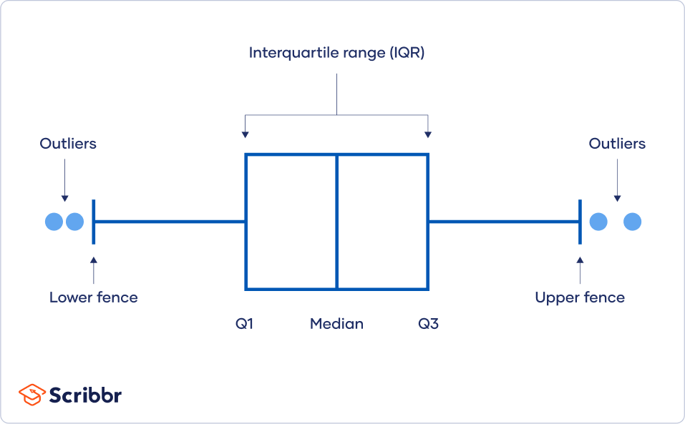

Slide 8
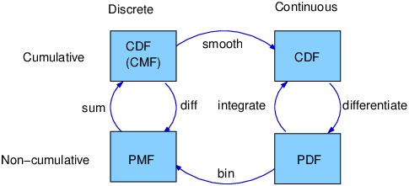
PMF-CDF-PDF-PPF

Slide 9
Thank you

