Slide 1

Stats

Slide 2
Correlation Analysis
Co-variance
Pearson correlation coefficient
Spearman’s Rank correlation

Slide 3
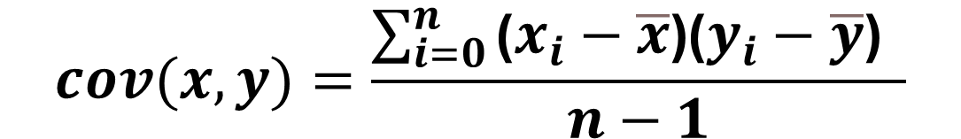
Co-variance
$$cov(x,y)=\frac{\sum_{i=0}^{n}{\text{(}x_{i}−\overline{x}\text{)(}y_{i}−\overline{y}\text{)} \text{​ }}}{n−1}$$

Slide 4
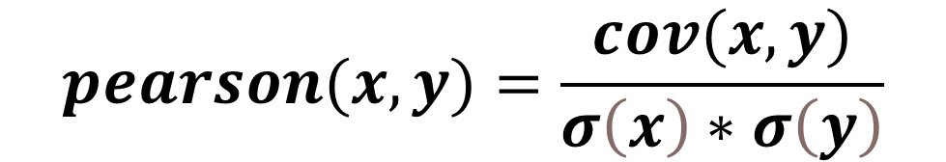
Pearson correlation coefficient
$$pearson(x,y)=\frac{cov(x,y)}{σ\left(x\right)∗σ\left(y\right)}$$

Slide 5
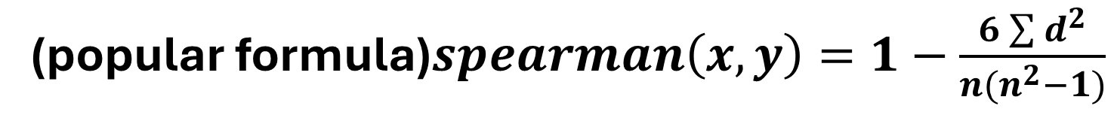
Spearman’s Rank Correlation
(popular formula)$spearman\left(x,y\right)=1−\frac{6\sum{d^{2}}}{n(n^{2}−1)}$
($spearman\left(x,y\right)=\frac{cov(R(x),R(y))}{σR\left(x\right)∗σR\left(y\right)}$
Notes:
We use the popular formula Only if all n ranks are distinct integers
We use Spearman’s Rank Correlation Only if we have non-linear relation

Slide 6
Kinds of Distribution
Normal Dist (Gaussian)
Binomial
Poisson
Uniform
Exponential
Chi-Square
Student’s t-Dist
F-Dist
Lognormal
Notes:
- Binomial Distribution:
Models the number of successes in a fixed number of independent Bernoulli trials.
Each trial has a binary outcome (e.g., success or failure).
The number of trials is fixed and finite.
Example: The number of heads obtained when flipping a coin 10 times.
- Poisson Distribution:
Models the number of events occurring in a fixed interval of time or space.
Events occur randomly and independently of each other.
The interval of time or space is fixed, but the number of events can vary.
Example: The number of phone calls received at a call center in an hour.
-Student's t-Distribution :
Description: The Student’s t-distribution is a continuous probability distribution that describes the relationship between observed and expected, is used in hypothesis testing and constructing confidence intervals for the mean of a normally distributed population when the sample size is small and the population standard deviation is unknown.

Slide 7
Type 1 and 2 Errors
Type 1 : we reject the null hypothesis test, when in reality it’s true (False positive )
Type 2: we accept the null hypothesis test, when in reality it’s false (false negative)

Slide 8
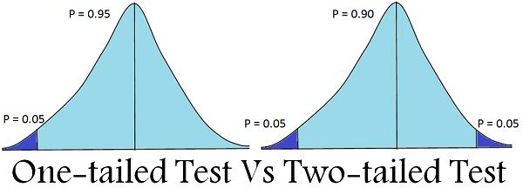
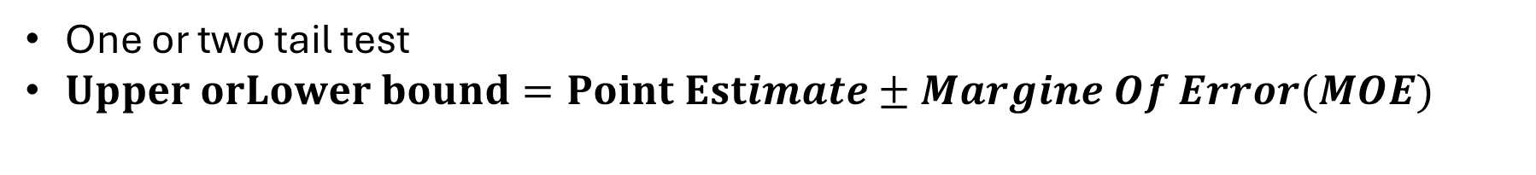
Confidence Interval (CI)
One or two tail test
$Upper orLower bound=Point Estimate±Margine Of Error(MOE)$
Notes:
Point Estimate is the sample mean ($\overline{x}$)
MOE = zα/2​ or tα/2​ * Standard Error(SE)
SE= $σ/{\sqrt{n}}$ for Z-test , $s/{\sqrt{n}}$ for T-test

Slide 9
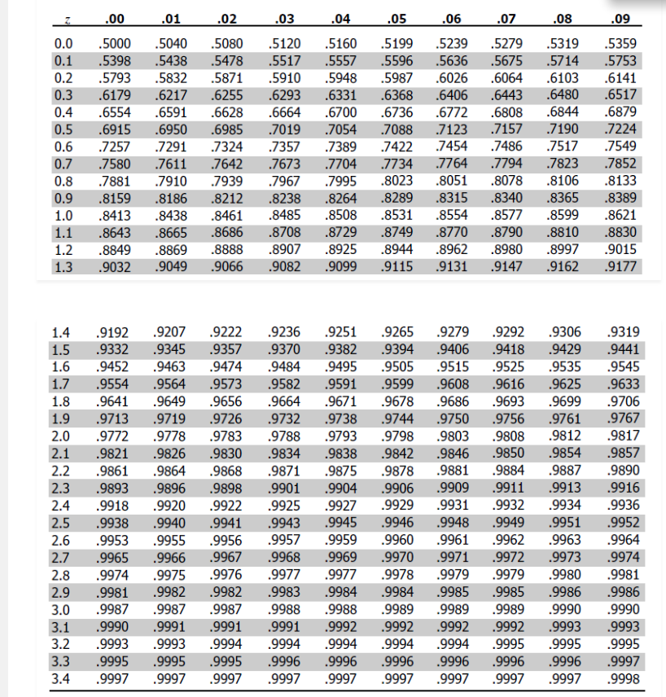
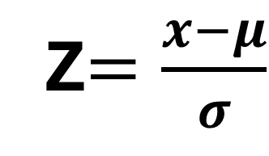
Z-score
Z$=\frac{x−μ}{σ}$

Slide 10

Z-test
Std For population
$$Z= \frac{\overline{x} − μ}{σ/{\sqrt{n}}}$$

Slide 11
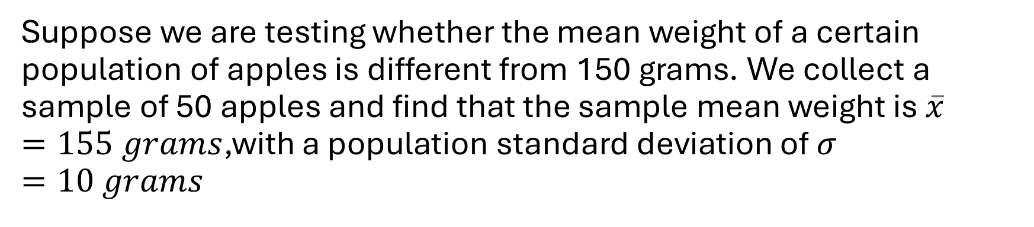
Example
Suppose we are testing whether the mean weight of a certain population of apples is different from 150 grams. We collect a sample of 50 apples and find that the sample mean weight is $\overline{x}=155 grams$,with a population standard deviation of $σ=10 grams$
Notes:
We want to test the null hypothesis:
H0 : $μ$= 150
Against the alternative hypothesis:
H1: $μ$ $≠$ 150
We will conduct a two-tailed z-test at a 95% confidence level.
First, we calculate the z-score using the formula for the z-test
$$Z= \frac{\overline{x} − μ}{σ/{\sqrt{n}}}$$
Z=3.536
The critical z-values for a two-tailed test at a 95% confidence level are approximately ±1.96. Since our calculated z-score (3.536) exceeds the critical value, we reject the null hypothesis.
Now, let's determine the upper and lower bounds of the confidence interval:
$$Upper orLower bound=Point Estimate±Margine Of Error(MOE)$$
MOE= Z * $\frac{σ}{\sqrt{n}}$
MOE≈2.772
Upper Bound: 155+2.772=157.772
Lower Bound: 155−2.772=152.228
Therefore, the 95% confidence interval for the population mean weight of apples is approximately (152.228, 157.772) grams.

Slide 12
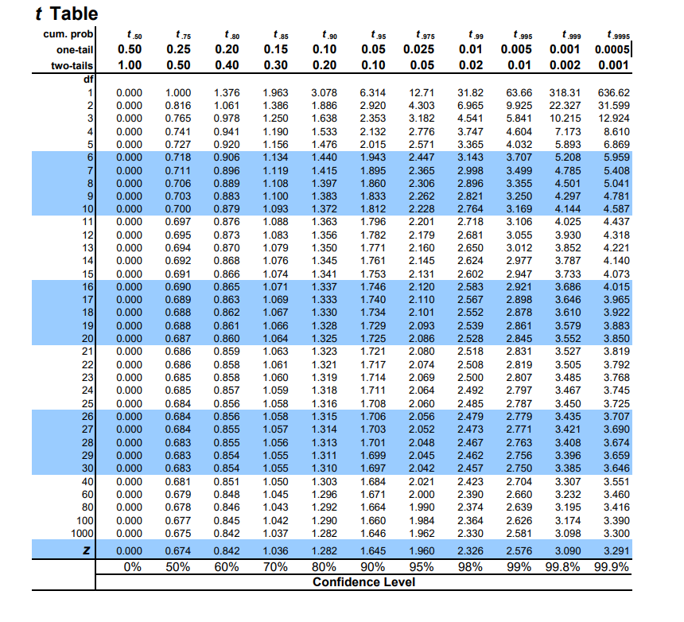
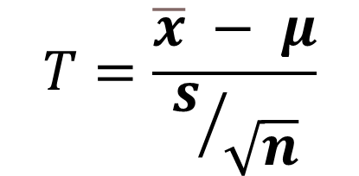
T-test
Degree of freedom(One sample T-test) = n-1
Std for sample
$$T=\frac{\overline{x} − μ}{s/{\sqrt{n}}}$$

Slide 13

Example
Suppose we are testing whether the mean weight of a certain population of apples is different from 150 grams. We collect a sample of 50 apples and find that the sample mean weight is $\overline{x}=155 grams$,with a sample standard deviation of $s=10 grams$
Notes:
We want to test the null hypothesis:
H0 : $μ$= 150
Against the alternative hypothesis:
H1: $μ$ $≠$ 150
$$df=n−1=49$$
t-value for a two-tailed test at 95% confidence level ≈ ±2.01 (from t-distribution tables)
$$T=\frac{\overline{x} − μ}{s/{\sqrt{n}}}$$
T=3.536
The critical t-values for a two-tailed test at a 95% confidence level are approximately ±2.01. Since our calculated t-score (3.536) exceeds the critical value, we reject the null hypothesis.
Now, let's determine the upper and lower bounds of the confidence interval:
$$Upper orLower bound=Point Estimate±Margine Of Error(MOE)$$
MOE= T * $\frac{s}{\sqrt{n}}$
Upper : 155 + 2.843= 157.843
Lower : 155 – 2.843= 152.157
Therefore, the 95% confidence interval for the population mean weight of apples is approximately (152.157, 157.843) grams.

Slide 14
Chi Square test
Categories Data
Calculate expected frequencies for each cell under the assumption of independence.
Compute the chi-square test statistic.
Determine the degrees of freedom.
Find the critical value for the chi-square statistic at the chosen significance level.
Compare the calculated chi-square statistic to the critical value.
Make a decision regarding the null hypothesis.

Slide 15
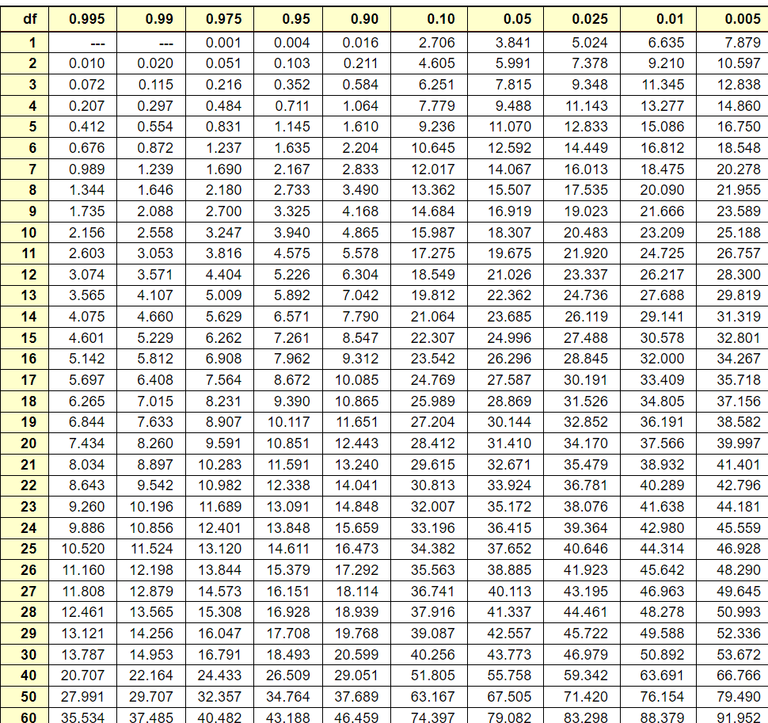
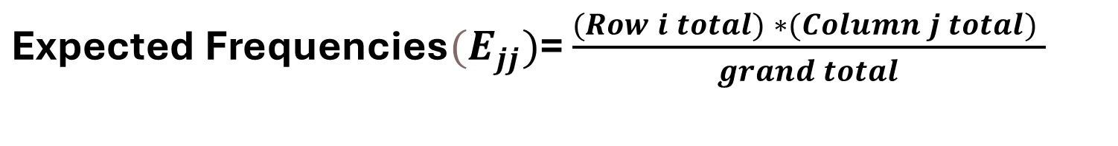
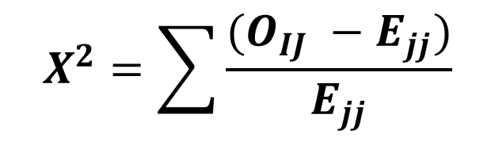
$\text{Expected} \text{Frequencies}{(E}_{jj})$= $\frac{(Row i total) ∗(Column j total) }{grand total}$
$$X^{2}=\sum{\frac{(O_{IJ} −E_{jj})}{E_{jj}}}$$

Slide 16
Example:
Suppose we have data on the favorite colors of individuals based on their gender. We want to test whether there is a significant association between gender and favorite color at a significance level of 0.05. Our null and alternative hypotheses are as follows:
Null Hypothesis (H0): There is no association between gender and favorite color.
Alternative Hypothesis (H1): There is an association between gender and favorite color.

Slide 17
Observed | Blue | Red | Green | Total
Male | 30 | 10 | 20 | 60
Female | 20 | 15 | 25 | 60
Total | 50 | 25 | 45 | 120
expected | Blue | Red | Green | Total
Male | 25 | 12.5 | 22.5 | 60
Female | 25 | 12.5 | 22.5 | 60
Total | 50 | 25 | 45 | 120
Notes:
$\text{Expected} \text{Frequencies}{(E}_{jj})$= $\frac{(Row i total) ∗(Column j total) }{grand total}$
$$X^{2}=\sum{\frac{(O_{IJ} −E_{jj})}{E_{jj}}}$$
$X^{2}$ ≈ 3.556
$$df=\left(r−1\right)∗ (c−1)$$
$df$= 2
Critical value for chi-square ≈ 5.991
Now, we compare the calculated chi-square statistic (3.556) to the critical value (5.991):
Since 3.556<5.991, we fail to reject the null hypothesis

Slide 18
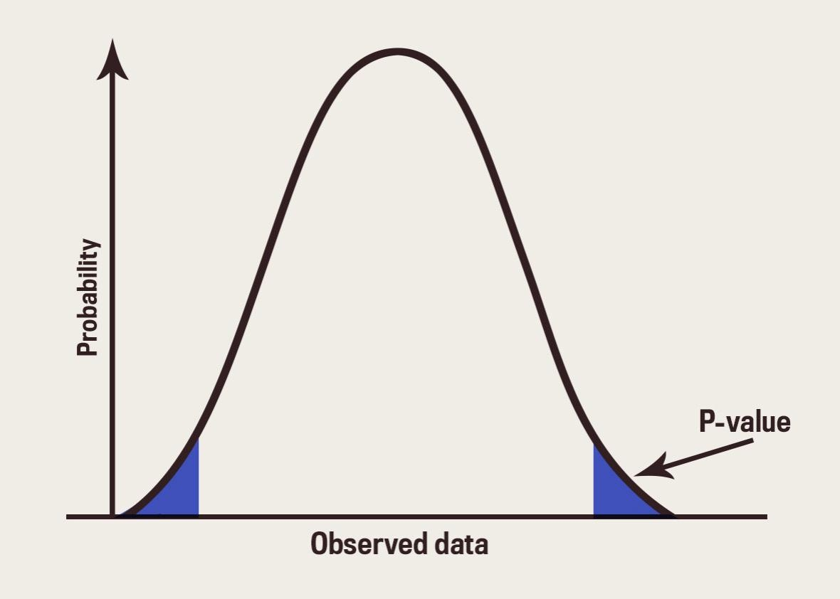
P-value

Slide 19
Thank you

