Slide 1
Restaurant Data Analysis
MOHAMMED SUHAIL M R
TABLEAU REINFORCEMENT PROJECT

Slide 2
INTRODUCTION
The objective of this project is to showcase ability to independently create a meaningful and visually engaging Tableau dashboard. This project includes, preparation, analysis, visualization, and presentation, allowing to demonstrate us proficiency with Tableau’s core features.
Created an aesthetically pleasing and functional dashboard that offers actionable insights. Added interactive elements and ensured that dashboard is intuitive and easy to navigate.

Slide 3
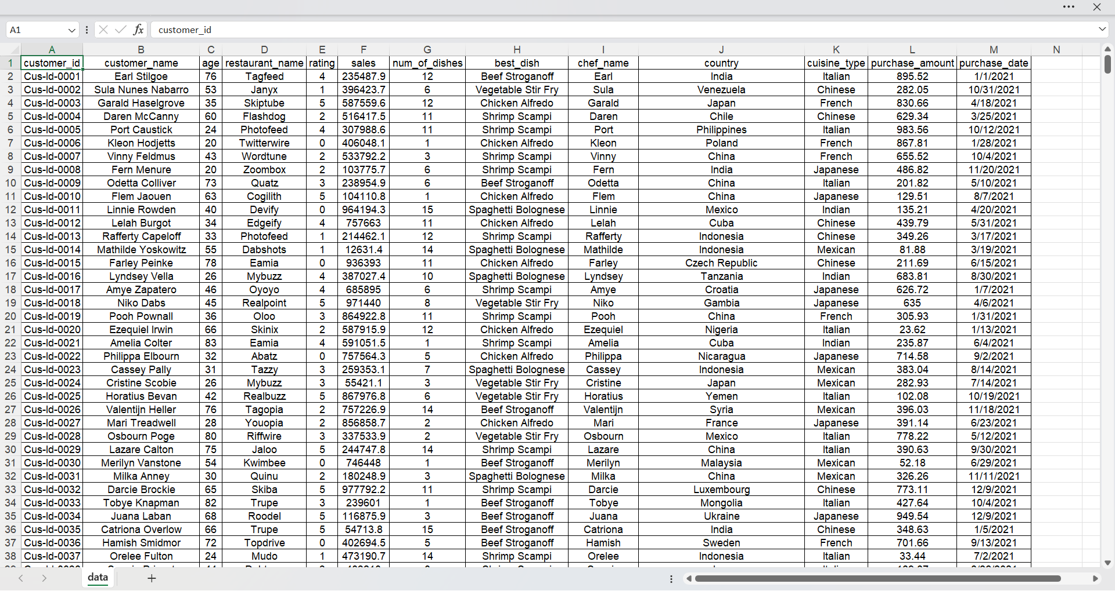
DATA SET
THIS IS THE DATA TAKEN FROM THE MACKROO.COM

Slide 4
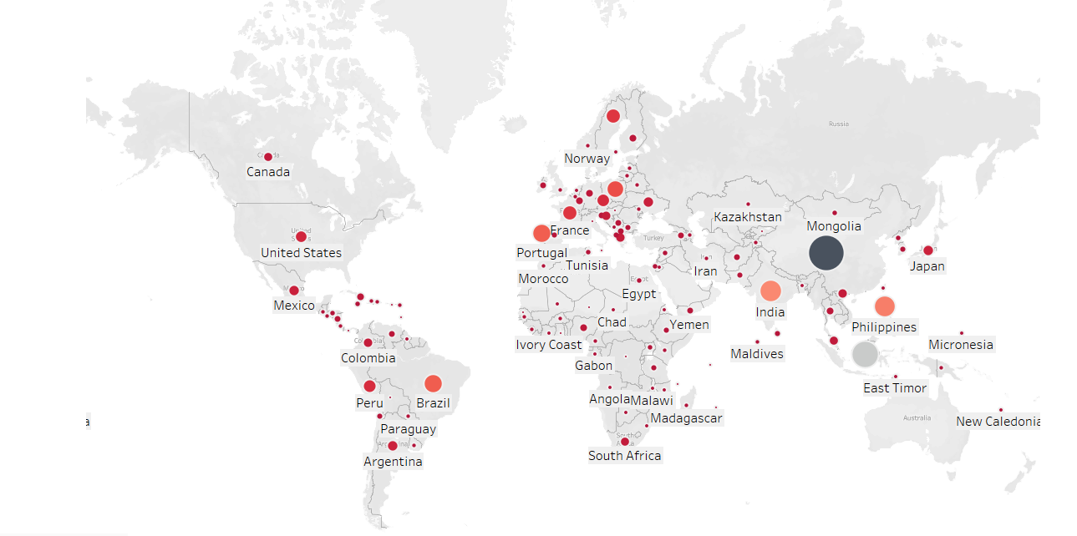
SALES VS COUNTRY

Slide 5
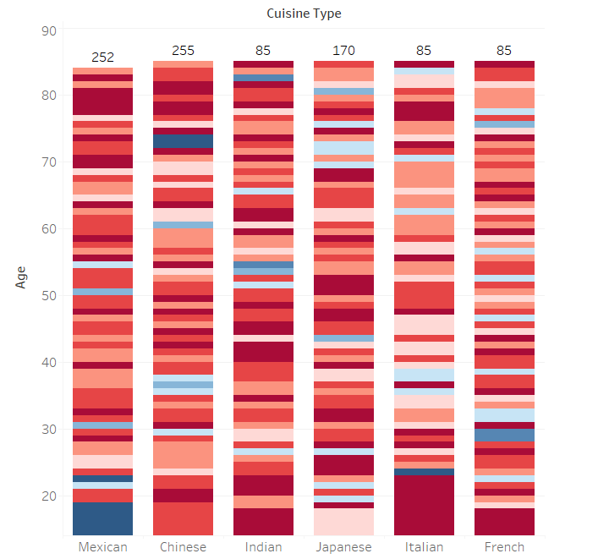
AGE VS CUISINE

Slide 6
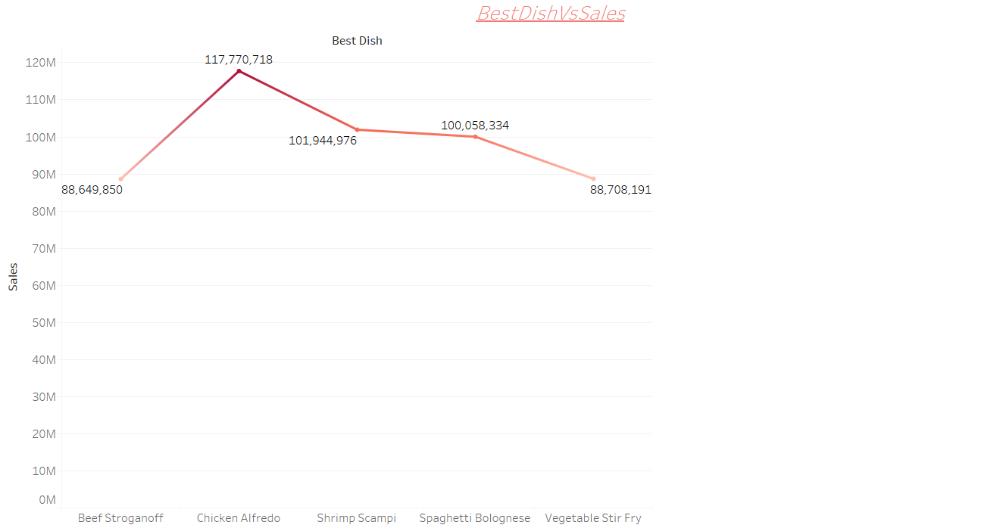
BEST DISH VS SALES

Slide 7
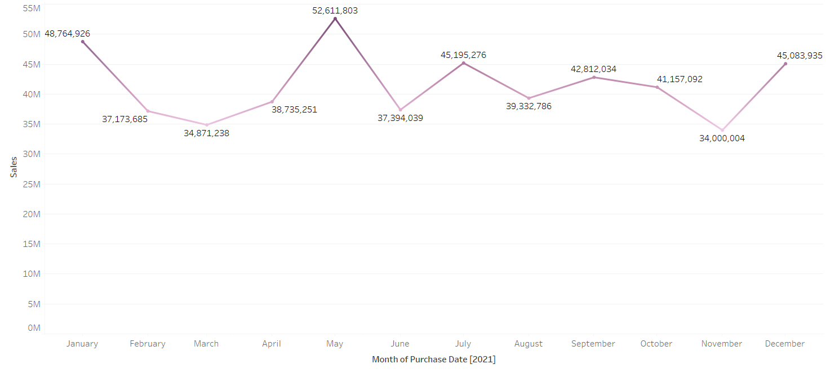
MONTHLY SALES

Slide 8
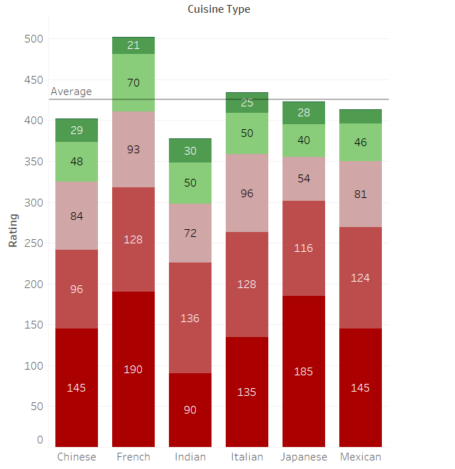
CUISINE VS RATING

Slide 9
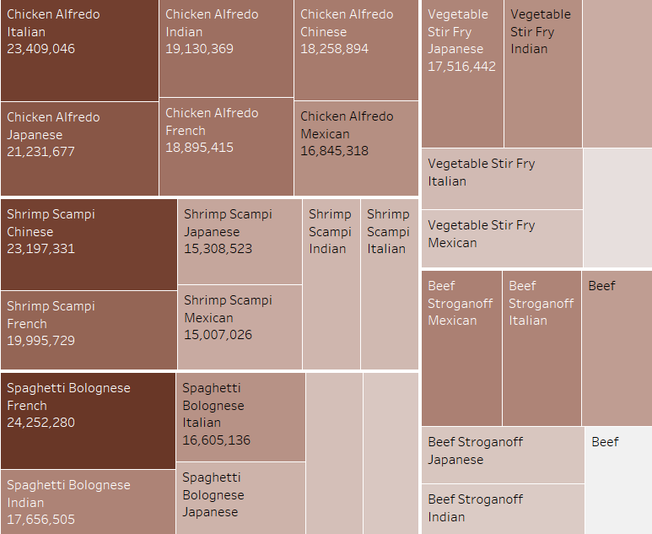
BEST DISH AND CUISINE AND SALES

Slide 10
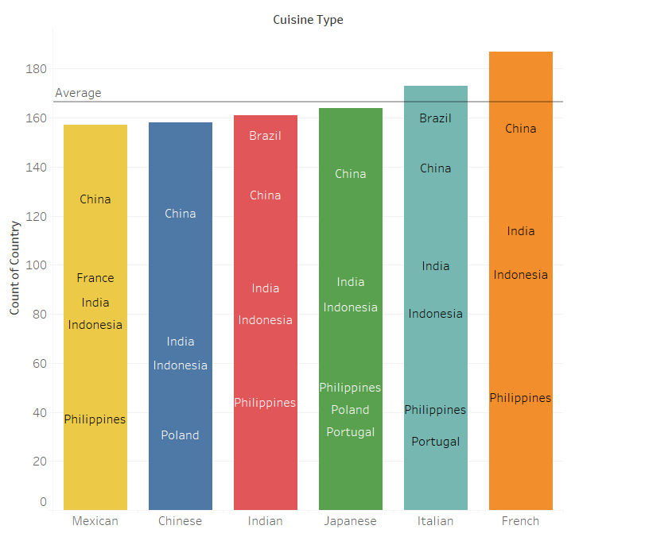
COUNT OF COUNTRY AND CUISINE TYPE

Slide 11
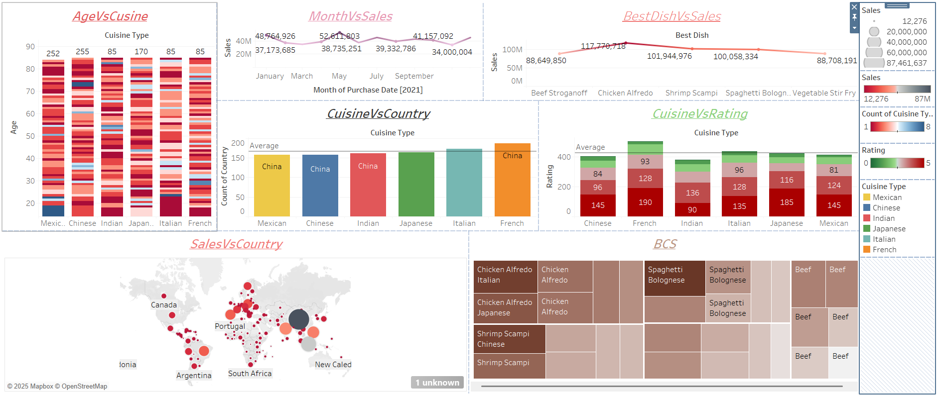
DASHBOARD

Slide 12
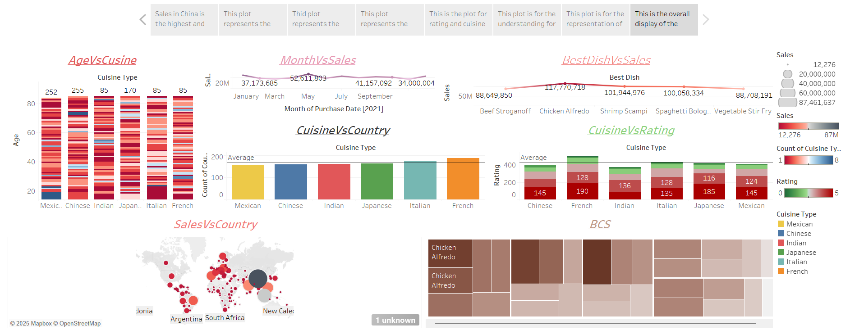
STORY

Slide 13
CONCLUSION
Created an aesthetically pleasing and functional dashboard that offers actionable insights. Added interactive elements and ensured that dashboard is intuitive and easy to navigate.
As per the understanding China has more sales and the least is Niger.
Business can be expanded in Russia and Australia.
Based on the ratings the Indian food need to be concentrated more on the quality to satisfy the rating said anyhow Indian food is quite decent in the sales part.
India should focus more on the French Cuisine to grow up the sales and compete China.

Slide 14

Mohammed Suhail M R

