Slide 1

Health insurance Fraud Detection Solution

Slide 2
Table of Contents
Introduction
Training Data Stage
Get Data from Database
Cleaning Data
Data Processing
Normalization
Calculate the k value by using elbow method
Create and Save a model (KMeans Clustering Algorithm) and export result to csv files
Insert the data(result) to oracle database after testing from domain experts.
Display the data on web application
Testing Data Stage
Get Data (Historical data related to subscribers new claims - Today)
Cleaning Data
Data Processing
Normalization
Predict new data and export result to csv files
Insert the result to oracle different table
Update the data
Summary

Slide 3
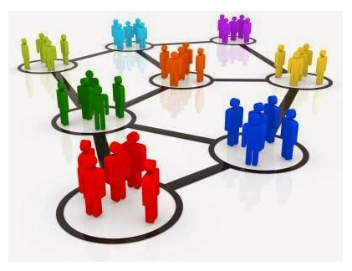
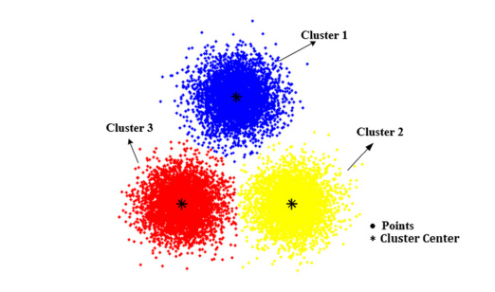
Introduction
In our case, the data is not labeled, which means that we didn’t have a column that shows if this subscriber is fraud or not.
The most famous algorithm in ML used for unsupervised data is KMeans Clustering .

Slide 4
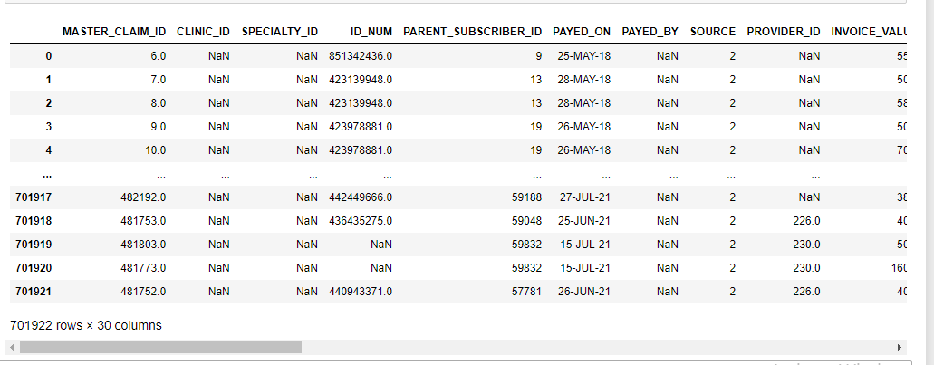
Training Data Stage
Get The Data from production
The data stored in our database at datacenter in Tamkeen insurance company.
I created SQl Statement to collect the data from more than one table
The Training Data is 701,922 rows and 30 column

Slide 5
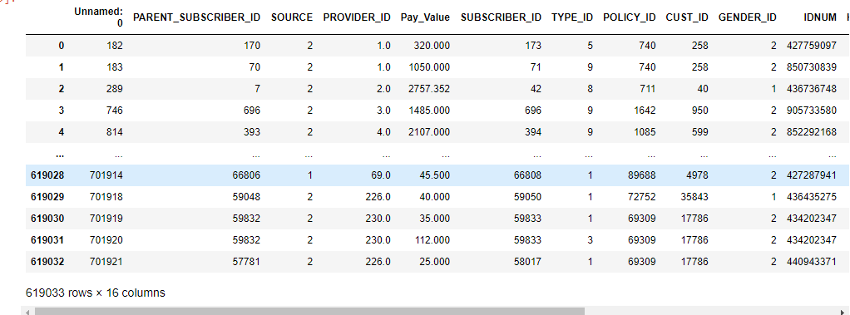
Training Data Stage
Cleaning Data
In this part we deleted column out of our scope.
I created new column to be used in our project .
Export the new data (Cleaning data) with 619,033 rows and 16 column

Slide 6
Training Data Stage
Data Processing
We created new features from columns and collect data based on ID Number for subscribers .
We exported the new data (After Processing ) with 19,161 rows and 31 column
The new features contain max value, average and count for unique ID Number.

Slide 7
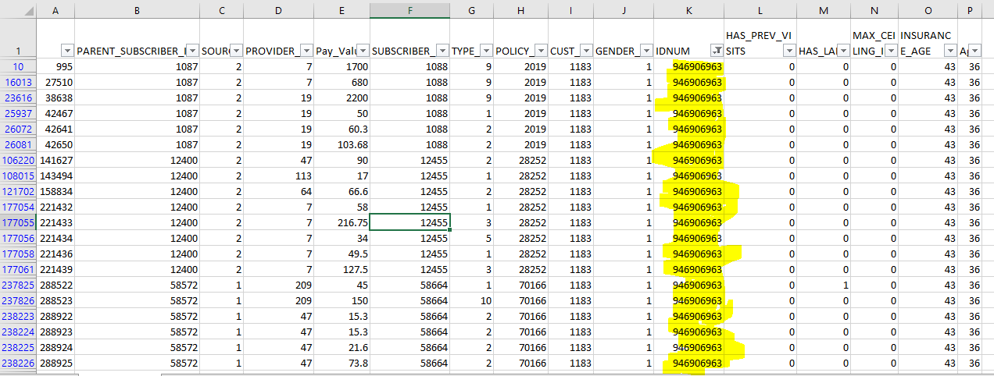
Training Data Stage
Data Processing

Slide 8
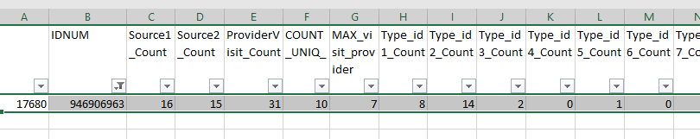
Training Data Stage
Data Processing

Slide 9
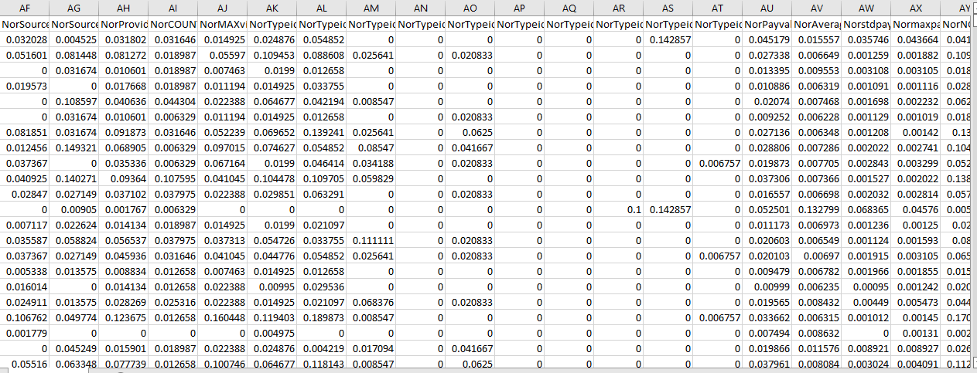
Training Data Stage
Normalization
In this part we used minmax scaler for every features after that transform it .
( Give every value in data new value from 0 to 1 )

Slide 10
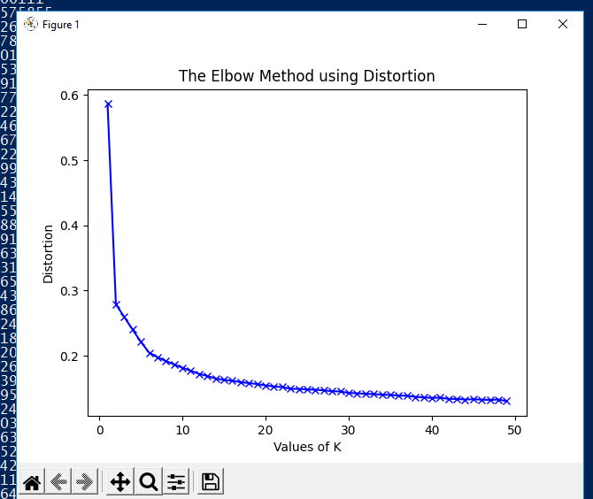
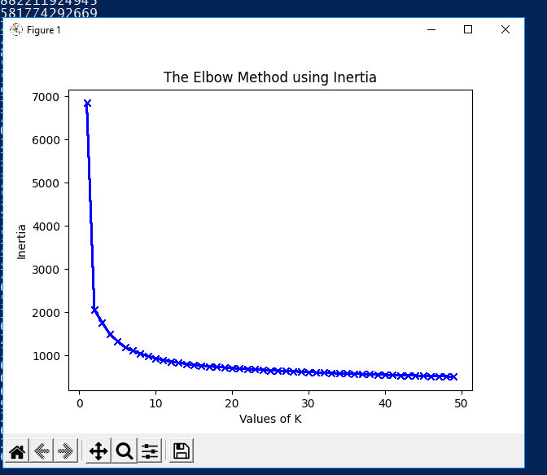
Training Data Stage
Elbow Method

Slide 11
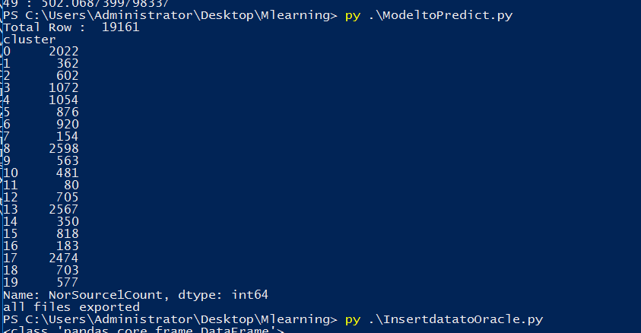
Training Data Stage
Create Model and Save

Slide 12
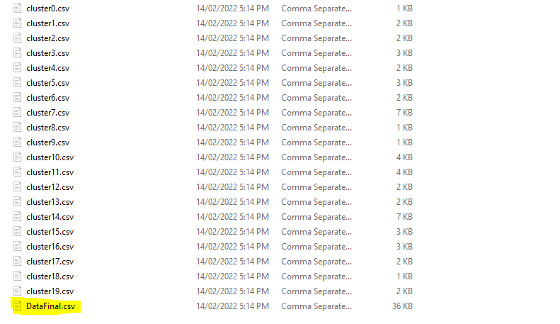
Training Data Stage
Create Model and Save

Slide 13
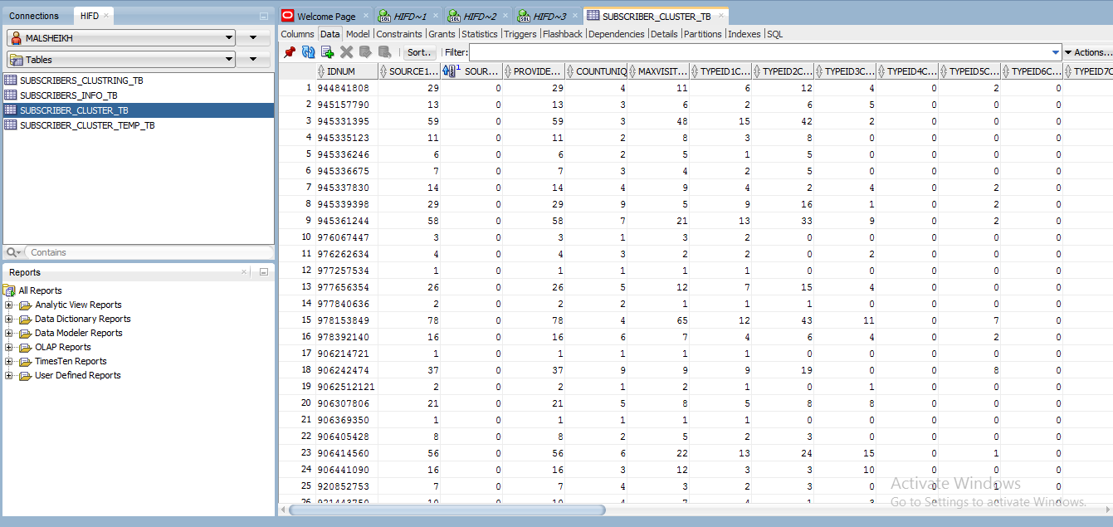
Training Data Stage
Insert Data to Oracle Table

Slide 14
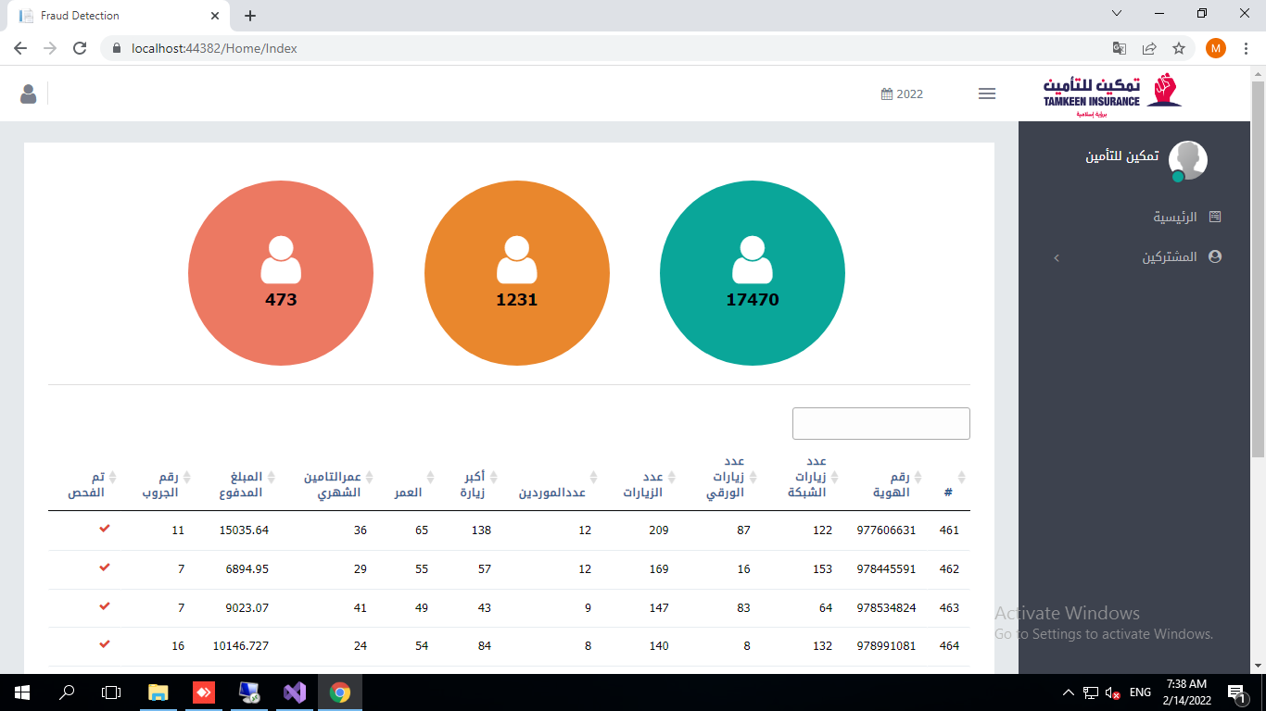
Training Data Stage
User Interface to the end user

Slide 15
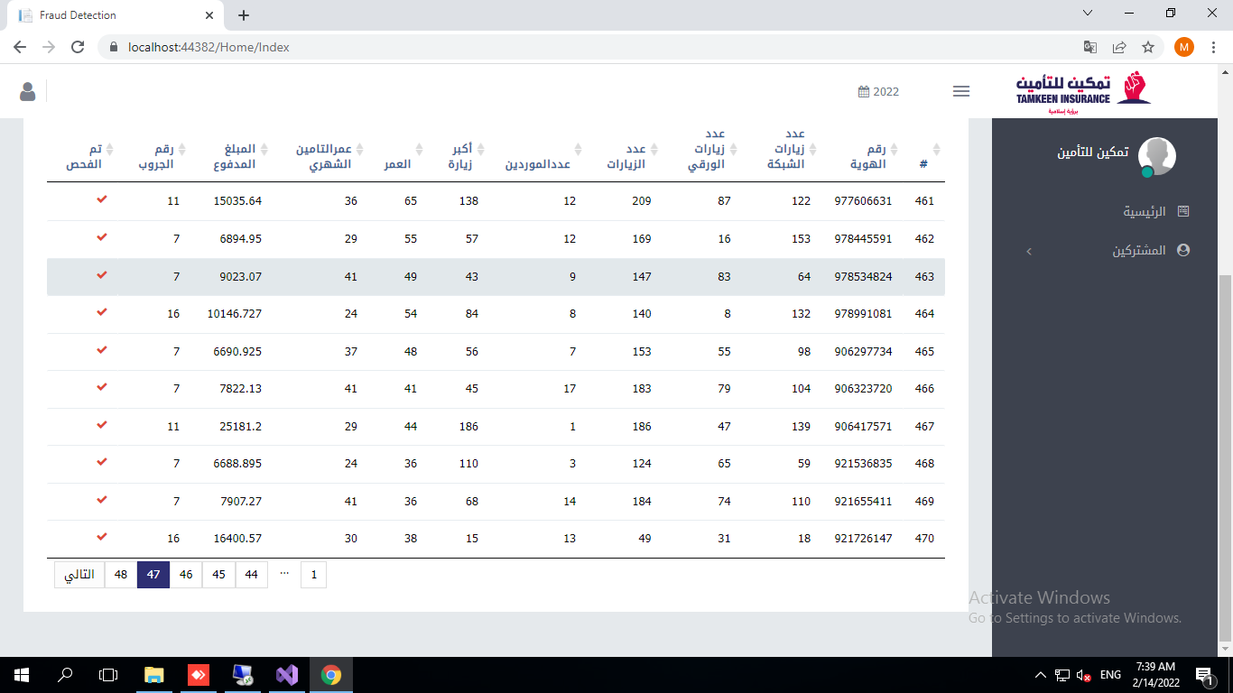
Training Data Stage
User Interface to the end user

Slide 16
Testing Data Stage
In this Part we repeat the process for the new data as following :
Cleaning Data
Data Processing
Normalization
Predict the new data
Insert new result to another table ( SUBSCRIBERS_CLUSTER_TEMP_TB).
Compare the data between tow table based on the id num , if record is exist then update on it else insert the new record
We created a batch file to run our script daily at 10:00 clock .

Slide 17
Q&A

