Slide 1

Health insurance Fraud Detection Solution
Prepared by :
Raed Jaber
Abrar Mady
Mohammad Al-Sheikh

Slide 2
Project Motivation
Insurance fraud is a very critical problem for insurance companies, and detecting frauds is very important to reduce cost and increase profits.
According to a recent survey, it is estimated that the 15 percent of total claims are fraud.
Insurance companies in USA incur losses over 30 billion USD annually to healthcare insurance frauds.

Slide 3
Our Solution
Our solution can analyzes claims to determine normal behavior patterns and detecting the abnormal claims where these can be investigated for fraudulent activity by insurance specialists and assist in discovering fraud/abuse patterns and help in setting new policies and track suspicious customers or medical providers.

Slide 4
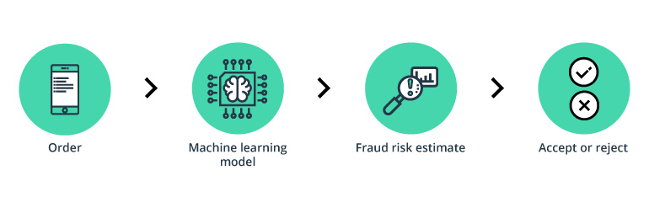
Decision support product

Slide 5
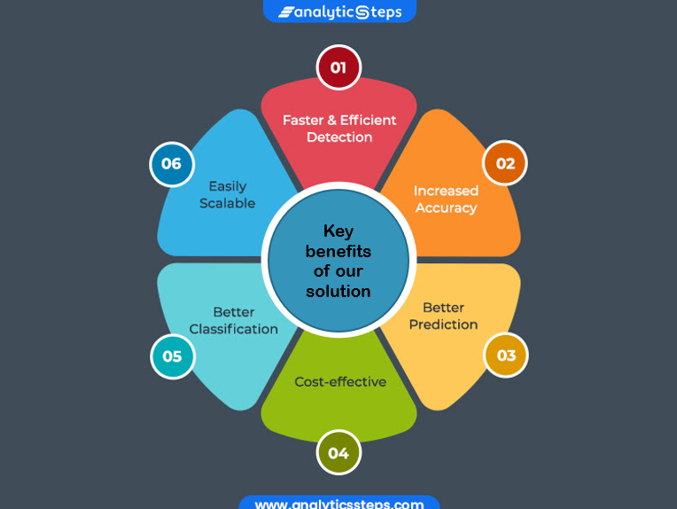

Slide 6
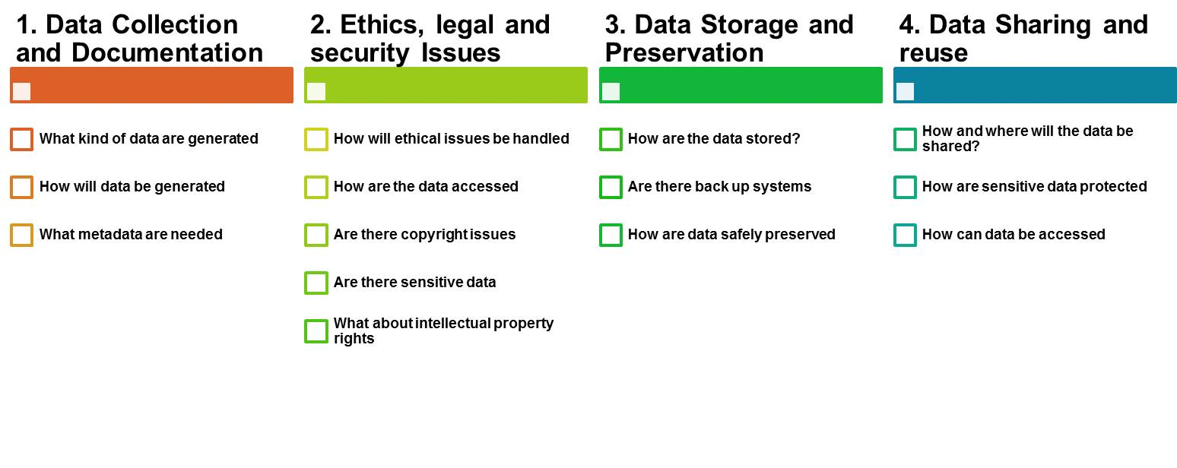
Data Management Plan

Slide 7
Data collection & Documentation
Data for health insured subscribers in a local Insurance Company located in Palestine called Tamkeen Insurance Co
The dataset is based on subscribers’ medical claims which was collected in Palestine from 2018 until today through a specific system.
The data is obtained by two primary sources:
1. Network: through a specific system on insurance company that is primarily responsible for registering subscribers’ data and receiving compensation requests from the supplier network
2.Re-impressment: invoices that are manually delivered to the compensation employee on insurance company, who later manually enters them into the company’s system.
*The first and second sources of data are stored in the insurance company's database

Slide 8
The data set comprises of nominal, continuous, as well as discrete variables.
The data is extracted and saved in the form of an Excel file (.csv)
We do not use metadata standards yet.
The data from company will be delivered including a data dictionary. For every variable this data dictionary contains an explanation of the values

Slide 9
Ethics , legal and security issues
Access to all storage drives and online data collection is password protected and limited to the research team.
Access will be restricted due to the sensitive nature of its contents. Anyone wishing to use the data must first contact and receive permission from the Tamkeen Insurance Co.

Slide 10
Data storage and preservations
Data storage is secure cloud based within the system server
Since data cannot easily be recreated or produced and it is costly to reproduce (experimental data), So Raw data and metadata will be collected with the possibility of modification by a user.

Slide 11
Data sharing and reuse
There is no intention to share the data.
In the future maybe will share it among researchers based on certain criteria to ensure that the data is used effectively, as any researcher in the future can obtain the data according to specific criteria and conditions. We determine the amount of data, privacy standards, and financial compensation for sharing based on each researcher’s goal.

Slide 12
Q&A

