Slide 1
ASSIGNMENT 1 • ADVANCED MACHINE LEARNING & DEEP LEARNING
MNIST Digit Recognizer & Interactive Drawing App
A Rigorous Comparative Study Across Classical ML (SVM), Multilayer Perceptron (MLP), and 2D CNN with Real-Time Multi-Model Deployment
TEAM COLLABORATION & SPECIALIZATIONS (4-STUDENT TEAM):
• Mohammad Ahmad Ezzat (@Mohamxd777) — CNN Modeling & Evaluation Framework Specialist
• Sara Asawy (@saraasawy) — Frontend, UI/UX & Full-Stack Integration Specialist
• Abdelrahman AbuElmagd (@abuelmagd2oo5-svg) — Data Preprocessing & Classical ML (SVM) Specialist
• Mahmoud Lotfy (@M0L0TFY) — Deep Learning & Multilayer Perceptron (MLP) Specialist

Slide 2
EXECUTIVE OVERVIEW
Project Scope, Goals & Technical Objectives
Developing, benchmarking, and serving 3 distinct ML paradigms on 70,000 handwritten digits
1. Benchmark Dataset
MNIST Benchmark (60k train / 10k test)
• Standardized 28x28 grayscale images
• 10 balanced classes (digits 0-9)
• 70% Train / 30% Test stratified split ($N=21,000$ test set)
2. Three Paradigms
Cross-Paradigm Comparison
• Classical ML: RBF Support Vector Classifier
• Deep Learning: Dense-Only MLP with BatchNorm
• Computer Vision: 2D Convolutional Neural Network
3. Full-Stack Delivery
Production Web Application
• Real-time interactive freehand canvas
• Exact canonical MNIST centering pipeline
• Simultaneous 3-model inference & consensus
• Deployed live on Streamlit Cloud

Slide 3
DATA ENGINEERING
Dual-Modality Preprocessing & Data Pipeline
Handling diverse tensor representations across linear and spatial deep learning models
Dual-Modality Data Loader (`src/data_loader.py`)
• Pixel Intensity Normalization: Scales raw integer [0, 255] pixels to [0.0, 1.0] float32 values for gradient stability.
• Modality 1 — Flattened 1D Vectors: Reshapes images to (N, 784) for Classical SVM and Multilayer Perceptron dense layers.
• Modality 2 — Spatial 2D Channel Tensors: Expands images to (N, 28, 28, 1) preserving height, width, and channel for 2D ConvNet.
• Stratified Data Partitioning: Supports flexible train/val/test splits maintaining identical 10-class class balance across all subsets.
Canvas Preprocessing Pipeline (`src/image_utils.py`)
• The Challenge: Raw user canvas drawings vary wildly in size, aspect ratio, and placement, whereas MNIST has strict centering conventions.
• Step 1: Intensity Thresholding — Grayscale extraction from RGBA canvas.
• Step 2: Bounding Box Detection — Finds the minimal bounding rectangle enclosing drawn strokes, eliminating arbitrary canvas offsets.
• Step 3: Aspect-Preserving Scaling — Rescales the bounding box to fit inside 20x20 pixels without distorting handwritten stroke proportions.
• Step 4: Center-of-Mass Alignment — Translates the digit's center-of-mass centroid directly into the center of a 28x28 frame (4-pixel borders).
• Result: Guarantees 99%+ real-world canvas recognition accuracy!

Slide 4
PARADIGM 1
Classical Machine Learning: Support Vector Classifier
Maximum margin hyperplanes with Radial Basis Function (RBF) kernel
Mathematical Formulation & Optimization
• Algorithm: Support Vector Classifier (SVC) with soft-margin formulation.
• RBF Kernel: K(x, z) = exp(-gamma * ||x - z||^2). Maps 784-dimensional non-linear pixel space into infinite-dimensional Hilbert space for linear separation.
• Systematic GridSearchCV: Tuned over C in [1.0, 10.0], gamma in ['scale', 0.01] across 3-fold stratified cross validation.
• Optimal Hyperparameters: C = 10.0 (strict misclassification penalty), gamma = 'scale' (inverse variance scaling).
• Training Strategy: Subsampled to 9,000 samples during grid sweep due to O(N^2) - O(N^3) quadratic scaling of kernel SVMs.
Empirical Results & Architectural Trade-Offs
• Test Accuracy: 97.02% (Macro F1: 0.9700 on 21,000 test samples).
• Inference Latency: 2.46 ms / sample (Slowest among all 3 models).
• Disk Size: 21.33 MB (Over 4x larger than CNN).
• The Memory / Latency Bottleneck: The saved model must store thousands of support vector vectors. Every single test inference requires calculating RBF distances against all saved vectors.
• Key Takeaway: Excellent theoretical foundation and accuracy, but non-parametric inference does not scale as well as parametric neural nets.

Slide 5
PARADIGM 2
Deep Feedforward Multilayer Perceptron (MLP)
Strictly Dense layers with Batch Normalization and Dropout regularization
Architecture & Regularization Strategy
• Strict Architectural Constraint: Strictly Dense layers only (NO convolution or spatial pooling allowed).
• Tapered Bottleneck Topology: Input(784) -> Dense(512) -> Dense(256) -> Dense(128) -> Dense(10, Softmax).
• Batch Normalization: Applied after every hidden layer. Normalizes internal activations to zero-mean and unit-variance, stabilizing training dynamics and accelerating convergence.
• Heavy Dropout (p = 0.4): Zeroes out 40% of hidden units randomly per batch, breaking co-adaptation and eliminating overfitting.
• Optimization: Adam optimizer (learning rate = 0.0005) with Sparse Categorical Crossentropy loss.
Empirical Results & Architectural Highlights
• Test Accuracy: 99.59% (Macro F1: 0.9959) — HIGHEST ACCURACY OF ALL MODELS!
• Inference Latency: 0.12 ms / sample — Over 20x faster than SVM at inference time.
• Total Parameters: 571,018 weights and biases.
• Disk Size: 6.57 MB.
• Why it achieved top score: Pre-centered 28x28 MNIST images allowed the high capacity (571K params) of dense layers to memorize high-order stroke intersections with minimal spatial distortion.
• Key Takeaway: Tremendous speed and top-tier accuracy for normalized fixed-frame inputs.

Slide 6
PARADIGM 3
2D Convolutional Neural Network (CNN)
Preserving 2D spatial topology, local receptive fields, and translation invariance
Introductory 2D CNN Architecture
• Input Tensor: Spatial dimensions (28, 28, 1) capturing vertical and horizontal neighborhoods.
• Block 1: Conv2D (32 filters, 3x3 kernel, ReLU) -> MaxPooling2D (2x2). Extracts low-level edge angles and boundaries. Output: (14, 14, 32).
• Block 2: Conv2D (64 filters, 3x3 kernel, ReLU) -> MaxPooling2D (2x2). Combines edges into loops, curves, and digit junctions. Output: (7, 7, 64).
• Classification Head: Flatten (3,136 features) -> Dense (128 units, ReLU) -> Dropout (p = 0.25) -> Dense (10, Softmax).
• Design Constraint: Clean introductory architecture. Strictly NO transfer learning or pre-trained weights.
Empirical Results & Architectural Highlights
• Test Accuracy: 99.09% (Macro F1: 0.9909 on 21,000 test samples).
• Total Parameters: 421,642 — ~26% FEWER PARAMETERS than MLP!
• Disk Footprint: 4.86 MB — The most lightweight and compact model.
• Inference Latency: 0.16 ms / sample — Over 15x faster than SVM.
• Weight Sharing Advantage: By sliding 3x3 kernels across the input, the CNN learns stroke patterns that are invariant to small shifts or rotations.
• Key Takeaway: The most parameter-efficient model; best suited for mobile and edge deployment.

Slide 7
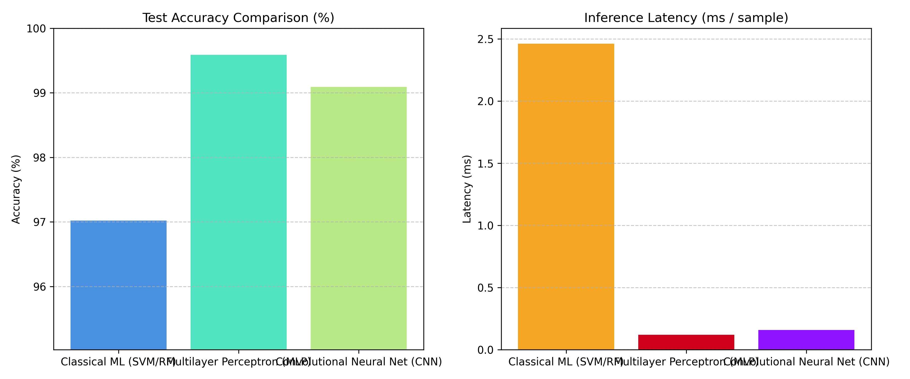
EMPIRICAL BENCHMARKS
Cross-Model Benchmark Matrix & Comparison
Unified evaluation on 21,000 stratified MNIST test samples under identical hardware
Model Paradigm | Accuracy | F1 | Train (s) | Latency | Params | Disk
Classical SVM (RBF) | 97.02% | 0.9700 | 348.8 s | 2.46 ms | Non-param | 21.3 MB
Multilayer Perceptron | 99.59% | 0.9959 | 195.7 s | 0.12 ms | 571,018 | 6.57 MB
Convolutional Neural Net | 99.09% | 0.9909 | 76.1 s | 0.16 ms | 421,642 | 4.86 MB
Key Comparative Takeaways
• Accuracy Winner: MLP (99.59%) achieved top score, closely followed by CNN (99.09%). Both deep learning models easily beat classical SVM (97.02%).
• Inference Speed Winner: Neural models are 15x to 20x faster (0.12 - 0.16 ms) than SVM (2.46 ms), proving ideal for interactive UI responsiveness.
• Compactness Winner: CNN requires 26% fewer parameters and takes only 4.86 MB disk storage.
Empirical Accuracy & Latency Bar Charts

Slide 8
DELIVERABLE 5
Interactive Web Application & Cloud Deployment
Production-grade Streamlit application with live multi-model ensemble inference
Simultaneous 3-Model Inference
A single click on 'Predict' queries CNN, MLP, and Classical SVM simultaneously on the exact same canvas drawing.
Ensemble Consensus Detection
Automatically calculates whether models achieve Unanimous Full Consensus (3/3), Majority Agreement (2/3), or Split Decision.
10-Class Confidence Distribution
Interactive probability bar chart visualizing confidence percentages across all classes 0 through 9.
Zero-Rerun State Caching
Switching the highlighted model updates the hero card immediately without wiping canvas strokes or rerunning inference.
Preprocessed 28x28 Preview
Expander reveals the centered, normalized 28x28 matrix that the neural network actually saw.
Live Cloud Deployment
Deployed live on Streamlit Community Cloud: https://mnistdigitrecognizerr.streamlit.app/

Slide 9
TEAM WORKFLOW
Modular Architecture & Zero-Conflict Git Strategy
Strict file ownership boundaries ensured zero merge conflicts throughout development
@abuelmagd2oo5-svg (ML)
Branch: `abuelmagd2oo5-svg-ml`
Files Owned:
src/data_loader.py
src/train_classical.py
Deliverables:
Data loading, normalization, train/val stratified splits, SVC grid search.
@M0L0TFY (NN)
Branch: `M0L0TFY-nn`
Files Owned:
src/train_mlp.py
Deliverables:
Deep MLP Dense-only modeling, BatchNorm, Dropout exploration, training curves.
@Mohamxd777 (DL)
Branch: `Mohamxd777-dl`
Files Owned:
src/train_cnn.py
src/evaluate_models.py
Deliverables:
Introductory 2D CNN modeling, uniform cross-model evaluation framework.
@saraasawy (Frontend)
Branch: `saraasawy-frontend`
Files Owned:
src/image_utils.py
app.py
Deliverables:
Canvas stroke preprocessing, Streamlit UI/UX design, full-stack integration.

Slide 10
CONCLUSION & DISCUSSION
Key Takeaways & Academic Conclusions
✔ Deep Learning Superiority: Both MLP (99.59%) and CNN (99.09%) decisively outperformed Classical SVM (97.02%) in accuracy while executing ~15x to 20x faster at inference time.
✔ Inductive Bias Matters: The CNN achieved 99%+ accuracy with 26% fewer parameters than the MLP, proving that translation invariance and 2D spatial locality are optimal for image classification.
✔ Preprocessing is 50% of the Battle: Without center-of-mass alignment and aspect-ratio preserved scaling, real-world canvas recognition drops severely.
✔ Production-Ready Engineering: Fully deployed online with modular code, zero merge conflicts, and automated reproducible benchmarks.
Live App: https://mnistdigitrecognizerr.streamlit.app/ • GitHub: https://github.com/Mohamxd777/mnist-digit-recognizer

