Slide 1
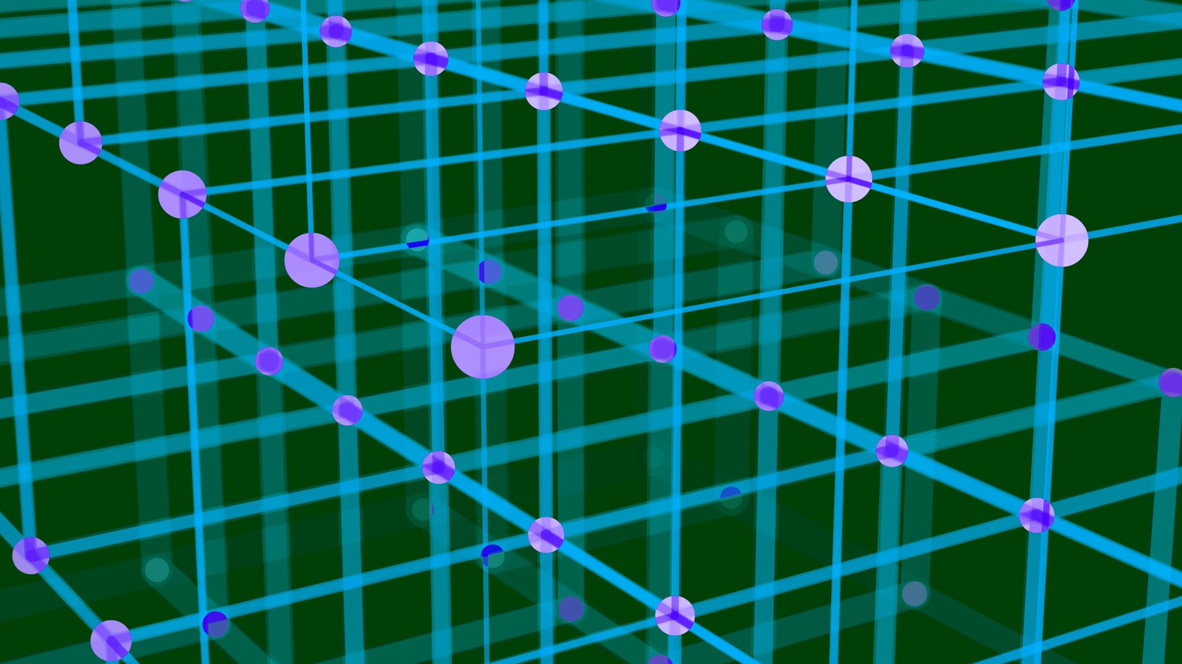
System modeling&simulation
Prepared by:
Eng. Hossam Badran

Slide 2
Grading
4th week – lecture (10 marks)
7th week – lecture (15 marks)
7th week – section (5 marks)
Assignments – section (5 marks)

Slide 3
What is simulation?
Simulation is a problem-solving technique that builds a model of a real system and uses experiments on that model to understand system behavior and predict future performance safely, without risking the real system.

Slide 4
Why simulation?
Simulation is a powerful problem-solving and analysis technique especially when:
1. Real experimentation is impractical or impossible
Some systems are too expensive, risky, dangerous, slow, or complex to test with real prototypes. Simulation lets you experiment virtually instead.
Examples:
aircraft in dangerous conditions
nuclear processes
Notes:
Simulation
High computational power
Many many trials
Lead to Less error

Slide 5
Why simulation?
2. There’s uncertainty or randomness
When a system involves random variables or complex interactions (like traffic flow, weather patterns, or human behavior), classical mathematics may not work. Simulation can still produce useful approximate insights.
3. We want control over time
Simulations can compress or expand time. For example, months of aircraft operation can be simulated in minutes, enabling rapid analysis.

Slide 6
Why simulation?
4. Safe “what-if” analysis
Simulation lets you test multiple scenarios to see the effects of changes (e.g., adjusting parameters like speed, load, rules) without any real-world risk.

Slide 7
Real-World Example: Crash Simulation
The Problem:
Testing how a vehicle performs in a crash traditionally involved building multiple physical prototypes and crashing them with dummies. This is:
expensive
time-consuming
destructive to the prototype.
Moreover, real crash tests can only explore a limited set of scenarios and conditions.

Slide 8
The Simulation Solution
Modern automotive engineers use computer-based crash simulation software (e.g., tools like PAM-CRASH) to model the physics of a car and occupants under collision conditions. The software:
uses a virtual model of the car with all relevant physics (materials, structures, joints),
runs numerous simulated crash scenarios,
measures predicted forces, deformation, and injury outcomes, and
allows engineers to change design parameters and rerun simulations quickly.

Slide 9
How It Helps
Before building any physical prototypes, simulation enables engineers to:
-evaluate dozens or hundreds of crash scenarios -spot weak points in design -improve structural safety features (e.g., crumple zones) -reduce development costs -shorten the design cycle -enhance occupant protection and meet safety standards without as many real crashes.
This method has been widely adopted in the automotive industry globally and is now a key part of safety certification and design optimization.

Slide 10
Problem 1
Use the one-digit random number (6,3,5,0,8) to generate Random observations for:
1-Throwing a fair coin
2-Throwing a biased coin to head by 20%
Notes:
5 steps for this kind of questions
Theo.prob.
Allocation
R.O
SIM. PROB.
error

Slide 11
Solution-1
One digit RN 0→9 (10 numbers)
S={H,T}
Since coin is fair
Therefore Allocation
P(H)=0.5 0,1,2,3,4
P(T)=0.5 5,6,7,8,9
No.of trials=no.of random numbers=5
Then
(6,3,5,0,8)---R.O--->(T,H,T,H,T)
Theo.
Prob.

Slide 12
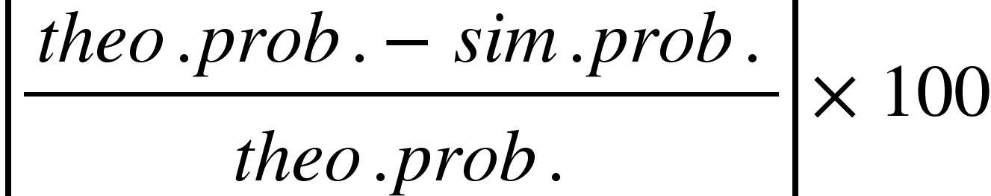
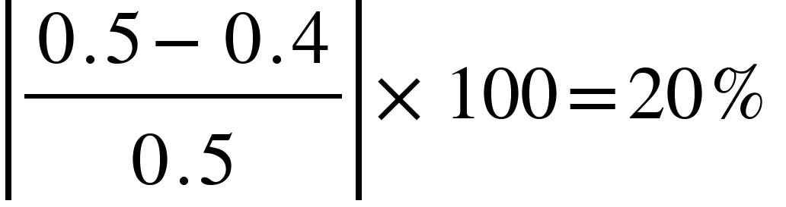
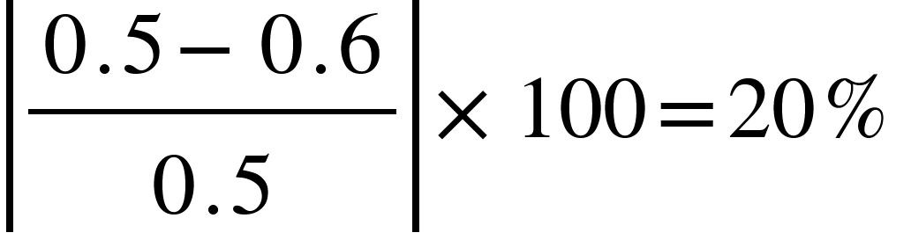
Solution-1
Simulated prob. of H=no. of repeating of H/no. of trials=2/5=0.4
Simulated prob. of T=no. of repeating of T/no. of trials=3/5=0.6
Relative Error=
E(H)=
E(T)=
Meaning of 20% probability increased or decreased by 20% of the theoritical probability
(simulated probability is smaller or larger than theoritical prob. By 20%)
Notes:
If theoritical probability is zero
Calculate absolute error
|theo. - sim |

Slide 13
Solution-2
One digit RN 0→9 (10 numbers)
S={H,T}
Since coin is unfair
Therefore Allocation
P(H)=0.7 0,1,2,3,4,5,6
P(T)=0.3 7,8,9
No.of trials=no.of random numbers=5
Then
(6,3,5,0,8)---R.O--->(H,H,H,H,T)
Notes:
Is biased to be: If given p(H)
P(T)=1-p(H)

Slide 14
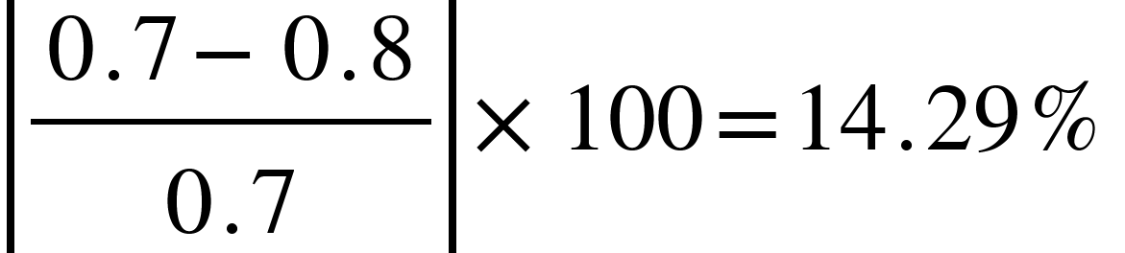
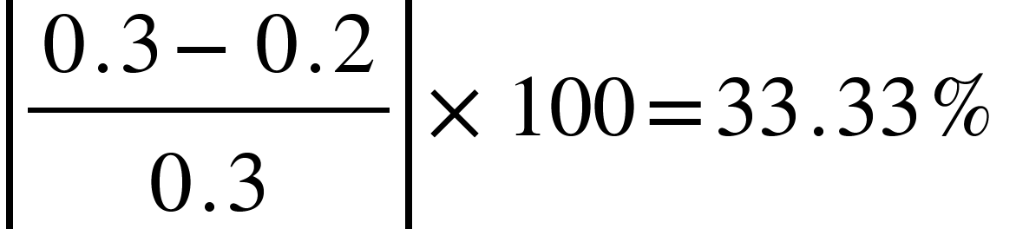
Solution-2
Simulated prob. of H=no. of repeating of H/no. of trials=4/5=0.8
Simulated prob. of T=no. of repeating of T/no. of trials=1/5=0.2
Relative Error=
E(H)=
E(T)=

Slide 15
Let’s try a Fair coin simulation program

Slide 16
assignment
Write a C or C++ program to simulate the following and write an observation
N of trials | P(H) | E(H) | P(T) | E(T)
1 | 1 | 100% | 0 | 100%
3
5
7
10
100
1000
1000000

