Slide 1
Establishing a Deterministic TinyML Inference Baseline on ESP32-S3
Master's Thesis Progress Presentation (Semester 2) — Mohan Pulugur Subramanya
Research Topic: Latency-Focused TinyML Benchmarking & Optimization on Microcontrollers
Semester Goal: Problem formulation -> Baseline selection -> Latency isolation -> Optimization comparison
Target Hardware: Heltec Wireless Tracker (ESP32-S3 @ 240 MHz, 8 MB QIO Flash, 320 KB SRAM)
Key Result Achieved: Deterministic steady-state inference baseline isolated at 3,121.43 us (3.12 ms)
Notes:
Good morning/afternoon Professor and TA. Today I am presenting my past two weeks of work establishing my thesis baseline. My overarching goal this semester is to define the latency bottleneck for TinyML on microcontrollers, lock in a reproducible hardware baseline, and then evaluate model-level optimizations. Over the past two weeks, I set up the ESP-IDF v5.3.1 toolchain on an ESP32-S3 board, resolved six hardware and RTOS roadblocks, and isolated pure neural network execution time at 3.12 milliseconds per inference.

Slide 2
Problem Definition: Why MCU Latency & Determinism Matter
Severe Resource Constraints: MCUs operate with ~320 KB SRAM, no MMU, and strict power budgets
Hard Real-Time Deadlines: Streaming Keyword Spotting (KWS) requires processing every 20 ms audio stride
The Latency-Energy Link: Faster inference directly increases deep-sleep duty cycle on battery nodes
The Measurement Problem in Standard Demos:
  Physical I2S DMA waits (portMAX_DELAY) and RTOS scheduling pollute timing measurements
  To scientifically evaluate model optimizations, pure tensor execution must be isolated from I/O noise
Notes:
Why focus on inference latency on microcontrollers? In always-on tasks like keyword spotting, the system processes a new window of audio every 20 milliseconds. If inference takes 19 ms, the CPU is active 95% of the time. If we cut inference latency down to 3 ms, the MCU can sleep for over 84% of the frame. However, standard TinyML example code mixes microphone I/O blocking and RTOS delays with model execution. My first task was isolating pure tensor execution time from hardware I/O noise.

Slide 3
Literature Foundation & Baseline Selection
1. MLPerf Tiny Benchmark (Banbury et al., NeurIPS 2021, arXiv:2106.07597):
  Establishes Keyword Spotting (KWS) as a canonical ultralow-power microcontroller benchmark
2. TensorFlow Lite Micro (David et al., MLSys 2021, arXiv:2010.08678):
  Interpreter architecture using a contiguous static tensor_arena (no dynamic heap allocation)
3. MCUNet (Lin et al., NeurIPS 2020, arXiv:2007.10319):
  Demonstrates co-design of neural architecture and SRAM scheduling for microcontrollers
Candidate Optimizations Selected for Comparison:
  SIMD Kernel Acceleration (ESP-NN INT8) vs. Scalar ANSI-C, Early-Exit Gating, and Memory-Aware Execution
Notes:
My literature review anchors on three core papers: Banbury et al.'s MLPerf Tiny benchmark, David et al.'s TensorFlow Lite Micro runtime paper, and Lin et al.'s MCUNet paper. Based on these works, I selected the TFLite Micro Keyword Spotting pipeline as my software testbed, with plans to compare SIMD kernel acceleration, early-exit architectures, and memory-aware optimizations.

Slide 4
Experimental Platform: Hardware & Software Toolchain
Hardware: Heltec Wireless Tracker (ESP32-S3, Dual-Core Xtensa LX7, Chip Rev v0.2)
  Clock & Flash: 240 MHz CPU clock | 8 MB Quad-SPI Flash @ 80 MHz QIO mode
  Memory: 320 KB internal SRAM (~256 KB free heap at boot), 16 KB I-Cache, 32 KB D-Cache, PSRAM disabled
  Peripheral Constraint: No onboard I2S microphone attached
Software Toolchain: ESP-IDF v5.3.1 on Windows (GCC 13.2.0 xtensa-esp32s3-elf, -O2 perf)
TinyML Stack: espressif/esp-tflite-micro (v1.4.1) + espressif/esp-nn (v1.4.1)
Baseline Workload: micro_speech (DepthwiseConv2D, FullyConnected, Softmax, Reshape; 30 KB Tensor Arena)
Notes:
Here is the exact experimental setup. I am using the Heltec Wireless Tracker built around the ESP32-S3 running at 240 MHz with 8 MB of QIO SPI Flash and 320 KB of internal SRAM. This board has no onboard I2S microphone. On the software side, I migrated from the broken WSL Makefile workflow to Espressif's ESP-IDF v5.3.1 component registry using esp-tflite-micro v1.4.1 and esp-nn v1.4.1.

Slide 5
Methodology: I/O-Decoupled Latency Measurement Pipeline
1. Dummy Audio Provider (main/audio_provider.cc):
  Removed blocking I2S driver (mic.i2s_readsamples) and FreeRTOS ring-buffer tasks
  Feeds deterministic zeroed PCM buffer (memset silence) + advances timestamp by +20 ms per cycle
  Executes vTaskDelay(pdMS_TO_TICKS(20)) to yield CPU0 and keep Native USB Serial/JTAG alive
2. Spectrogram Feature Extraction (main/feature_provider.cc):
  Converts 20 ms audio slices into 49x40 INT8 spectrogram tensor (1,960 bytes)
3. Microsecond Hardware Stopwatch (main/main_functions.cc):
  Wraps esp_timer_get_time() (1-us resolution) strictly around interpreter->Invoke()
Notes:
To measure pure inference time without microphone jitter, I modified three files in the pipeline. First, in audio_provider.cc, I removed the blocking I2S hardware driver and built a deterministic Dummy Audio Provider that feeds zeroed silence, increments the timestamp by 20 ms, and yields to FreeRTOS for 20 ms so Native USB stays alive. Second, in main_functions.cc, I wrapped esp_timer_get_time()—which has 1-microsecond resolution—strictly around interpreter->Invoke().

Slide 6
Chronological Debugging Log: 6 Roadblocks & Fixes
# | Symptom / Error Log | Root Cause | Engineering Fix
1 | WSL make failed (tflite dir missing) | Upstream TFLM repo restructured | Switched to ESP-IDF v5.3.1 component registry
2 | CMake: Failed to resolve esp-tflite-micro | Cloned inside ESP-IDF framework root | Created clean C:\esp_projects\micro_speech workspace
3 | Flash semaphore / write timeout | Targeted ghost COM3/COM4 vs real port | Found COM7 via serial.tools.list_ports plug test
4 | waiting for download / ClearCommError | ESP32-S3 Native USB reset enumeration | Used monitor --no-reset & RTS reset sequence
5 | Hang at 'Audio Recording started' / USB drop | Missing I2S mic blocked forever; tight loop starved USB | Dummy provider (+20 ms stride + vTaskDelay 20 ms)
6 | error_reporter not declared in this scope | TF_LITE_REPORT_ERROR removed in v1.4.1 | Replaced with MicroPrintf() and ESP_LOGW()
Notes:
Getting a clean baseline took two weeks of debugging across six distinct failures: migrating from the broken WSL Makefile flow to ESP-IDF, moving the project out of the IDF root folder, identifying the true Native USB port on COM7, handling Native USB reset enumeration, fixing the I2S deadlock and CPU0 USB starvation with a 20 ms vTaskDelay, and updating deprecated TFLM v1.4.1 error reporting macros.

Slide 7
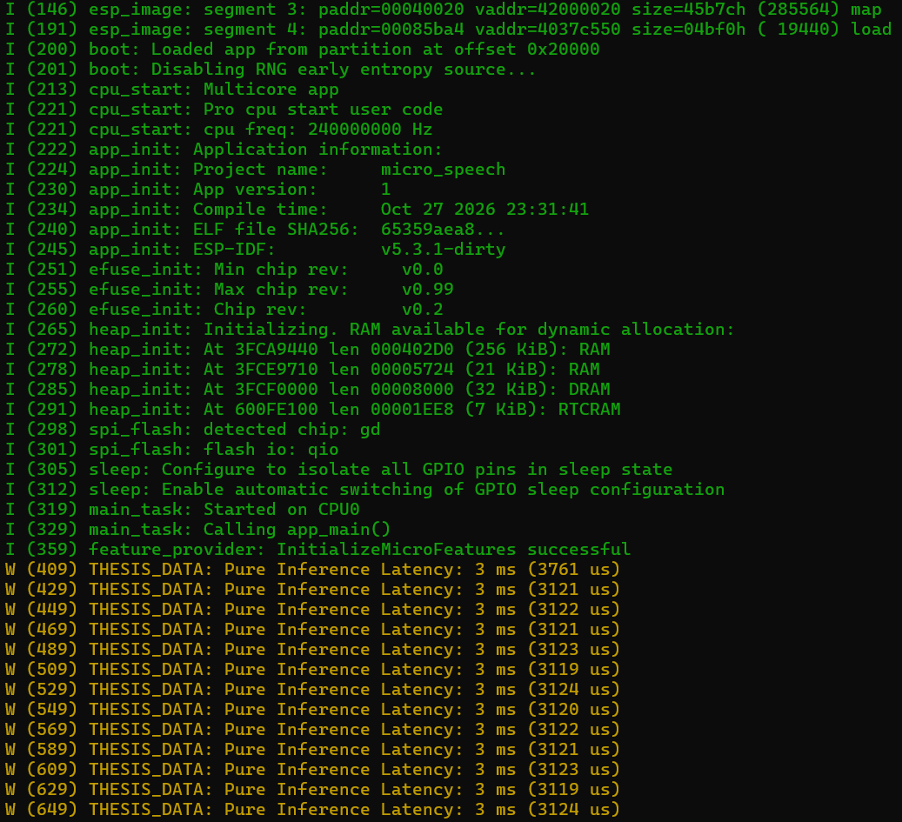
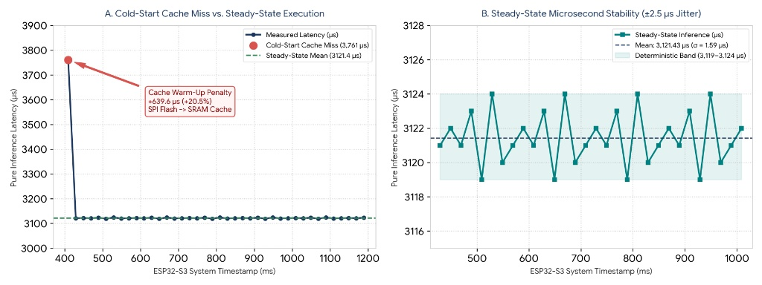
Baseline Results: Raw Serial Telemetry & Microsecond Stability
Cold-Start Inference (Run #1): 3,761 us (3.76 ms) | Steady-State Mean (Runs #2..1244): 3,121.43 us (3.12 ms)
Deterministic Band: Min 3,119 us / Max 3,124 us (+/-2.5 us jitter, sigma = 1.59 us, <0.08% variance)
Memory Footprint: App Binary = 0x6A7C0 bytes (~426 KB, 78% Flash free) | Configured Tensor Arena = 30 KB
Notes:
Here are the measured baseline results at 240 MHz. On the left is the raw ESP-IDF monitor log, and on the right is the time-series plot across 1,244 inferences. The first inference takes 3,761 microseconds. From the second run onward, latency locks into a tight band between 3,119 and 3,124 microseconds—averaging 3,121.43 microseconds with a standard deviation of 1.59 microseconds.

Slide 8
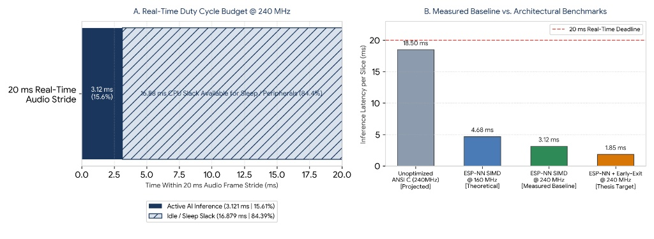
Hardware Interpretation: Cache Warm-Up & Real-Time Duty Cycle
Cold-Start Cache Miss Penalty (+639.6 us / +20.5%): Run #1 stalls fetching g_model weights from 80 MHz QIO SPI Flash (0x3C050020) into the 32 KB SRAM Data Cache; Runs #2+ execute entirely from warm cache.
Real-Time Duty Cycle (15.61% Active): 3.121 ms compute per 20.0 ms audio frame leaves 16.879 ms (84.39%) CPU slack for sleep or wireless tasks.
Notes:
Analyzing the data reveals two key architectural behaviors. First, the first inference incurs a 640-microsecond (+20.5%) penalty to fetch weights across the SPI Flash bus into the 32 KB data cache. Once cached, execution stabilizes at 3.12 ms. Second, 3.12 ms inside a 20 ms audio window yields a 15.61% active CPU duty cycle, leaving 84.39% slack for low-power sleep.

Slide 9
Limitations & Threats to Validity (Honest Self-Assessment)
1. Model Topology (Espressif micro_speech vs. MLPerf Tiny DS-CNN):
  Current binary uses Espressif's 4-layer TinyConv example (~20 KB weights), not the larger MLPerf Tiny DS-CNN reference model
2. ESP-NN SIMD Acceleration Already Active by Default:
  sdkconfig sets CONFIG_NN_OPTIMIZED=y; 3.12 ms already uses Xtensa LX7 SIMD assembly, not unoptimized scalar C
3. Zeroed Input Data (Silence):
  Conv/Dense MAC loops are input-invariant, but dynamic optimizations (Early-Exit) require real speech waveforms
4. Pre-Processing Excluded & Unmeasured Metrics:
  Timer wraps Invoke() only (excludes FeatureProvider FFT); peak arena_used_bytes(), accuracy, and power (mW) not yet logged
Notes:
I want to highlight four limitations in this baseline. First, the Espressif micro_speech example uses a compact 4-op TinyConv model rather than the larger MLPerf Tiny DS-CNN model. Second, CONFIG_NN_OPTIMIZED=y is enabled by default in sdkconfig, meaning 3.12 ms already benefits from ESP-NN SIMD assembly. Third, the timer currently wraps Invoke() on zeroed silence inputs and excludes spectrogram generation. Finally, true peak arena_used_bytes(), accuracy, and power draw are not yet measured.

Slide 10
Next Steps & Timeline (Weeks 3 to 8)
Weeks 3-4: Controlled Kernel Ablation & Exact Memory Profiling
  Benchmark CONFIG_NN_ANSI_C=y (scalar C) vs. CONFIG_NN_OPTIMIZED=y (ESP-NN SIMD) on hardware
  Log interpreter->arena_used_bytes(), idf.py size-components, and time feature_provider->PopulateFeatureData()
Weeks 5-6: Official MLPerf Tiny DS-CNN Port & Accuracy Harness
  Replace TinyConv flatbuffer with official MLPerf Tiny KWS DS-CNN model
  Feed pre-recorded PCM test arrays (test_data/ yes & no) to verify top-1 accuracy alongside latency
Weeks 7-8: Optimization Comparison & Thesis Evaluation
  Implement Confidence-Gated Early-Exit and Mixed-Precision Quantization; generate Pareto trade-off curves
Notes:
Over the next six weeks, my plan is divided into three 2-week sprints. In Weeks 3-4, I will run a controlled ablation toggling CONFIG_NN_ANSI_C=y to measure the true speedup of ESP-NN SIMD over scalar C, log arena_used_bytes(), and time the spectrogram FeatureProvider. In Weeks 5-6, I will port the official MLPerf Tiny DS-CNN model and evaluate accuracy on real PCM test samples. In Weeks 7-8, I will benchmark Early-Exit and quantization optimizations.

Slide 11
Expected Contributions of This Thesis
1. Open-Source I/O-Decoupled TinyML Benchmarking Harness for ESP32-S3 (ESP-IDF v5.3.1):
  Eliminates I2S peripheral deadlocks and Native USB starvation for reproducible microsecond profiling
2. Empirical Hardware-Software Characterization on Xtensa LX7:
  Quantifies SPI Flash DROM cache warm-up penalty (+20.5%), FreeRTOS jitter (+/-2.5 us), and ESP-NN SIMD speedup
3. Multi-Metric Optimization Trade-Off Analysis:
  Head-to-head evaluation of Quantization and Early-Exit across Latency (us), Peak SRAM (KB), Flash (KB), and Accuracy (%)
Notes:
By the end of the semester, this work will deliver an open-source, hardware-independent ESP-IDF v5.3.1 benchmarking harness, an empirical characterization of ESP32-S3 cache and SIMD behaviors, and a multi-metric trade-off analysis across latency, SRAM, Flash, and accuracy.

Slide 12
Q&A Preparation: 8 Likely Questions & Defense Answers
Q1 (Zero Inputs): Dense/Conv SIMD loops have fixed iteration counts regardless of zero values; real PCM arrays next.
Q2 (SIMD vs Scalar C): CONFIG_NN_OPTIMIZED=y is on by default; Week 3 tests CONFIG_NN_ANSI_C=y for true scalar baseline.
Q3 (Feature Extraction): Timer wraps Invoke() only; adding second timer around PopulateFeatureData() in Week 3.
Q4 (Model Choice): Started with Espressif micro_speech (TinyConv) to stabilize harness; porting MLPerf DS-CNN in Week 5.
Q5 (Peak RAM): 30 KB is static buffer allocation; calling interpreter->arena_used_bytes() next to get exact usage.
Q6 (+/-2.5 us Jitter): ~600 clock cycles at 240 MHz caused by 100 Hz FreeRTOS tick & Native USB background interrupts.
Q7 (USB Crash): ESP32-S3 uses CPU-managed Native USB; unthrottled loop starved CPU0 until vTaskDelay(20) was added.
Q8 (Further Optimization): Scaling to DS-CNN + adding Early-Exit branches to skip layers on silence frames.
Notes:
Thank you. I am happy to take any questions on the experimental setup, the cache warm-up analysis, or the roadmap for the next six weeks.

