Slide 1
Spotify Songs' Genre Segmentation
Major Project
Machine Learning & Recommendation System

Slide 2
Problem Statement
Large music catalogues are difficult to organize manually.
We need automated song segmentation using audio characteristics.
The final system should support genre understanding and recommendations.

Slide 3
Objectives
Preprocess and clean the Spotify dataset.
Perform comprehensive EDA and correlation analysis.
Discover song segments using K-Means clustering.
Predict playlist genre using a machine-learning baseline.
Recommend similar tracks using nearest-neighbor search.

Slide 4
Dataset
32,833 supplied track records
23 columns
6 playlist genres and 24 subgenres
10,693 unique artists
Audio features: danceability, energy, loudness, speechiness, acousticness, instrumentalness, liveness, valence, tempo and duration

Slide 5
Data Preprocessing
Remove exact duplicates
Handle missing track metadata
Convert numeric fields to valid numeric types
Convert duration from milliseconds to minutes
Clip bounded audio features and popularity to valid ranges

Slide 6
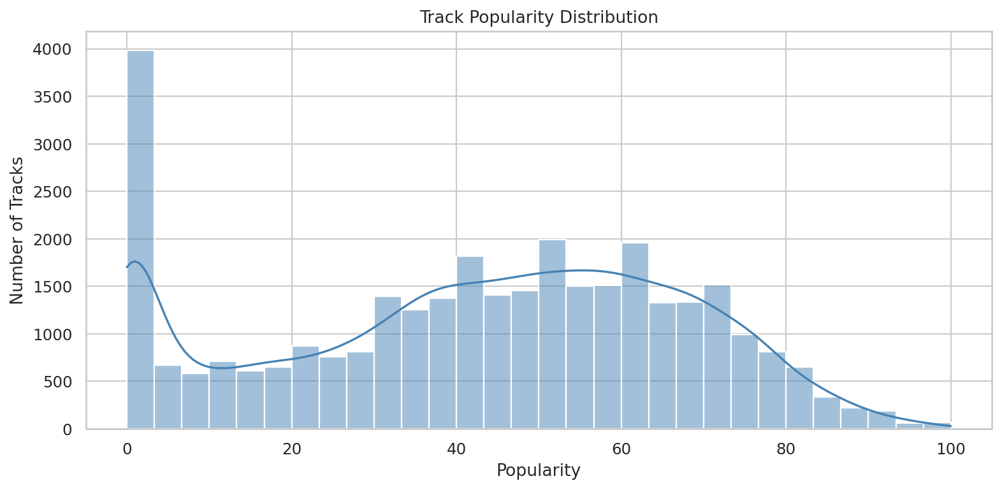
EDA – Popularity

Slide 7
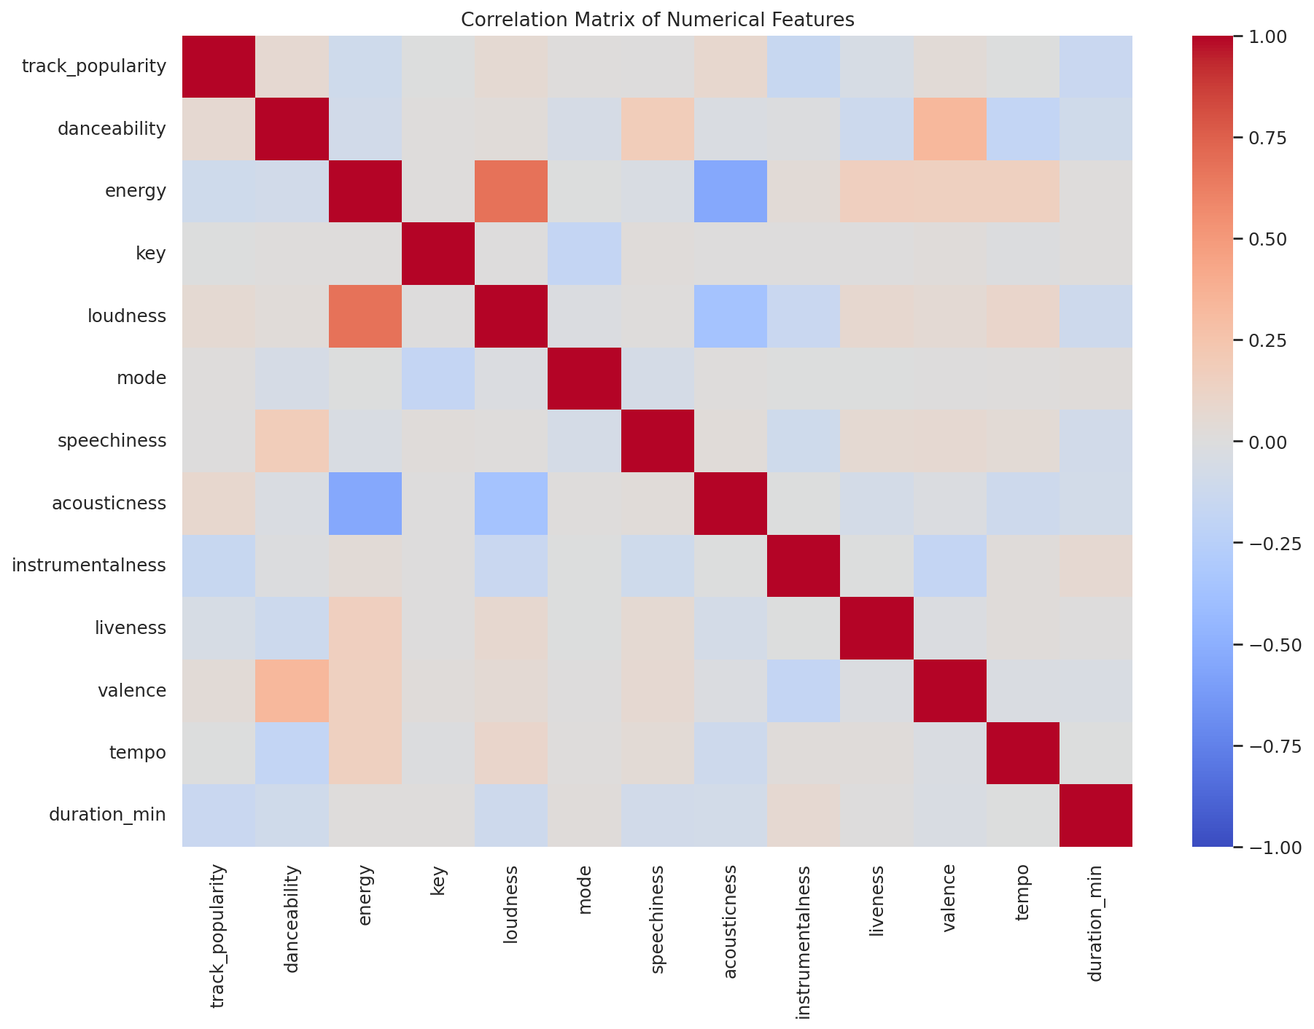
EDA – Correlation Matrix

Slide 8
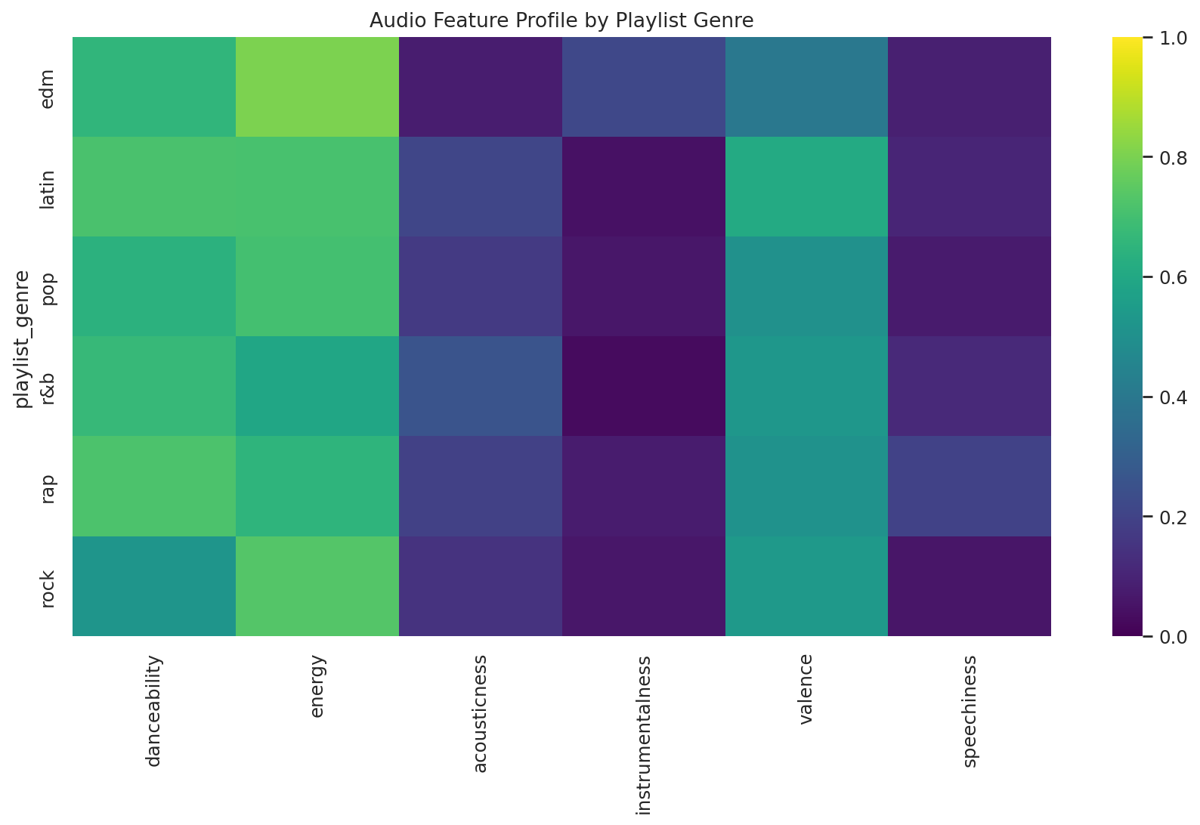
EDA – Genre Feature Profiles

Slide 9
Clustering Methodology
Standardize numerical audio features.
Evaluate K=2 to K=10 using silhouette, Calinski-Harabasz and Davies-Bouldin scores.
Use K=6 for the final practical genre-segmentation space.
Use PCA only for visualization of the learned clusters.

Slide 10
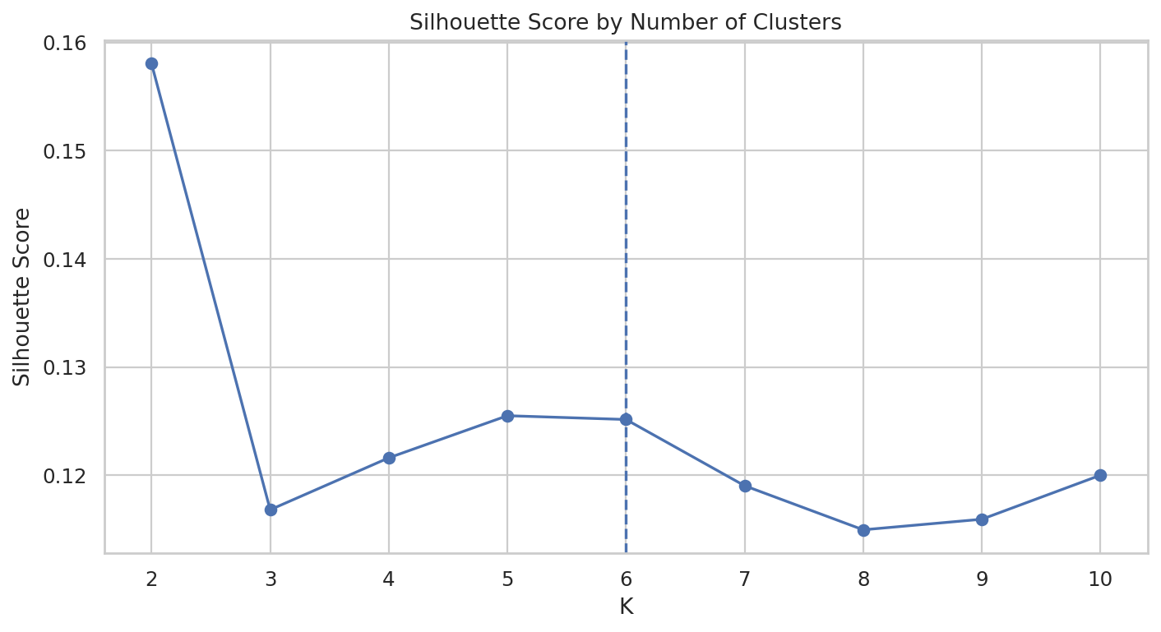
Cluster Evaluation

Slide 11
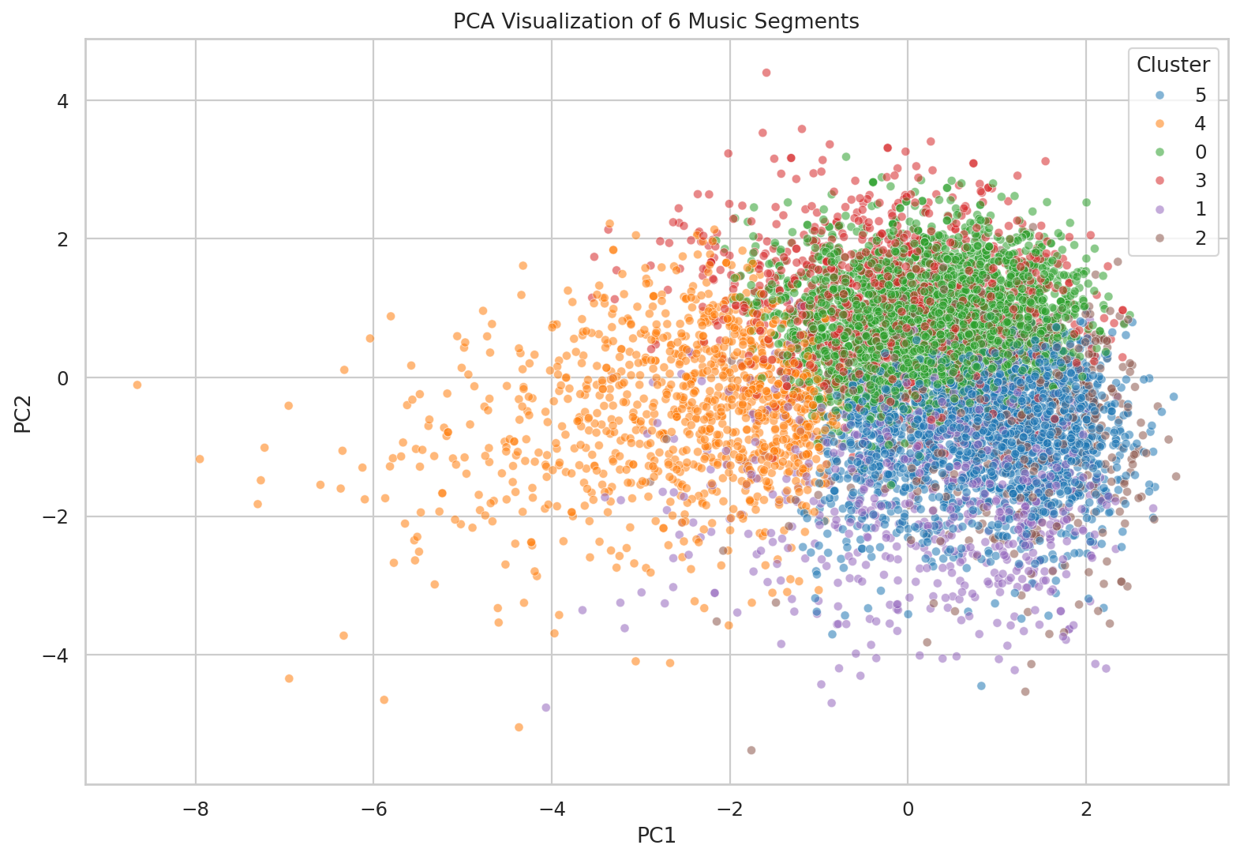
Final Music Segments

Slide 12
Genre Prediction
Random Forest classifier trained on audio features.
Stratified 80/20 train-test split.
Accuracy: 55.98%
Best-performing classes include EDM and Rock; Pop is more difficult to distinguish from neighboring styles.

Slide 13
Recommendation System
Input: a song/audio-feature profile.
Scale the feature vector using the saved scaler.
Predict playlist genre and K-Means segment.
Retrieve nearest tracks using Euclidean distance.
Return track, artist, genre, subgenre and segment information.

Slide 14
Results
6 final music segments
K=6 silhouette score: 0.1252
Genre classification accuracy: 55.98%
Working recommendation prototype with saved models and Streamlit UI

Slide 15
Conclusion & Future Work
Complete end-to-end ML pipeline achieved.
Content-based recommendations are functional.
Future: collaborative filtering, user profiles, embeddings, hybrid recommendation and live API integration.

Slide 16
Thank You
Questions?

