Slide 1
Data_Is_future
Kenneth Joel , Christy Jacob , Mohan Prabhakar

Slide 2
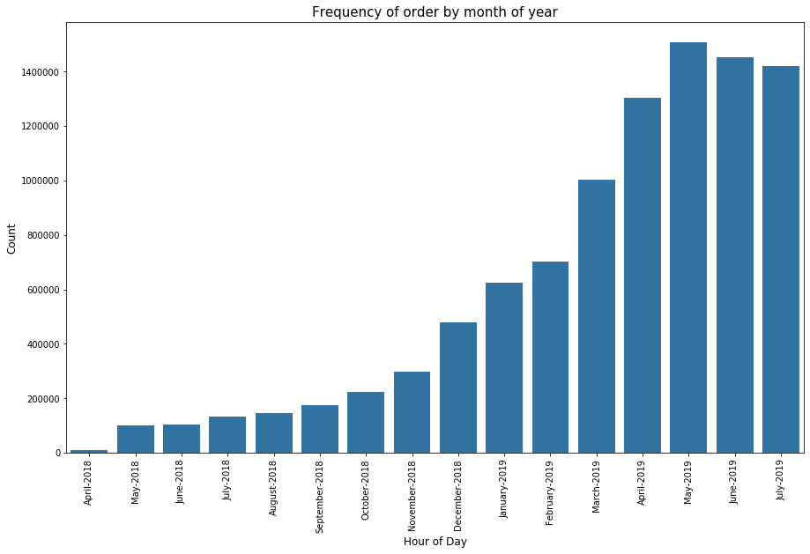
Preliminary analysis (Insight 1)
Identify trends in monthly purchases
Inference: Monthly purchases increased exponentially till May 2019 and dropped insignificantly in June and July 2019

Slide 3
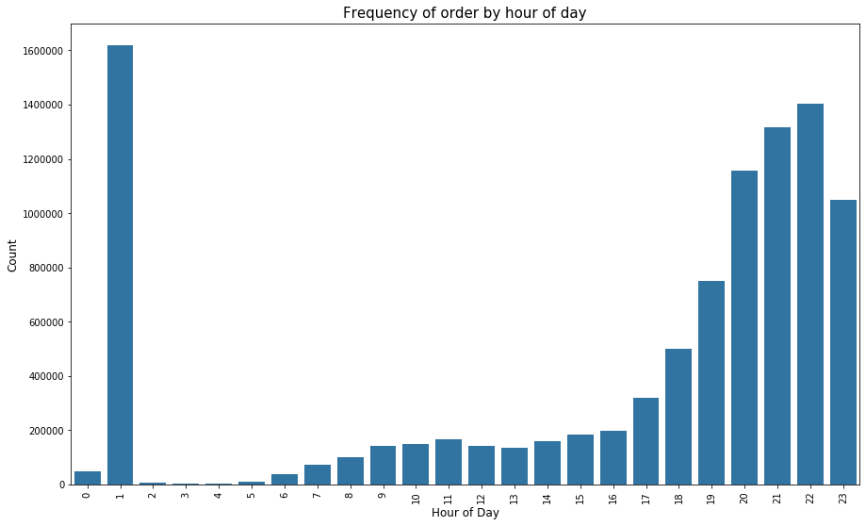
Preliminary analysis (Insight 2)
Identify trends in hourly purchases
Inference: Everyday at 1 am there seems to be a huge surge which was later clarified to be the regular subscriptions getting added to the cart automatically.
The number of orders surge again between 8-10 pm since more users are likely to be free at that time.

Slide 4
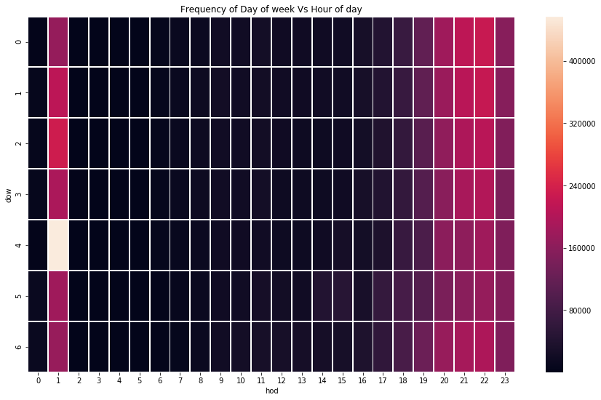
Preliminary analysis (Insight 3)
Identify trends in daily purchases
Inference: The heat map to the left shows that the number of orders are high on Friday 1 am compared to all the other days of the week.

Slide 5

Recommendation Engine using FPgrowth
Influence Average Order Value by:
Increasing Order Size
Decreasing number of orders by clubbing them

Slide 6
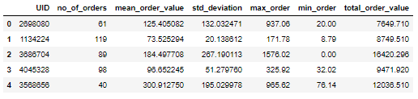
The Ideal Customer
High AOV
High total purchase value
Low SD in AOV

Slide 7
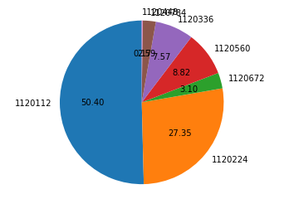
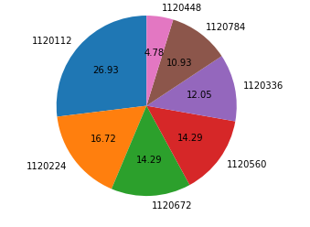
City Specific Considerations
Transaction volume
No of Active Days
Notes:
Given this we concluded that it is best to treat every city as an independent case

Slide 8
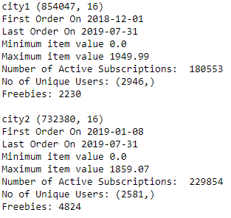
Analysis of two similar cities

