Slide 1


INFORMATICS INSTITUTE OF TECHNOLOGY
4COSC008C.2 :Trends in Computer Science
1.QUANTUM COMPUTING

Slide 2

Group Members
Student Full Name | UOW Number | IIT Number
Mohamed Amhar Mohamed Fairoze | w1867698 | 20210734
Saumiyamoorthy Rakshaagar | w1870613 | 20200923
Surendran Nishanthan | w1867646 | 20210704
Shanmugaratnam Mohanaranjan | w1870584 | 20200607

Slide 3
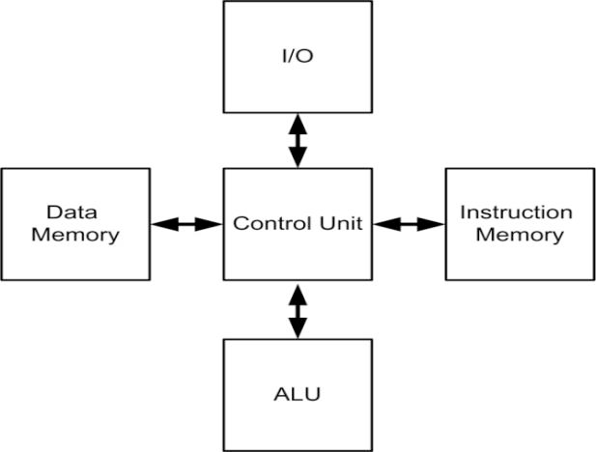
1a. Overview of Quantum Computing. How does it compare to the conventional Von Neumann computer architecture?
A quantum computer is a computational framework based on the quantum mechanism. In 1965, Richard Feynman proposed quantum electrodynamics. Quantum computing has achieved remarkable success in some specific tasks. You'll see how quantum computing can be used in everyday life.
Real-Life Problems and Solutions
Stock market
Medicine
Information technology
Automating Manual and Semi-manual Processes
Reducing Costs and Improving Profits

Slide 4
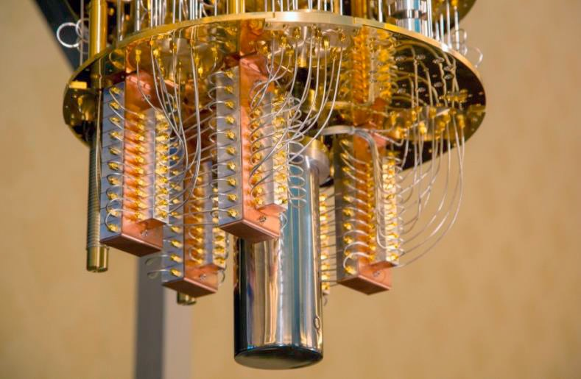
Types of Quantum Computers
IBM has made it a cinch for the public to get access to a quantum circuit computer. In this book, we will learn to write quantum programs for these quantum computers. Many concepts are a distant cousin of conventional computers and, thus, easier to digest.
Quantum Circuit Computers
Adiabatic Quantum Computers
Architectures
Single CPU architecture
Multiple CPU architecture

Slide 5
1b. Overview of Quantum Computing. Which new opportunities does it bring?
Quantum computing has the capability to spur breakthroughs in fitness care, monetary strategies, protection and extra due to its 3 quantum mechanical properties. Quantum computer systems are located to offer the computing strength had to resolve troubles presently unsolvable with the aid of using classical computer systems.
Quantum computing has many capability applications:
Disease control – Even aleven though the radical coronavirus pandemic has now no longer been curbed, quantum computing can assist scientists and researchers find out vaccines withinside the destiny and deal with fitness crises
Cloud computing – Google plans to provide industrial cloud computing on its quantum laptop to technique complex troubles and offer outcomes to character users.

Slide 6
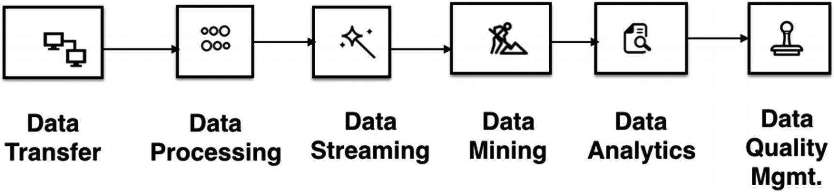
Cryptography – Quantum cryptography can doubtlessly extrade information protection, growing tamper-evidence cybersecurity measures. From monetary modeling to climate forecasting to synthetic intelligence, quantum computing can reimagine a number of the methods that exist already and create answers for a few complicated troubles.
Quantum computing doubtlessly opens up new possibilities in synthetic intelligence, which regularly includes the combinatoric processing of very huge portions of information with a view to make higher predictions and decisions Quantum computer systems have the capability to boost up clinical discovery and innovation, revolutionize monetary marketplace modeling and simulations, and empower device getting to know and synthetic intelligence.
Four Ways Quantum Computing Could Change the World.
Drug And Materials Development
Finance
Climate Change
Cyber And Information Security

Slide 7
Quantum computer systems can have the electricity to interrupt via the public-key encryption broadly relied upon these days to guard records, that means that data, irrespective of how stable it can be proper now, can be at risk of destiny attack. That’s a quite terrifying prospect for any business enterprise with touchy records to guard.
It’s clean that quantum computer systems can have a big effect on agencies across the world, advancing the era in a manner that we can’t but absolutely comprehend. It’s crucial that we train ourselves at the capability dangers that might come if such strength is misused. When it involves cybersecurity, for example, the capability effects are devastating, so it’s critical that we take it seriously. However first and most important we have to make certain that businesses, governments and the public are knowledgeable at the truth of quantum computer systems, so that it will put together for what's coming — the good, the horrific and the ugly.

Slide 8

1d. What impact might Quantum computing have on computer security?
Impacts of Quantum computing on computer security
What are the data protection issues?
Impact on public-key cryptography
Retrospective decryption

Slide 9
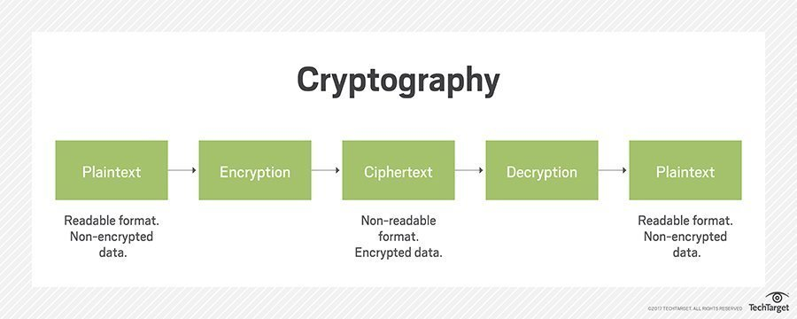
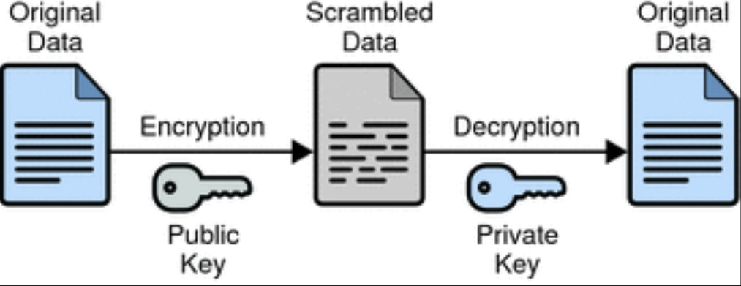

Slide 10
1.E What benefits might we be able to achieve using Quantum Computing than we cannot achieve with conventional computers?
Quantum Computing is the generation with a view to form our future. We will see a booming transitional section over the following 5 to 10 years. As quantum improvements grow to be a part of the mainstream computing environment. Such contemporary-day machines could have excessive layout and overall performance variability. Moreover, will now no longer have a easy programming model. Nor will it's usually relevant to all problems.
Speed
Quantum Computers will supply substantial velocity for unique troubles. These kind of laptops can perform computation at a far quicker rate than normal computers. Quantum computers have computation power above supercomputers also. Some calculations if performed by a standard computer can take 1000 years is completed by quantum computers in exceedingly few seconds.

Slide 11
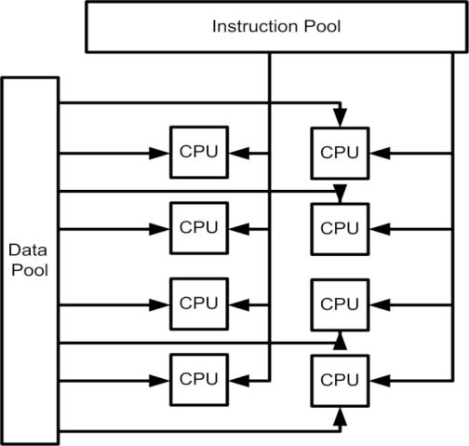
Computation
The speed of quantum computers can improve many of our technologies. Especially, that require huge computation power. Like Machine Learning, 5G (and even quicker net speeds), bullet trains (and many different transport methods), and plenty of more.
Big Data
Quantum computing is essential withinside the modern-day
age of Big Data. As we want green computer
systems to system the big quantity of statistics we're generating daily.
Power reduction
Despite being computational, Quantum computer systems can
lessen energy consumption. From a hundred to one thousand
instances, they use Quantum tunneling .
Best of simulation
Quantum computers are best for doing information simulation computing. There are several algorithms created that may simulate numerous things like weather forecasting, chemical simulation and so forth.

Slide 12

High of privacy
These computers will build high coding and is nice at cryptography. it's not possible to interrupt the protection of quantum computers. Recently China has launched a satellite that uses quantum computing and china claimed that this satellite can not be hacked.
Used in artificial intelligence
These sort of computers perform well in artificial intelligence. they will build selections a lot of exactly than traditional computers. Scientists can do higher analysis victimization these computers.
Medicine creation
These variety of computers can work higher within the
medical field. they'll discover diseases and might produce a
formula for medicines. completely different type of diseases
are often diagnosed and tested in scientific laboratories
victimization these computers.

Slide 13
Referrences
Lukasz OLENJNK/ Robert RIEDMANN (2020) ( 2nd issue: EDPS).
Available at : https://edps.europa.eu/data-protection/our-work/publications/techdispatch/techdispatch-22020-quantum-computing-and_en
Kumaresan Ramanathan (Quantum Computing and Quantum Physics for Beginners)
Available at: https://learning.oreilly.com/videos/quantum-computing-and/9781838989934/9781838989934-video2_1/
Bhagyan Kommadi, (Quantum Computing Solutions) (December 2020)
Available at : https://learning.oreilly.com/library/view/quantum-computing-solutions/9781484265161/
Mikio Nakahara , and Yoshitaka Sasaki (World Scientific Publishing Company) (2012-09-17)
Available at : https://ebookcentral.proquest.com/lib/westminster/reader.action?docID=1069829
Author : Jonathan Reichenta (Dr. Jonathan Reichental is an award-winning technology leader. In 2013 ).(Linked Learning)
Available at: https://www.linkedin.com/learning/introduction-to-quantum-computing/a-brief-timeline-of-quantum-research-to-date?autoAdvance=true&autoSkip=false&autoplay=true&resume=false&u=76664938

Slide 14

Thank You

