Slide 1
A Comparative analysis of Data Fragmentation in Distributed Database
Under the guidance of :
Dr. Ananth Narayana V.S
Presented by: PRESENTED TO:
A.Mohan Sai(202IT002) Ms. Shruthi j r

Slide 2
Problem Statement
To understand and implement the different types of fragmentation.
Types of Fragmentation:
Horizontal Fragmentation
Vertical Fragmentation
Hybrid/Mixed Fragmentation

Slide 3
Technology:
RDBMS: Oracle DB
GUI: Toad for Oracle
Remote Server: Hosted on GoDaddy.
Programming Language: Python
Dataset: Employee Dataset(Downloaded from Kaggle)

Slide 4
Methodology 1:
Horizontal Fragmentation:
All the attributes will be present
Only number of the rows will be reduced
Fj = σ Qj(R), where 1≤ j≤ i , Where
Qj is the selection conditions as a simple predicate and
i is the maximum number of fragments.

Slide 5
Methodology 2:
Vertical Fragmentation:
Bond-Energy Algorithm: To find the ordering of the attributes and find the splitting point.
Usage Matrix and Attribute Affinity matrix given as input.
Cluster Affinity matrix generated.
Only columns are split
All rows will be present.

Slide 6
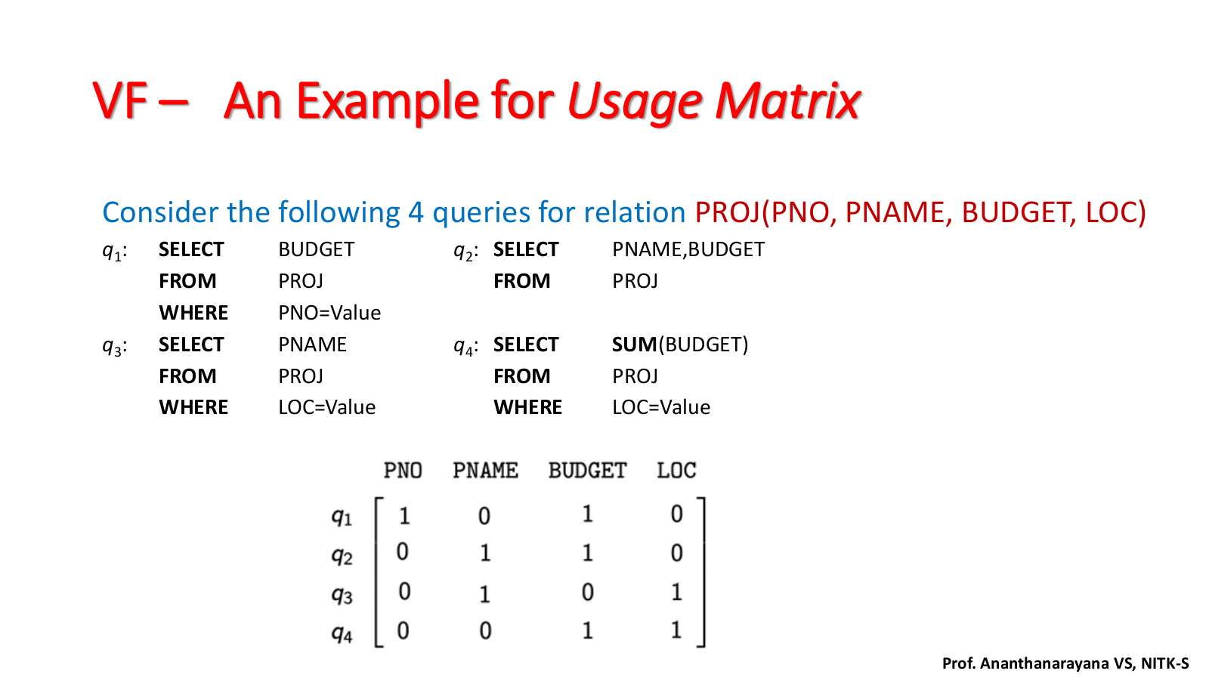

Slide 7
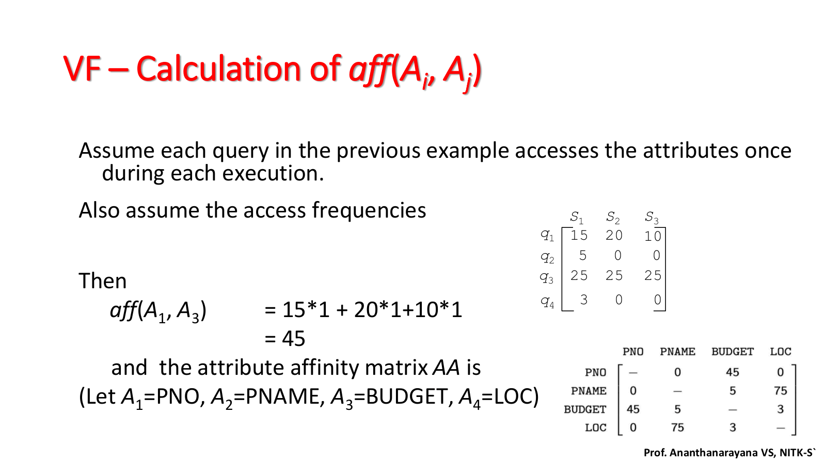

Slide 8
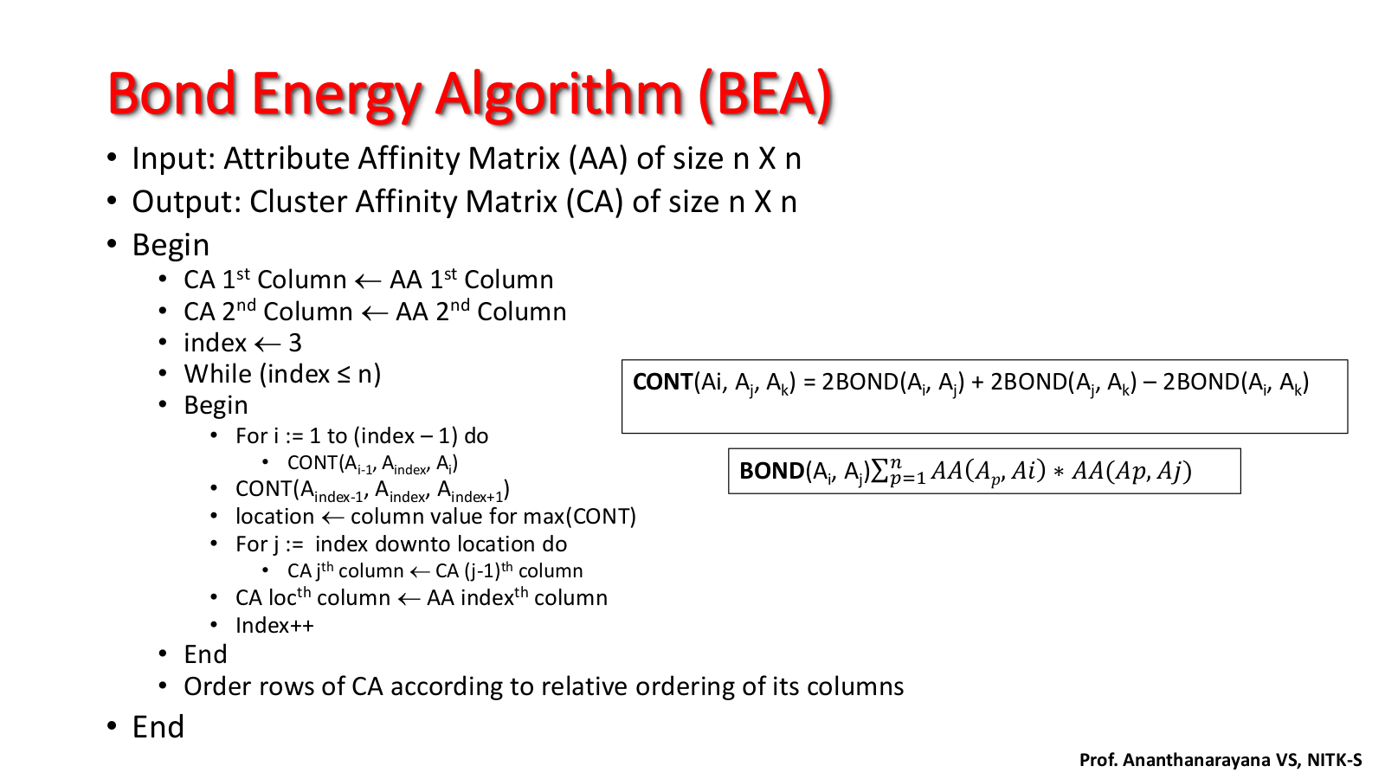
Bond-Energy Algorithm:

Slide 9
Hybrid Fragmentation:
Mix of both horizontal and vertical fragmentation.
Number of rows will be reduced.
Number of columns will also be reduced.

Slide 10
Correctness Criteria:
Completeness
Re-construction
Disjointness

Slide 11
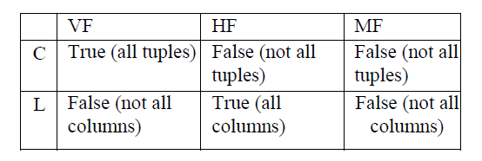
Results:

Slide 12
References:
Dr. Ananth Narayan Sir slides.
A comparative analysis of data fragmentation in distributed database(Paper Implemented)
https://ieeexplore.ieee.org/document/8079934

Slide 13
Thank You

