Slide 1

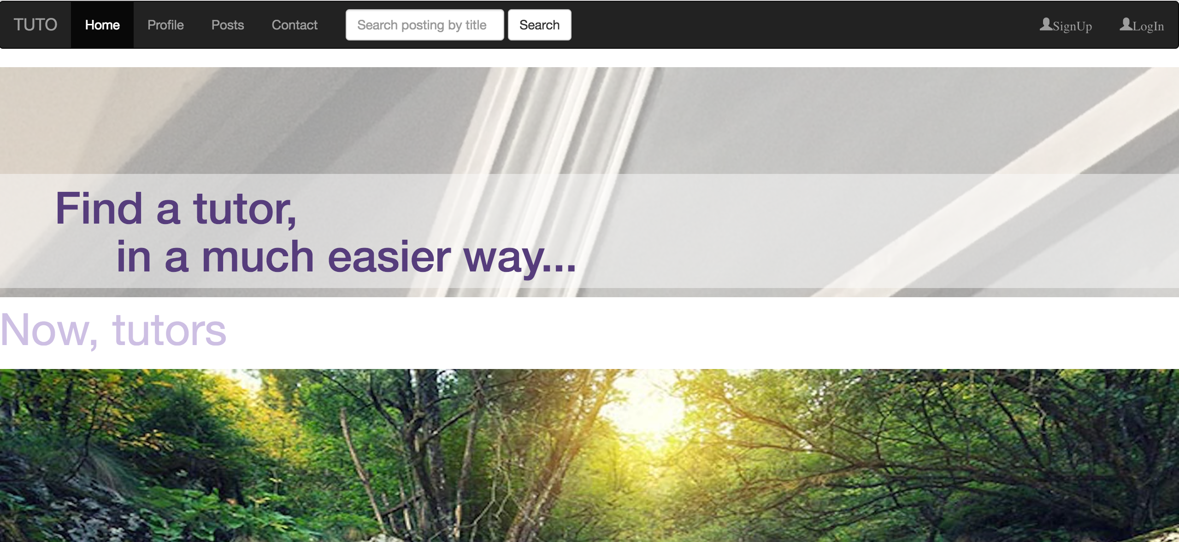
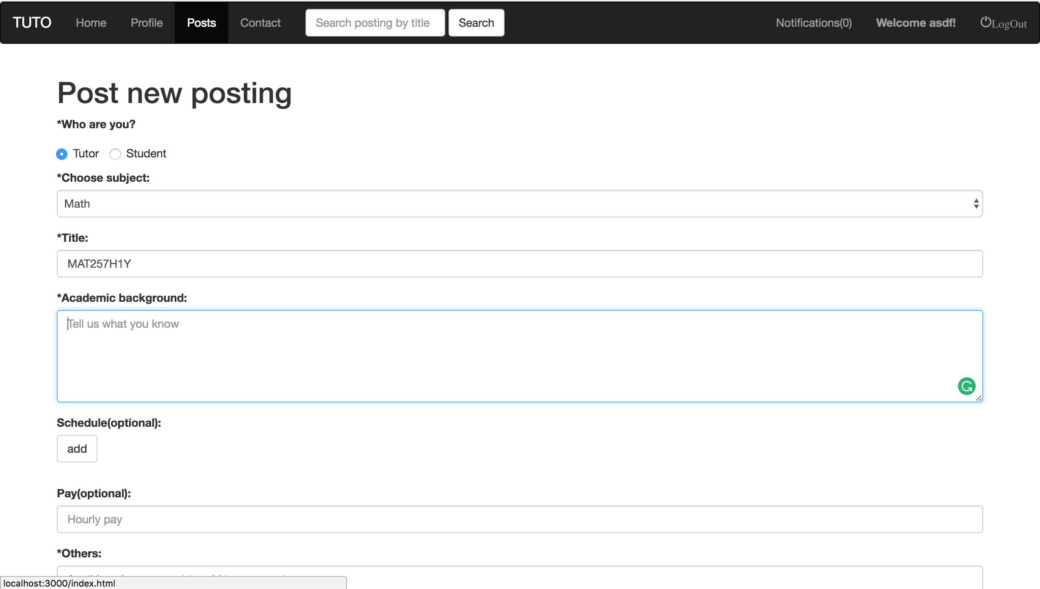
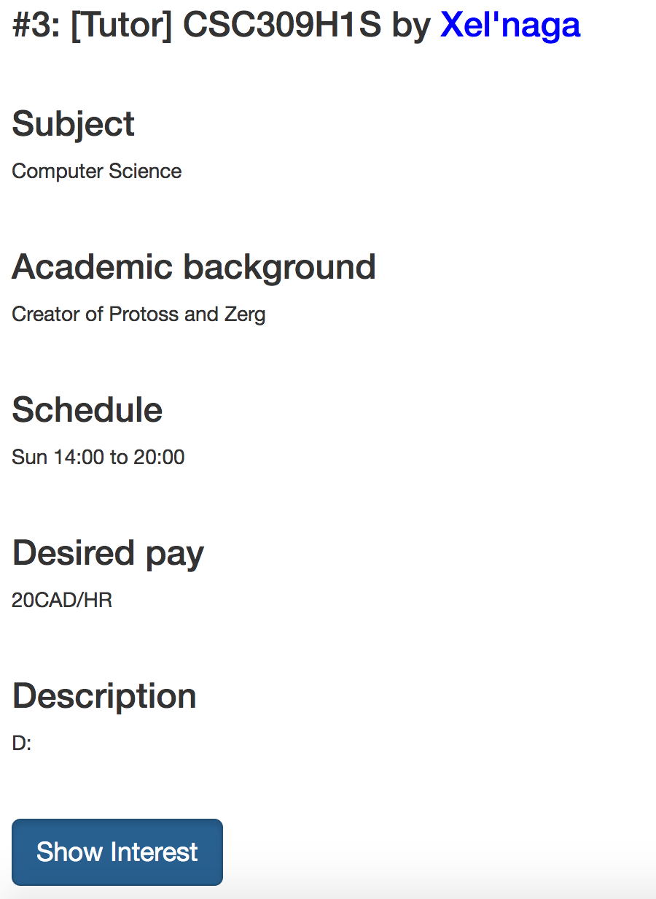
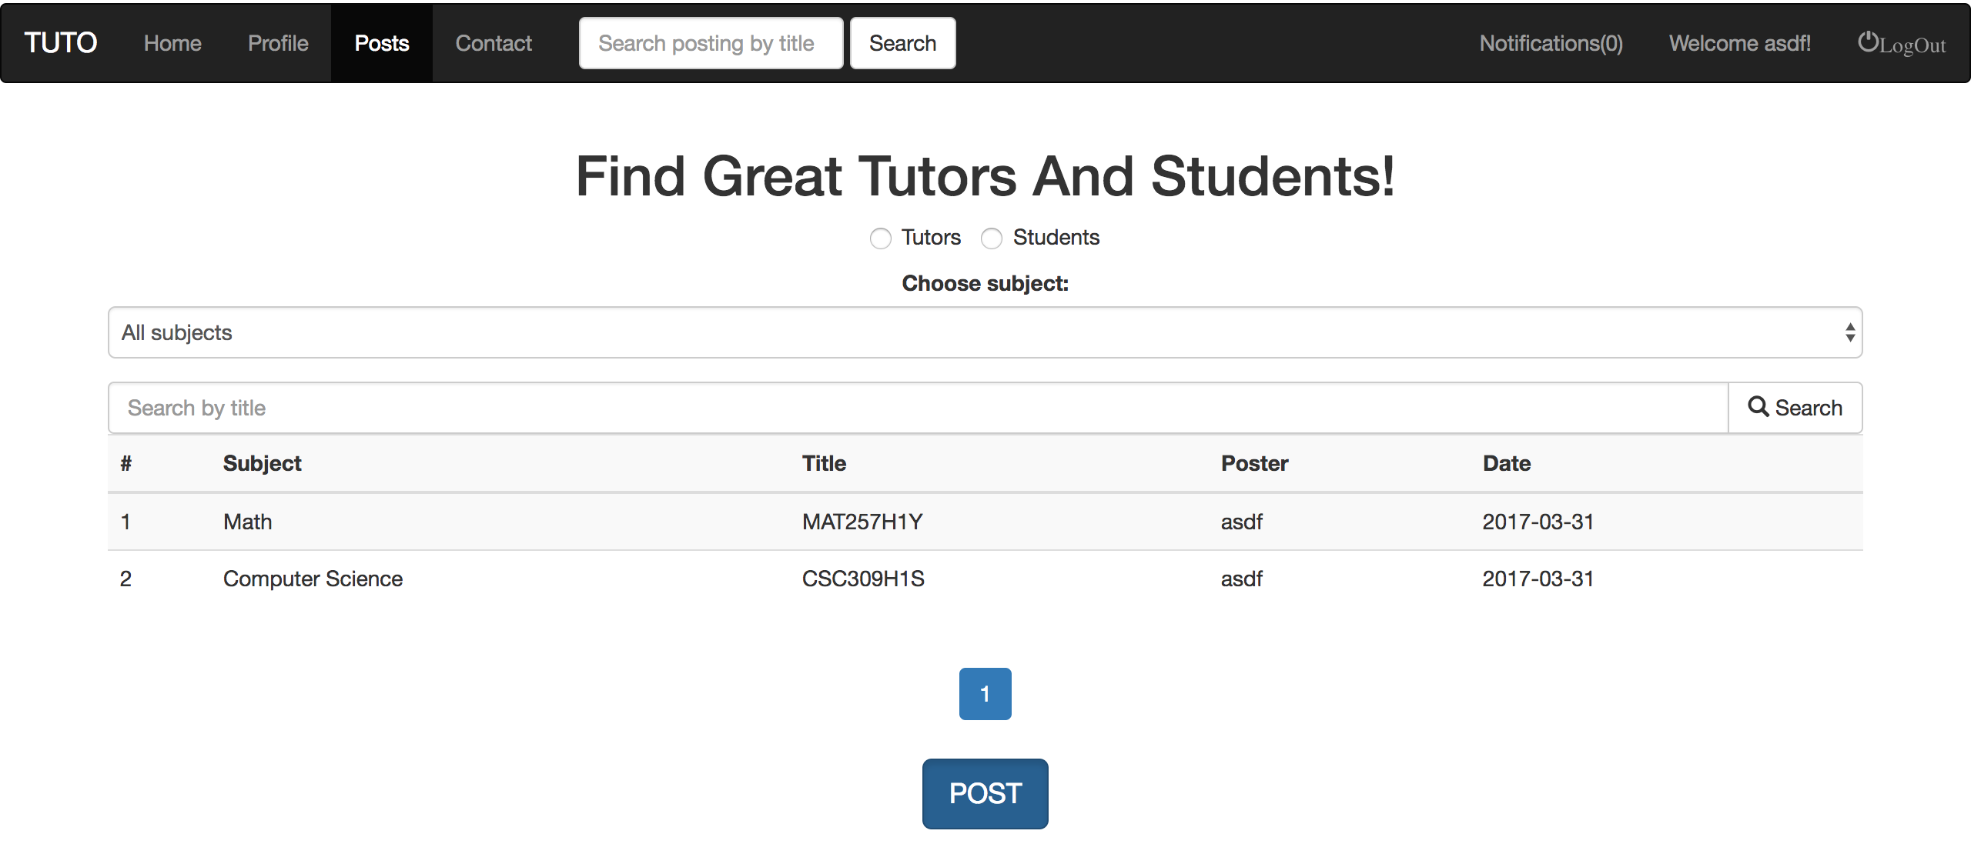
CSC309
Team 38: TUTO
Mohan Zhang Email: morgan.zhang@mail.utoronto.ca
Daewoo Kang Email: daewoo.kang@mail.utoronto.ca
1
Introduction
Since currently there are many students want a personal or public instructor to instruct them on some specific fields, such as IELTS, GRE, CPA and so on (just see the first floor of BA). Our goal is to build a website that let those who want to instruct or to be instructed, find each other in an efficient way, instead of putting posters and fliers everywhere.
2
Tell us about yourself!
3
Play around!
You can register as a tutor or a student. As a tutor, you will need to fill in your personal info, so that students will be interested in you. You can also browse though students in need and communicate with them if you want. As a student, you can post what kind of help you want, or browse tutors you are interested in.
Don’t forget to rate tutors!
We will recommend tutors that have high rates.
There are all kinds of thing you can search through, posts, courses, do whatever you want!
Also, messages send to you will show notifications. Chat with each other!
4
Follow
You can show interest to any post, to follow any activity and change might occur.

