Slide 1

Literature Survey on Hallucination Evaluation in Large
Language Models: State-of-the-Art (SOTA)
Under the guidance of: Prof. Uzair Ahmad
Submitted by: Yash Khare, Mohan Bhosale, Karthikeyan Sugavanan
Affiliation: Khoury College of Computer Sciences, Northeastern University
Date: December 8, 2024

Slide 2
Content
Introduction
Methodology
What is Hallucination?
Hallucination Mitigation
Thematic Analysis
Comparative Analysis
Insights and Research Gaps
Implications
Future Directions
Conclusion
Contributions

Slide 3
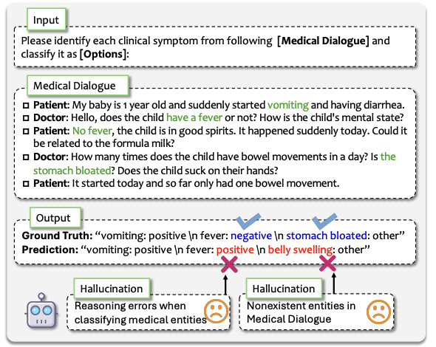
Introduction
Background
Hallucinations in LLMs refer to outputs that appear plausible but are factually incorrect or nonsensical.
Example: A healthcare chatbot suggesting non-existent treatments.
Hallucinations challenge reliability in applications like healthcare, legal advice, and education.
Mitigating hallucinations is critical for building trustworthy AI.

Slide 4
Introduction
Objectives
Identify Contributing Factors
Assess Impact
Evaluate Mitigation Techniques
Identify Research Gaps
Scope
Reviewed research from 2020–2024.
Focused on scholarly articles, conference papers, and technical reports.
Covered diverse domains: biomedicine, multimodal tasks, cultural contexts.
Analyzed datasets, evaluation metrics, and benchmarks.

Slide 5






Methodology
Search Strategy
Utilized databases: Google Scholar, IEEE Xplore, arXiv, ACM Digital Library, SpringerLink.
Targeted first-page results using specific keywords.
Ensured inclusion of relevant and high-quality papers.
Keywords
LLM Hallucinations
Factual Consistency in LLM
Mitigating LLM Hallucinations

Slide 6
Methodology
Selection Criteria
Relevance of first-page results.
Preference for peer-reviewed sources.
Assessment of contributions (datasets, models, solutions).
Citation metrics and publication quality.
Publisher | LLM | LMM
IEEE | 7 | 6
arXiv | 29 | 27
ACM | 9 | 6
Springer | 6 | 3
Science Direct | 4 | 6
Total | 55 | 48
Distribution of Papers
Categorized by keywords and subcategories: Multimodal & Language.
Total papers reviewed: 103.
Majority from arXiv, followed by IEEE and ACM.

Slide 7
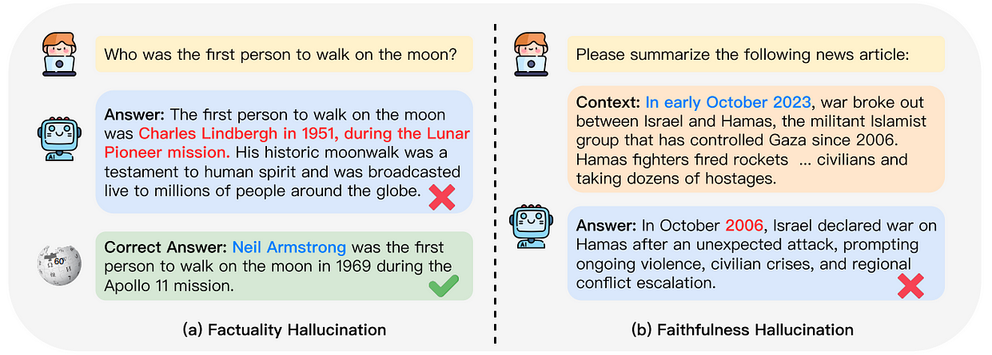
What is Hallucination?
Definition:
Generation of plausible yet incorrect or nonsensical information.
Causes:
Training Data Quality: Inaccurate or biased data.
Model Architecture: Limitations in model design.
Inference Mechanisms: Challenges during the generation process.
Examples:
Incorrect factual statements.
Fabricated references or citations.

Slide 8
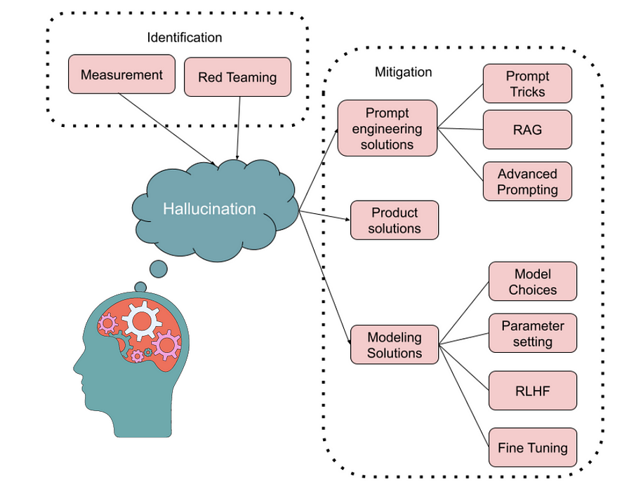
Hallucination Mitigation
Impact of Hallucinations:
Reliability Issues: Decreases trust in LLM applications.
High-Stakes Consequences: Potential misinformation in healthcare, legal, and educational settings.
Mitigation Strategies:
Fine-Tuning: Adjusting models with high-quality data.
Reinforcement Learning: Enhancing model responses through feedback.
External Knowledge Integration: Incorporating verified knowledge bases.
Challenges in Mitigation:
Interpretability: Difficulty in understanding model decisions.
Energy Inefficiency: High computational resources required.

Slide 9
Thematic Analysis
Benchmark Name | Reasoning | Domain-Specific | Reliability | Unique Contributions
DAHL, 2024 | Fact-conflict analysis | Biomedical | In-depth evaluation over multiple-choice methods | - 8,573 curated biomedical questions - DAHL Score for atomic accuracy - Minimal accuracy gain beyond 7-8B parameters
Reefknot, 2024 | Relation hallucination | Visual Genome | Comprehensive over object/attribute benchmarks | - 20,000+ real-world samples - Defined relation hallucinations - VG-based corpus - 9.75% reduction via mitigation
FreshQA, 2023 | Current knowledge | Real-time QA Tasks | Two-mode correctness and hallucination | - Dynamic QA benchmark - FreshPrompt method - Concise answers reduce hallucination - Impact of evidence retrieval

Slide 10
Comparative Analysis
Benchmark Name | Methods Used | Dataset Type | Challenges Addressed | Evaluation Metrics | Baseline Models Evaluated | Year
DAHL, 2024 | Deconstructing responses into atomic units and evaluating fact-conflicting hallucinations | Biomedical domain-specific dataset with 8,573 questions across 29 categories | Hallucination in long-form text generation within the biomedical domain | DAHL Score (average accuracy of atomic units) | GPT-4, BioGPT | 2024 (submitted on 14 Nov 2024)
FreshQA, 2024 | Dynamic question answering platform with weekly question announcements and evaluations | Dynamic QA benchmark with diverse question types, including fast-changing world knowledge and questions with false premises | Answering questions about up-to-date information, challenging static assumptions in open-domain QA | Real-time evaluation results | GPT-3, T5 | 2024 (last revised on 28 Feb 2024)

Slide 11
Insights and Research Gaps
Category | Details
Key Insights | Benchmark Sophistication: Focus on complex reasoning and multimodal evaluations.
 | Diverse Detection Strategies: Ensemble classifiers (e.g., ViBe), real-time augmentation (e.g., FreshQA), cross-model consistency (e.g., SAC3).
 | Reliability and Trustworthiness: Robust frameworks (e.g., HQM) ensure evaluation reliability.
Gaps in Current Research | Interpretability: Limited tools to explain why hallucinations occur.
 | Energy Efficiency: High computational costs and environmental concerns.
 | Cultural Diversity: Need for benchmarks covering broader linguistic and cultural contexts.
 | Real-Time Adaptability: Difficulty evaluating evolving knowledge (e.g., FreshQA, RealTime QA).

Slide 12
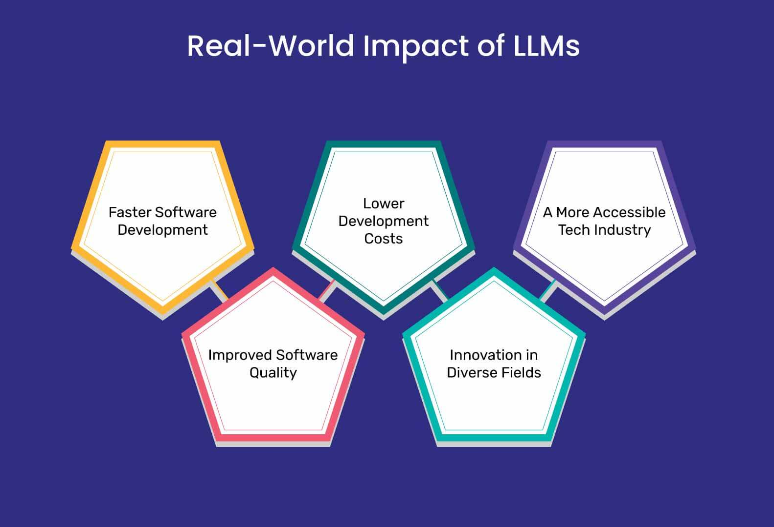
Implications
Healthcare: AI hallucinations can lead to misdiagnosis or inappropriate treatments, posing significant risks to patient safety and trust in medical technologies.
Education: Inaccurate or fabricated information from AI tutors can mislead learners, compromising the quality of education and eroding trust in AI-assisted learning tools.
Automation: Hallucinations in AI-generated content undermine decision-making in business applications, resulting in inefficiencies and potential reputational damage.

Slide 13
Future Directions
Hybrid Models: Combine structured and unstructured data to enhance accuracy.
Energy Efficiency: Develop sustainable algorithms to reduce environmental impact.
Diverse Benchmarks: Expand to include more languages and cultural contexts.
Dynamic Frameworks: Enable real-time updates to evaluation systems.
Improved Interpretability: Create tools to explain and refine model outputs.

Slide 14
Summary
Hallucination Challenge: A critical issue in LLMs, driving efforts in detection, mitigation, and building trust.
Evolving Benchmarks: Advancements highlight the need for better interpretability and diversity.
Future Focus: Ethical, sustainable, and globally inclusive AI development is paramount.
Survey Insights: Progress from factual checks to multimodal and domain-specific evaluations, emphasizing trust and applicability.

Slide 15
Reflection and Contributions
Learning Experience: Gained insights into literature review methodologies, LLM advancements, and hallucination evaluation.
Key Insights: Explored benchmarks, methodologies, and challenges in detecting hallucinations in LLMs.
Team Contributions:
Yash Khare: Conducted literature search and analysis; documented findings in the report and presentation.
Mohan Bhosale: Conducted literature search and analysis; documented findings in the report and presentation.
Karthikeyan Sugavanan: Focused on documenting findings in the report and presentation.

Slide 16
Thank You!
Presentation Recording:
Meeting in NLP Project-20241208_175326-Meeting Recording.mp4

