Slide 1


Trainers
Students
Company

Slide 2
Registration
Users can register based on their categories like Trainers, Students and companies.
If the user are Volunteer to train the students with high level experience in the particular technology can register by selecting trainers.
If the user want to test their skills or want to train themselves before attending their interviews can start registration by selecting students and technology.

Slide 3
Registration
If the Companies need to conduct the online test for the bulk of students with their prepared questions, they can start register by selecting the company.
Start registering and develop you skills.

Slide 4

Trainers
Trainers can create the test based on their technology.
  They can also add the student and send them a test link .
Based on the students mark they conduct the practice session with basic questions.

Slide 5

Students
  Reviewing your class notes on the same day you take them!
  Look over your class notes and make sure that they are complete and accurate
  Make note of anything that was confusing
Plan for short, frequent review sessions

Slide 6
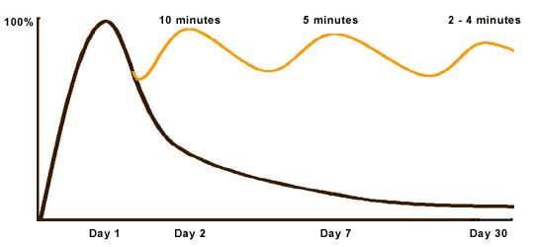
Students
Take a test based on your technology.
Time will be calculated.
you can practice the test session day by day until you completing the test with in the time limit on selecting correct answers.
By doing this will help you for your interview preparation.

Slide 7

Students
Test for fresher's- If the students are in starting level in the particular technology they can start with basics.
Test for experience- If the students has a experience they can select the test based on their experience.

Slide 8

Company
Companies can conduct the test for bulk of students and once the students submit their exams their results will viewed in table.
By this the company can shortlist the students based on the mark.

Slide 9

Question Types
  Read test directions- (E.g. Only answer 80 of the 100 multiple choice questions)
  Begin with the easy questions- Begin with those that seem easiest to you. You can answer these questions quickly, leaving more time for questions that require greater effort.
  Watch the clock- keep track of how much time is left and how you are progressing

Slide 10
Question Types
Video and audio formatted questions are available.
Users can also practice their programming skills.

Slide 11

Prepare Physically
Get adequate amounts of sleep- adequate amounts of sleep have an impact on your memory
Eat healthy- Avoid foods high in sugar.
Avoid large amounts caffeine- Too much caffeine can make it difficult to focus
3 meals a day- Eating nothing leaves you drained, and eating too much food can make you sleepy

Slide 12
Start Connecting with Zeptoh Online Test Application!

